Slide 1

How to Use This Presentation
To View the presentation as a slideshow with effects
select “View” on the menu bar and click on “Slide Show.”
To advance through the presentation, click the right arrow key or the space bar.
From the resources slide, click on any resource to see a presentation for that resource.
From the Chapter menu screen click on any lesson to go directly to that lesson’s presentation.
You may exit the slide show at any time by pressing
the Esc key.
Notes:
Header – dark yellow 24 points Arial Bold
Body text – white 20 points Arial Bold, dark yellow highlights
Bullets – dark yellow
Copyright – white 12 points Arial
Size:
Height: 7.52"
Width: 10.02"
Scale: 70%
Position on slide:
Horizontal - 0"
Vertical - 0"

Slide 2
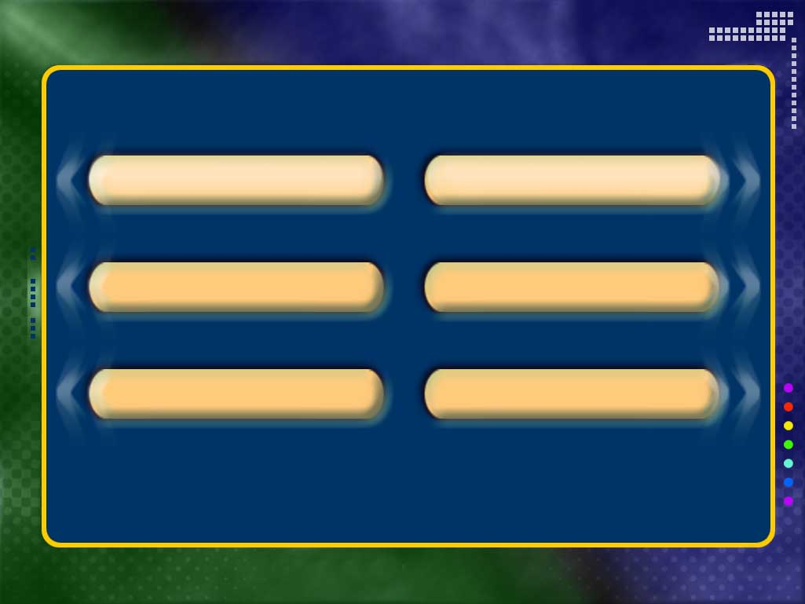

Resources
Chapter Presentation
Transparencies
Bellringers
Image and Activity Bank
Brain Food Video Quiz
Quotes About Character
Chapter Menu
Copyright © by Holt, Rinehart and Winston. All rights reserved.
Notes:
Header – dark yellow 24 points Arial Bold
Body text – white 20 points Arial Bold, dark yellow highlights
Bullets – dark yellow
Copyright – white 12 points Arial
Size:
Height: 7.52"
Width: 10.02"
Scale: 70%
Position on slide:
Horizontal - 0"
Vertical - 0"

Slide 3
Quotes About Character
“A man’s character is his fate.”
—Heraclitus
Notes:
Header – dark yellow 24 points Arial Bold
Body text – white 20 points Arial Bold, dark yellow highlights
Bullets – dark yellow
Copyright – white 12 points Arial
Size:
Height: 7.52"
Width: 10.02"
Scale: 70%
Position on slide:
Horizontal - 0"
Vertical - 0"

Slide 4

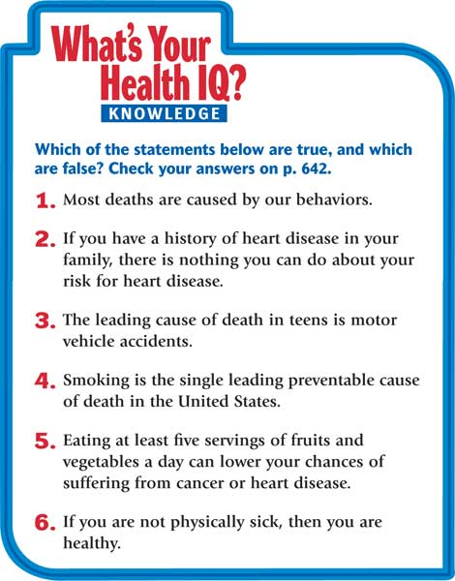
Chapter 1
Leading a Healthy Life
Notes:
Header – dark yellow 24 points Arial Bold
Body text – white 20 points Arial Bold, dark yellow highlights
Bullets – dark yellow
Copyright – white 12 points Arial
Size:
Height: 7.52"
Width: 10.02"
Scale: 70%
Position on slide:
Horizontal - 0"
Vertical - 0"

Slide 5
Chapter 1
Leading a Healthy Life
Contents
Section 1 Health and Teens
Section 2 Health and Wellness
Section 3 Health in Your Community
Notes:
Header – dark yellow 24 points Arial Bold
Body text – white 20 points Arial Bold, dark yellow highlights
Bullets – dark yellow
Copyright – white 12 points Arial
Size:
Height: 7.52"
Width: 10.02"
Scale: 70%
Position on slide:
Horizontal - 0"
Vertical - 0"

Slide 6
Chapter 1
Section 1 Health and Teens
Bellringer
What do you think are the most serious health problems for teens?
Notes:
Header – dark yellow 24 points Arial Bold
Body text – white 20 points Arial Bold, dark yellow highlights
Bullets – dark yellow
Copyright – white 12 points Arial
Size:
Height: 7.52"
Width: 10.02"
Scale: 70%
Position on slide:
Horizontal - 0"
Vertical - 0"

Slide 7
Chapter 1
Section 1 Health and Teens
Objectives
Compare the major causes of death in the past with the major causes of death today.
Distinguish between controllable risk factors and uncontrollable risk factors.
Compare the major causes of death for teens with those for other age groups in the United States.
List the six health risk behaviors that lead to health problems in teens.
Name three behaviors you can adopt now to improve your health.
Notes:
Header – dark yellow 24 points Arial Bold
Body text – white 20 points Arial Bold, dark yellow highlights
Bullets – dark yellow
Copyright – white 12 points Arial
Size:
Height: 7.52"
Width: 10.02"
Scale: 70%
Position on slide:
Horizontal - 0"
Vertical - 0"

Slide 8
Chapter 1
Section 1 Health and Teens
Health Today
Health in the Past Infectious diseases were the most significant health problems in the past.
Health Today Many health problems today are caused in part by unhealthy lifestyles. Diabetes, heart disease, and cancer are examples of lifestyle diseases.
Notes:
Header – dark yellow 24 points Arial Bold
Body text – white 20 points Arial Bold, dark yellow highlights
Bullets – dark yellow
Copyright – white 12 points Arial
Size:
Height: 7.52"
Width: 10.02"
Scale: 70%
Position on slide:
Horizontal - 0"
Vertical - 0"

Slide 9
Chapter 1
Section 1 Health and Teens
Health Risk Factors
A risk factor is anything that increases the likelihood of injury, disease, or other health problems.
Controllable Risk Factors You can control some risk factors by making choices about your behavior.
Uncontrollable Risk Factors Risk factors you cannot control include age, race, gender, and heredity.
Notes:
Header – dark yellow 24 points Arial Bold
Body text – white 20 points Arial Bold, dark yellow highlights
Bullets – dark yellow
Copyright – white 12 points Arial
Size:
Height: 7.52"
Width: 10.02"
Scale: 70%
Position on slide:
Horizontal - 0"
Vertical - 0"

Slide 10
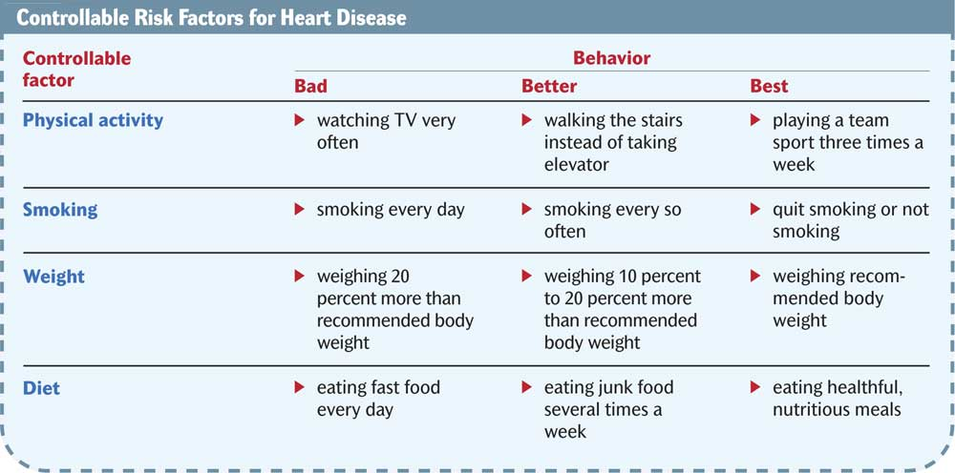
Chapter 1
Section 1 Health and Teens
Notes:
Header – dark yellow 24 points Arial Bold
Body text – white 20 points Arial Bold, dark yellow highlights
Bullets – dark yellow
Copyright – white 12 points Arial
Size:
Height: 7.52"
Width: 10.02"
Scale: 70%
Position on slide:
Horizontal - 0"
Vertical - 0"

Slide 11
Chapter 1
Section 1 Health and Teens
Risk Factors and Your Health
You can protect your health by focusing on controllable risk factors.
Know the leading causes of death for people in your age group.
Be aware of the leading causes of death for people of all ages.
Notes:
Header – dark yellow 24 points Arial Bold
Body text – white 20 points Arial Bold, dark yellow highlights
Bullets – dark yellow
Copyright – white 12 points Arial
Size:
Height: 7.52"
Width: 10.02"
Scale: 70%
Position on slide:
Horizontal - 0"
Vertical - 0"

Slide 12
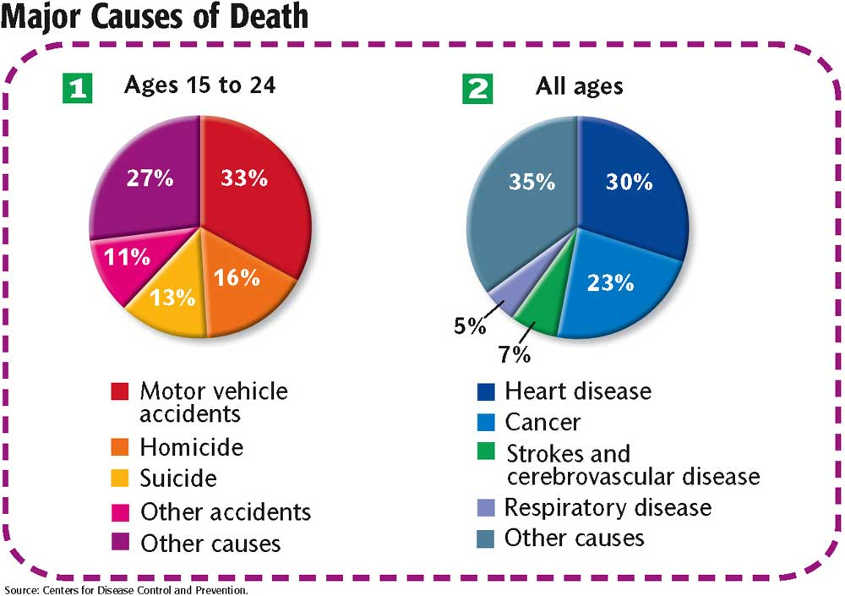
Chapter 1
Section 1 Health and Teens
Notes:
Header – dark yellow 24 points Arial Bold
Body text – white 20 points Arial Bold, dark yellow highlights
Bullets – dark yellow
Copyright – white 12 points Arial
Size:
Height: 7.52"
Width: 10.02"
Scale: 70%
Position on slide:
Horizontal - 0"
Vertical - 0"

Slide 13
Chapter 1
Section 1 Health and Teens
Six Health Risk Behaviors
Sedentary Lifestyle
Alcohol and Other Drug Use
Sexual Activity
Behaviors That Cause Injuries
Tobacco Use
Poor Eating Habits
Notes:
Header – dark yellow 24 points Arial Bold
Body text – white 20 points Arial Bold, dark yellow highlights
Bullets – dark yellow
Copyright – white 12 points Arial
Size:
Height: 7.52"
Width: 10.02"
Scale: 70%
Position on slide:
Horizontal - 0"
Vertical - 0"

Slide 14
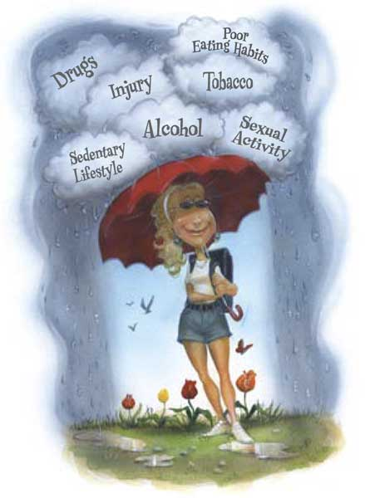
Chapter 1
Section 1 Health and Teens
Six Health Risk Behaviors
What risk factors do you think are the most common at your school?
Notes:
Header – dark yellow 24 points Arial Bold
Body text – white 20 points Arial Bold, dark yellow highlights
Bullets – dark yellow
Copyright – white 12 points Arial
Size:
Height: 7.52"
Width: 10.02"
Scale: 70%
Position on slide:
Horizontal - 0"
Vertical - 0"

Slide 15
Chapter 1
Section 2 Health and Wellness
Bellringer
Describe a person you know whom you consider to be healthy. What does this person do to be healthy? What else could he or she do to be more healthy?
Notes:
Header – dark yellow 24 points Arial Bold
Body text – white 20 points Arial Bold, dark yellow highlights
Bullets – dark yellow
Copyright – white 12 points Arial
Size:
Height: 7.52"
Width: 10.02"
Scale: 70%
Position on slide:
Horizontal - 0"
Vertical - 0"

Slide 16
Chapter 1
Section 2 Health and Wellness
Objectives
Describe each of the six components of health.
State the importance of striving for optimal health.
Describe four influences on wellness.
Describe three ways to take charge of your wellness.
Name two ways you can improve two components of your health.
Notes:
Header – dark yellow 24 points Arial Bold
Body text – white 20 points Arial Bold, dark yellow highlights
Bullets – dark yellow
Copyright – white 12 points Arial
Size:
Height: 7.52"
Width: 10.02"
Scale: 70%
Position on slide:
Horizontal - 0"
Vertical - 0"

Slide 17
Chapter 1
Section 2 Health and Wellness
Six Components of Health
Health is the state of well being in which all the components of health are in balance.
Health may be categorized into six components: physical, emotional, social, mental, spiritual, and environmental.
To be truly healthy, you must take care of all six components.
Notes:
Header – dark yellow 24 points Arial Bold
Body text – white 20 points Arial Bold, dark yellow highlights
Bullets – dark yellow
Copyright – white 12 points Arial
Size:
Height: 7.52"
Width: 10.02"
Scale: 70%
Position on slide:
Horizontal - 0"
Vertical - 0"

Slide 18
Chapter 1
Section 2 Health and Wellness
Six Components of Health
Physical Health refers to the way your body functions.
Emotional Health involves coping with your feelings and expressing them in a positive way.
Social Health is the quality of your relationships with friends, family, teachers, and others.
Notes:
Header – dark yellow 24 points Arial Bold
Body text – white 20 points Arial Bold, dark yellow highlights
Bullets – dark yellow
Copyright – white 12 points Arial
Size:
Height: 7.52"
Width: 10.02"
Scale: 70%
Position on slide:
Horizontal - 0"
Vertical - 0"

Slide 19
Chapter 1
Section 2 Health and Wellness
Six Components of Health
Mental Health is the ability to recognize reality and cope with the demands of daily life.
Spiritual Health involves having spiritual direction and purpose. This includes living according to one’s ethics, morals, and values.
Environmental Health involves keeping your air and water clean, your food safe, and the land around you enjoyable.
Notes:
Header – dark yellow 24 points Arial Bold
Body text – white 20 points Arial Bold, dark yellow highlights
Bullets – dark yellow
Copyright – white 12 points Arial
Size:
Height: 7.52"
Width: 10.02"
Scale: 70%
Position on slide:
Horizontal - 0"
Vertical - 0"

Slide 20
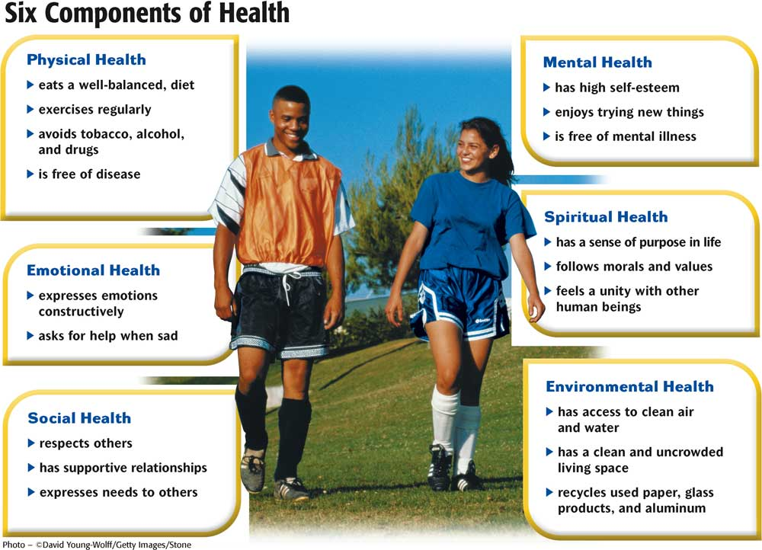
Chapter 1
Section 2 Health and Wellness
Notes:
Header – dark yellow 24 points Arial Bold
Body text – white 20 points Arial Bold, dark yellow highlights
Bullets – dark yellow
Copyright – white 12 points Arial
Size:
Height: 7.52"
Width: 10.02"
Scale: 70%
Position on slide:
Horizontal - 0"
Vertical - 0"

Slide 21
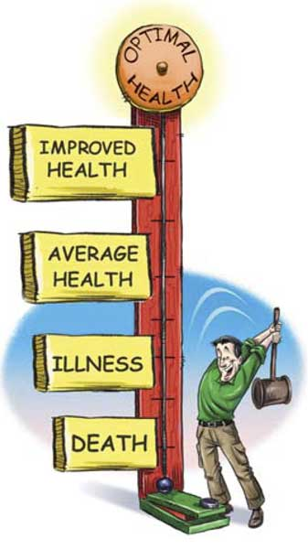
Chapter 1
Section 2 Health and Wellness
Wellness: Striving for Optimal Health
Wellness is a continuum ranging from death to optimal health.
You can choose your behaviors to move closer to optimal health.
Notes:
Header – dark yellow 24 points Arial Bold
Body text – white 20 points Arial Bold, dark yellow highlights
Bullets – dark yellow
Copyright – white 12 points Arial
Size:
Height: 7.52"
Width: 10.02"
Scale: 70%
Position on slide:
Horizontal - 0"
Vertical - 0"

Slide 22
Chapter 1
Section 2 Health and Wellness
Influences on Your Wellness
Hereditary Influences
Social Influences
Cultural Influences
Environmental Influences
Notes:
Header – dark yellow 24 points Arial Bold
Body text – white 20 points Arial Bold, dark yellow highlights
Bullets – dark yellow
Copyright – white 12 points Arial
Size:
Height: 7.52"
Width: 10.02"
Scale: 70%
Position on slide:
Horizontal - 0"
Vertical - 0"

Slide 23
Chapter 1
Section 2 Health and Wellness
Taking Charge of Your Wellness
Knowledge You need information to make good choices about your health.
Lifestyle You can improve your health by making behavioral changes to your lifestyle.
Attitude By focusing on your attitudes, you can act in ways that make you a healthier person.
Notes:
Header – dark yellow 24 points Arial Bold
Body text – white 20 points Arial Bold, dark yellow highlights
Bullets – dark yellow
Copyright – white 12 points Arial
Size:
Height: 7.52"
Width: 10.02"
Scale: 70%
Position on slide:
Horizontal - 0"
Vertical - 0"

Slide 24
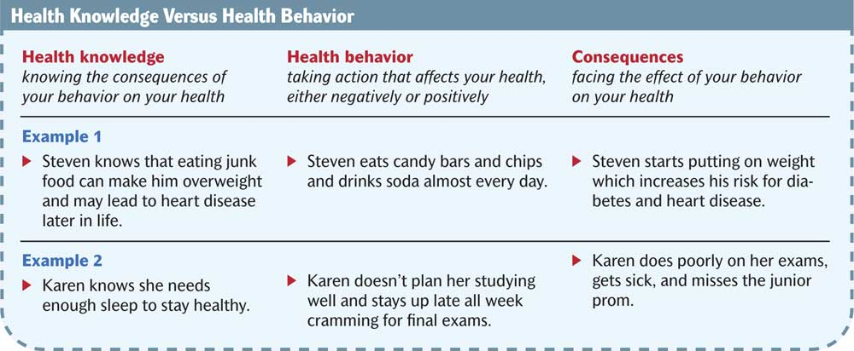
Chapter 1
Section 2 Health and Wellness
Notes:
Header – dark yellow 24 points Arial Bold
Body text – white 20 points Arial Bold, dark yellow highlights
Bullets – dark yellow
Copyright – white 12 points Arial
Size:
Height: 7.52"
Width: 10.02"
Scale: 70%
Position on slide:
Horizontal - 0"
Vertical - 0"

Slide 25
Chapter 1
Section 3 Health in Your Community
Bellringer
What are some things people in your community are doing to promote and enhance the public’s health?
Notes:
Header – dark yellow 24 points Arial Bold
Body text – white 20 points Arial Bold, dark yellow highlights
Bullets – dark yellow
Copyright – white 12 points Arial
Size:
Height: 7.52"
Width: 10.02"
Scale: 70%
Position on slide:
Horizontal - 0"
Vertical - 0"

Slide 26
Chapter 1
Section 3 Health in Your Community
Objectives
Describe four ways society addresses health problems.
List three ways you can promote an issue to improve the health of others.
Notes:
Header – dark yellow 24 points Arial Bold
Body text – white 20 points Arial Bold, dark yellow highlights
Bullets – dark yellow
Copyright – white 12 points Arial
Size:
Height: 7.52"
Width: 10.02"
Scale: 70%
Position on slide:
Horizontal - 0"
Vertical - 0"

Slide 27
Chapter 1
Section 3 Health in Your Community
Four Ways Society Addresses Health Problems
Medical Advances
Technology
Public Policy
Education
Notes:
Header – dark yellow 24 points Arial Bold
Body text – white 20 points Arial Bold, dark yellow highlights
Bullets – dark yellow
Copyright – white 12 points Arial
Size:
Height: 7.52"
Width: 10.02"
Scale: 70%
Position on slide:
Horizontal - 0"
Vertical - 0"

Slide 28
Chapter 1
Section 3 Health in Your Community
What You Can Do
Be an Advocate! To advocate is to speak or act in support of something.
Volunteer at a clinic
Take meals to the elderly
Promote health issues at school
Train for a career in a health field
Set a good example through your behavior
Notes:
Header – dark yellow 24 points Arial Bold
Body text – white 20 points Arial Bold, dark yellow highlights
Bullets – dark yellow
Copyright – white 12 points Arial
Size:
Height: 7.52"
Width: 10.02"
Scale: 70%
Position on slide:
Horizontal - 0"
Vertical - 0"

Slide 29
Chapter 1
Section 3 Health in Your Community
What You Can Do
Get Your Point Across
Be Informed
Know Your Audience
Notes:
Header – dark yellow 24 points Arial Bold
Body text – white 20 points Arial Bold, dark yellow highlights
Bullets – dark yellow
Copyright – white 12 points Arial
Size:
Height: 7.52"
Width: 10.02"
Scale: 70%
Position on slide:
Horizontal - 0"
Vertical - 0"

Slide 30

Brain Food Video Quiz
Click below to watch the Brain Food Video Quiz that accompanies this chapter.
You may stop the video at any time by pressing
the Esc key.
Brain Food Video Quiz
Notes:
Header – dark yellow 24 points Arial Bold
Body text – white 20 points Arial Bold, dark yellow highlights
Bullets – dark yellow
Copyright – white 12 points Arial
Size:
Height: 7.52"
Width: 10.02"
Scale: 70%
Position on slide:
Horizontal - 0"
Vertical - 0"

Slide 31
End of Chapter 1 Show
Notes:
Header – dark yellow 24 points Arial Bold
Body text – white 20 points Arial Bold, dark yellow highlights
Bullets – dark yellow
Copyright – white 12 points Arial
Size:
Height: 7.52"
Width: 10.02"
Scale: 70%
Position on slide:
Horizontal - 0"
Vertical - 0"

Slide 32
Chapter 1
Section 1 Health and Teens
Notes:
Header – dark yellow 24 points Arial Bold
Body text – white 20 points Arial Bold, dark yellow highlights
Bullets – dark yellow
Copyright – white 12 points Arial
Size:
Height: 7.52"
Width: 10.02"
Scale: 70%
Position on slide:
Horizontal - 0"
Vertical - 0"

Slide 33
Chapter 1
Section 1 Health and Teens
Notes:
Header – dark yellow 24 points Arial Bold
Body text – white 20 points Arial Bold, dark yellow highlights
Bullets – dark yellow
Copyright – white 12 points Arial
Size:
Height: 7.52"
Width: 10.02"
Scale: 70%
Position on slide:
Horizontal - 0"
Vertical - 0"

Slide 34
Chapter 1
Section 2 Health and Wellness
Notes:
Header – dark yellow 24 points Arial Bold
Body text – white 20 points Arial Bold, dark yellow highlights
Bullets – dark yellow
Copyright – white 12 points Arial
Size:
Height: 7.52"
Width: 10.02"
Scale: 70%
Position on slide:
Horizontal - 0"
Vertical - 0"

Slide 35
Chapter 1
Section 2 Health and Wellness
Notes:
Header – dark yellow 24 points Arial Bold
Body text – white 20 points Arial Bold, dark yellow highlights
Bullets – dark yellow
Copyright – white 12 points Arial
Size:
Height: 7.52"
Width: 10.02"
Scale: 70%
Position on slide:
Horizontal - 0"
Vertical - 0"

Slide 36
Quotes About Character
“If you stand straight, do not fear a crooked shadow.”
—Chinese Proverb
Notes:
Header – dark yellow 24 points Arial Bold
Body text – white 20 points Arial Bold, dark yellow highlights
Bullets – dark yellow
Copyright – white 12 points Arial
Size:
Height: 7.52"
Width: 10.02"
Scale: 70%
Position on slide:
Horizontal - 0"
Vertical - 0"

Slide 37
Quotes About Character
“One falsehood spoils a thousand truths.”
—African Proverb
Notes:
Header – dark yellow 24 points Arial Bold
Body text – white 20 points Arial Bold, dark yellow highlights
Bullets – dark yellow
Copyright – white 12 points Arial
Size:
Height: 7.52"
Width: 10.02"
Scale: 70%
Position on slide:
Horizontal - 0"
Vertical - 0"

Slide 38
Quotes About Character
“A man cannot be comfortable without his own approval.”
—Mark Twain
Notes:
Header – dark yellow 24 points Arial Bold
Body text – white 20 points Arial Bold, dark yellow highlights
Bullets – dark yellow
Copyright – white 12 points Arial
Size:
Height: 7.52"
Width: 10.02"
Scale: 70%
Position on slide:
Horizontal - 0"
Vertical - 0"

Slide 39
Quotes About Character
“Our reverence is good for nothing if it does not begin with self-respect.”
—Oliver Wendell Holmes
Notes:
Header – dark yellow 24 points Arial Bold
Body text – white 20 points Arial Bold, dark yellow highlights
Bullets – dark yellow
Copyright – white 12 points Arial
Size:
Height: 7.52"
Width: 10.02"
Scale: 70%
Position on slide:
Horizontal - 0"
Vertical - 0"

Slide 40
Quotes About Character
“When the character of a man is not clear to you, look at his friends.”
—Japanese Proverb
Notes:
Header – dark yellow 24 points Arial Bold
Body text – white 20 points Arial Bold, dark yellow highlights
Bullets – dark yellow
Copyright – white 12 points Arial
Size:
Height: 7.52"
Width: 10.02"
Scale: 70%
Position on slide:
Horizontal - 0"
Vertical - 0"

Slide 41
Quotes About Character
“What lies behind us and what lies before us are small matters compared to what lies within us.”
—Ralph Waldo Emerson
Notes:
Header – dark yellow 24 points Arial Bold
Body text – white 20 points Arial Bold, dark yellow highlights
Bullets – dark yellow
Copyright – white 12 points Arial
Size:
Height: 7.52"
Width: 10.02"
Scale: 70%
Position on slide:
Horizontal - 0"
Vertical - 0"

Slide 42
Quotes About Character
“A good name, like good will, is got by many actions and lost by one.”
—Lord Jeffrey
Notes:
Header – dark yellow 24 points Arial Bold
Body text – white 20 points Arial Bold, dark yellow highlights
Bullets – dark yellow
Copyright – white 12 points Arial
Size:
Height: 7.52"
Width: 10.02"
Scale: 70%
Position on slide:
Horizontal - 0"
Vertical - 0"

Slide 43
Quotes About Character
“To enjoy the things we ought and to hate the things we ought has the greatest bearing on excellence of character.”
—Aristotle
Notes:
Header – dark yellow 24 points Arial Bold
Body text – white 20 points Arial Bold, dark yellow highlights
Bullets – dark yellow
Copyright – white 12 points Arial
Size:
Height: 7.52"
Width: 10.02"
Scale: 70%
Position on slide:
Horizontal - 0"
Vertical - 0"

Slide 44
Quotes About Character
“He that respects himself is safe from others; He wears a coat of mail that none can pierce.”
—Henry Wadsworth Longfellow
Notes:
Header – dark yellow 24 points Arial Bold
Body text – white 20 points Arial Bold, dark yellow highlights
Bullets – dark yellow
Copyright – white 12 points Arial
Size:
Height: 7.52"
Width: 10.02"
Scale: 70%
Position on slide:
Horizontal - 0"
Vertical - 0"

Slide 45
Quotes About Character
“The reputation of a thousand years may be determined by the conduct of one hour.”
—Japanese Proverb
Notes:
Header – dark yellow 24 points Arial Bold
Body text – white 20 points Arial Bold, dark yellow highlights
Bullets – dark yellow
Copyright – white 12 points Arial
Size:
Height: 7.52"
Width: 10.02"
Scale: 70%
Position on slide:
Horizontal - 0"
Vertical - 0"

Slide 46
Quotes About Character
“Dreams are the touchstones of our character.”
—Henry David Thoreau
Notes:
Header – dark yellow 24 points Arial Bold
Body text – white 20 points Arial Bold, dark yellow highlights
Bullets – dark yellow
Copyright – white 12 points Arial
Size:
Height: 7.52"
Width: 10.02"
Scale: 70%
Position on slide:
Horizontal - 0"
Vertical - 0"

Slide 47
Quotes About Character
“A man’s character is his fate.”
—Heraclitus
Notes:
Header – dark yellow 24 points Arial Bold
Body text – white 20 points Arial Bold, dark yellow highlights
Bullets – dark yellow
Copyright – white 12 points Arial
Size:
Height: 7.52"
Width: 10.02"
Scale: 70%
Position on slide:
Horizontal - 0"
Vertical - 0"

Slide 48
Quotes About Character
“Character is that which reveals moral purpose, exposing the class of things a man chooses and avoids.”
—Aristotle
Notes:
Header – dark yellow 24 points Arial Bold
Body text – white 20 points Arial Bold, dark yellow highlights
Bullets – dark yellow
Copyright – white 12 points Arial
Size:
Height: 7.52"
Width: 10.02"
Scale: 70%
Position on slide:
Horizontal - 0"
Vertical - 0"

Slide 49
Quotes About Character
“What you do speaks so loud that I cannot hear what you say.”
—Ralph Waldo Emerson
Notes:
Header – dark yellow 24 points Arial Bold
Body text – white 20 points Arial Bold, dark yellow highlights
Bullets – dark yellow
Copyright – white 12 points Arial
Size:
Height: 7.52"
Width: 10.02"
Scale: 70%
Position on slide:
Horizontal - 0"
Vertical - 0"

Slide 50
Quotes About Character
“Abstinence is the surety of temperance.”
—Plato
Notes:
Header – dark yellow 24 points Arial Bold
Body text – white 20 points Arial Bold, dark yellow highlights
Bullets – dark yellow
Copyright – white 12 points Arial
Size:
Height: 7.52"
Width: 10.02"
Scale: 70%
Position on slide:
Horizontal - 0"
Vertical - 0"

Slide 51
Quotes About Character
“This above all, to thine own self be true/And it must follow, as the night the day/ Thou canst not then be false to any man.”
—William Shakespeare
Notes:
Header – dark yellow 24 points Arial Bold
Body text – white 20 points Arial Bold, dark yellow highlights
Bullets – dark yellow
Copyright – white 12 points Arial
Size:
Height: 7.52"
Width: 10.02"
Scale: 70%
Position on slide:
Horizontal - 0"
Vertical - 0"

Slide 52
Quotes About Character
“No change of circumstances can repair a defect of character .”
—Ralph Waldo Emerson
Notes:
Header – dark yellow 24 points Arial Bold
Body text – white 20 points Arial Bold, dark yellow highlights
Bullets – dark yellow
Copyright – white 12 points Arial
Size:
Height: 7.52"
Width: 10.02"
Scale: 70%
Position on slide:
Horizontal - 0"
Vertical - 0"

Slide 53
Quotes About Character
“Men acquire a particular quality by constantly acting a particular way . . . you become just by performing just actions, temperate by performing temperate actions, brave by performing brave actions.”
—Aristotle
Notes:
Header – dark yellow 24 points Arial Bold
Body text – white 20 points Arial Bold, dark yellow highlights
Bullets – dark yellow
Copyright – white 12 points Arial
Size:
Height: 7.52"
Width: 10.02"
Scale: 70%
Position on slide:
Horizontal - 0"
Vertical - 0"

Slide 54
Quotes About Character
“The way to gain a good reputation is to endeavor to be what you desire to appear.”
—Socrates
Notes:
Header – dark yellow 24 points Arial Bold
Body text – white 20 points Arial Bold, dark yellow highlights
Bullets – dark yellow
Copyright – white 12 points Arial
Size:
Height: 7.52"
Width: 10.02"
Scale: 70%
Position on slide:
Horizontal - 0"
Vertical - 0"

Slide 55
Quotes About Character
“Do what you know and perception is converted into character.”
—Ralph Waldo Emerson
Notes:
Header – dark yellow 24 points Arial Bold
Body text – white 20 points Arial Bold, dark yellow highlights
Bullets – dark yellow
Copyright – white 12 points Arial
Size:
Height: 7.52"
Width: 10.02"
Scale: 70%
Position on slide:
Horizontal - 0"
Vertical - 0"

Slide 56
Quotes About Character
“Rather fail with honor than succeed by fraud.”
—Sophocles
Notes:
Header – dark yellow 24 points Arial Bold
Body text – white 20 points Arial Bold, dark yellow highlights
Bullets – dark yellow
Copyright – white 12 points Arial
Size:
Height: 7.52"
Width: 10.02"
Scale: 70%
Position on slide:
Horizontal - 0"
Vertical - 0"

Slide 57
Quotes About Character
“Character is higher than intellect.”
—Ralph Waldo Emerson
Notes:
Header – dark yellow 24 points Arial Bold
Body text – white 20 points Arial Bold, dark yellow highlights
Bullets – dark yellow
Copyright – white 12 points Arial
Size:
Height: 7.52"
Width: 10.02"
Scale: 70%
Position on slide:
Horizontal - 0"
Vertical - 0"

Slide 58
Quotes About Character
“To know what is right and not do it is the worst cowardice.”
—Confucius
Notes:
Header – dark yellow 24 points Arial Bold
Body text – white 20 points Arial Bold, dark yellow highlights
Bullets – dark yellow
Copyright – white 12 points Arial
Size:
Height: 7.52"
Width: 10.02"
Scale: 70%
Position on slide:
Horizontal - 0"
Vertical - 0"

Slide 59
Quotes About Character
“It takes less time to do a thing right, than it does to explain why you did it wrong.”
—Henry Wadsworth Longfellow
Notes:
Header – dark yellow 24 points Arial Bold
Body text – white 20 points Arial Bold, dark yellow highlights
Bullets – dark yellow
Copyright – white 12 points Arial
Size:
Height: 7.52"
Width: 10.02"
Scale: 70%
Position on slide:
Horizontal - 0"
Vertical - 0"

Slide 60
Quotes About Character
“Nature magically suits a man to his fortunes, by making them the fruit of his character.”
—Ralph Waldo Emerson
Notes:
Header – dark yellow 24 points Arial Bold
Body text – white 20 points Arial Bold, dark yellow highlights
Bullets – dark yellow
Copyright – white 12 points Arial
Size:
Height: 7.52"
Width: 10.02"
Scale: 70%
Position on slide:
Horizontal - 0"
Vertical - 0"

Slide 61
Quotes About Character
“That soul that can be honest is the only perfect man.”
—John Fletcher
Notes:
Header – dark yellow 24 points Arial Bold
Body text – white 20 points Arial Bold, dark yellow highlights
Bullets – dark yellow
Copyright – white 12 points Arial
Size:
Height: 7.52"
Width: 10.02"
Scale: 70%
Position on slide:
Horizontal - 0"
Vertical - 0"

Slide 62
Quotes About Character
“One does evil enough when one does nothing good.”
—German Proverb
Notes:
Header – dark yellow 24 points Arial Bold
Body text – white 20 points Arial Bold, dark yellow highlights
Bullets – dark yellow
Copyright – white 12 points Arial
Size:
Height: 7.52"
Width: 10.02"
Scale: 70%
Position on slide:
Horizontal - 0"
Vertical - 0"

Slide 63
Quotes About Character
“There is no pillow so soft as a clear conscience.”
—French Proverb
Notes:
Header – dark yellow 24 points Arial Bold
Body text – white 20 points Arial Bold, dark yellow highlights
Bullets – dark yellow
Copyright – white 12 points Arial
Size:
Height: 7.52"
Width: 10.02"
Scale: 70%
Position on slide:
Horizontal - 0"
Vertical - 0"

Slide 64
Quotes About Character
“Don't forget to love yourself.”
—Soren Kierkegaard
Notes:
Header – dark yellow 24 points Arial Bold
Body text – white 20 points Arial Bold, dark yellow highlights
Bullets – dark yellow
Copyright – white 12 points Arial
Size:
Height: 7.52"
Width: 10.02"
Scale: 70%
Position on slide:
Horizontal - 0"
Vertical - 0"

Slide 65
Quotes About Character
“Character is the indelible mark that determines the only true value of all people and all their work.”
—Orison Swett Marden
Notes:
Header – dark yellow 24 points Arial Bold
Body text – white 20 points Arial Bold, dark yellow highlights
Bullets – dark yellow
Copyright – white 12 points Arial
Size:
Height: 7.52"
Width: 10.02"
Scale: 70%
Position on slide:
Horizontal - 0"
Vertical - 0"

Slide 66
Quotes About Character
“What we think or what we believe is, in the end, of little consequence. The only thing of consequence is what we do.”
—John Ruskin
Notes:
Header – dark yellow 24 points Arial Bold
Body text – white 20 points Arial Bold, dark yellow highlights
Bullets – dark yellow
Copyright – white 12 points Arial
Size:
Height: 7.52"
Width: 10.02"
Scale: 70%
Position on slide:
Horizontal - 0"
Vertical - 0"

Slide 67
Quotes About Character
“Fame is vapor, popularity an accident, riches take wing, and only character endures.”
—Horace Greeley
Notes:
Header – dark yellow 24 points Arial Bold
Body text – white 20 points Arial Bold, dark yellow highlights
Bullets – dark yellow
Copyright – white 12 points Arial
Size:
Height: 7.52"
Width: 10.02"
Scale: 70%
Position on slide:
Horizontal - 0"
Vertical - 0"

Slide 68
Quotes About Character
“You can easily judge the character of a man by how he treats those who can do nothing for him.”
—James D. Miles
Notes:
Header – dark yellow 24 points Arial Bold
Body text – white 20 points Arial Bold, dark yellow highlights
Bullets – dark yellow
Copyright – white 12 points Arial
Size:
Height: 7.52"
Width: 10.02"
Scale: 70%
Position on slide:
Horizontal - 0"
Vertical - 0"

Slide 69
Quotes About Character
“Right is right, even if everyone is against it; and wrong is wrong, even if everyone is for it.”
—William Penn
Notes:
Header – dark yellow 24 points Arial Bold
Body text – white 20 points Arial Bold, dark yellow highlights
Bullets – dark yellow
Copyright – white 12 points Arial
Size:
Height: 7.52"
Width: 10.02"
Scale: 70%
Position on slide:
Horizontal - 0"
Vertical - 0"

Slide 70
Quotes About Character
“Our deeds determine us, as much as we determine our deeds.”
—George Eliot
Notes:
Header – dark yellow 24 points Arial Bold
Body text – white 20 points Arial Bold, dark yellow highlights
Bullets – dark yellow
Copyright – white 12 points Arial
Size:
Height: 7.52"
Width: 10.02"
Scale: 70%
Position on slide:
Horizontal - 0"
Vertical - 0"

Slide 71
Quotes About Character
“Character is the result of two things: mental attitude and the way we spend our time.”
—Elbert Hubbard
Notes:
Header – dark yellow 24 points Arial Bold
Body text – white 20 points Arial Bold, dark yellow highlights
Bullets – dark yellow
Copyright – white 12 points Arial
Size:
Height: 7.52"
Width: 10.02"
Scale: 70%
Position on slide:
Horizontal - 0"
Vertical - 0"

Slide 72
Quotes About Character
“A man without character is like a ship without a rudder.”
—Karl G. Maeser
Notes:
Header – dark yellow 24 points Arial Bold
Body text – white 20 points Arial Bold, dark yellow highlights
Bullets – dark yellow
Copyright – white 12 points Arial
Size:
Height: 7.52"
Width: 10.02"
Scale: 70%
Position on slide:
Horizontal - 0"
Vertical - 0"

Slide 73
Quotes About Character
“Character is much easier kept than recovered.”
—Thomas Paine
Notes:
Header – dark yellow 24 points Arial Bold
Body text – white 20 points Arial Bold, dark yellow highlights
Bullets – dark yellow
Copyright – white 12 points Arial
Size:
Height: 7.52"
Width: 10.02"
Scale: 70%
Position on slide:
Horizontal - 0"
Vertical - 0"

Slide 74
Quotes About Character
“Character is power.”
—Booker T. Washington
Notes:
Header – dark yellow 24 points Arial Bold
Body text – white 20 points Arial Bold, dark yellow highlights
Bullets – dark yellow
Copyright – white 12 points Arial
Size:
Height: 7.52"
Width: 10.02"
Scale: 70%
Position on slide:
Horizontal - 0"
Vertical - 0"

Slide 75
Quotes About Character
“An individual step in character training is to put responsibility on the individual.”
—Robert Baden-Powell
Notes:
Header – dark yellow 24 points Arial Bold
Body text – white 20 points Arial Bold, dark yellow highlights
Bullets – dark yellow
Copyright – white 12 points Arial
Size:
Height: 7.52"
Width: 10.02"
Scale: 70%
Position on slide:
Horizontal - 0"
Vertical - 0"

Slide 76
Quotes About Character
“Character is a by-product; it is produced in the great manufacture of daily duty.”
—Woodrow T. Wilson
Notes:
Header – dark yellow 24 points Arial Bold
Body text – white 20 points Arial Bold, dark yellow highlights
Bullets – dark yellow
Copyright – white 12 points Arial
Size:
Height: 7.52"
Width: 10.02"
Scale: 70%
Position on slide:
Horizontal - 0"
Vertical - 0"

