Slide 1

Family Presentation: Yondr
December 4th, 2024
C/S

Slide 2
Agenda
The Why
CMS Data
Yondr Plan
Questions

Slide 3




The Why

Slide 4
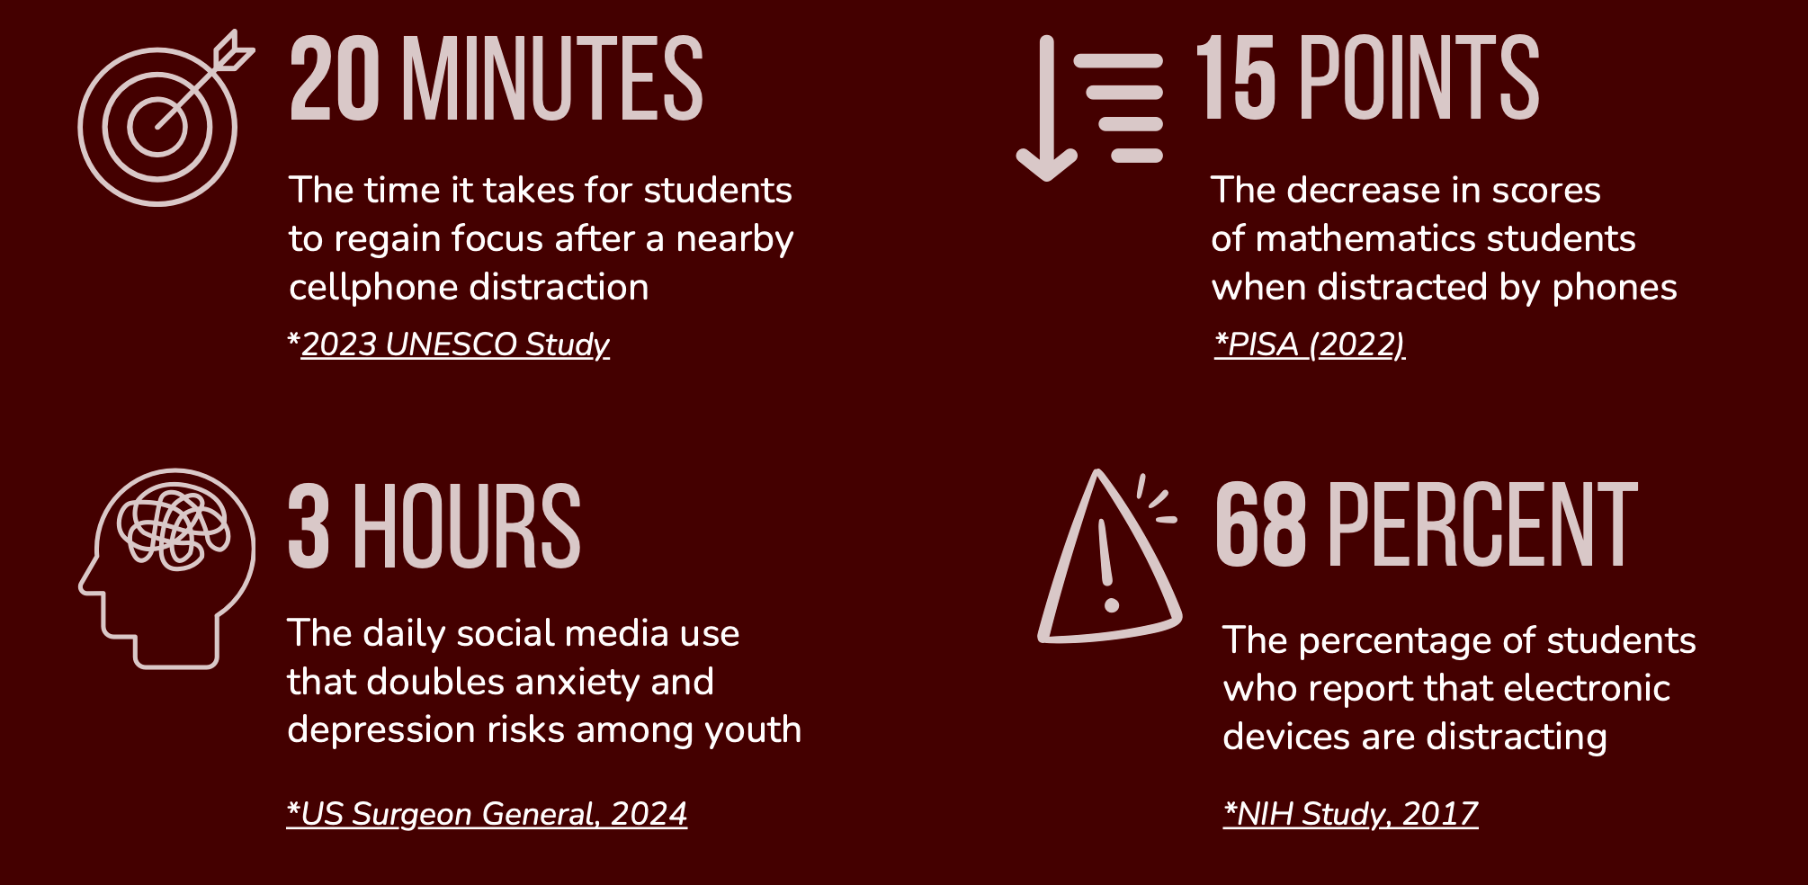
Negative impacts of cell phones on academics
Notes:
Research leaves no doubt: cell phones and social media are harming the mental health of our youth and are having significantly negative impact on academics.
It takes 20 minutes for students to regain focus every time they are distracted by a cell phone.
According to the US Surgeon General, average social media use is 3 hours per day. This doubles anxiety and depression risks among our youth.
Phone distractions can lead to a 15 point decrease in mathematics scores
68% of students report that electronic devices are distracting.
The PROBLEM is CLEAR - Widespread and constant smartphone use is presenting an undeniable social, psychological, and academic crisis.
[NEXT SLIDE]

Slide 5

TOP OFFICIALS ARE SOUNDING
THE ALARM AND TAKING ACTION.
“We are in the middle of a national youth mental health crisis, and I am concerned that social media is an important driver of that crisis—one that we must urgently address.”
– US Surgeon General, Vivek Murthy
Notes:
In fact, the US Surgeon General issued a warning about social media’s impact on the mental health of our youth.
[NEXT SLIDE]

Slide 6
CELL PHONE REGULATION IS SURGING.
75% of public schools in the US have some form of restriction on cellphone use during school hours
CMS actually SESD has had this regulation in place for over 10 years. We are now looking for a tool to help us enforce the policy in place.

Slide 7
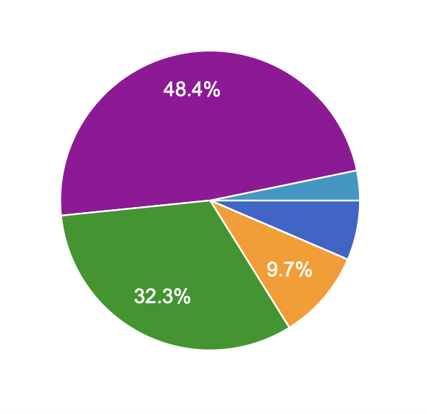
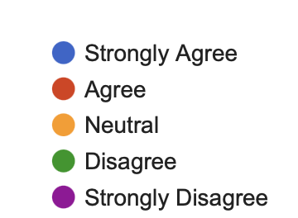
CMS Teacher Data
Cell Phone use during school is necessary to support student learning and engagement?
80.7% Disagree

Slide 8
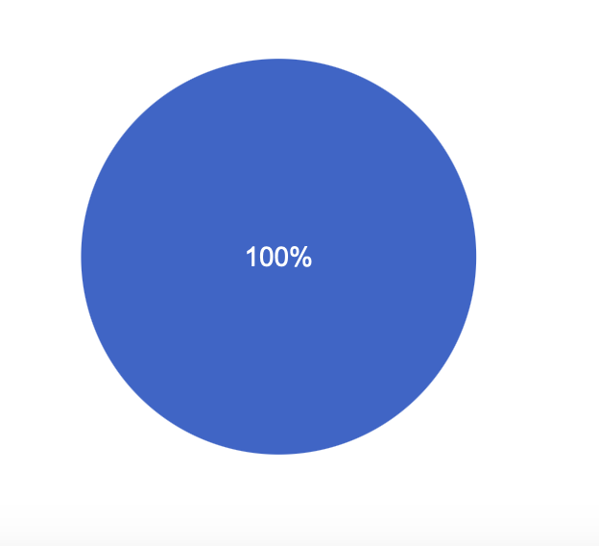

CMS Teacher Data
Do you believe there are negative effect to cell phone use?

Slide 9
Biggest issues
Cyberbullying: 90.3%
Distraction and reduced engagement: 87.1%

Slide 10
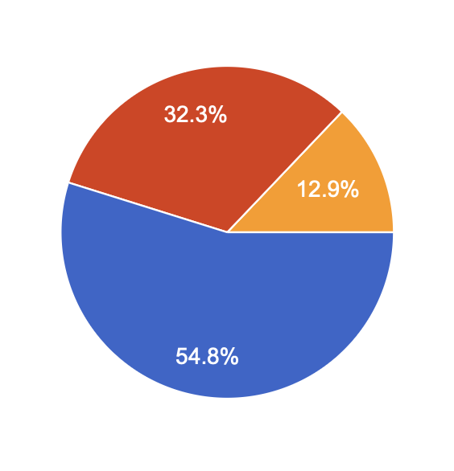
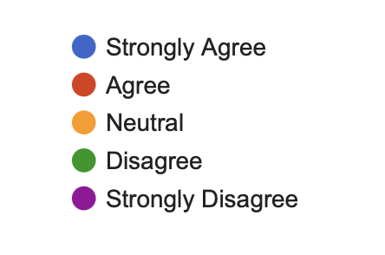
CMS Teacher Data
Overuse of cell phones on social media platforms can increases the incidence of cyberbullying and harassment.
87.1% Agree

Slide 11

THE SOLUTION:
THE YONDR PROGRAM
Experience the focus, creativity, and relief
that comes from a phone-free school day.
Notes:
The Yondr Program
Yondr helps educators like you create phone-free classrooms and campuses, using our patented phone pouches combined with our best in class support program.
[NEXT SLIDE]

Slide 12


Since 2014, Millions of students have benefitted from a PHONE-FREE EDUCATION WITH YONDR.
Millions OF students
USE YONDR DAILY
SCHOOL PARTNERS IN 27 COUNTRIES
AND ALL
50 STATES
Notes:
Yondr is the industry leader and inventor of phone-free spaces. We have partnered with schools and educators like you for over a decade, spanning 27 countries and all 50 states.
[NEXT SLIDE]

Slide 13
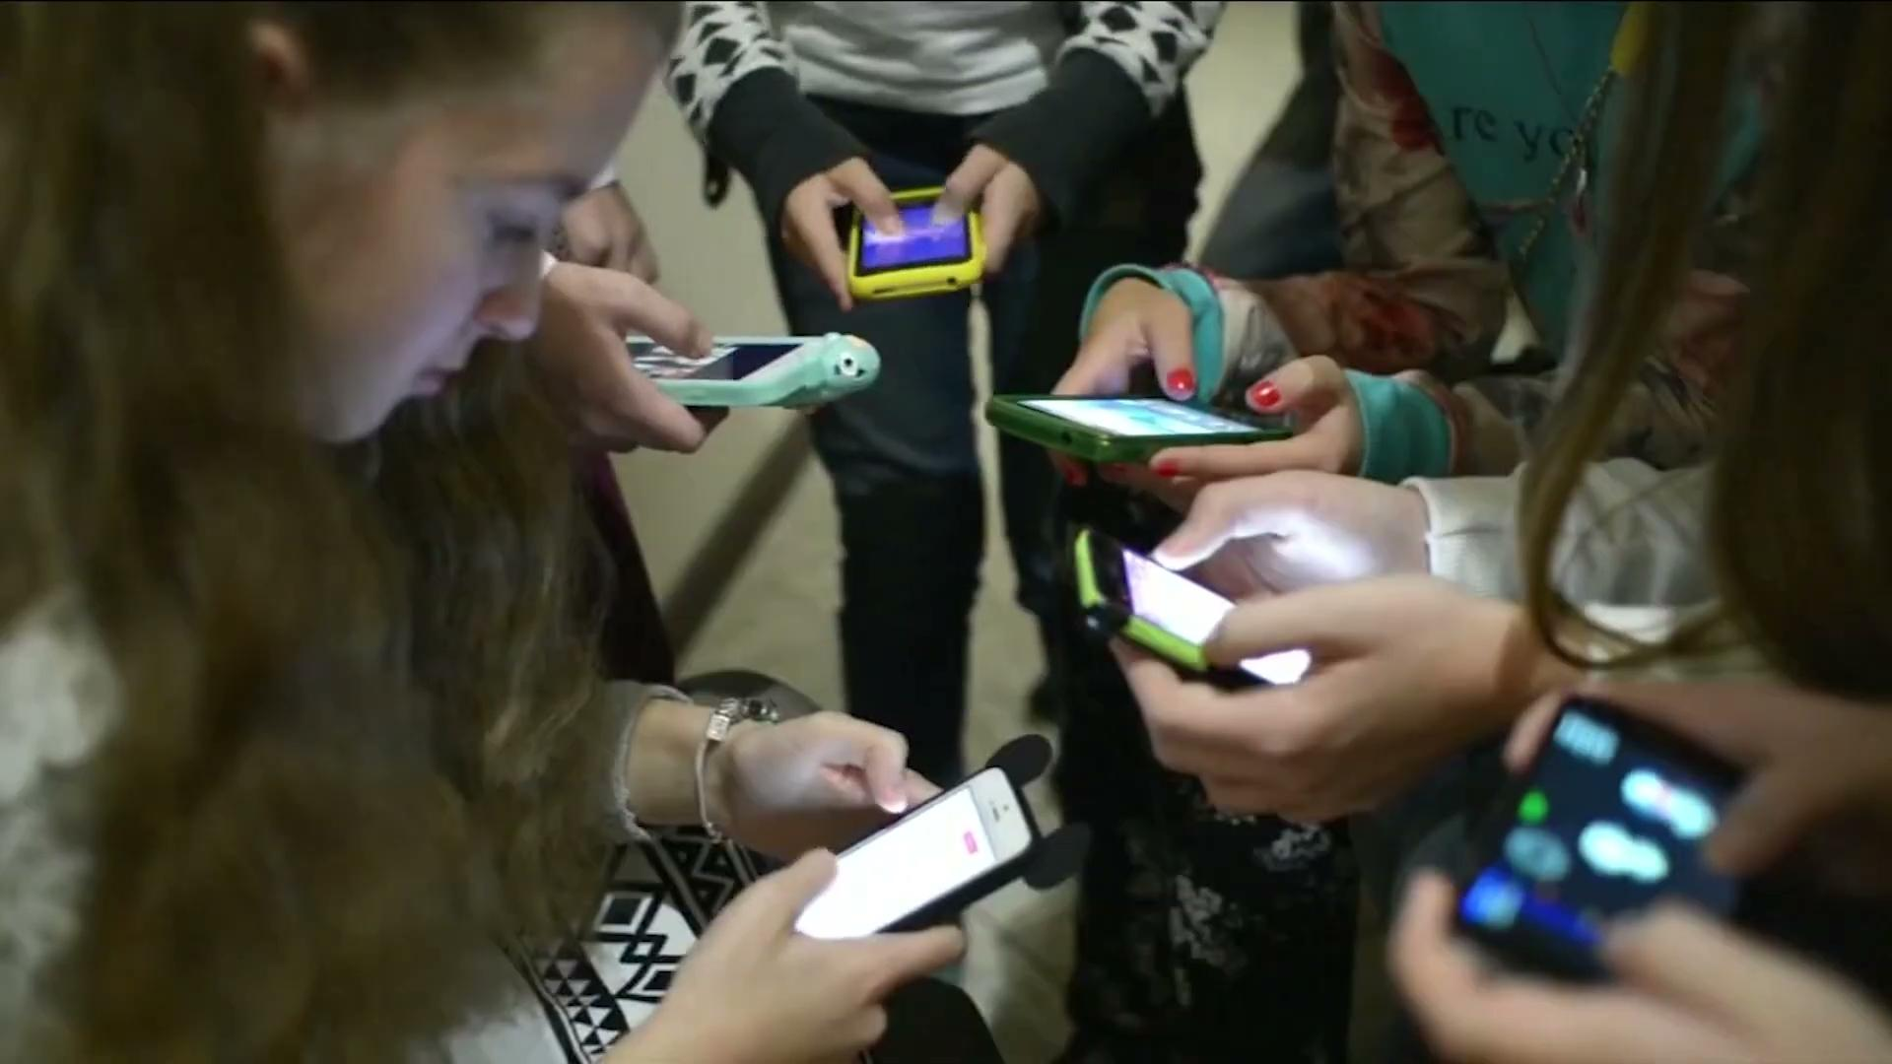
WATCH THE YONDR PROGRAM IN ACTION.
Notes:
[PLAY VIDEO]
[NEXT SLIDE]

Slide 14


86%
Saw a positive impact
on safety and wellness
YONDR
SCHOOL SURVEY
RESULTS:
84%
Saw a positive change
in student engagement
68%
Saw an improvement
in academic performance
PRIVATE AND CONFIDENTIAL OVERYONDR.COM
‹#›
Notes:
Feedback from Yondr school partners is overwhelmingly positive. In our latest survey:
86% saw a positive impact in student safety and wellness
84% saw an improvement in student engagement in the classroom
68% saw an improvement in academic performance
[NEXT SLIDE]

Slide 15
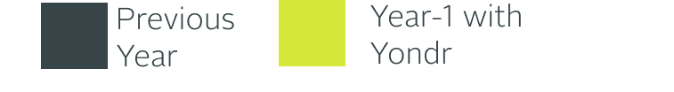
Student success rate
89%
84%
84%
84%
82%
80%
80%
After implementing Yondr 38% increased probability of passing grades in academically focused classes for 11th and 12th grades, and academic success increased across all grade levels.
Source: Yondr in Education: An Examination of Academic and Behavioral Outcomes
78%
78%
75%
6th grade
8th grade
10th grade
11th grade
12th grade
Notes:
This chart illustrates student success pre- and post- Yondr implementation. The data is taken from a study conducted by an independent researcher testing the efficacy of the
Yondr Program and its ability to enhance educational outcomes. This study is the first of its kind in the United States.
As you can see, students experience an increase in academic success with the Yondr Program. This is most notable in students preparing to make the transition to college, career, and life.
[NEXT SLIDE]

Slide 16
Positive impact on behavior
Behavior referrals
BULLYING/
HARASSMENT
DOWN 43.72%
DOWN 34.72%
Source: Yondr in Education: An Examination of Academic and Behavioral Outcomes
Notes:
In addition to academics, the study looked at Yondr’s impact on student behavior. General behavior referrals were down by 43.72%. Yondr partners saw large reductions in discrimination/harassment/bullying as well - a decrease of 34.72%.
Research reveals Yondr partner schools see increased academic success and improved student behavior.

Slide 17






EDUCATOR TESTIMONIALS
“It's an absolute game- changer. Our campus is so much more energetic and positive.”
— Allison Silvestri, Principal
“It's given children back their youth. We have a beautiful courtyard that no one used before we had the Yondr pouches. Now, they use it."
— Principal, West Philadelphia HS
"We had more books checked out in one week than all of last year combined."
— Librarian, Stanhope Elmore HS
“Students are actually talking to one another again.”
— Yvonne Shiu, School Principal
“Discipline issues are down significantly, by about a third.”
— Eric Mackey, State Superintendent
“Our US History pass rate went
up five fold.”
— James Villa, School Principal
Notes:
We’ve looked at the research, let’s look at what educators like you have to say about the Yondr program.
[READ THE QUOTES AS THEY APPEAR ON THE SLIDE]
[CLICK - READ Allison]
[CLICK - READ Librarian]
[CLICK - READ Eric]
[CLICK - READ Principal]
[CLICK - READ Yvonne]
[CLICK - READ James]
[NEXT SLIDE]

Slide 18


A PHONE-FREE EDUCATION MAKES ALL THE DIFFERENCE
Let's work together to create an environment where teachers can teach and students can thrive.
PRIVATE AND CONFIDENTIAL OVERYONDR.COM
‹#›
Notes:
Removing phones from classrooms is a crucial step toward cultivating an educational atmosphere where students can truly thrive.
Yondr partners with schools to foster a more focused learning environment, promoting deeper engagement and creating stronger connections between students and educators.
Let’s make a difference together, creating phone-free classrooms where learning, creativity, connection, and authentic experiences can thrive.

Slide 19
The Plan
Every student will receive a Yondr Pouch
Students will be required to place their cell phone and smart watches into the pouch, then seal it for the day, and put it in their backpacks.
At the end of the day, unlocking stations will be deployed for students to unlock their phones.

Slide 20
What happens if students don’t place their phones inside the pouch?
If a cell phone is seen out during the school day it will be confiscated and turned into the front office.
Parents would then be responsible for picking up phone during the established pick up times.
If this is a recurring pattern, then progressive discipline.

Slide 21
Most Frequently asked question so far:
What happens if there is an emergency on campus?

Slide 22
Questions

Slide 23
Next Steps
Hold Grade Level Assembly to explain roll out of pouches to students.
Communicate expectations and consequences to families.
Hope is to roll out in the new year 2025.

