Slide 1
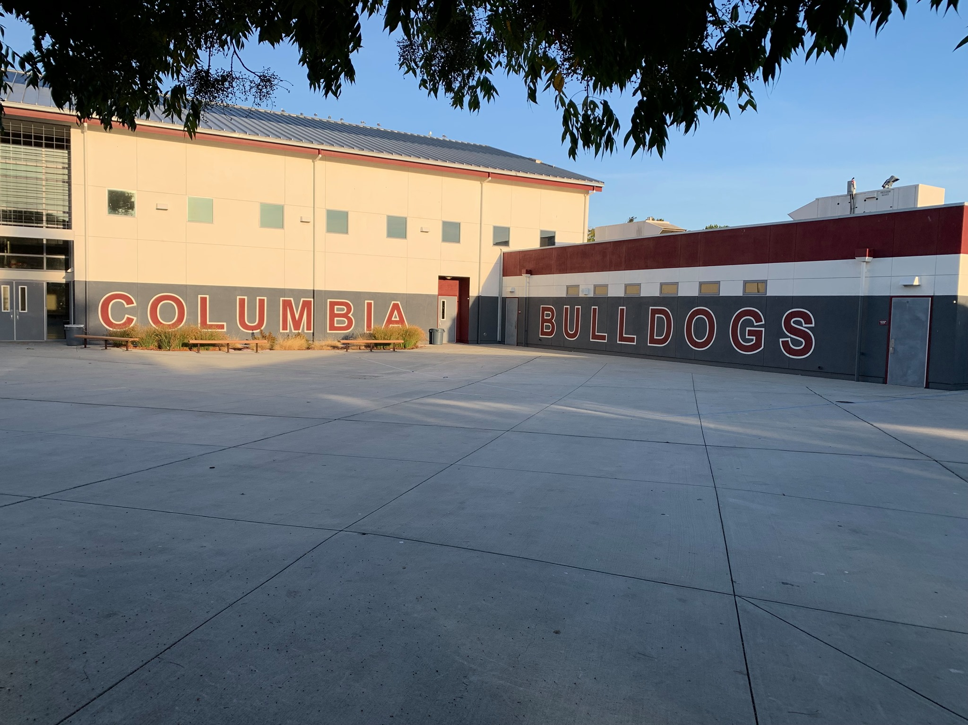

Columbia Middle School
NWEA Parent Informational

Slide 2

Introductions
Daniel Poo, Principal
Jamie Bradley, Assistant Principal
Dr. Vicky Tarumoto, Assistant Principal

Slide 3
Agenda
Why are we having this meeting?
What is NWEA?

Slide 4
The Why?
Over the last few months, I’ve been gathering feedback from students and parents about the NWEA.
Student Trends: Students stated that they don’t take the test seriously because it doesn’t impact them.
Parent Trends: Many didn’t know what the test measured or how the results are being used.
The plan for me, was to meet with students, families and staff and do a whole reboot on how CMS will move forward with being more transparent about how NWEA is used.

Slide 5
What is NWEA
The Northwest Evaluation Association (NWEA) is a researched-based, not-for profit organization that creates assessments and learning solutions that precisely measure growth and proficiency.
The NWEA assessment is adaptive, so if students answer correctly, the next question is more challenging. If they answer incorrectly the next one is easier.

Slide 6
What is MAP Growth
MAP (Measures of Academic Progress)
The test in NOT timed!
Adaptive test with 40-43 questions.
  Ends when you score 50% right/50% wrong.
Test in Math, Reading, Spanish
RIT: Rasch unIT scale (Ready for Instruction Today)
  Measures what students know, regardless of their grade level. It also measures growth over time, allowing you to track your student's progress throughout the school year and multiple years.

Slide 7
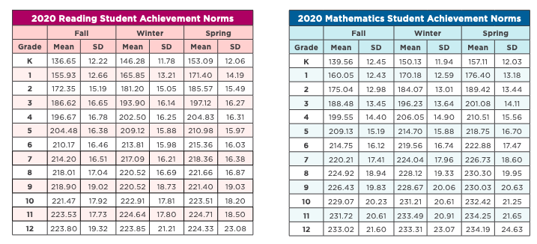
RIT Score: NWEA uses assessment data from over 11 million students across the country to create national norms
Notes:
NWEA Map Growth Normative Data Overview

Slide 8
When do students take the NWEA?
K-8 students at Sunnyvale School District take the NWEA three time a year, in Math, ELA, Spanish (Juntos).
August (Baseline), November (Winter)
Current Window (Spring):
  Spanish: March 10th-March 14th
  English Language Arts: March 18th-March 21st*
  Math: March 24th-March 28th

Slide 9
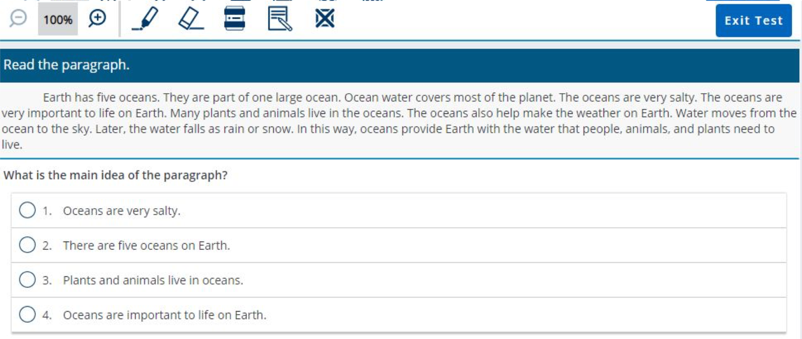
What does the test look like?

Slide 10
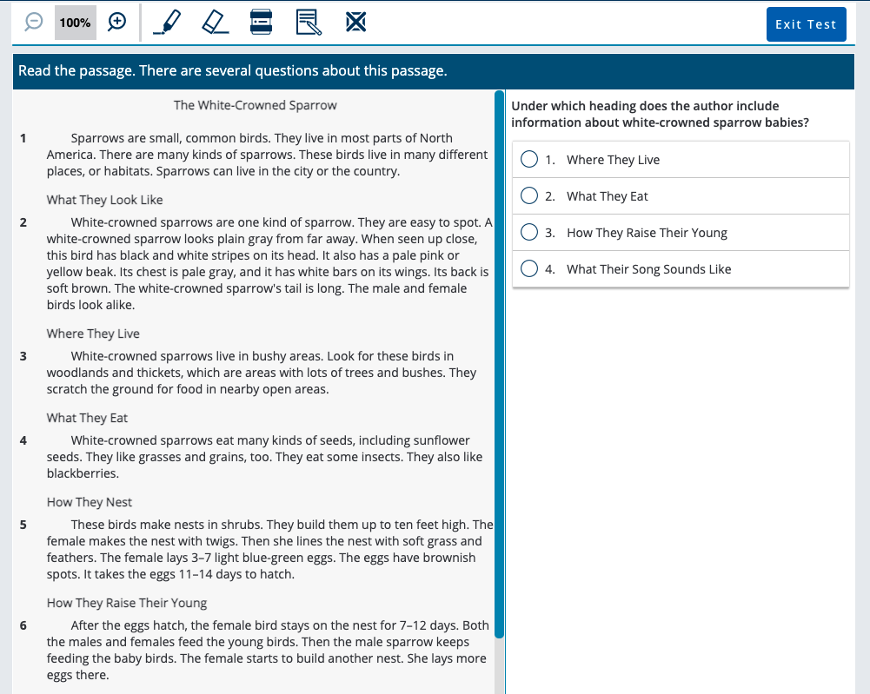

Slide 11
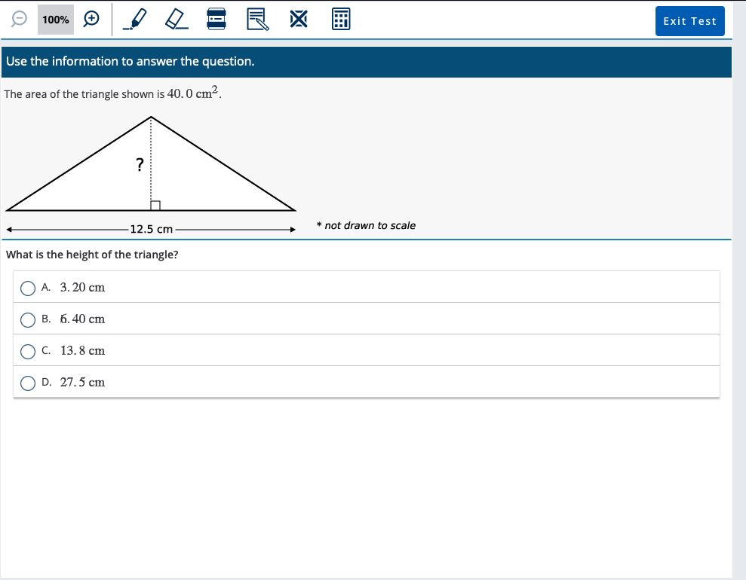

Slide 12
How does CMS use the results?
Determines Seal of Biliteracy Pathway award criteria
Helps determine math placement
Qualifying score needed to be considered for Reclassification
Helps identify students that need more foundational support (AST)
Teacher can progress monitor student growth and achievement
Teachers utilize RIT score and formative assessment data to inform instruction.

Slide 13
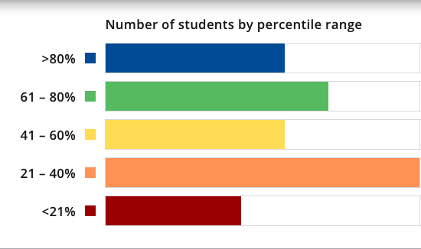
Cut Scores
Predict likely performances on state summative assessments as well as college entrance exams such as the SAT and ACT.
While there is no exact RIT number assigned with proficiency, the percentile range that has the highest correlation to proficiency is 61% and above.
This is the cut off we use for the Biliteracy Pathway Award (Juntos).
  If students in the Juntos Program do not meet the cut-off they will be given one more additional opportunity to meet the requirement.

Slide 14
How else is this data used?
Fremont Union High School District does make informed decisions based on their own assessment while taking into account our NWEA scores.

Slide 15
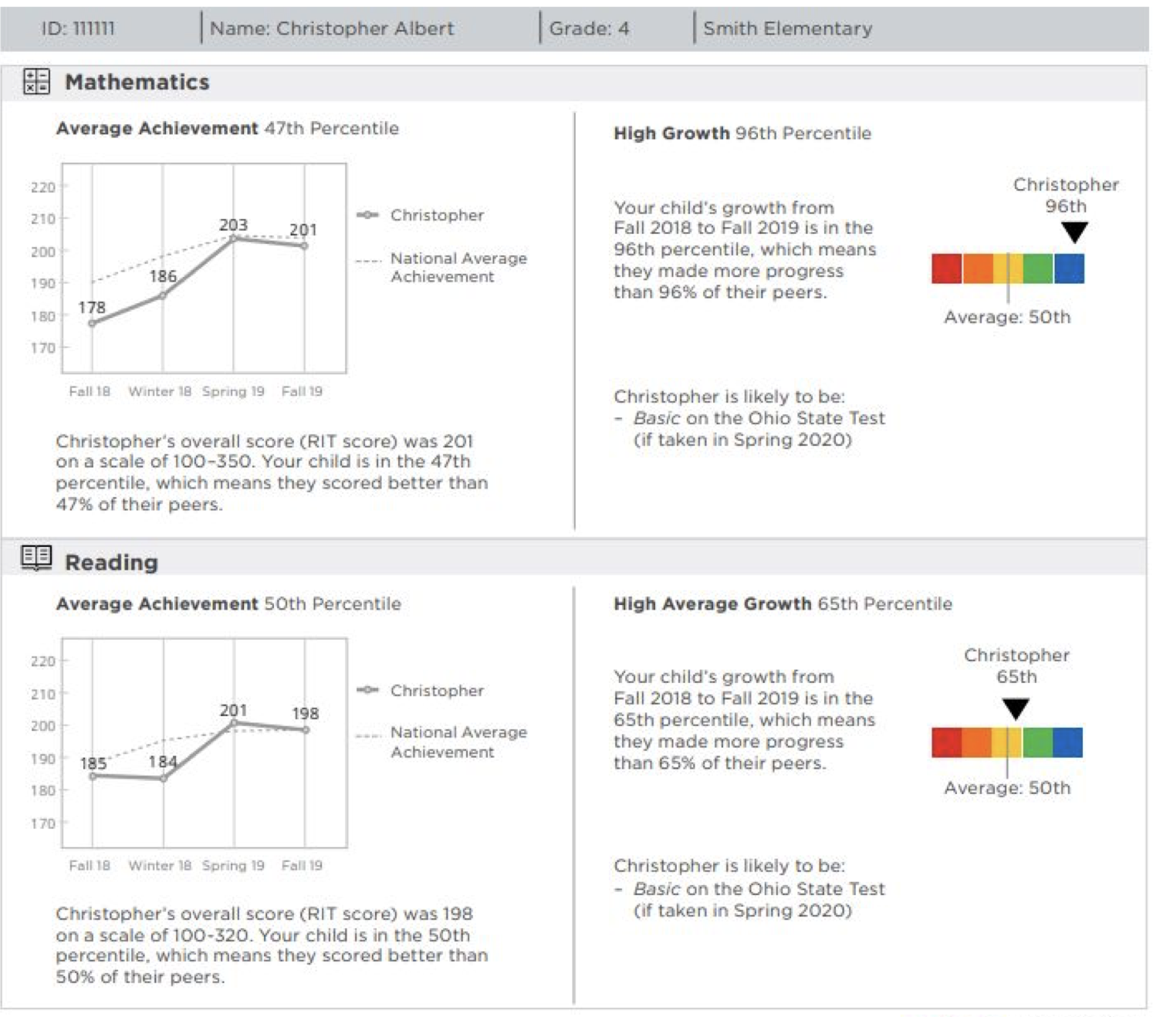
Family Report

Slide 16
How can I use this report?
Talk to your student’s teacher: Here are some questions to ask.
  What strategies are being used in the classroom that I can reinforce at home?
  Does my child need extra help in any specific area?
  How do you measure my child’s growth in your classroom?
  How is my child doing in comparison to grade-level expectations?

Slide 17
Where can I get more information?
Check out https://nwea.org/familytoolkit for more information on MAP Growth.
For sample test questions in all subject visit: https://warmup.nwea.org

Slide 18

Questions
What questions do you have for us?
Mr. Poo**
Daniel.Poo@sesd.org
Mr. Bradley
Jamie.Bradley@sesd.org
Dra. Tarumoto**
Victoria.Tarumoto@sesd.org
** bilingue

