Slide 1
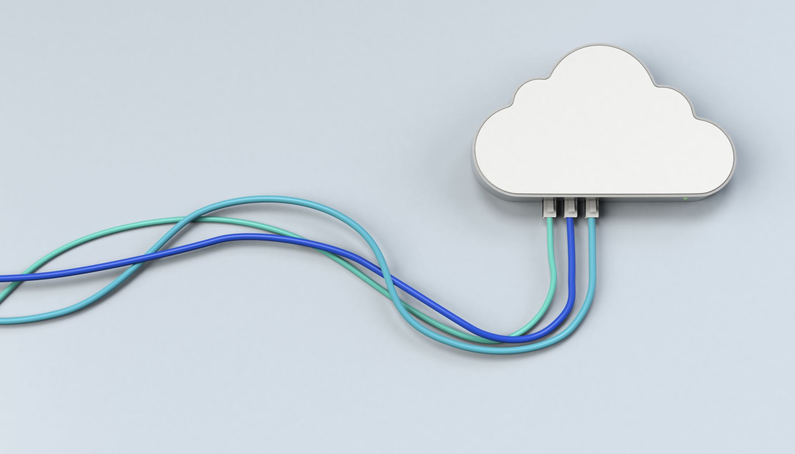
Downloading Google Drive for Desktop
Back up and Sync your files

Slide 2
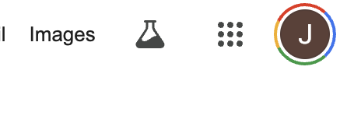
Click on the link below or type the web address into your browser.
www.google.com
Sign in to your school account if you are not already signed in.
Once signed in, click on the dots in the top right and open ”Drive”

Slide 3
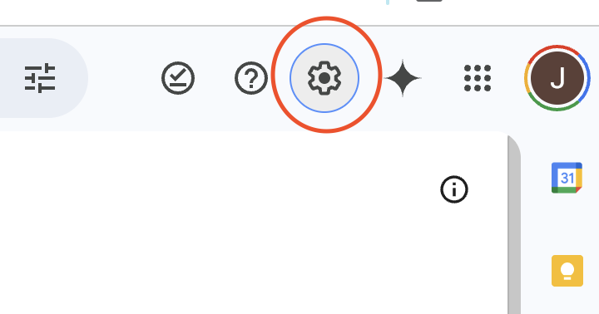
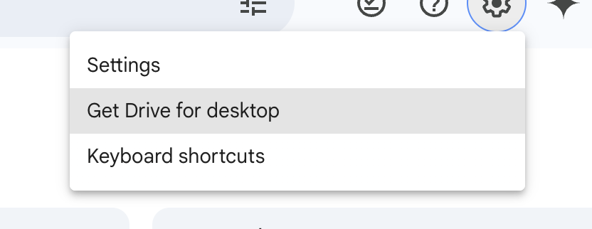
With your drive open, you will now click on settings.
And then select “get drive for desktop”
Notes:
Page may say “get started”
Click get drive for desktop

Slide 4
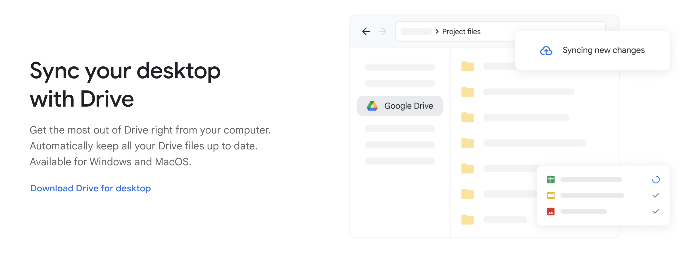
You should now see the the screen below:
Click “Download Drive for Desktop”
Notes:
Page may say “get started”
Click get drive for desktop

Slide 5
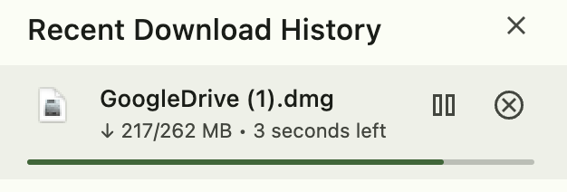
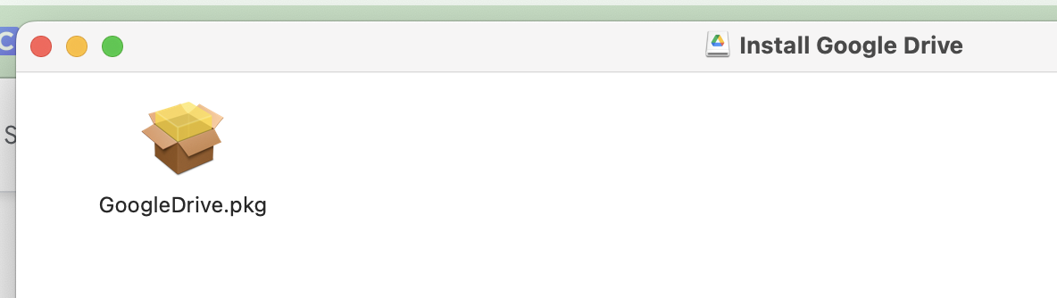
This will be in your download folder, once it is downloaded, double click on the new downloaded folder/file
This will pop up next, double click on the “box”/googledrive.pkg

Slide 6
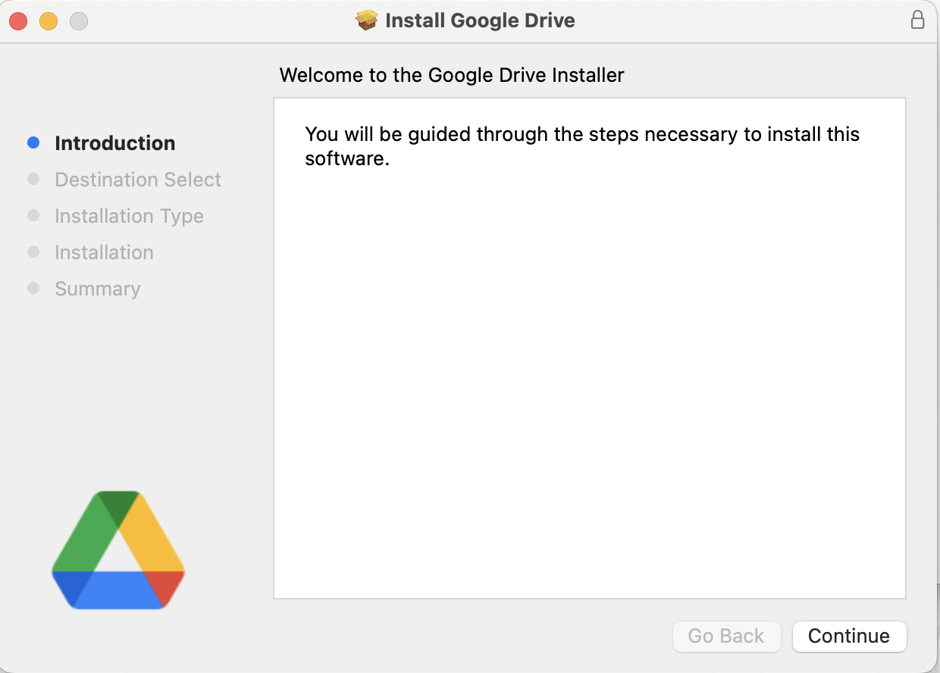
Follow the prompts and proceed through the install

Slide 7
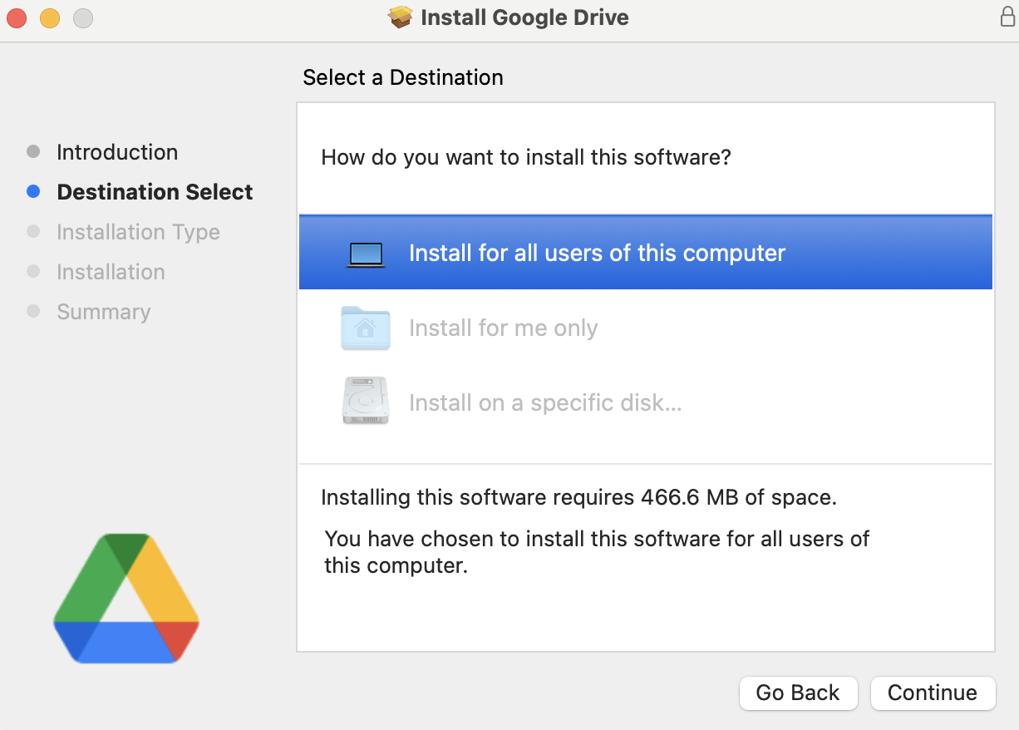
Select “install for all users of this computer”

Slide 8
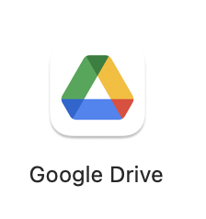
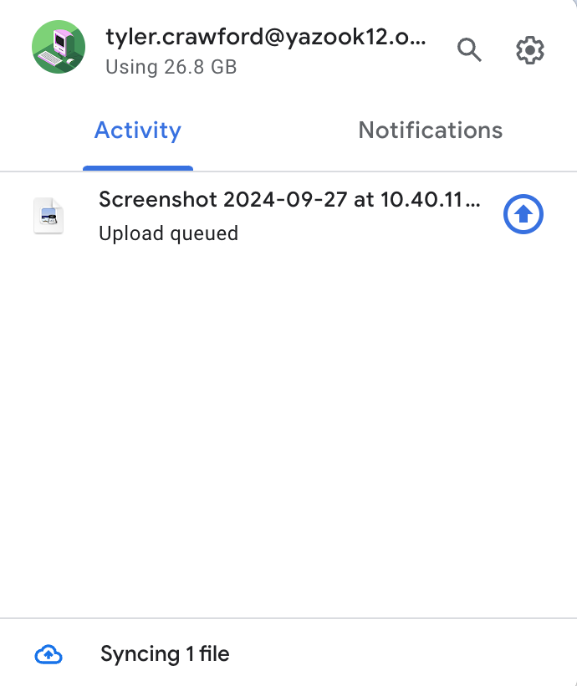
Once installed, find this icon in your applications folder and double click to open
You should see this screen next

Slide 9
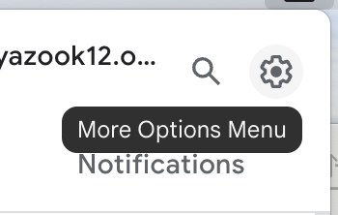
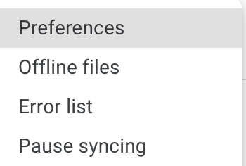
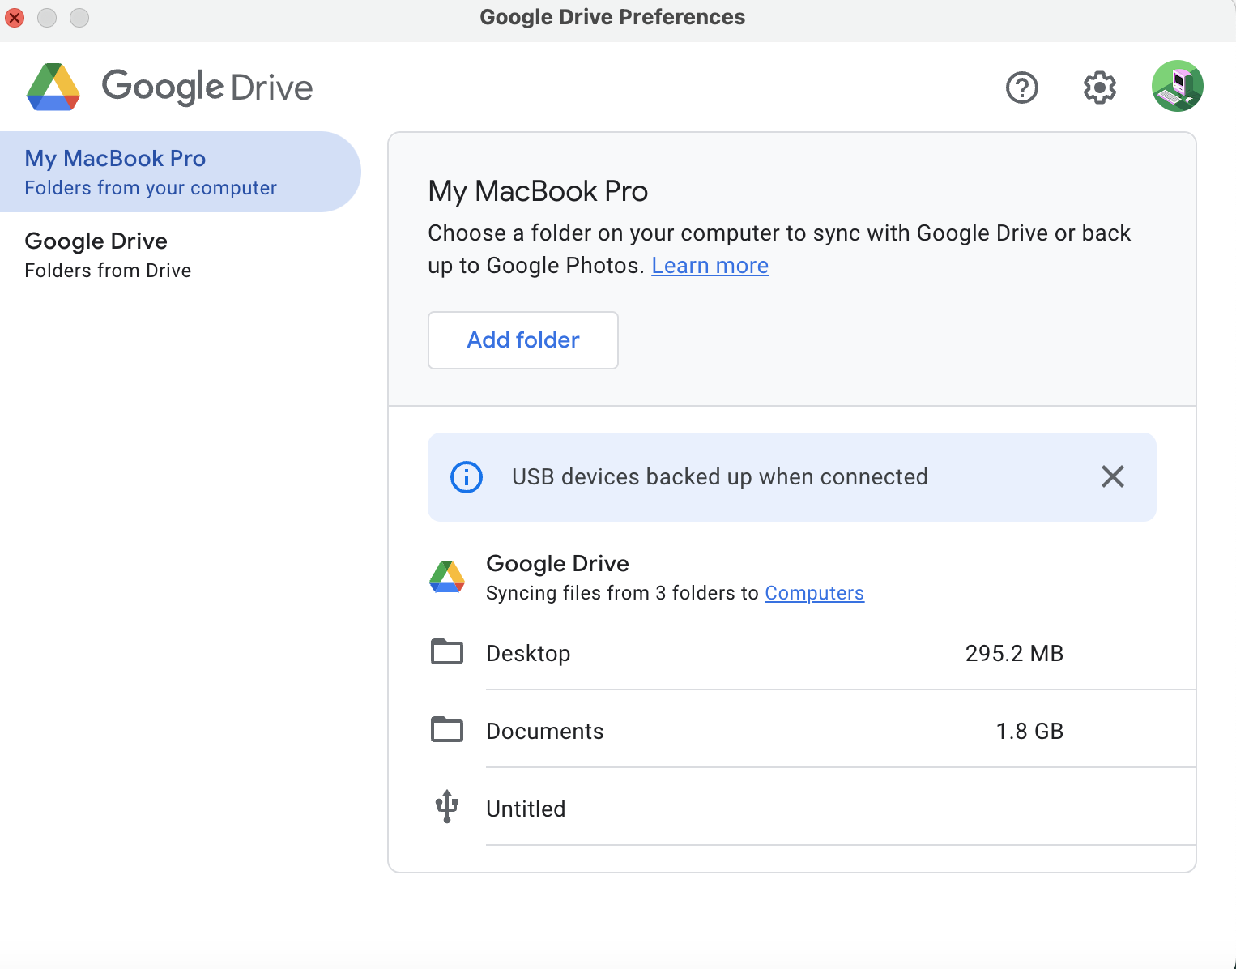
Select the gear in the top right “more options menu” and select Preferences
You should see this screen next. Click ”add folder”

Slide 10
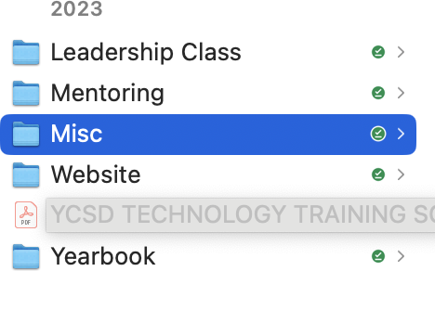
Find the folder you want to backup/sync
Google will start backing up whatever you save to that folder. Make sure to ”allow” if/when asked.

Slide 11

You should see the drive icon at the top of your screen
When you save files, they will automatically back up to your drive as well as your device

