Slide 1

Welcome to the Annual Triad Meeting
Presented By:
Rialto Induction Team

Slide 2

Welcome & Introductions
So glad you could make it!!

Slide 3

Induction Process
Personnel gives list of teachers who qualify for Induction to Induction Program Specialist -> Mrs. Paluba
Program Specialist assigns the Induction Teacher to a Mentor
The mentors make contact with the Induction Teacher via email
Advisement and Orientation is scheduled for the Induction Teacher
Support Meetings and Classroom Observations commence

Slide 4


Roles & Responsibilities
2023-2024
Notes:
Depending on the number in attendance, use;
Popcorn read
Call on participant to read

Slide 5

As an Induction Teacher,
I will:
2023-2024
Commit to my growth as a teacher and complete all requirements at the agreed-upon times.
Be available and present for scheduled mentoring hours.
Reflect on my CSTP Growth Goals via my ILP.
Attend Professional Learning opportunities per my growth plan.
Be observed by the Induction Mentor(s), Program Specialist, and Lead Agent of Professional Development or any other district personnel at any time.
Prepare and use Lesson Plans consistently.
Maintain the confidentiality of your Induction process.

Slide 6

As an Induction Mentor, I will:
2023-2024
Provide teacher support in site and district-wide initiatives, policies, procedures, and practices.
Provide Professional Learning opportunities that will assist the Induction Teacher to grow in their chosen CSTPs.
Provide mentoring support through scheduling and follow-through.
Observe the teacher and provide timely feedback for discussion.
Be sensitive to the Induction Teacher’s social-emotional needs, classroom needs and provide support that will allow for success.
Maintain confidentiality as required by the Induction Program.

Slide 7

As a Site Administrator,
I will:
2023-2024
Provide teacher information and support regarding site and district-wide initiatives, policies, procedures, and practices.
Support Mentor/Induction Teacher relationship.
Communicate observed areas of need to the teacher and Program Specialist, if needed.
Be mindful of the Mentor/Inductee confidentiality.
Be mindful that the ILP is designed and implemented solely for the professional growth and development of the participating teacher and not for evaluation or employment purposes.

Slide 8

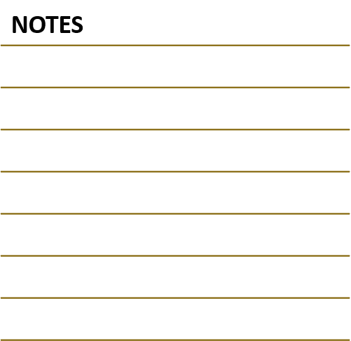
Questions for the Instructional Leader:
2023-2024
What are your campus goals for addressing numeracy and literacy?
What support systems are in place for your Induction Teachers, from yourself, site staff and district staff for instructional support?
What support systems are in place for your Induction Teachers, from yourself, site staff and district staff for social emotional support?
What additional support will you offer your Induction teacher with their chosen CSTP?
In what ways do you foster a culture of collaboration to encourage professional growth?

Slide 9

Discussion of Expectations
Administrator:
What are your expectations regarding Induction Teacher’s site responsibilities, adjunct duties, and IEP obligations?
Where can your teachers find your Critical Response Plans?
Induction Teacher:
Ask questions or discuss concerns:

Slide 10

Thank You!!
2023-2024
2023-2024
IMPORTANT!

Slide 11

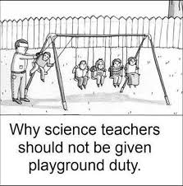
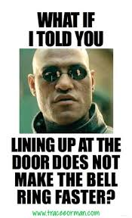
Here goes your title.
Here goes your text.

Slide 12


Here goes your title.
Here goes your text.
Some notes here!!

Slide 13
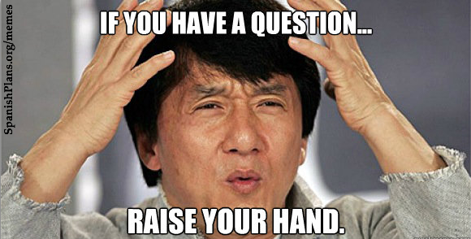


Here goes your title.
Some more text here.
Buy presents for John and Martha.

Slide 14
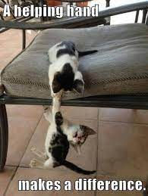

Here goes your title.
Some more text here.
Buy groceries!

Slide 15
Here goes your title.
Here goes your text.
“Go the extra mile, it’s never crowded”

