Slide 1

Welcome Kindergarten Families!
Mrs. Lucero
Mrs.Barton
Mr.Morineau

Slide 2


Welcome Kindergarten families!
Thank you for being here and
for trusting your children with us.
Objective:
Inform you on school procedures and expectations
2. Help you to set up your child for success
Insert Picture
WELCOME

Slide 3
Kindergarten School Schedule
Week 1:
8:15a.m.-1:00p.m. Wednesday and Friday
8:15a.m.-2:45p.m. Thursday
Week 2 and beyond:
8:15a.m. -2:45p.m.
Minimum days and Fridays:
8:15a.m.-1:00p.m.

Slide 4
Apps We Will Use

Slide 5
ClassDojo Communication
VERY IMPORTANT TO DOWNLOAD AND LOGIN ASAP!
App can be used to send direct messages to teacher
Teacher will be posting flyers, important information, and student work to our “Class Story”

Slide 6
Morning Drop Off
Drop off:
Walk with child, holding hands to front gate near the office
Students line up in their designated area on blacktop

Slide 7
Pick Up
Pick Up:
Please arrive early for pick up to secure a parking space
Please wait outside the classroom if you are in Mrs.Lucero’s and Mr.M’s class
Mrs.Barton will be walking out to the front
Students will be dismissed one at a time for safety
You must have a picture ID (everyday)
Anyone picking up your child must be on the list in the computer and have a picture ID
To add names to the list you must do it in person in the office
Add as many names as you would like at anytime
If someone is not on the list in the computer or they don’t have an ID, we cannot release your child to them.

Slide 8
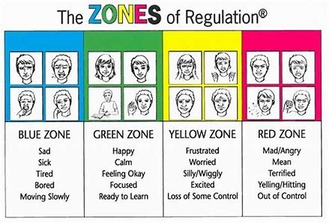
Success at Home and at School
Red Yellow Blue Green Mad, angry, yelling, or hitting Take a break, count to 10. Talk about it with an adult. Silly, hyper, frustRYello Blue Green Mad, angry, yelling, or hitting Take a break, count to 10. Talk about it with an adult. Silly, hyper, frustrated Take a break, deep breathing. Think before you act. Sad, tired, sick, bored Talk to an adult, take a break. Think happy thoughts. Calm, happy, ready to learn Help others, listen to Take a break, deep breathing. Think before you act. Sad, tired, sick, bored Talk to an adult, take a break. Think happy thoughts. Calm, happy, ready to learn Help others, listen to teacher. Complete your work.

Slide 9
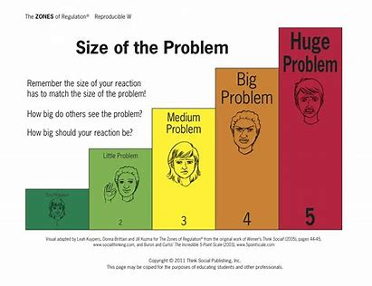
Success at Home and at School
Red Yellow Blue Green Mad, angry, yelling, or hitting Take a break, count to 10. Talk about it with an adult. Silly, hyper, frustRed Yellow Blue Green Mad, angry, yelling, or hitting Take a break, count to 10. Talk about it with an adult. Silly, hyper, frustrated Take a break, deep breathing. Think before you act. Sad, tired, sick, bored Talk to an adult, take a break. Think happy thoughts. Calm, happy, ready to learn Help others, listen to teacher. Complete your work.rated Take a break, deep breathing. Think before you act. Sad, tired, sick, bored Talk to an adult, take a break. Think happy thoughts. Calm, happy, ready to learn Help others, listen to teacher. Complete your work.

Slide 10

Attendance
Healthy habits start now
Attendance is critical to your child’s security and success
Absences and tardies are kept track of for each child
Perfect attendance awards are given each quarter and for the whole school year

Slide 11
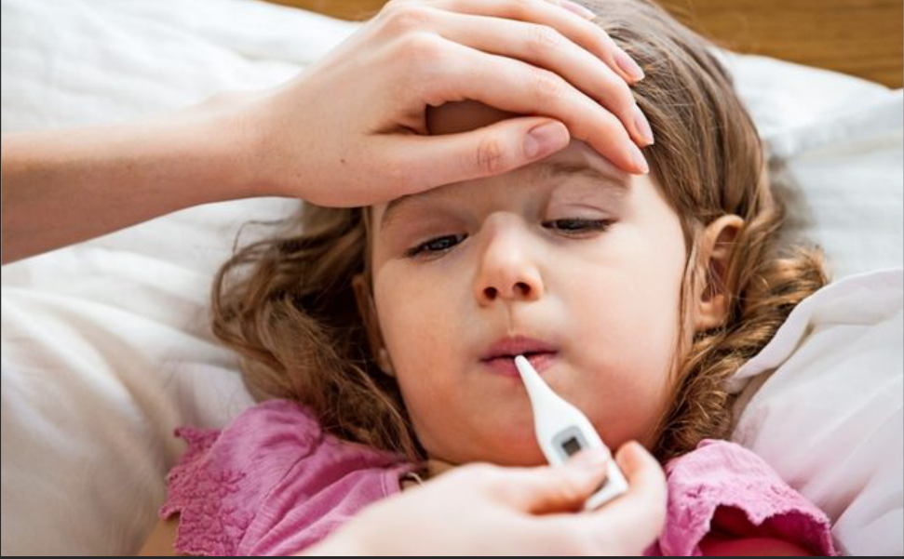
Sick
DO NOT send your child to school when they are sick (recent fever, recent vomiting, heavy coughing, runny nose with mucus or other chronic illness (asthma attack, severe allergic reaction, etc.)
Having open communication with teacher at all times.
Call the Attendance Secretary- Ms. Jennifer Rubio
in the morning every time your child must stay home at (619) 420-5533 EXT 470110.
IMPORTANT - Please inform your child’s teacher of any special medical needs: chronic or severe illness or allergy.
Free Breakfast _______am
Free lunch (2-3 choices)
Please send a small, healthy snack everyday (not too much and no candy)
Please send a labeled water bottle
If your child has an allergy please let the nurse know right away.
Free Breakfast 7:30-7:50am
Free lunch (2-3 choices)
Please send a small, healthy snack everyday (not too much and no candy)
Please send a water bottle
If your child has an allergy please let the nurse know right away.

Slide 12

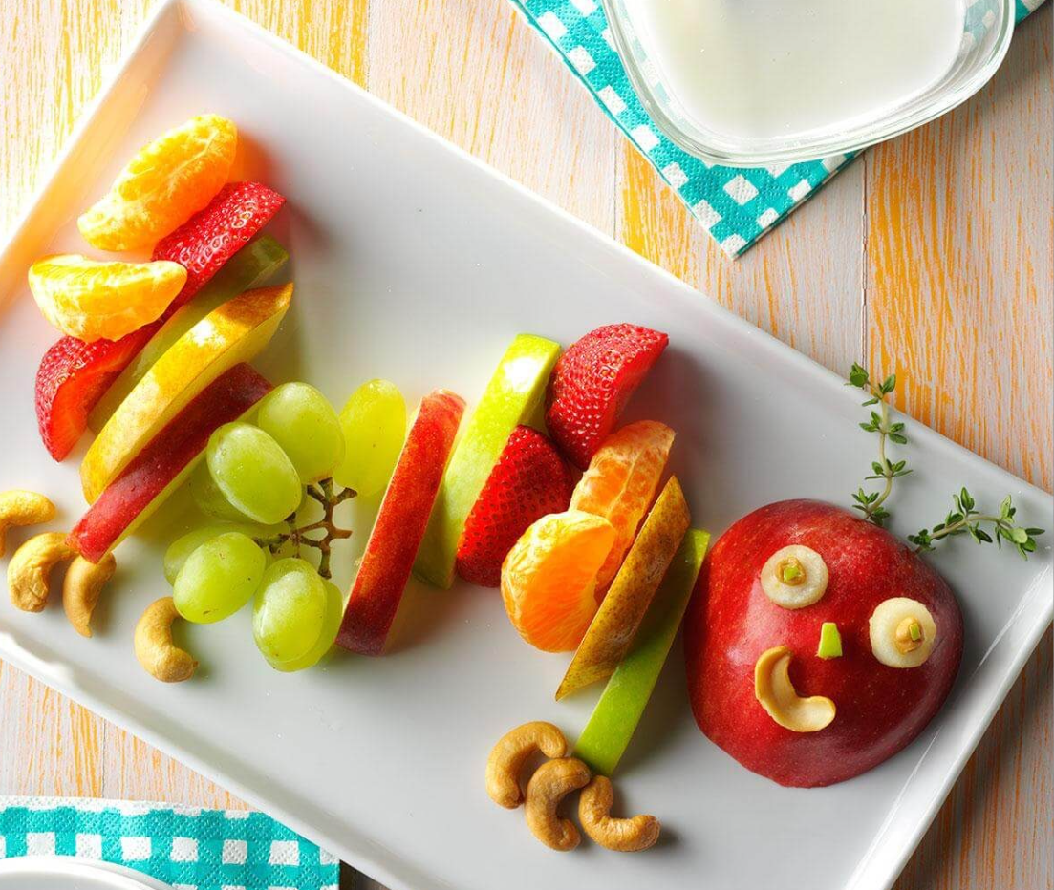
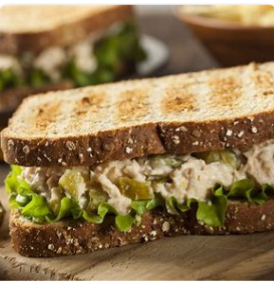
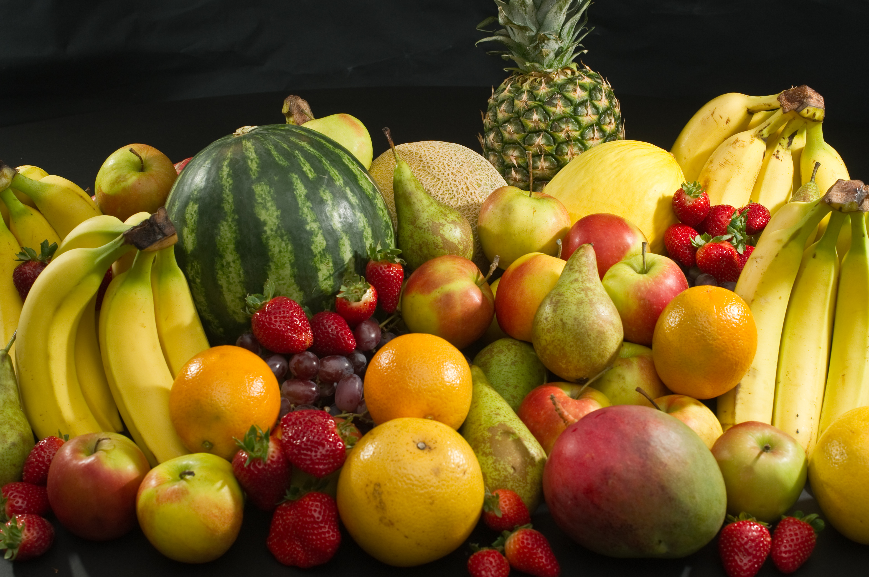
Food
Free Breakfast _______am
Free lunch (2-3 choices)
Please send a small, healthy snack everyday (not too much and no candy)
Please send a labeled water bottle
If your child has an allergy please let the nurse know right away.
Free Breakfast 7:30-7:50am
Free lunch (2-3 choices)
Please send a small, healthy snack everyday (not too much and no candy)
Please send a water bottle
If your child has an allergy please let the nurse know right away.
Free School Breakfast 7:50-8:10a.m.
Free lunch (2-3 choices)
Please send a small, healthy snack everyday (not too much and no candy)
Please send a labeled water bottle
If your child has an allergy please let the nurse and teacher know right away.

Slide 13


Birthdays
We love birthdays and they are exciting but…
No birthday parties at school
No sending sweets to share
(no cookies, cupcakes, ice cream, etc.)
All parties and sweets should be done at home
Invitations can be passed out after school
If you want you can send pencils, stickers or a small non-edible item to be handed out at the end of the day
Free Breakfast _______am
Free lunch (2-3 choices)
Please send a small, healthy snack everyday (not too much and no candy)
Please send a labeled water bottle
If your child has an allergy please let the nurse know right away.
Free Breakfast 7:30-7:50am
Free lunch (2-3 choices)
Please send a small, healthy snack everyday (not too much and no candy)
Please send a water bottle
If your child has an allergy please let the nurse know right away.

Slide 14
Uniforms are optional
Uniforms are optional. If your child will not be wearing a uniform this school year, please complete a Uniform Exemption form online sent by Ms.Reyes.
Student’s without an exemption form will be expected to be in uniform while at school.
Uniforms consist of a dark or light blue polo shirt or Rohr t-shirt and beige/khaki pants/skorts.
Friday’s are casual dress at Rohr. Student’s must follow dress code.
Shoes must be worn at all times. Sandals must have closed toes and heel straps. Flip-flops or other backless shoes or sandals are not safe.
Free Breakfast 7:30-7:50am
Free lunch (2-3 choices)
Please send a small, healthy snack everyday (not too much and no candy)
Please send a water bottle
If your child has an allergy please let the nurse know right away.

Slide 15
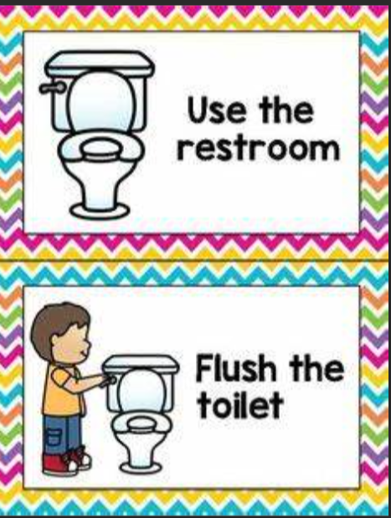
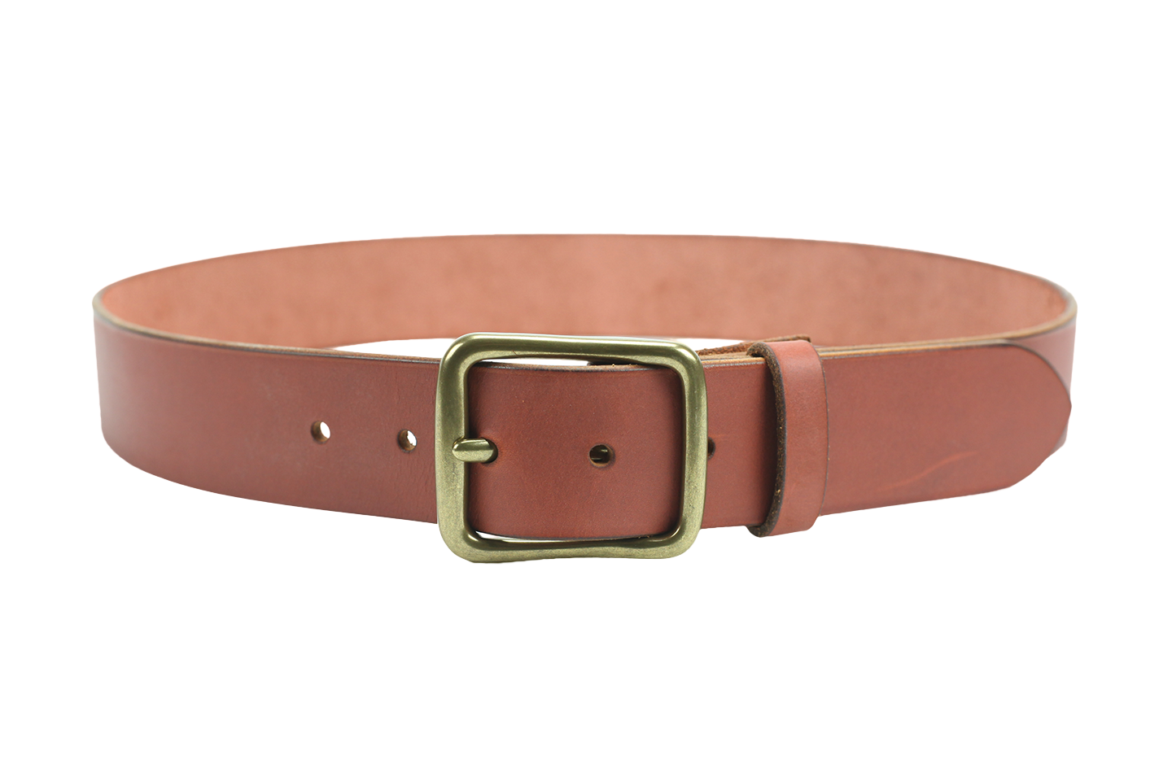
Bathroom
Free Breakfast _______am
Free lunch (2-3 choices)
Please send a small, healthy snack everyday (not too much and no candy)
Please send a labeled water bottle
If your child has an allergy please let the nurse know right away.
Free Breakfast 7:30-7:50am
Free lunch (2-3 choices)
Please send a small, healthy snack everyday (not too much and no candy)
Please send a water bottle
If your child has an allergy please let the nurse know right away.
All children must be able to use the bathroom on their own including wiping themselves.
Teachers cannot help
Please do not send your child wearing a belt
Send a change of clothes in backpack in case of an accident (Please label clothes and bag with child’s name.)

Slide 16
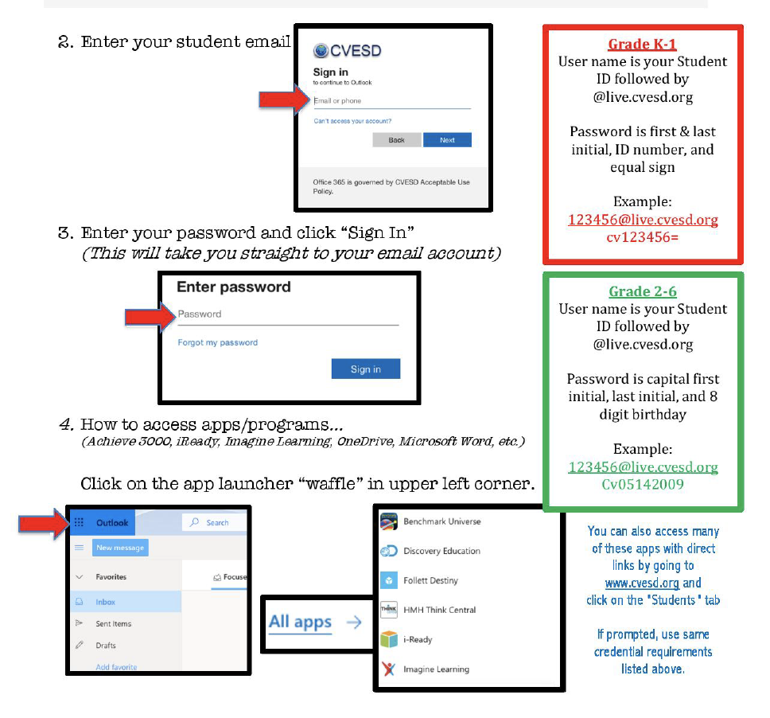
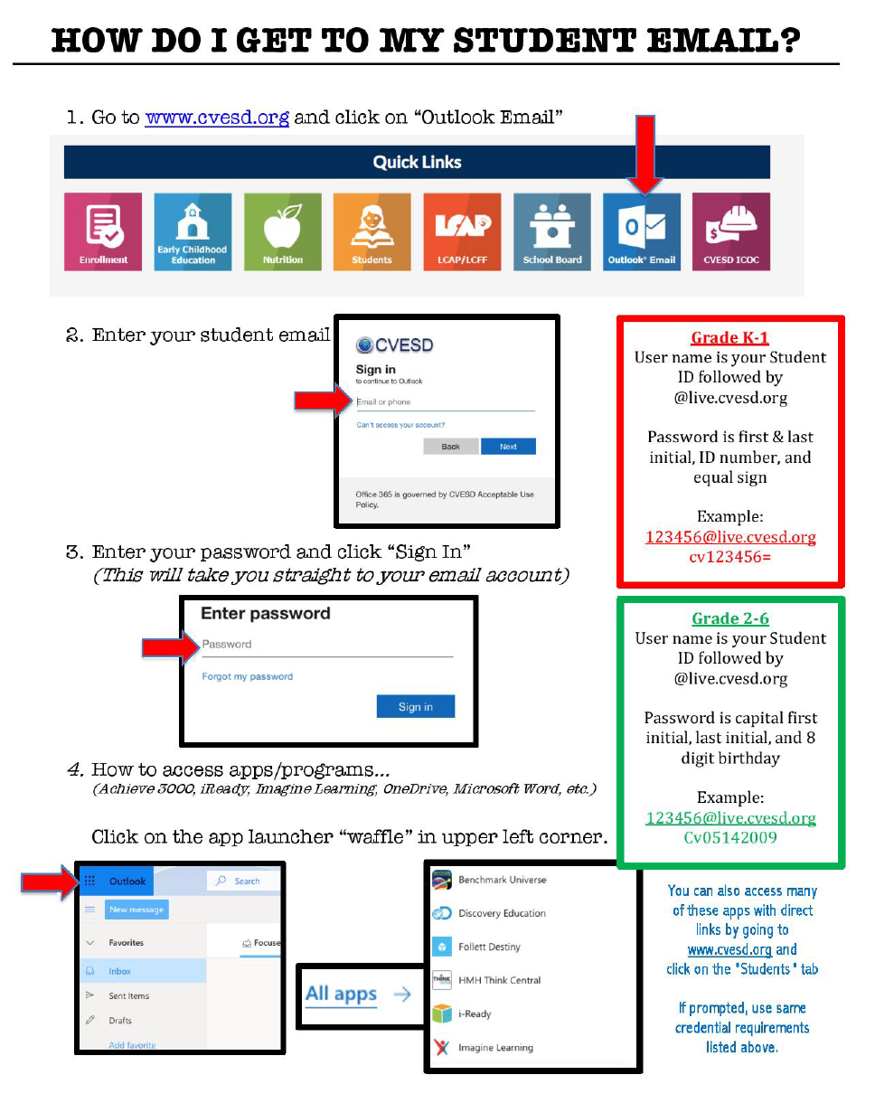
Single Sign On Login Instructions

Slide 17
Kindergarten Standards
Some of the End of Year Expectations Are:
Students will be able to read 100 High Frequency Words (aka “sight words”)
Students will be able to read a Level C text
Students will be able to produce writing that is legible and on topic
Students will be able to add, subtract, and model word problems in different ways

Slide 18
Kindergarten Standards
Helping your child at home to be successful:
Read everyday
Practice Sight Words Daily
Practice their handwriting at home (legible penmanship)
Work with your child at home on their challenge areas

Slide 19
Classroom Rules
Class Rules
Respect yourself, others, and materials.
Raise your hand to get the teacher’s attention.
Keep hands, feet, and objects to yourself.
Help each other learn and make good choices.

Slide 20
Encouraging Good Behavior
Teachers and staff use positive praise techniques to encourage appropriate behavior.
Students will be expected to know and follow all school/classroom rules.
Rewards
Individual:
ROAR tickets
Positive praise
Special privilege
Parent communication
Consequences
Additional check in with student and parent
Student contract

Slide 21
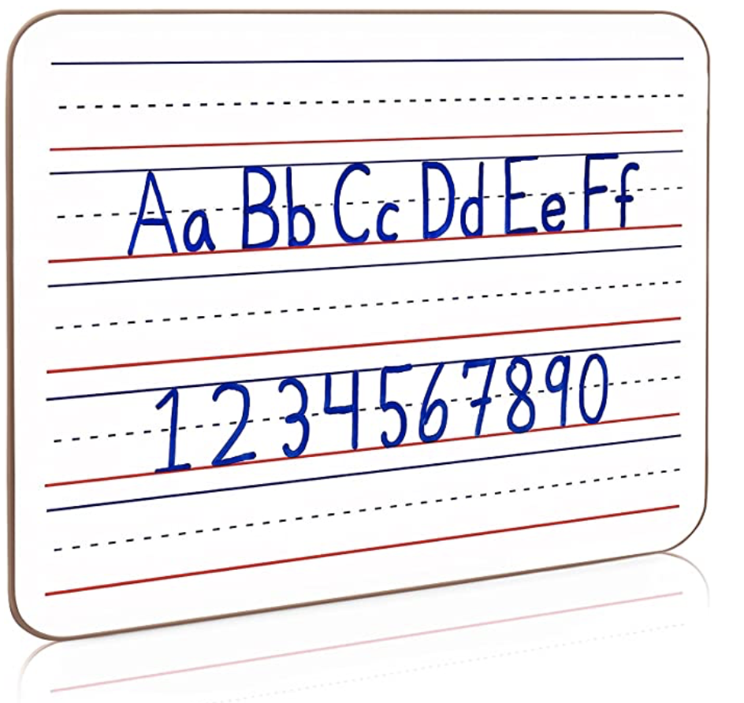
Assignments and Homework
Homework can include the following: reading, sight word practice, math and online programs
Online Programs include: iReady and SmartyAnts
HOMEWORK POLICY
Homework is an integral part of the educational experience. Students develop life skills such as self-discipline, problem solving, time management and responsibility when homework is valued and adhered to. To ensure the success of all students, Rohr Elementary School has established the homework policy.

Slide 22
Assignments and Homework
Homework should help a child:
  Develop independent study habits and self-discipline.
  Reinforce classroom instruction by further application and experience.
  Enrich school experiences as a result of independent study, individual research and experimentation.

Slide 23
Assignments and Homework
  Parents are encouraged to:
  Provide a study place with a minimum of distractions and interruptions.
  Monitor the student as needed.
  Communicate with the teacher if there are questions about homework assignments or if students
  have difficulty in completing assignments in a reasonable time.
  Make sure that school materials are returned.
  Check to see that work is completed.

Slide 24
Assignments and Homework
  A student is expected to:
•. Complete the assignments neatly, accurately and on time.
• Bring necessary materials home and return materials on time

Slide 25
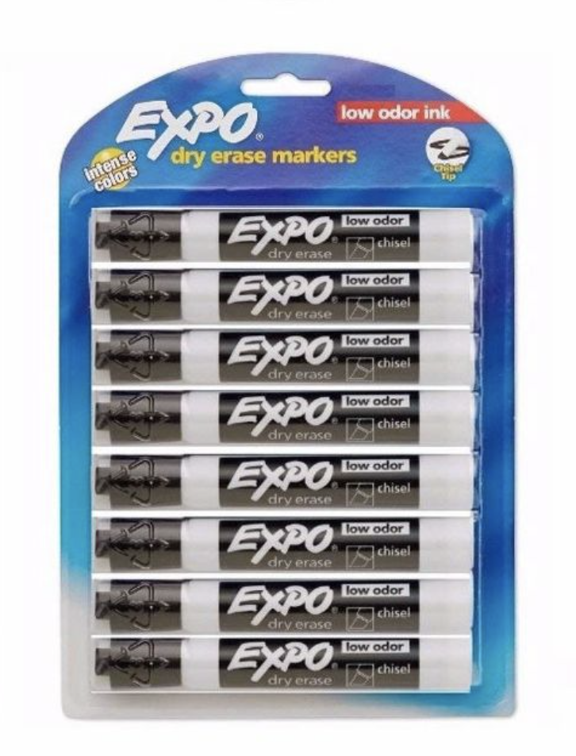
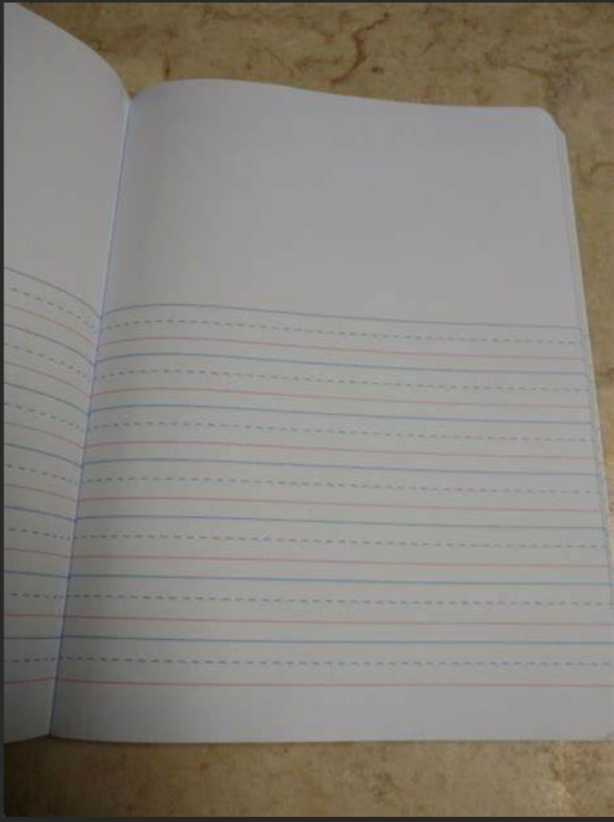
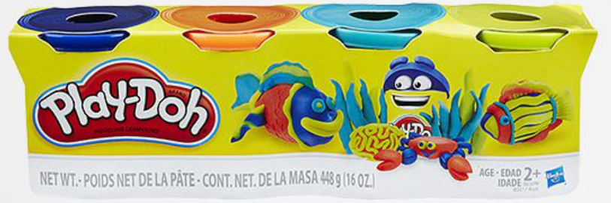
School Supplies

Slide 26
School Supplies
1. BACKPACK—LABELED ​with your child’s name ​with two arm straps​ that can hang on a chair. The backpack needs to be big enough to hold student’s homework folder and all belongings.
2. REUSABLE SNACK/LUNCH BAG—LABELED​ with your child’s name. Also, ​easy-to-open reusable containers​ to hold food items that you send each day for your child to have at snack and lunch. No glass allowed.
3. WATER BOTTLE—LABELED ​with your child’s name. No glass
allowed.

Slide 27

School Supplies
5. Primary Lined Notebook with area for drawing (2 are requested)
6. Whiteboard, black white board markers, white board eraser (for home/school)
7. Label all clothing with your child’s name (jackets, lunch bags, backpacks, etc.)
Unmarked clothing will be turned into the “Lost and Found.”
Comfortable shoes must be sturdy and cover the feet (for playground safety purposes).
8. Students are not allowed to bring toys or objects from home, unless requested in written form and approved by the teacher. Please do not send markers or pens with your student.

Slide 28
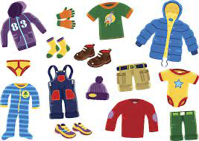
Personal Items
Label all clothing with your child’s name (jackets, lunch bags, backpacks, etc.)
Unmarked clothing will be turned into the “Lost and Found.”
Comfortable shoes must be sturdy and cover the feet (for playground safety purposes).
Students are not allowed to bring toys or objects from home, unless requested in written form and approved by the teacher.
Please do not send markers, pens or toys with your student unless asked by the teacher.

Slide 29


Information to Share
Allergies
Emotional & Behavioral concerns
Health Issues
Significant Family Changes

Slide 30
Classroom Donations Accepted
Play-doh or Black White Board Markers

Slide 31
Encouraging Good Behavior
BEHAVIORAL EXPECTATIONS
The students and staff at Rohr Elementary School believe that a safe and positive school environment is important to a child’s learning in the classroom and to his or her growth as a citizen.
To provide such an environment, Rohr Elementary School has adopted the following set of rights and behavioral standards.
All Rohr lions will (be):
➢Respectful and Kind
➢Own Choices
➢Always Be Safe
➢Responsible

Slide 32
Kinder Year Overview

Slide 33
Alphafriends Songs and More
Letter Factory Song on YouTube
Jack Hartman (Count to 100)
Jack Hartman (Subitize)
Get dice and practice counting objects
SmartyAnts(Single Sign on)
iReady Math

Slide 34
TAKE AWAYS
        Be on time to school every day- 8:15 a.m. (A little earlier 8:10a.m.)
        Talk to your student on how they are feeling and help them solve problems
        Read books and practice sight words every night with your child
        Anyone who picks up MUST be on the emergency card and MUST bring an ID.
        Please check Class Dojo often.

Slide 35
Welcome Rohr Kindergarten families!

