Slide 1
Working With Defiant Kids: Communication Tools For Teachers
www.interventioncentral.org
(Jim Wright)

Slide 2
Why do classroom conflicts between teachers and students seem to occur so frequently?
Students who are prone to conflict often do poorly in school.
They may act out in part to mask their embarrassment about their limited academic skills.
They may lack basic prosocial strategies that would help them work through everyday school difficulties.
Students can sometimes adopt defiance toward teachers as a deliberate strategy because it has “paid off” for them.
Teachers who get pulled into power struggles, may not realize that they are often simply reacting to student provocation.
If a teacher has already decided that a student is generally defiant, they may be overly quick to jump to conclusions, interpreting any ambiguous behavior of the student to be deliberate or confrontational.

Slide 3

What is the most important point to keep in mind when working with a defiant or noncompliant student?
The cardinal rule in managing conflicts with students is to stay outwardly calm and to maintain a professional prospective.

Slide 4
Instructors who successfully stay calm in the face of student provocation often see 2 additional benefits:
1. Over time, students may become less defiant, because they no longer experience the “reward” of watching you react in anger.
2. Because you now deal with student misbehavior impartially, efficiently and quickly, you will have more instructional time available that used to be consumed in epic power struggles.

Slide 5
How do I deliver a teacher command in a way that will minimize the chance of a power struggle?
You can increase the odds that a student will follow a teacher command by:
Approaching the student privately and using a quiet voice
Establishing eye contact and calling the student by name before giving the command
Stating the command as a positive (do) statement, rather than a negative (don’t) statement
Phrasing the command in clear and descriptive terms(using simple language that is easily understood) so the student knows exactly what he or she is expected to do. ( rule of 5/consistency)

Slide 6
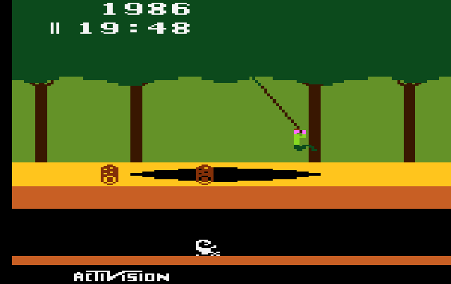
Conflict “Pitfalls” to watch out for:
Avoid mismatch between you words and non verbal signals.
Do not become entangled in a discussion or argument w/ a confrontational student.
Do not try to coerce or force the student to comply.
Take time to plan your response before reacting to provocative student behavior or remarks. “If you speak when angry, you’ll make the best speech you’ll ever regret.” –Groucho Marx
This Photo by Unknown Author is licensed under CC BY-SA

Slide 7
There is no magic strategies for managing behaviors of defiant students…
However, research shows that certain techniques tend to work best with these children and youth:
Give the student positive recognition
Monitor the classroom frequently and intervene proactively.
Avoid saying or doing things that are likely to anger or set off student.
When you must intervene; convey the message to the student that you will not tolerate the problem behavior-but that you continue to value and accept the student.
Remember the ultimate goal of any disciplinary measure is to teach the student more positive ways of behaving.
Develop a classroom “crisis response plan” to be implemented in the event that one or more students display aggressive behaviors that threaten their own safety or safety of others.

Slide 8
Other ideas for managing defiant or non-compliant students:
Allow the Student a “Cool-Down” Break
Ask Open Ended Questions
Assign a Reflective “Processing” Essay After Misbehavior
Do Not Get Entangled in Arguments
Emphasize the Positive in Teacher Requests
Expand the Range of Classroom Interventions
Give praise That is Specific and Does not Embarrass the Student
Give Problem Students Frequent Positive Attention
Increase “Reinforcement” Quality of the Classroom
Keep Responses Calm, Brief, and Buisness like.
Listen Actively
Off the Student a Face-Saving Out
Proactively Interrupt the Student’s Anger Early in the Escalation Cycle
Project Calmness When Approaching an Escalating Student
Relax Before Responding
Reward Alternative (Positive) Behvaiors
State Teacher Directives as Two-Part Choice Statements
Use a “Buddy Teacher” for Brief Student Breaks
Use Non-Verbal and Para-Verbal Behaviors to Defuse Potential Confrontations
Use “Soft” Reprimands
Validate Student’s Emotion by Acknowledging It

Slide 9
Final Thoughts…
While you can never predict what behaviors your students might bring into your classroom, you will usually achieve the best outcomes by:
Remaining Calm
Following Pre-Planned Intervention Strategies for Misbehavior
Acting With Consistency and Fairness
Acknowledge Positive Behavior:
Recognizing students for following rules, directives, directions, participating, etc, is one of the most effective tools for managing, promoting, and correcting undesired behaviors.
Children respond far much better typically to positive reinforcement then negative.

Slide 10
Jason Lee
District Behavioral Specialist
Unified School District of Marshfield,WI leej@marshfieldschools.org
Contact:

