Slide 1

Pennsauken Board of Education
2025-2026
Budget Presentation

Slide 2
Board Members & Administrators
Board Members
Administrators
JoAnn Young, Board President
Diane Johnson, Board Vice President
Ana Matos, Board Member
Jaclyn Hutton, Board Member
Jeffrey Carey, Board Member
Jerry Bennett, Board Member
Matthew McDevitt, Board Member
Osvaldo Alves III, Board Member
Lisa Eckel, Board Member
Acting Superintendent:
  Caroline Steer, MAT. M.Ed.
School Business Administrator/Board Secretary:
  John A. Ogunkanmi

Slide 3
Budget Process
December 2024
Preparation of Budget Documents
January 2025
Distribution of budget document to department heads
February 2025
- Preparation and approval of budget timeline by Board
- Collaboration with all departmental heads on proposed budget
March 2025
Public meetings’ budget discussion with the board
April 2025
Budget approval by the state
April 2025
Budget presentation/hearing

Slide 4
Budget Goals
1. | Expansion of pre-school through Baldwin classroom additions.
2. | Continuation of expanding and redesigning of basic skill and “RTI" program.
3. | Improvement of technology initiatives by updating educational software and replacement of antiquated hardware.
4. | Utilization of online software technology to start a gifted/talented program and improve instruction.
5. | Expansion of individual vocational education and mental health initiative.
6. | Building professionalism among teachers and administrators to better prepare students for standardized testing.
7. | Upgrades of building facilities for student safety, instruction and extra curriculum activities.
8. | Improvement of alternative behavior program and the expansion of both bilingual and special education.
9. | Improvement of share services opportunity to neighboring schools in the area of special education, transportation and risk management.
10. | Addressing learning loss due to recent pandemic event through various initiatives in the district.

Slide 5
District
Enrollment
YEAR | ENROLLMENT | PERCENTAGE
2025-26 | 5589 | 0.52%
2024-25 | 5560 | 1.91%
2023-24 | 5456 | 2.46%
2022-23 | 5325 | -1.48%
2021-22 | 5405 | 4.30%
2020-21 | 5182 | -0.46%
2019-20 | 5206 | 1.90%
2018-19 | 5109 | 1.07%
2017-18 | 5055 | 0.66%
2016-17 | 5022 | 1.23%

Slide 6
Budget Revenue

Slide 7
Budget Revenue Comparison
SOURCE | 2024-25 | % | 2025-26 | %
LOCAL TAX LEVY | 45,714,335 | 25.25% | 45,714,335 | 25.72 %
STATE AID | 93,327,941 | 51.55% | 99,382,839 | 55.92%
OTHERS | 21,696,511 | 11.98% | 16,647,642 | 9.37%
RESV TRANSFERS | 8,500,000 | 4.69% | 6,600,000 | 3.71%
 | 169,238,787 |  | 168,344,816
FEDERAL GRANTS | 9,318,644 | 5.15% | 6,887,676 | 3.88%
DEBT SERVICES | 2,487,844 | 1.37% | 2,496,569 | 1.40%
TOTAL | 181,045,275 | 100% | 177,729,061 | 100%

Slide 8
Budget Revenue Overview 25-26
SOURCE | 2025-26
LOCAL TAX LEVY | 25.72%
STATE AID | 55.92%
OTHERS | 9.37%
RESV TRANSFERS | 3.71%
FEDERAL GRANTS | 3.88%
DEBT SERVICES | 1.40%
TOTAL | 100.00%

Slide 9
Local Revenue Analysis
2024-2025 |  |  | 2025-2026
$45,714,335.00 | LOCAL LEVY |  | $45,714,335.00 | LOCAL LEVY
$1,862,473.00 | DEBT SERVICE |  | $1,880,342.00 | DEBT SERVICE
$47,576,808.00 | TOTAL TAX |  | $47,594,677.00 | PROPOSED TOTAL TAX
$2,376,807,809.00 | RATABLE BASE |  | $4,914,832,164.00 | RATABLE BASE
$142,700.00 | AVERAGE HOME |  | $282,600.00 | AVERAGE HOME
2.002 | ACTUAL SCHOOL TAX RATE |  | 0.968 | PROPOSED SCHOOL TAX RATE
$2,856.44 | ACTUAL AVERAGE SCHOOL TAX |  | $2,736.67 | PROPOSED AVERAGE SCHOOL TAX
 | ($119.77) |  | PROPOSED FISCAL YEAR TAX INCREASE
 | ($9.98) |  | PROPOSED FISCAL MONTHLY TAX INCREASE
TAX SAVINGS CALCULATION
INCREASE IN ENROLLMENT ADJ |  |  | 230,956.00
DECREASE IN HEALTHCARE COSTS |  |  | 2,352,222.00
TAX LEVY 2% LEGISLATED ANNUAL INCREASE |  |  | 918,906.00
EXPIRING BANKED CAP |  |  | 1,604,637.00
POTENTIAL TAX LEVY INCREASE ABOVE 2% |  |  | 5,106,721.00
TAX LEVY INCREASE |  |  | 0.00
TAX LEVY SAVINGS |  |  | 5,106,721.00
ANNUAL AVE. COST PER HOME OWNERS |  |  | 293.63

Slide 10
Local Revenue Tax Savings
2024-2025 |  |  | 2025-2026
$45,714,335.00 | LOCAL LEVY |  | $50,821,056.00 | LOCAL LEVY
$1,862,473.00 | DEBT SERVICE |  | $1,880,342.00 | DEBT SERVICE
$47,576,808.00 | TOTAL TAX |  | $52,701,398.00 | PROPOSED TOTAL TAX
$2,376,807,809.00 | RATABLE BASE |  | $4,914,832,164.00 | RATABLE BASE
$142,700.00 | AVERAGE HOME |  | $282,600.00 | AVERAGE HOME
2.002 | ACTUAL SCHOOL TAX RATE |  | 1.072 | PROPOSED SCHOOL TAX RATE
$2,856.44 | ACTUAL AVERAGE SCHOOL TAX |  | $3,030.30 | PROPOSED AVERAGE SCHOOL TAX
 | $173.86 |  | PROPOSED FISCAL YEAR TAX INCREASE
 | $14.49 |  | PROPOSED FISCAL MONTHLY TAX INCREASE
TAX SAVINGS FOR 2025/26
ANNUAL TAX SAVINGS | $293.63
MONHTLY TAX SAVINGS | $24.47

Slide 11
State Revenue Allocation
STATE AID | 2024-2025 | 2025-2026 | DIFFERENCE
Equalization Aid | $ 80,389,922.00 | $ 84,660,518.00 | $ 4,270,596.00
Special Education Aid | $ 6,137,002.00 | $ 7,628,323.00 | $ 1,491,321.00
Security Aid | $ 2,673,966.00 | $ 2,334,436.00 | $ (339,530.00)
Preschool Education Aid | $ 1,534,981.00 | $ 2,082,300.00 | $ 547,319.00
Transportation Aid | $ 2,592,070.00 | $ 2,677,262.00 | $ 85,192.00
PARCC Readiness Aid | $ - | $ - | $ -
PER Public Growth Aid | $ - | $ - | $ -
Professional Learning Community Aid | $ - | $ - | $ -
Other State Aid | $ - | $ - | $ -
General Fund Total | $ 93,327,941.00 | $ 99,382,839.00 | $ 6,054,898.00
Debt Service | $ 625,371.00 | $ 616,227.00 | $ (9,144.00)
Debt Service Total | $ 625,371.00 | $ 616,227.00 | $ (9,144.00)
GRAND TOTAL | $ 93,953,312.00 | $ 99,999,066.00 | $ 6,045,754.00

Slide 12
Budget Appropriation

Slide 13
Appropriation By Function
DESCRIPTION | 2025-2026 | PERCENTAGES
INSTRUCTIONS | 57,443,824.00 | 32.32%
SPECIAL SERVICES | 9,853,200.00 | 5.54%
SUPPORT SERVICES | 14,842,838.00 | 8.35%
EMPLOYEE BENEFITS | 30,592,925.00 | 17.21%
FACILITIES MAINTENANCE | 14,206,204.00 | 7.99%
SECURITY | 1,733,000.00 | 0.98%
TRANSPORTATION | 10,002,300.00 | 5.63%
ATHLETICS & EXTRA CURRICULUM | 2,667,700.00 | 1.50%
CHARTER SCHOOLS | 11,261,062.00 | 6.34%
CAPITAL OUTLAY | 15,944,113.00 | 8.97%
DEBT SERVICES | 2,496,569.00 | 1.40%
PRE-SCHOOL AID | 2,592,952.00 | 1.46%
FEDERAL GRANTS | 4,092,374.00 | 2.30%
 | 177,729,061.00 | 100.00%

Slide 14
Appropriation By Department
 | 2024-2025 |  | 2025-2026 |  | DIFFERENCE |  | PERCENTAGES
LOCATIONS
ADMIN | $24,326,017.00 |  | $26,554,199.00 |  | $2,228,182.00 |  | 14.94%
SUPERINTENDENT | $67,000.00 |  | $55,000.00 |  | ($12,000.00) |  | 0.03%
CURRICULUM | $767,800.00 |  | $1,091,347.00 |  | $323,547.00 |  | 0.61%
PERSONNEL | $21,849,492.00 |  | $25,150,049.00 |  | $3,300,557.00 |  | 14.15%
MAINTENANCE | $4,759,980.00 |  | $2,915,000.00 |  | ($1,844,980.00) |  | 1.64%
TECHNOLOGY | $1,019,548.00 |  | $944,465.00 |  | ($75,083.00) |  | 0.53%
TRANSPORTATION | $4,205,959.00 |  | $4,500,000.00 |  | $294,041.00 |  | 2.53%
SPECIAL SERVICES | $3,309,770.00 |  | $3,900,000.00 |  | $590,230.00 |  | 2.19%
ELEMENTARY SCHOOLS | $199,000.00 |  | $196,000.00 |  | ($3,000.00) |  | 0.11%
ROOSEVELT (STEM) INTM | $70,000.00 |  | $60,000.00 |  | ($10,000.00) |  | 0.03%
INTERM SCH | $92,000.00 |  | $92,000.00 |  | $0.00 |  | 0.05%
PHIFER MIDDLE | $165,000.00 |  | $165,000.00 |  | $0.00 |  | 0.09%
BURLIN (ALT) HS | $36,000.00 |  | $36,000.00 |  | $0.00 |  | 0.02%
PHS | $844,713.00 |  | $840,000.00 |  | ($4,713.00) |  | 0.47%
CHARTER SCHOOLS | $10,801,871.00 |  | $11,261,062.00 |  | $459,191.00 |  | 6.34%
PAYROLL | $71,218,070.00 |  | $74,842,931.00 |  | $3,624,861.00 |  | 42.11%
DEBT SERVICE | $2,487,844.00 |  | $2,496,569.00 |  | $8,725.00 |  | 1.40%
CAPITAL EXPENSES | $25,687,568.00 |  | $15,944,113.00 |  | ($9,743,455.00) |  | 8.97%
PRE SCHOOL (Other Exp) | $1,710,459.00 |  | $2,592,952.00 |  | $882,493.00 |  | 1.46%
FED GRANTS | $7,427,184.00 |  | $4,092,374.00 |  | ($3,334,810.00) |  | 2.30%
TOTAL | $181,045,275.00 |  | $177,729,061.00 |  | ($3,316,214.00) |  | 100.00%

Slide 15


Slide 16
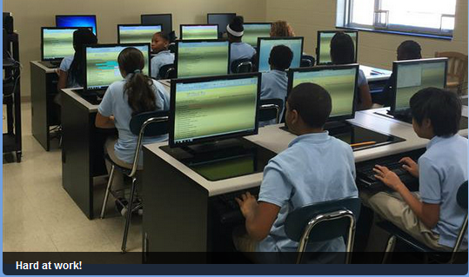
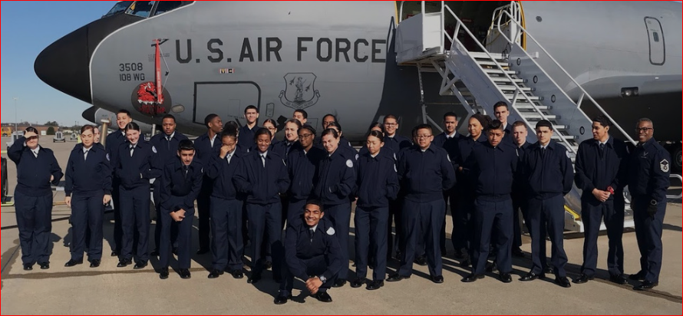
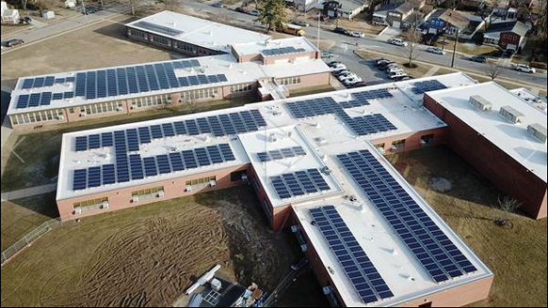
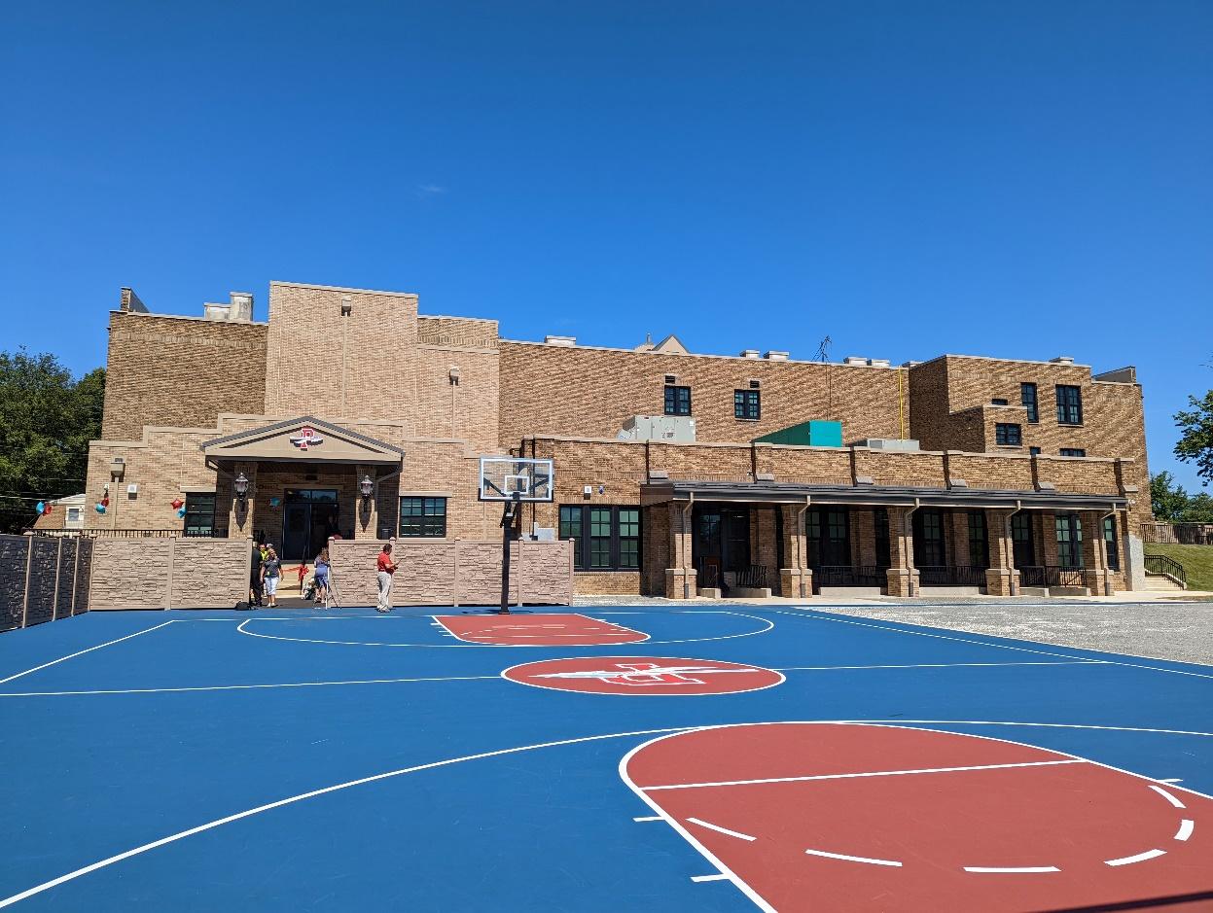

“Striving for Excellence”

