Slide 1
Word Ladders and Frayer Model

Slide 2
Word Ladders
Brief Description: Adapted from the work of Cunningham and Cunningham (1992) and Rasinski (1999), in this strategy the children are given a key phrase. The letters in the key phrase are used to compose new words based on teacher prompts and hints. Word ladders activities are a fun supplemental intervention that can be added to your curriculum to get students involved in manipulating sounds in words to increase spelling skills. This strategy should be done with paper and pencil; however, letter cards or tiles can be used for students with orthographic processing difficulties who need to work on spelling skills. Using representations of the letters removes the cognitive demand of the orthographic process and isolates the phonetic process involved in spelling. For students who need to begin increasing their orthographic skill, this strategy can be a fun way to practice writing.

Slide 3
Implementation- Whole or Small Group- Independent
Implementation: This strategy can be implemented in small groups, or whole group. It can be facilitated by a teacher, paraprofessional or adult volunteer.
The teacher writes the key phrase on the board and the children copy it onto their paper (or are given letter tiles to construct it). For example: “Team to Work”
The phrase and letters are reviewed with the children. The facilitator may review the letter sounds with the group.
Present the first hint orally. The children write the target word or use the letter cards to spell the word. For example, “Rearrange the letters in team to make the word that means the food we eat that comes from animals.” Answer- meat.
The child then reads the word he or she spelled. Give feedback until the child has the correct target word, spelled correctly.
Present the next hint orally. The children write the target word or use the letter cards to spell the word. Rearrange the letters to make the word that means not wild.” Answer- tame.
Continue through the word ladder until you reach the end. Giving feedback to the students throughout the lesson.
Schedule for implementation: The suggested intervention schedule is approximately 10-15 minutes daily.
.

Slide 4
Key Phrase: Team to Work
Target Word: Letter Changes Required Clue Team
Meat | Rearrange letters | Food that comes from animals.
Tame | Rearrange letters | Not wild
Take | Chg 1 | To get possession of something. To grab.
Tale | Chg 1 | A story.
Tall | Chg 1 | Not short.
Toll | Chg 1 | A fee paid for a service or privilege. We had to pay a one dollar toll to cross the bridge.
Ton | -2, + 1 | A weight, 2,000 pounds.
Torn | + 1 | To have divided or separated something by pulling.
Worn | Chg 1 | To have caused something to deteriorate or go bad by using it or wearing it out.
Work | Chg 1 | What teams must do together.

Slide 5
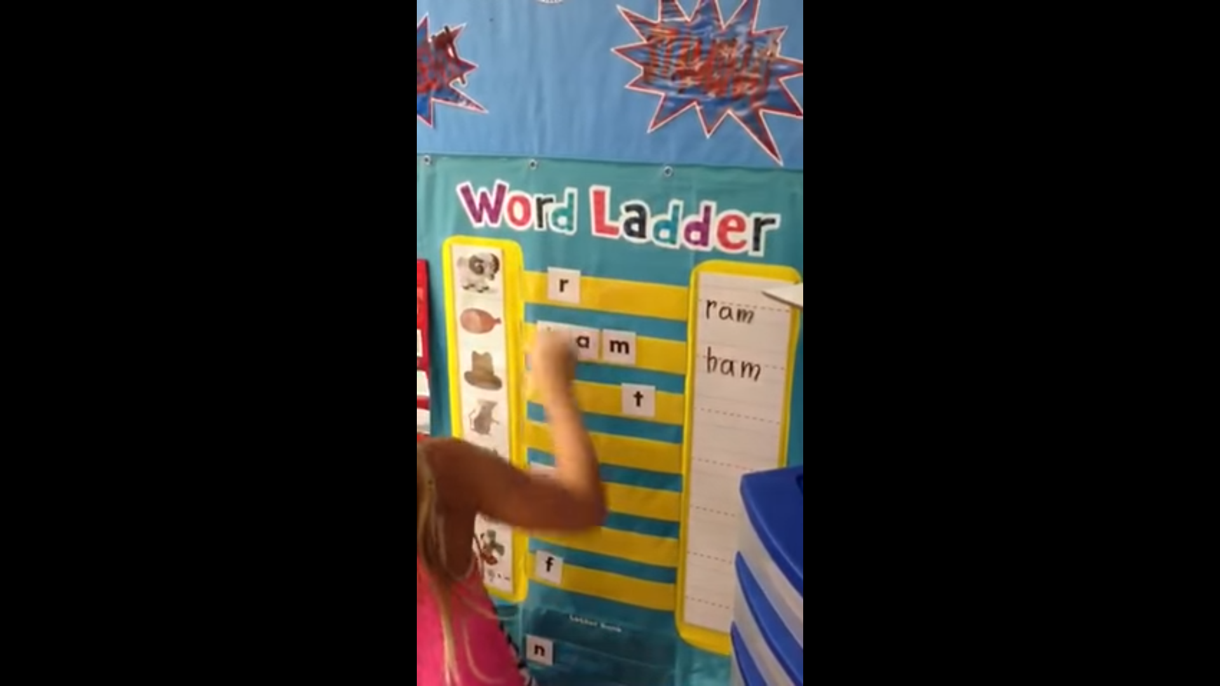
Word Ladder Resources
Timothy Rasinksi: http://www.timrasinski.com/
http://www.k12reader.com/subject/vocabulary/phonetics/word-ladders/
Search the web or Books available through Amazon:
Teachers Pay Teachers

Slide 6
Frayer Model- Vocabulary Graphic Organizer
Background
The Frayer Model is a strategy that uses a graphic organizer for vocabulary building. This technique requires students to (1) define the target vocabulary words or concepts, and (2) apply this information by generating examples and non-examples. This information is placed on a chart that is divided into four sections to provide a visual representation for students.
Benefits
This instructional strategy promotes critical thinking and helps students to identify and understand unfamiliar vocabulary. The Frayer Model can be used with the entire class, small groups, or for individual work. The Frayer Model draws on a student's prior knowledge to build connections among new concepts and creates a visual reference by which students learn to compare attributes and examples.

Slide 7
Implementation- Whole or Small Group-Independent
Create and use the strategy
Pre-select a list of key vocabulary from a reading selection. The Frayer Model should be explained and a graphic organizer provided to each student. Then direct students to complete the template individually, in small groups or as a whole class. Model the type and quality of desired answers for the specific concept.
Review vocabulary words or concept list with the class before students read the selection.
Have students read the assigned text and carefully define the target concepts. Have students complete the four-square chart for each concept.
Ask the students to share their conclusions with the entire class. These presentations may be used to review the entire list of new vocabulary or concepts.

Slide 8
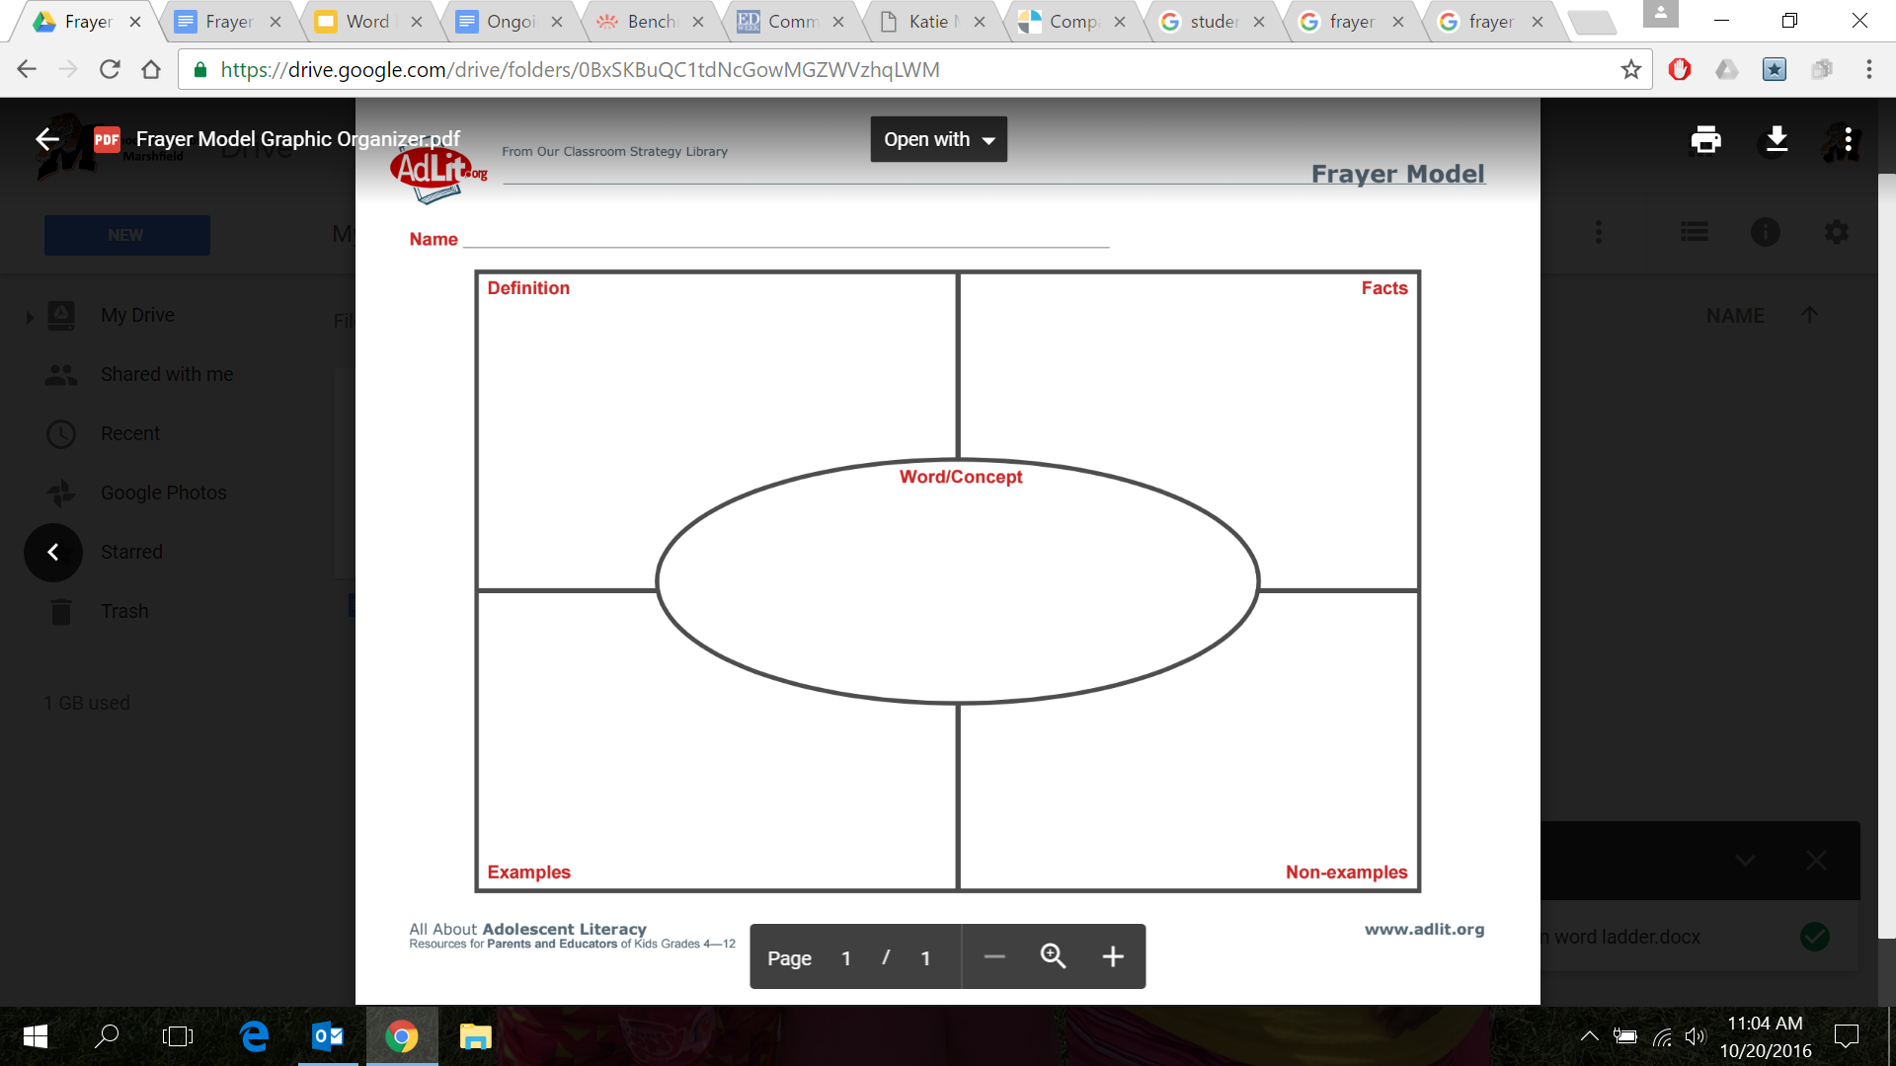

Slide 9
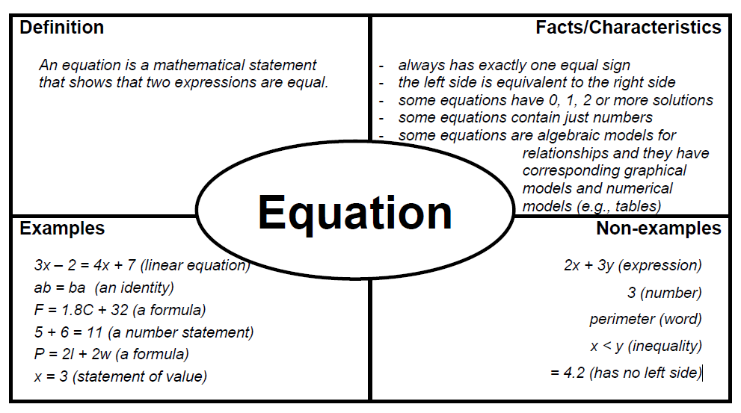
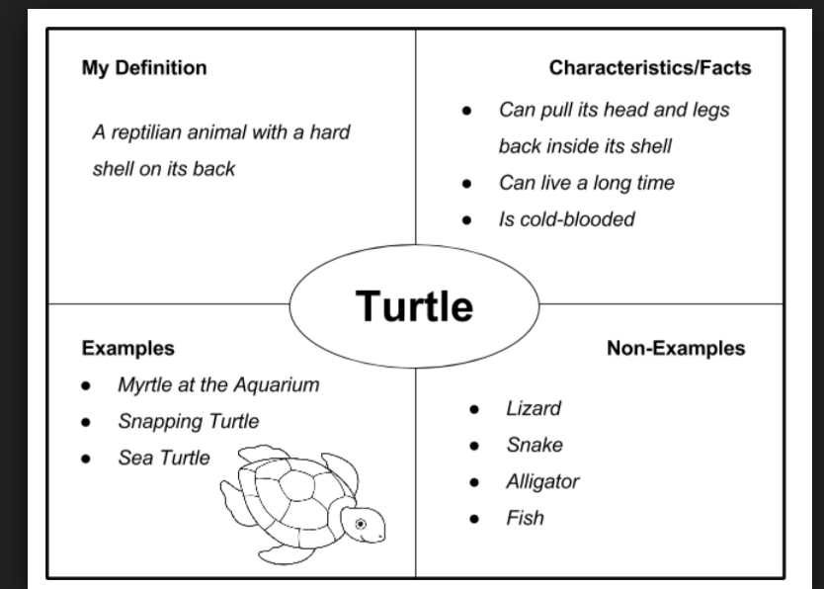
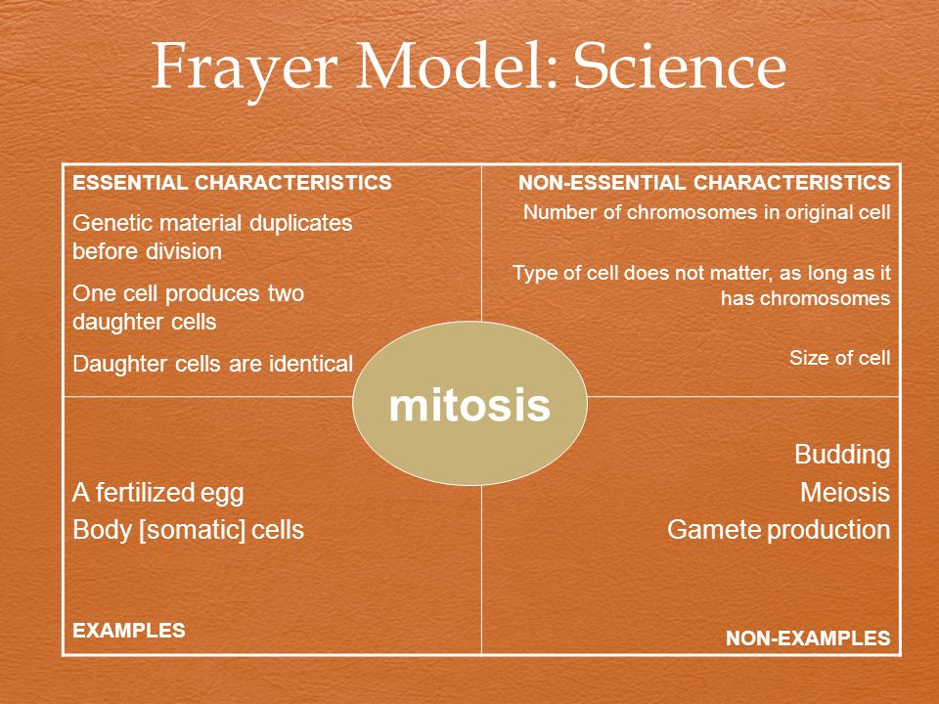
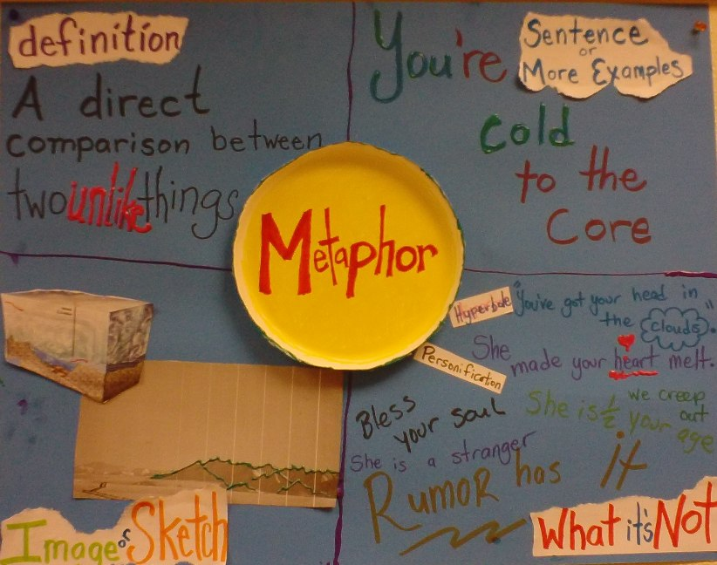

Slide 10
Frayer Model Resources
AdLit: http://www.adlit.org/
Marzano Research Site: http://www.marzanoresearch.com/
West Virgina Dept of Education: https://wvde.state.wv.us/strategybank/FrayerModel.html

