Slide 1


Welcome to
Fourth Grade!
2024-2025
Bowden, Northcutt, and Hertzka

Slide 2
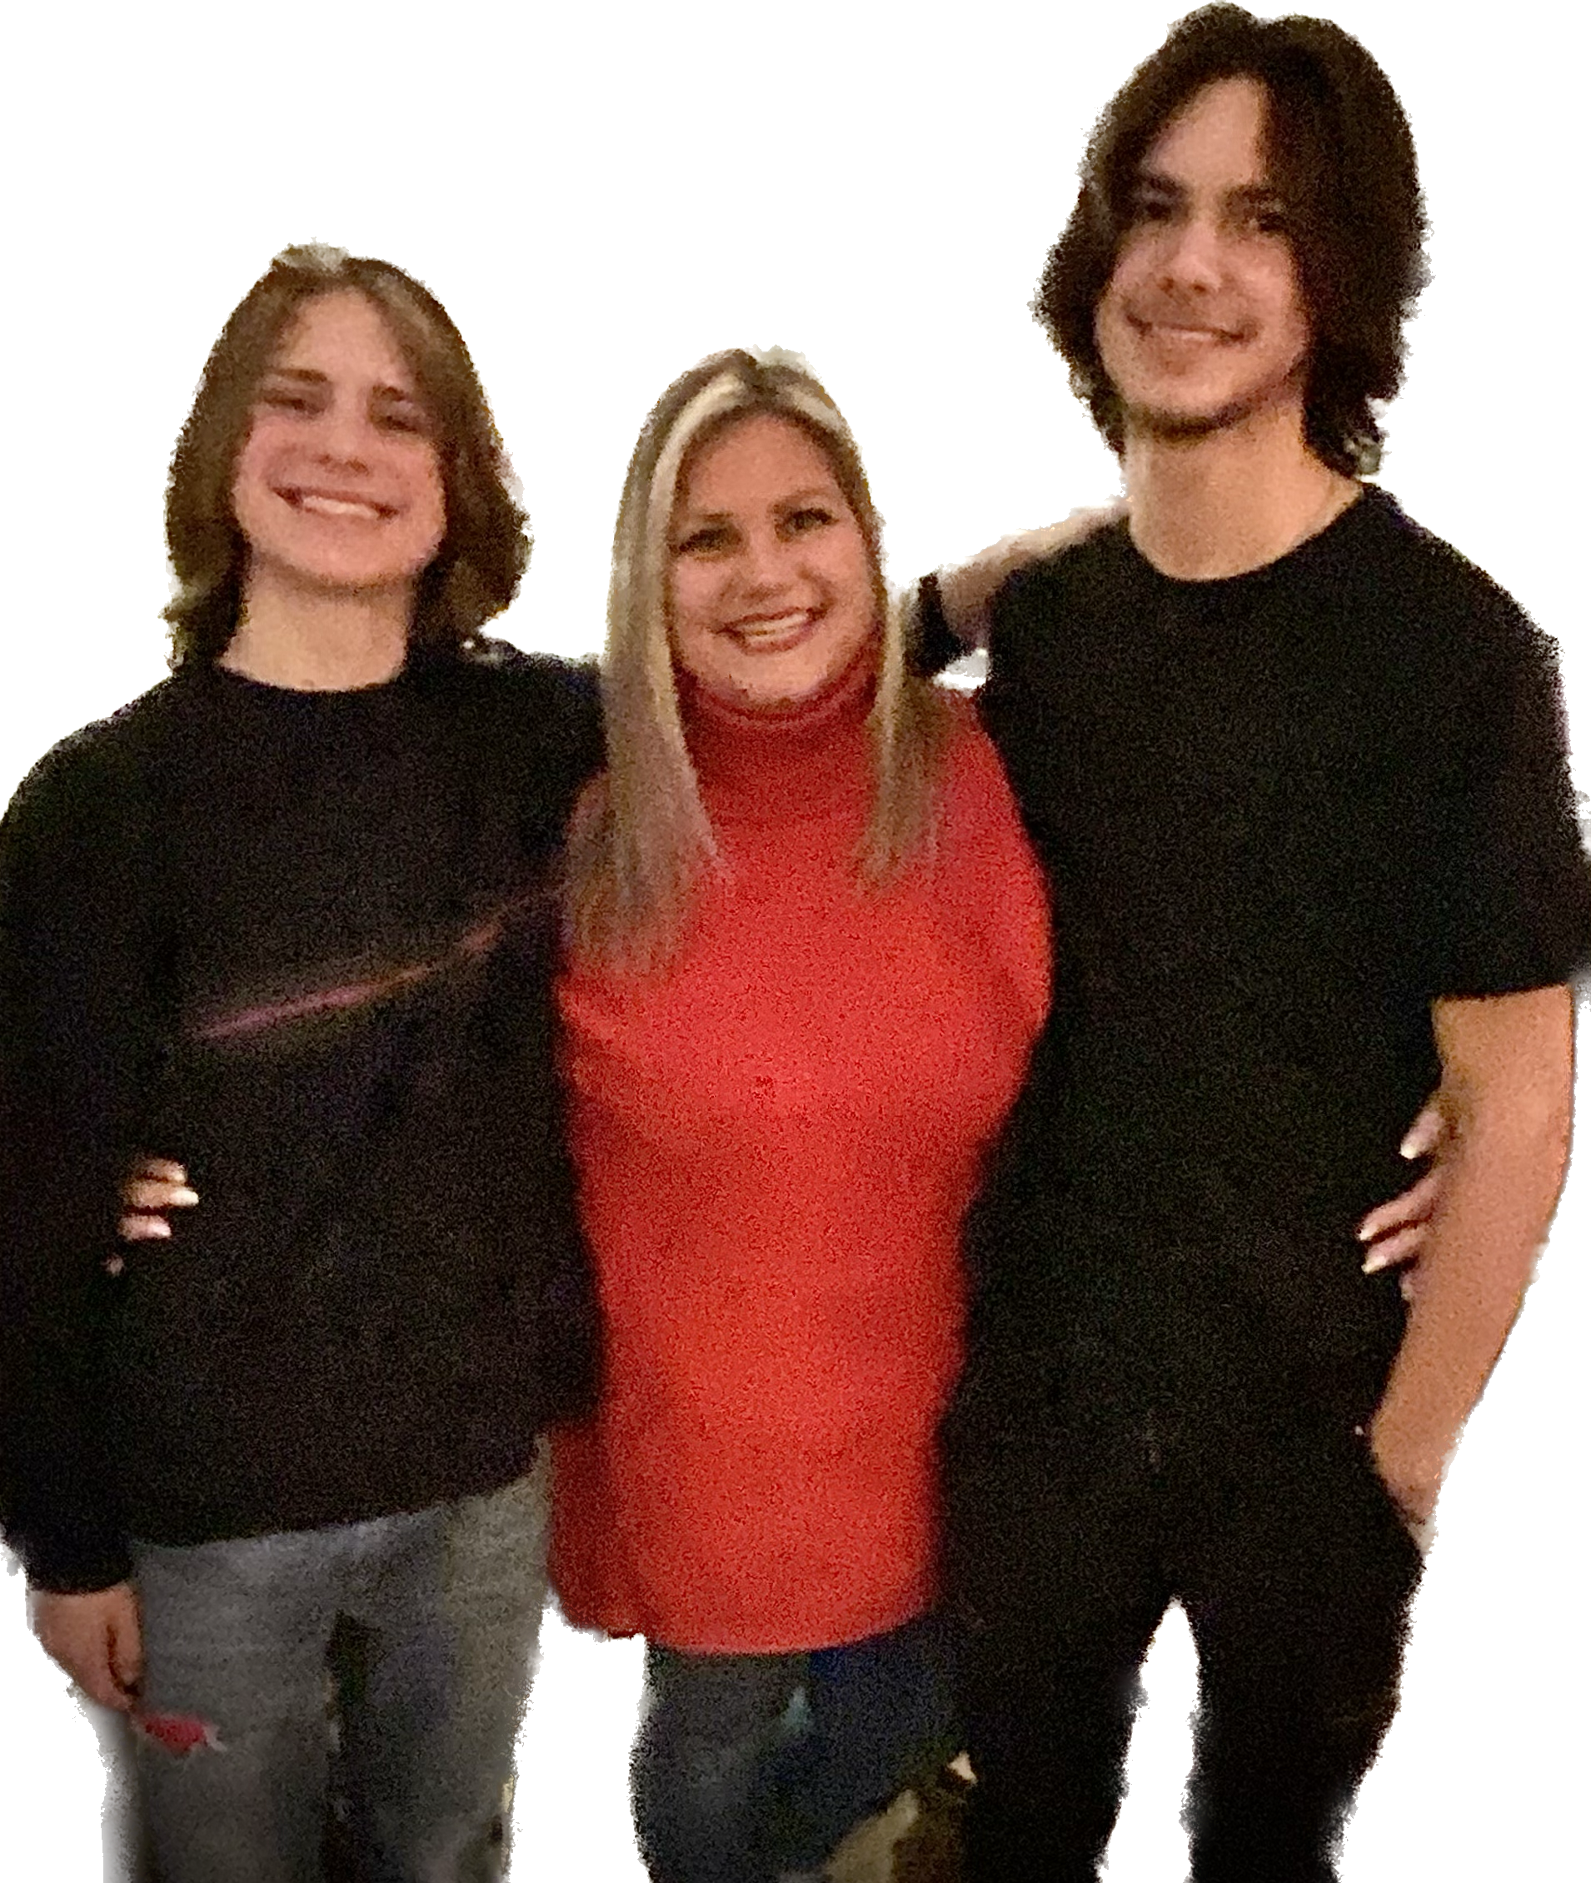
Ms. Bowden
•starting 6th full year at Richland Elementary
•Bachelor’s in Education, Teaching All Learners certified K-8, modified special ed. K-12
•I have a 20 year old son, Brock, at Moore Tech and a 16 year old son, Noah, at Houston High School

Slide 3
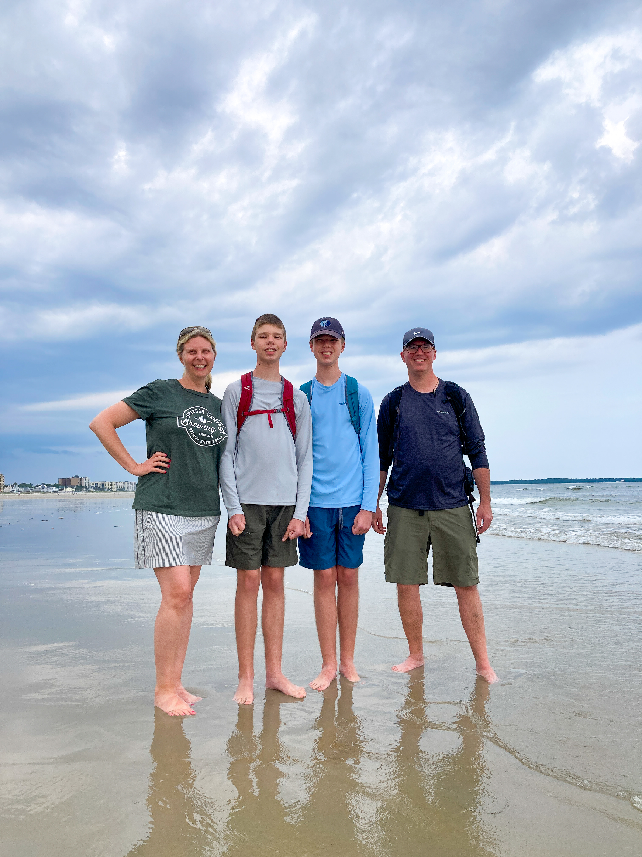
C. Northcutt
I have been teaching since 2002
Alumni of the University of Memphis (Go Tigers!!)
Bachelor of Science in Education, Endorsement K-8
Master of Science in Education, Reading K-6
Master of Science in Education, Mathematics K-6
I have identical twin middle school boys named Miles and Alex.
-

Slide 4
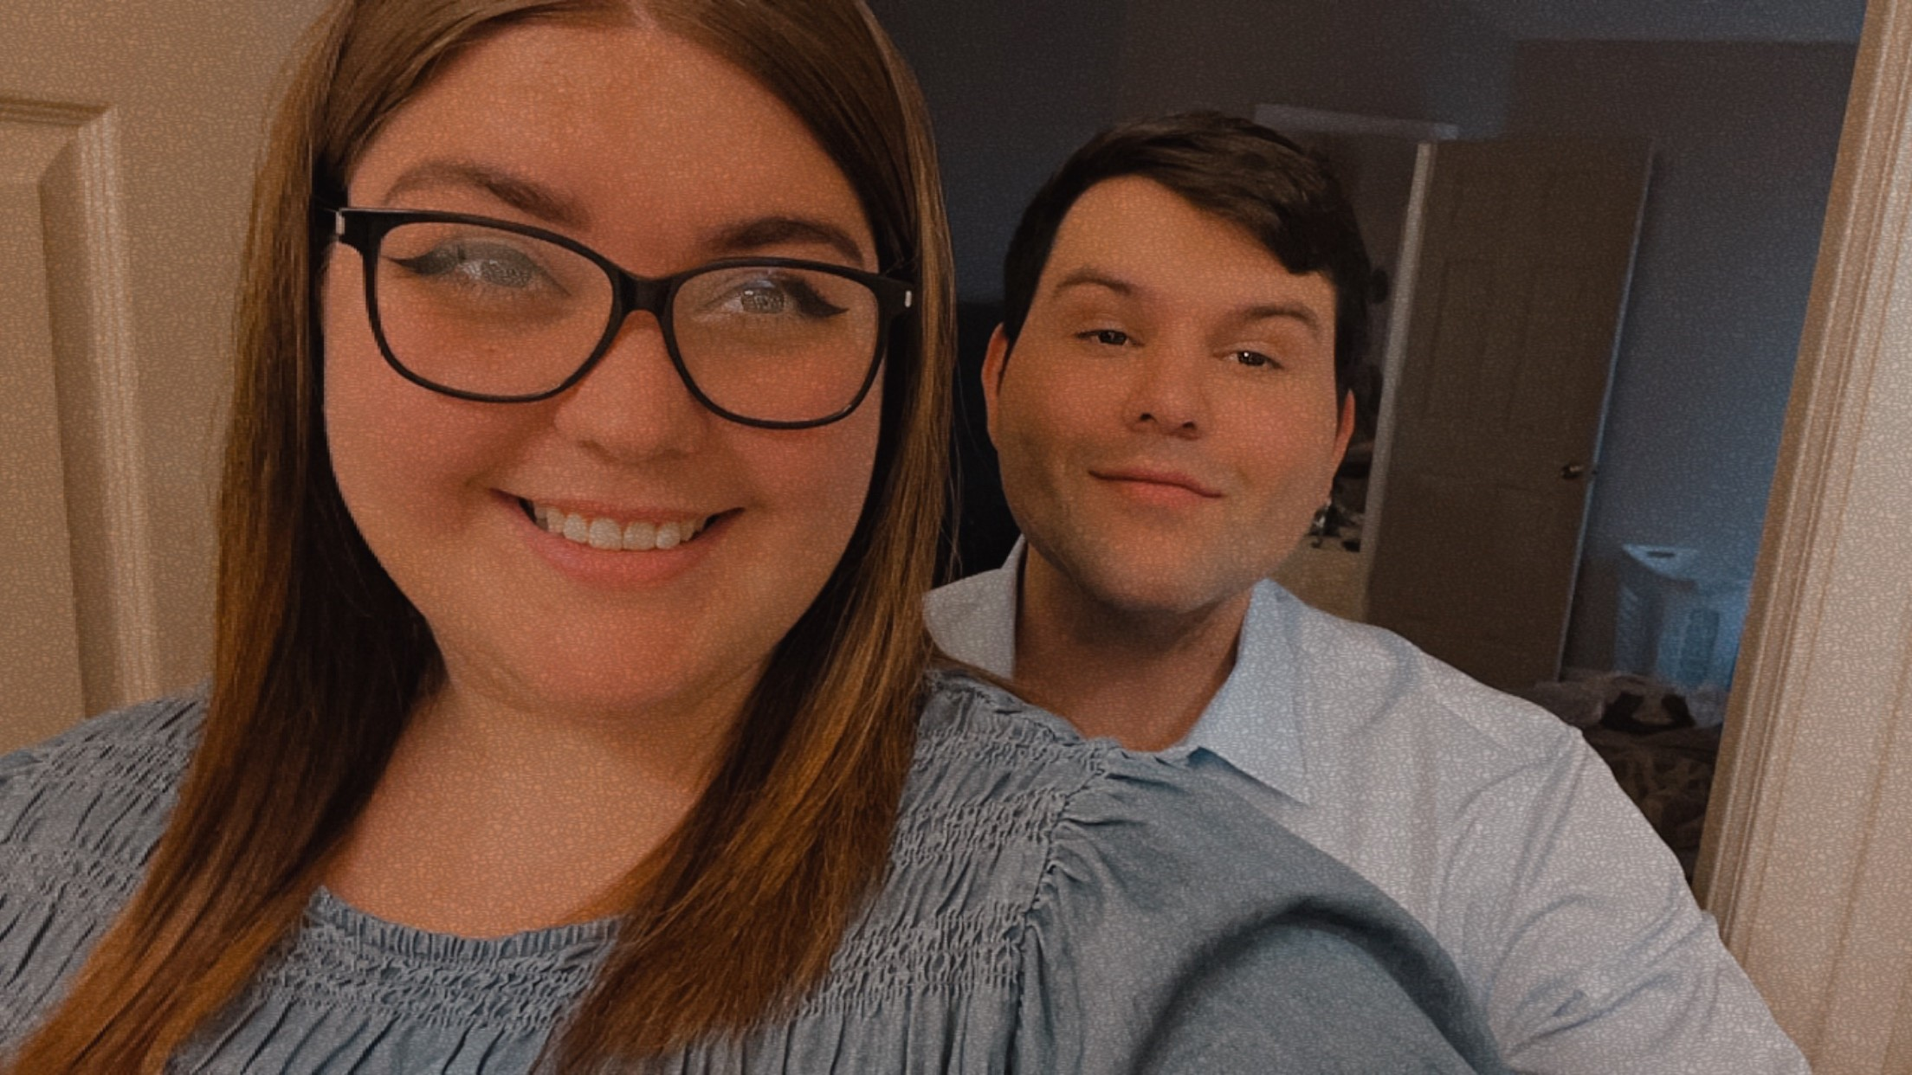
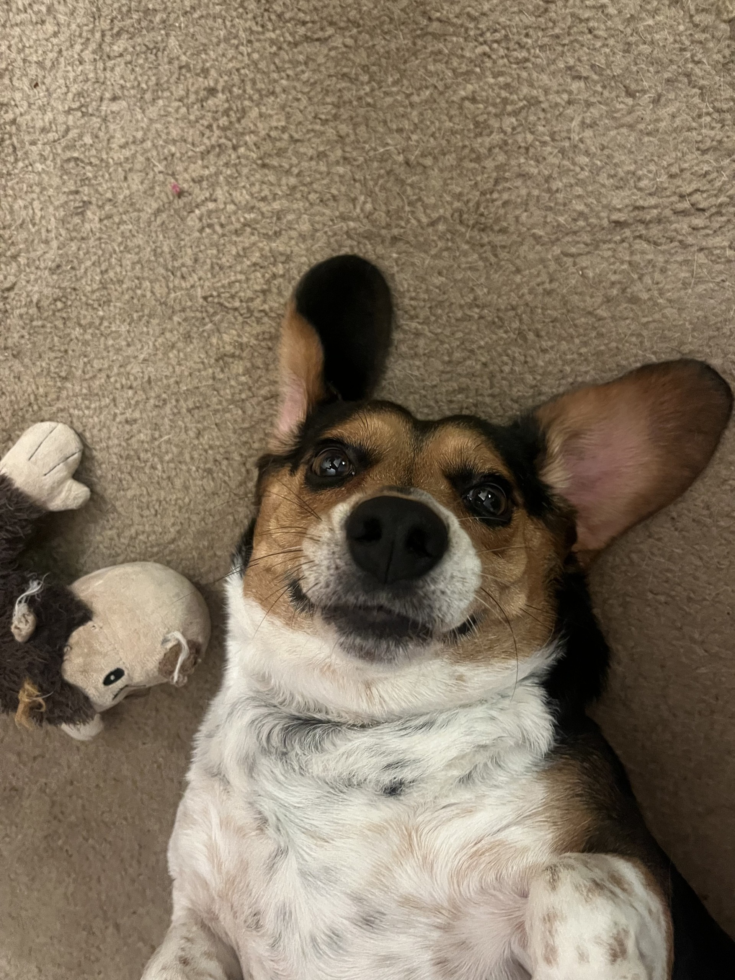
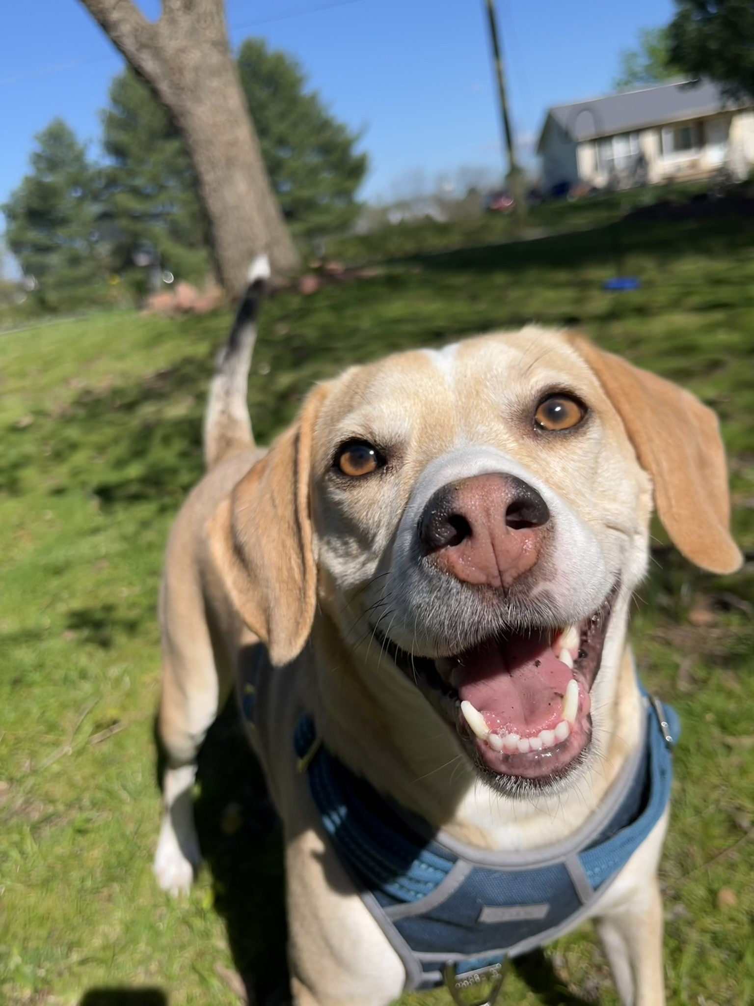
Mrs. Hertzka
B.S.Ed. -2023 from Union University
Beginning year 2 of teaching
Loves manatees
Married with two rescue beagles named Duck and Annie, both 5 years old.

Slide 5
Weekly Communication
Newsletters containing lessons for each subject will be posted on our websites by Friday afternoons. Each website will contain the SAME newsletter.
Newsletters can be found under “Updates” on each webpage.
Bowden's Webpage
Hertzka's Webpage
Northcutt's Webpage
IMPERATIVE: Please ensure you have a working email address in PowerSchool. Reach out ASAP if it is not current.

Slide 6
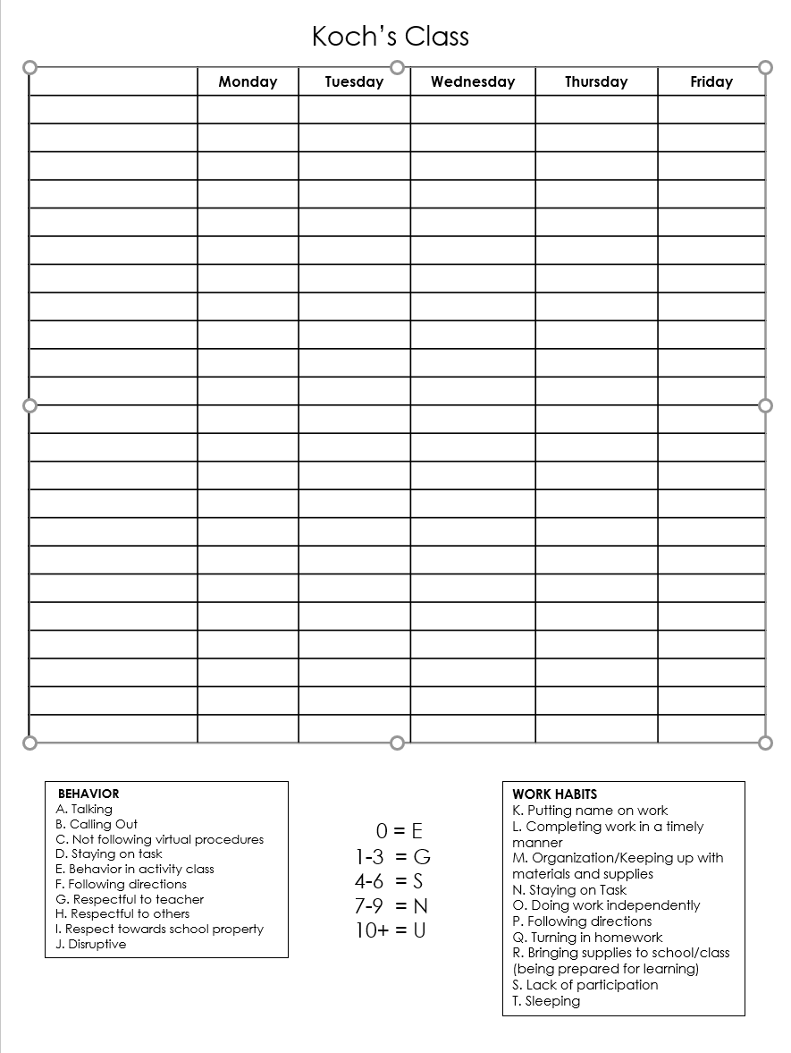
Behavior
We will follow SCS and Richland behavior guidelines.
We monitor classroom behavior daily. We use a clipboard that follows students to each class. We can then notify you if there is a behavior issue that occurs during the day.
The following chart will allow us to keep track of conduct/work habits throughout the quarter.

Slide 7
Attendance/Tardies/School Hours
School Hours: 8:15-3:15
If your child is going to be absent for several days, please let us know so that we can gather make up work. We will need ample notice to gather materials.
When your child returns to school, please send an excuse note/doctor note.
Make up work is the responsibility of the student!
Dismissal: Please pick up your child at 3:15. We often have meetings scheduled at 3:30 that we must attend.

Slide 8
4th grade Schedule
Tuesday will follow a modified schedule due to teacher planning.
RECESS occurs during the last 20 minutes of Sci/SS.
We will operate on an A/B schedule. See homeroom websites for specifics on schedules.
ENCORE: Varies by teacher
8:00-8:15: Good Morning (Homeroom check in)
8:15-9:00: BOOST
9:05-10:35: Block 1
10:35-11:25: ENCORE
11:30-1:00: Block 2
1:00-1:30: LUNCH
1:35-3:00: Block 3

Slide 9
SNACKS and WATER BOTTLES
Due to our late lunch, students may bring a healthy snack! (DRY)
Goldfish, pretzels, string cheese, apple sauce pouch, etc.
We will not allow candy, Takis, and full lunch items (ex: sandwiches)
We have working water fountains in each hallway. Students may bring water bottles to school. Each class will have specific water bottle procedures. Please no open straws (ie Stanleys)

Slide 10
Conferences
Email
If your concern is minimal, you are welcome to email at any time. We will respond within 24 hours.
bowdene@scsk12.org
northcuttcr@scsk12.org
hertzkam@scsk12.org
Please be mindful that emailing about an assignment after school hours may not receive a response prior to the next day.
We are generally available in the mornings (10:35-11:15), except Tuesdays.
Dependent upon schedules, after school meetings may take place.
If your concern is specific to reading, please contact Ms. Northcutt. Likewise, if your concern is specific to science/social studies, reach out to Ms. Bowden. Math concerns are directed to Ms. Hertzka.
We are happy to schedule conferences with you when you have a concern to discuss. You do not need to wait until parent-teacher conference night. (Thursday, September 5th)

Slide 11

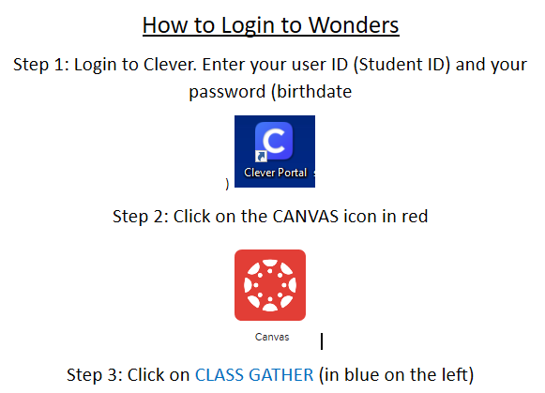
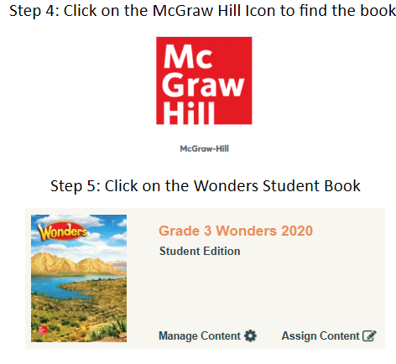
Curriculum: WONDERS

Slide 12
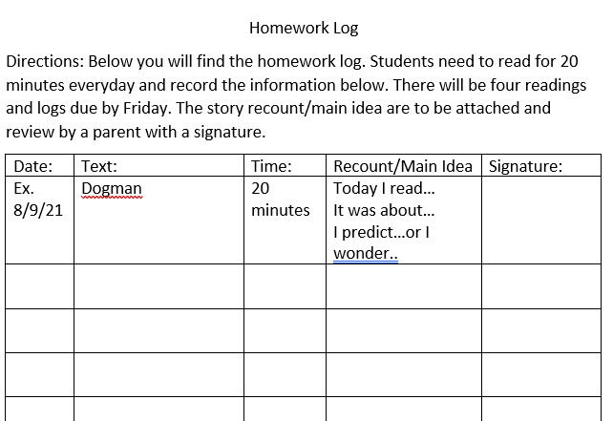
Reading Log

Slide 13
Curriculum: enVision Math
Math content will be taught based on TN State Standards. I will use Envision Math, parts of Eureka math, and teacher created resources to guide instruction.
Study guides will be provided prior to every test! Use them!
Please be mindful of negative perceptions/ attitudes surrounding math. It is most observed by children and they carry it into the classroom. Every child has enormous potential, and we need to do everything to maximize it!

Slide 14
Math Facts
I give a math facts quiz every Friday. It will have 20 problems and students will have 2 minutes. We will begin with the 2x math facts, then move to the 3x facts, and so on….
Math facts will be entered as project/portfolio grades which only account for 5% of the final average.
Students with 504s/IEPs will be given time and a half as noted in the plans. (if deemed necessary!)
BASIC NECESSITY in math: EXPO marker!!! These do not last all year and we will use them EVERY.SINGLE.DAY.

Slide 15
Science/Social Studies
Weekly quiz
Writing in Social Studies
Homework- will only be sent if classwork is unfinished or student has makeup work.
Reasearch!

Slide 16
SCS Grading Policy
Homework: 5% (minimum four grades)
Class Participation: 5% (minimum four grades)
Classwork: 40% (minimum four grades)
Projects, portfolios, or presentations: 5% (minimum one grade)
Tests: 45% (minimum four grades)
New 10 point grading scale

Slide 17
Homework
Homework is a required category in SCS grading policy. We must include a minimum of 4 homework grades per quarter. Homework comprises 5% of the final average.
Homework is graded for completion, not accuracy.

Slide 18
Viewing Grades
PowerSchool is available to all parents. This is the BEST way to monitor student grades. We try to update PS often.
Wednesday folders will also contain graded papers. Please check your child’s Wednesday folder and review graded work. SIGN that you have reviewed the work. We need all work that is below a 70 to be signed and returned. Keep everything else, please!
PLEASE make sure your email addresses are correct in PowerSchool. We send updates via email.

Slide 19
Birthdays
Healthy Foods Policy prohibits the sharing of treats. We are NOT allowed to pass out cookies, cupcakes, candy, etc. for student birthdays.
Invites: If your child is having a birthday party, please send out invites privately and/or electronically. If invites are sent to school to be dispersed, everyone must be invited.

Slide 20
4th grade Field Trip to Discovery
4th grade students go to Discovery Park of America in Union, TN in May! We encourage anyone to chaperone (no limit). However, ALL CHAPERONES must undergo a level 3 background check. This requires fingerprinting at the board.
This trip is a bit pricey, so plan ahead! (about $70)
We take a charter bus, not a school bus, which makes it more expensive.
It is encouraged to go ahead and start the level 3 background check process early! It does take some time to get approved!!!!

Slide 21
Arrival and Dismissal Procedures
Arrival
Students may arrive at school no earlier than 7:45
Please ensure that your student is coming into the correct door.
4th grade enters where we dismiss.
Dismissal
We will dismiss under the East overhang at 3:15.
Please arrive by 3:10 to avoid traffic tie-ups.
Please alert teachers of any changes by 10:00 am if possible.

Slide 22
Cross Country
Cross Country registration has started! If you are interested, Mrs. Williamson (Pre-K) has forms in a basket outside her door. Her room is located downstairs in the annex building. She is the first door on the right as you enter the annex.
Deadline: Aug. 28th
Williamsonmf@scsk12.org

Slide 23
Uniform Policy
Shirts- white, grey, red collared shirts OR Richland Spirit Wear shirts-
No Field Day shirts
Shorts/Pants/skirts- Khaki, black, navy- please check length
Dresses- white, red, gray
Jumpers-navy or Khaki
Jackets- black ,navy, red, grey- no logos or writing

Slide 24
Honor Society
Teachers will be submitting students for consideration of National Elementary Honor Society in Quarter 3.
Only students with cummulative A/Bs, Es in conduct, and no more than 5 unexcused absences will be considered. (not a rolling invitation)
Students will be inducted at the end of 4th grade and will continue as members through 5th grade (if all above criteria are met)
During 5th grade, the honor society will be a service organization, with service projects throughout the school year.

Slide 25
Communication! Download REMIND app!
Remind codes were sent out last week! Reach out to your child’s teacher if you need help signing up. We use Remind for quick messages or important updates.

Slide 26
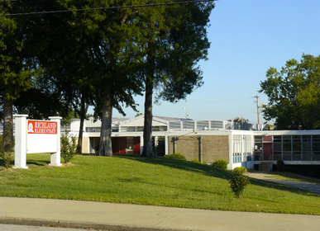
Contact
Erin Bowden
bowdene@scsk12.org
Courtney Northcutt
northcuttcr@scsk12.org
Madison Hertzka
hertzkam@scsk12.org

Slide 27

Questions??

