Slide 1

Kirby High School
2024-2025
Annual Title I Meeting
Wednesday, August 28th @ 5:30 pm / Thursday, August 29th @ 8:00 am

Slide 2

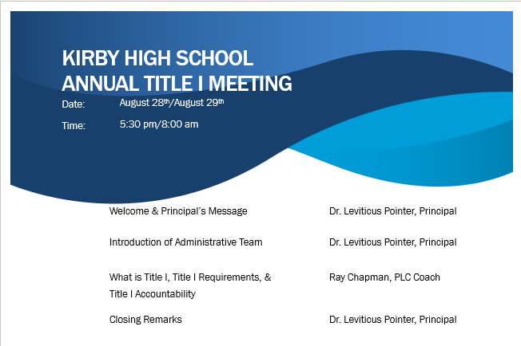
Agenda

Slide 3

Kirby High School
Principal’s Welcome Message
Administrative Team Introductions

Slide 4
Kirby High School
Mission/Vision
OUR MISSION
To prepare all students for success in learning, leadership, and life by providing a safe and nurturing environment that provides meaningful, engaging, relevant and purposeful experiences inside and outside of the classroom each day.
OUR VISION
Kirby High School will be among the top high schools in the district attracting a diverse student population and effective teachers, leaders, and staff all committed to excellence in providing meaningful, engaging, relevant, and purposeful experiences inside and outside of the classroom each day.

Slide 5

What is Title I
40% or more students on Free/Reduced Lunch
Title I is the federal program that provides funding to local school districts to improve the academic achievement of disadvantaged students (students on free or reduced lunch).
Section A of Title I provides grants to states to distribute directly to school districts. This is by far the largest source of federal money for local schools.
If more than 40% of the students in a school qualify as disadvantaged, the school is allowed to run "schoolwide" programs that serve all students, not just the disadvantaged.
Source: https://www2.ed.gov/programs/titleiparta/index.html

Slide 6
Title I Requirements
Parents’ Right to Know
School/Parent Compacts
Family Engagement Policy & Plan
Student Code of Conduct
Teacher Qualifications
Source: https://www2.ed.gov/programs/titleiparta/index.html

Slide 7
Title I
Parents’ Right To Know
All parents have the right to request the following:
A teacher’s professional qualifications, which includes: state qualifications, licensure, grade/s certification, waivers
A teacher’s baccalaureate and /or graduate degree, fields of endorsement, previous teaching experience
A paraprofessional’s qualifications
An assurance that their child’s name, address, and telephone listing not be released to military recruiters
All parents will receive information on the following:
Their child’s level of achievement in each of the state academic assessments
Their option to request a transfer to another school within the district if their child is the victim of a violent crime at school
Their right to timely notification that their child has been assigned, or has been taught for four or more consecutive weeks by, a teacher who is not highly qualified

Slide 8
Title I
School/Parent Compact
A School-Parent Compact for Achievement is an agreement that parents, students and teachers develop together. It explains how parents and teachers will work together to make sure all our students reach or exceed grade-level standards.
Effective compacts:
Link to goals of the school improvement plan
Focus on student learning skills
Describe how teachers will help students develop those skills using high-quality curriculum and effective instruction in a supportive learning environment
Share strategies parents can use at home
Explain how teachers and parents will communicate about student progress
Describe opportunities for parents to volunteer, observe, and participate in the classroom

Slide 9
Title I
Family Engagement Plan
The school’s written parent and family engagement policy commits a school to certain goals and actions focused on developing effective partnerships between school and home and identifies how these goals and actions will be implemented. It is an opportunity for clearer communication and meaningful collaboration with families.
SCS Family and Community Engagement
http://www.scsk12.org/face/

Slide 10
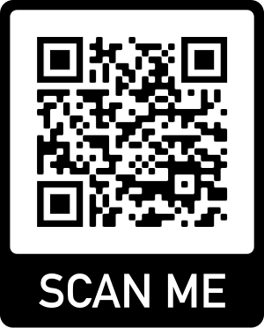
Title I
Student Code of Conduct
Can be found at the Kirby HS website
https://schools.scsk12.org/kirby-hs

Slide 11

Title I
Teacher Qualifications
In the event that your child is being taught by a teacher that has a Practitioner Teacher License or by a teacher not licensed in a particular subject, you will be notified by letter of that teacher’s status

Slide 12
Title I
Accountability
District/School Progress/School Status
Annual Measurable Objectives (AMO)
TSI/ATSI
Reporting Student Progress
Parent-Teacher Conferences
Parental Involvement Requirement

Slide 13
Title I
Annual Measurable Objectives (AMOs)
What are AMO’s?
Annual Measurable Objectives
What factors impact KHS’s AMO Success Rate?
TNReady ELA, Math, Science, Social Studies
Graduation rate
ACT
Ready Graduate

Slide 14
Title I
Annual Measurable Objectives (AMOs)
Kirby HS Data – Supe School/Network 5
TNReady ELA, Math, Science, Social Studies | Graduation Rate | ACT | Ready Graduate
2022 ELA (14.2%) Math (2.0%) Science (10.2%) | 2023 77.4% | 2023 - Composite (13.8) | 2023 44.8%
2023 ELA (24.6%) Math (2.3%) Science (9.1%) | 2024 79% | 2024 - Composite (14.2) | 2024 20.6%
2025 Goals
TNReady ELA, Math, Science, Social Studies | Graduation Rate | ACT | Ready Graduate
2025 ELA (35.0%) Math (14.5%) Science (20.5%) | 2025 85.0% | 2025 - Composite (18.0) | 2025 65.0%

Slide 15
Title I
Accountability
What is TSI/ATSI?
TSI: Targeted Support & Improvement
B/H/NA; ED; AA; SWD; H (bottom 5% for these subgroups)
ATSI: Additional Targeted Support & Improvement
ED (TSI and if considered as school on it’s own would be Priority school)

Slide 16
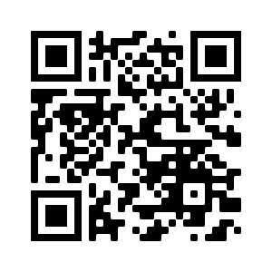
Title I
Student Progress
Progress Reports
September 4th
November 13th
February 5th
April 16th
Report Cards
October 23th
January 15th
March 26th
May 30th
https://scstn.powerschool.com/public/

Slide 17
Title I
Parent-Teacher Conferences
September 5, 2024
4 – 7 pm
February 13, 2025
4 – 7 pm
Other times/dates available upon request via preapproved appointment

Slide 18
What is Parental Involvement?
Parental involvement is a combination of commitment and active participation on the part of the parent with the school and to the student.
The participation of parents in regular, two-way, and meaningful communication involving student academic learning and other school activities, including: Every Student Succeeds Act (ESSA)
Parents play an integral role in assisting their child’s learning
Parents are encouraged to be actively involved in their child’s education at school.
Parents are full partners in their child’s education and are included, as appropriate, in decision making and on advisory committees to assist in the education of their child.

Slide 19

Family Engagement Plan
PURPOSE
The purpose of this policy is to partner with families in a coordinated effort to provide SCS students with a home/school/community environment that encourages academic achievement and enables students to meet Federal, state and city academic performance standards.
POLICY
1. To provide meaningful two-way communications between families and teachers and among families, schools, the district and the community;
2. To provide opportunities for meaningful and varied participation by families in district and school leadership organizations and other school activities and in programs and activities in the community that support student achievement;
3. Eliminate or reduce barriers to increase to family participation and effective parent/child relations
4. To provide training opportunities and informational seminars for families to enable them to understand student academic content and achievement standards and curricular materials and to improve their parenting skills.

Slide 20
Title I
Parent Training/Meetings
School Improvement Plan
Family Engagement Plan
School/Parent Compact
Family Data Nights

Slide 21
Title I
Contact Information
Professional Learning Community (PLC) Coach
Ray Chapman
chapmanrl@scsk12.org
901-416-1960
Instructional Facilitator
Kimberly Jefferson
lewisk@scsk12.org
901-416-1960

Slide 22

Title I
Questions?

