Slide 1
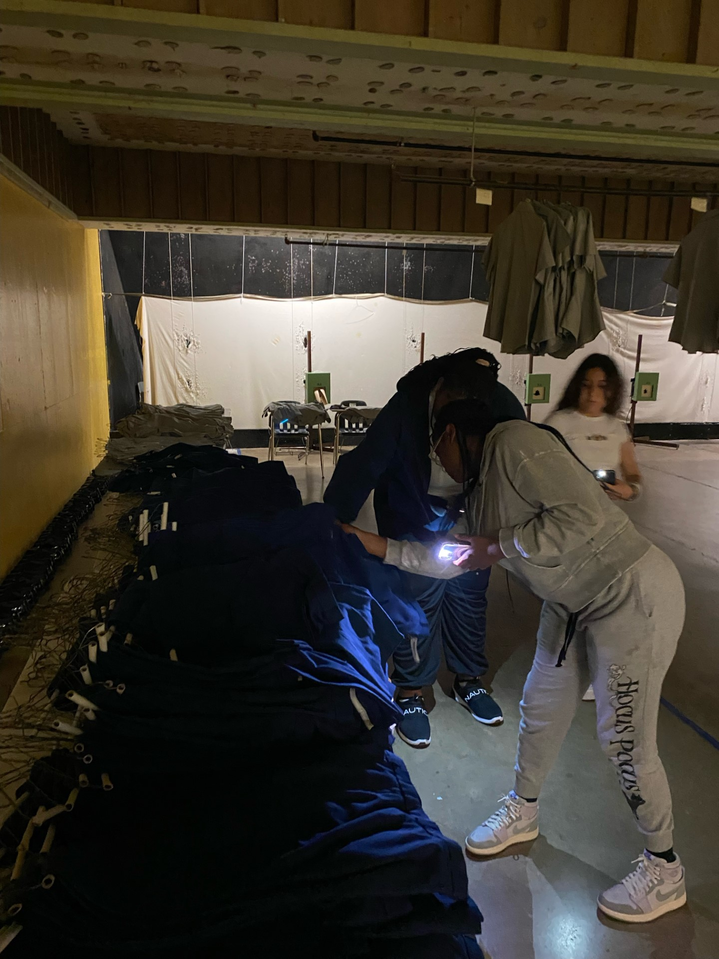
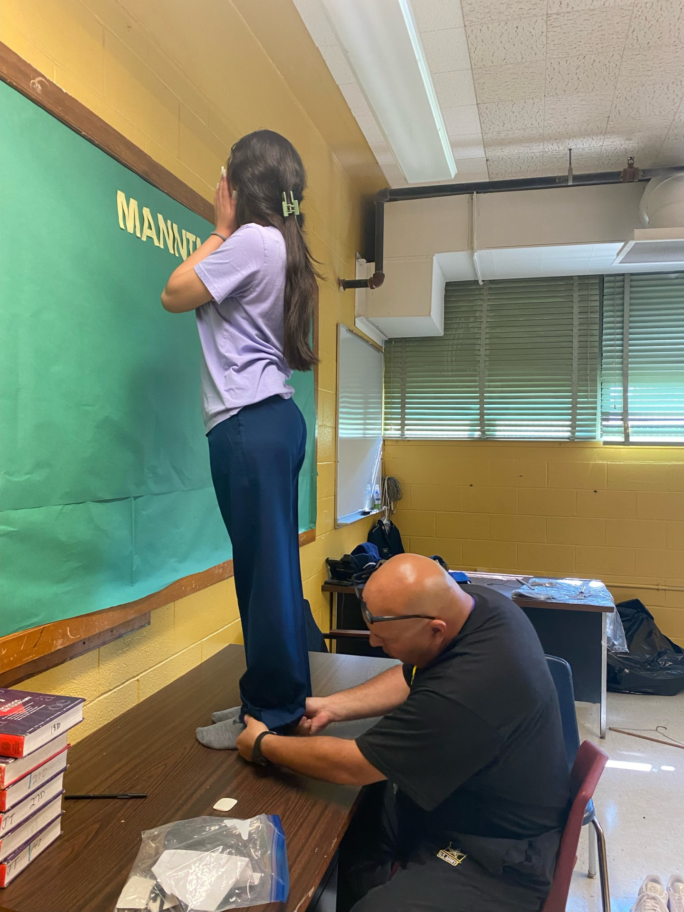
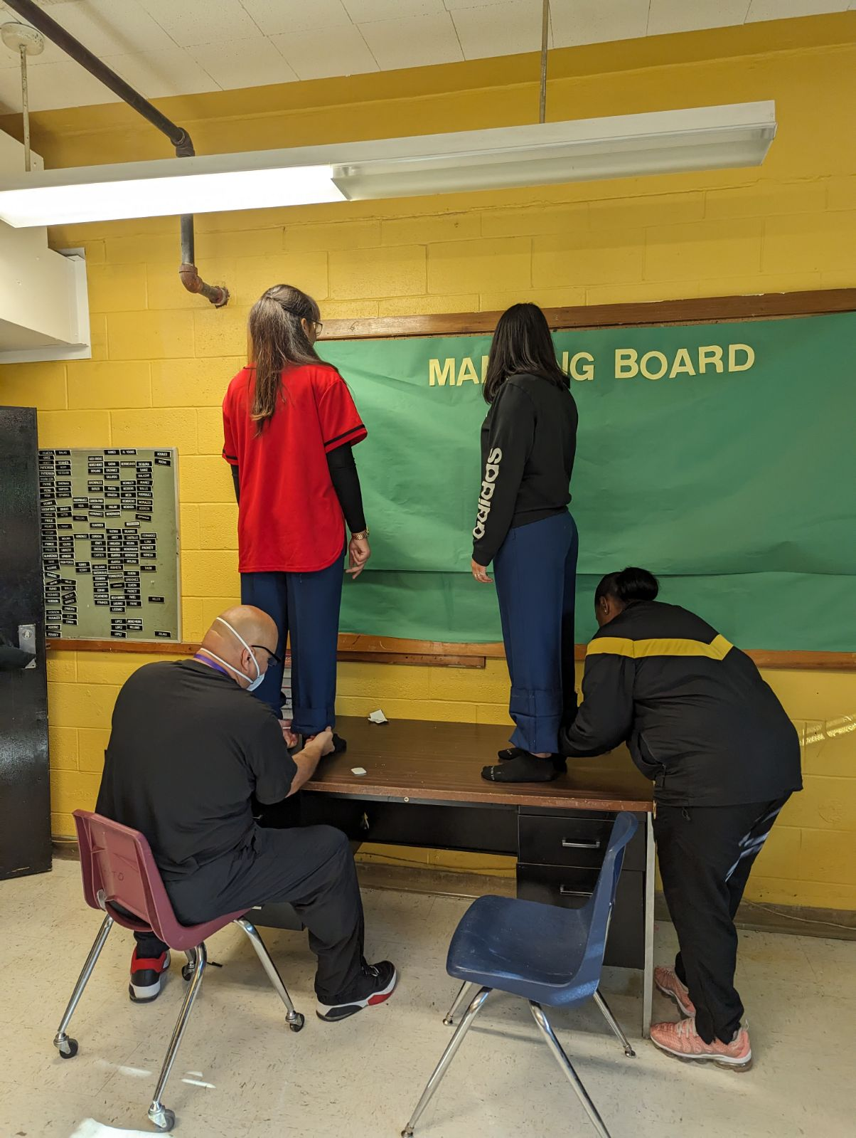
Kingsbury HS JROTC AUG-SEP 2023
Falcon Battalion Priority Number One
FALCON Battalion Cadets are working aggressively on uniform issuing. “Steady pace and paying attention to detail is necessary to ensure that Cadets are fitted properly and uniforms are issue and recorded to keep 100% of accountability of the property” said SFC Malone. It is a hard labor and time consuming task” said C/CPT Rodriguez; as the BN S4 he is task to assist the SAI and AI to complete the accountability of all uniforms that has been issued and to translate all transactions from paper hand receipts into JUMS. C/LTC Benitez (Battalion Commander) told us that we are on track to meet the deadline of all Cadets in uniform by 6 OCT 2023.
Go Falcons!

