Slide 1
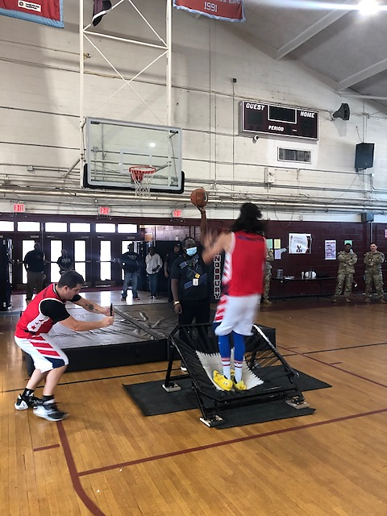
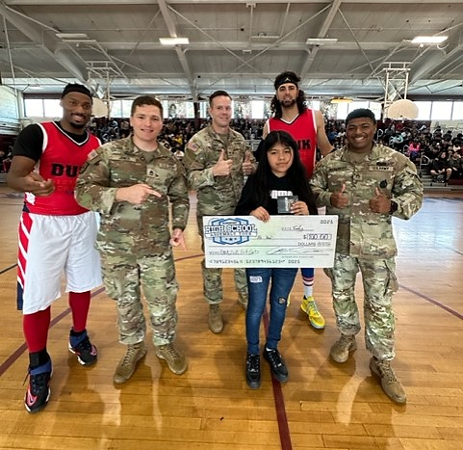
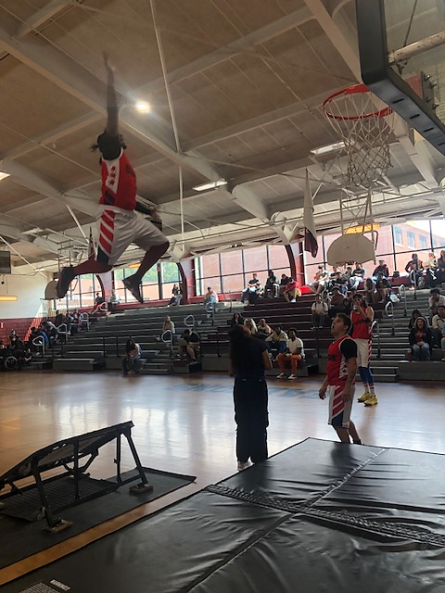
Kingsbury HS JROTC SEP-OCT 2023
Falcon Battalion Sponsor the “DUNK”
Kingsbury High School was visited by the AGANATION and their “DUNK” performers. This event combines dynamic basketball performers along with an educational and informational message on the dangers of distracted driving. Army recruiters provided with giveaways and the show was exited. The school used the venue to celebrated students with perfect attendance during the 1st nine weeks of the school year. Go Falcons!

Slide 2
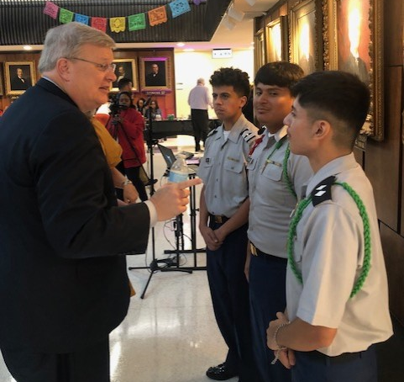
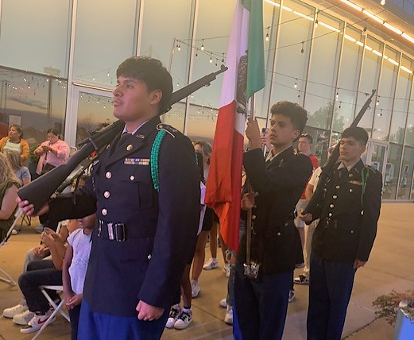
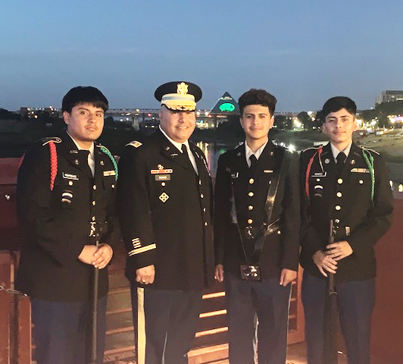
Kingsbury HS JROTC SEP-OCT 2023
Falcon Battalion Color Guard Performed at the Memphis City Hispanic Heritage Celebration
Kingsbury High School JROTC Color Guard was invited to participate as part of this year Annual Memphis Hispanic Heritage Proclamation ceremony at the City Hall. They had the privilege of meeting with the City Mayor Honorable Jim Strickland. During the evening event, our Color Guard
escorted the Mexican Government
Consul and his Colors during the “Grito de Mexico” celebration and the lighting of the Hernando de Soto bridge. Cadets LTC Samuel Benitez, CPT Josue Rodriguez and 1SG Horson Chaidez greatly and successfully represented the Falcon Battalion. Go Falcons!

Slide 3
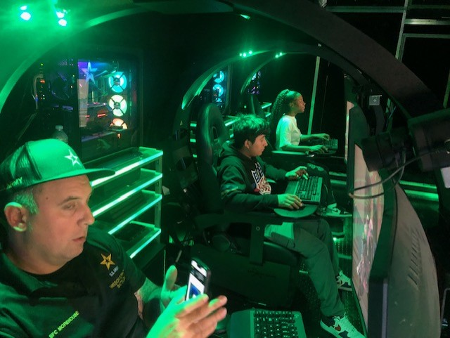
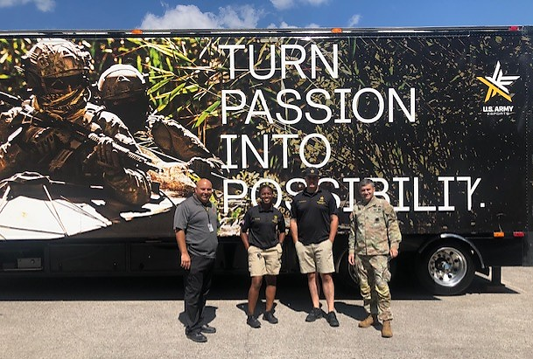
Kingsbury HS JROTC SEP-OCT 2023
USAREC Mobile Exibit Company visited the Falcon Nation
On 18 September 2023, Kingsbury High School JROTC sponsored an event involving on of the coolest displays that the U.S. Army Marketing and Engagement Brigade posses. Kingsbury students had the opportunity to experience the latest gamming technology and see that the Army does have time to relax. They also connected with Active duty Soldiers and learned about the Army’s mission and capabilities from this hero's first hand military experiences Go Falcons!

Slide 4
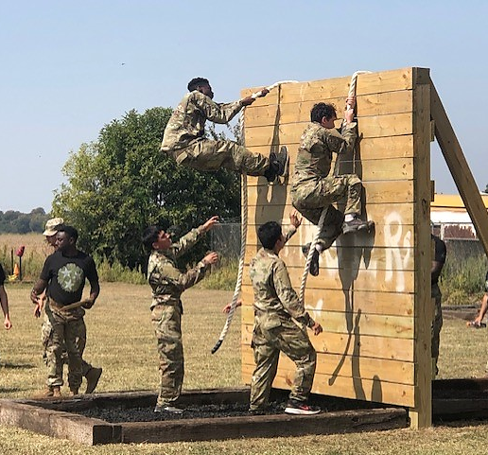
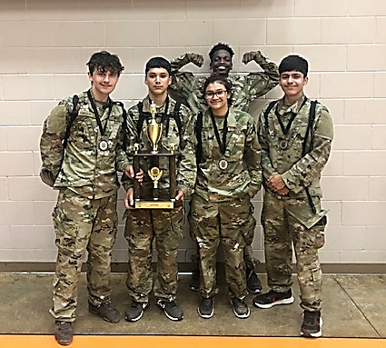
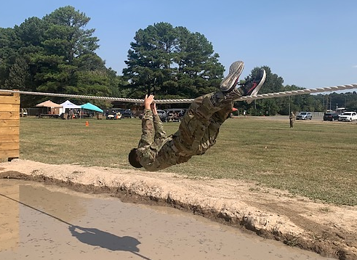
Kingsbury HS JROTC SEP-OCT 2023
Kingsbury Falcon Nation Start the Season in the Right Direction
After been named the Commanders Emerging unit last school year 2022-23, the Falcon Nation have their aim at winning in everything they do. Raider Challenge ‘Ranger Randy” competition was the first test. As last year raining champions they fought hard to defend their title and came just a little be short. Cadet SFC Ledys Dormes said “The Falcon team is known as the “Golden State” of the Memphis Shelby County Schools Raider competition after achieving 2nd place in every competition since 2017 and a superb win last year”. We had to settle for Second place, but still taste really sweet, said Cadet LTC Samuel Benitez (Battalion CDR). Cadets CPT Reymundo Chaidez, SSG Landon Harris and SFC Jakarious Mason were also part of this amazing Raiders Team.
Go Falcons!

