Slide 1
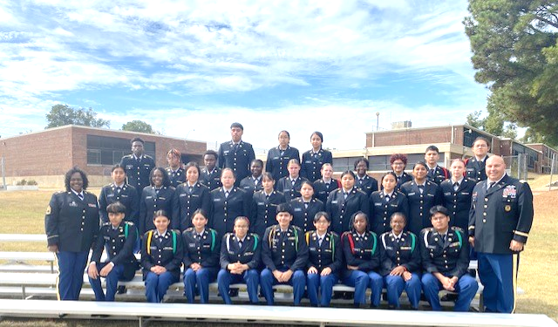
Kingsbury HS JROTC OCT-NOV 2023
Falcon Battalion JROTC Program Accreditation Inspection
Kingsbury High School was visited by the Memphis-Shelby County Schools Director of Instruction staff which conducted the triennial JPA Inspection. The Drill Team and Color Guard performed their routines and 1SG Lovelace (DAI Logistics NCO) said “You are on of the top two units I have evaluated this year”. Our Service Learning Committee briefed LTC Bobo (DAI) and layout our year SL Project; which partnering with the Memphis National Cemetery to learned of their important mission and assisted with area beautification in preparation for Veteran’s day activities earned a perfect score. The Falcon BN Staff briefed LTC Bobo regarding the continues improvement plan, which is a continues project when it come to the Cadets wearing the uniform. Very challenging to issue, fit and maintain uniforms for over 340 Cadets. LTC Bobo praised the staff efforts on the task and was please with how the staff approach this briefing.
L/R: 1st Row, SFC Malone, BN Staff, MAJ Dumas. 2nd Row, Cadet Portfolio TM.
3rd Row, Drill TM. 4th Row, Service Learning Team
Lastly, SGM McDaniel interviewed our Cadet Portfolio representatives. As result, he selected one of our LET1 Cadets to attend the MSCS 8th Grade Fair due to her impressive performance during the interview. Over all, it was a great day to be a Falcon as we earned the Honor Unit with Distinction JPA grade. Go Falcons!

Slide 2
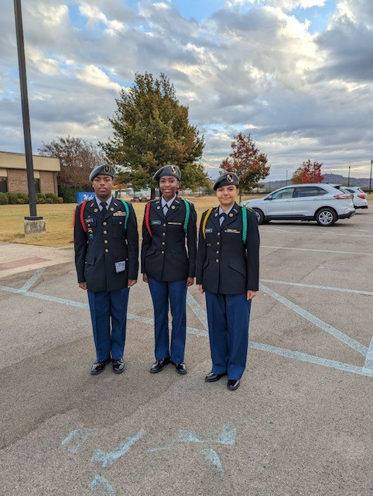
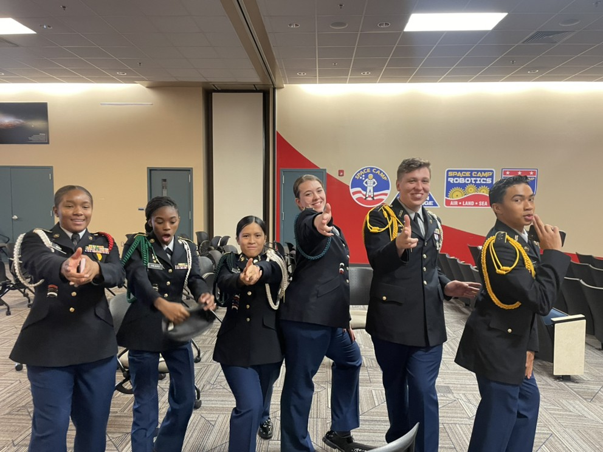
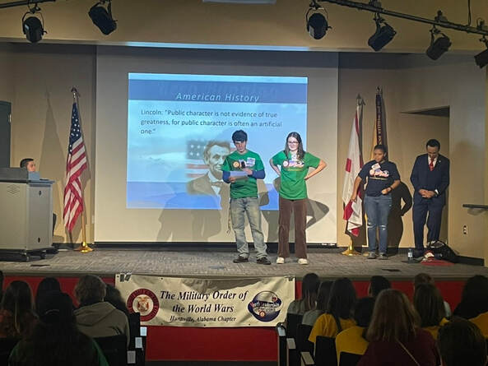
Kingsbury HS JROTC OCT-NOV 2023
Falcon Battalion Cadets attended the HsvMOWW YLC at Hunstville Alabama
Kingsbury High School JROTC Cadets CPTs Erieuna Johnson and Ana Brokamp and Kirby High School JROTC Cadet MAJ were selected to represent Memphis-Shelby County Schools at the annual Huntsville AL, Military Order of the World Wars Youth Leadership Conference. This three day Conference focused on Leadership, American Heritage and Patriotism, and Free Enterprise.
L/R: C/ MAJ Jeremy Grissom (Kirby HS)
C/CPTs Erieuna Johnson
and Ana Brokamp (Kingsbury HS)
“Meeting Cadets and students from the tri-state area and share experiences with those was very refreshing” said Cadet CPT Brokamp. “ Cadet CPT Johnson commented “this was an awesome opportunity to expand our minds and see that they are numerous organizations that offer education and career opportunities beyond our communities and State”. Go Falcons!

