Slide 1
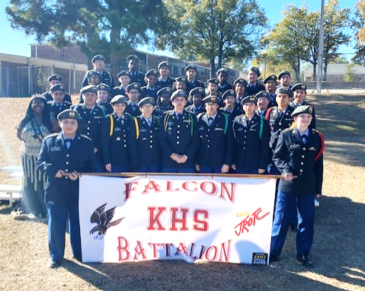
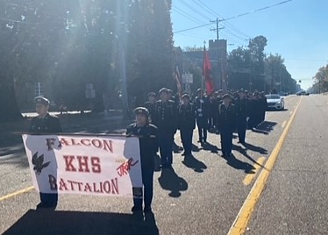
Kingsbury HS JROTC NOV-DEC 2023
F/R: Banner Guards, Staff, Color Guard, Troop Formation and Falcon BN Quen
Falcon Battalion Participated in the Whitehaven Chritsmass Parade
Kingsbury High School Falcon Battalion stand sharp in formation during this year Whitehaven’s Christmas Parade. “We had a full complement to represent our BN, and all Cadets performed to a high level of professionalism” said C/LTC Samuel Benitez, Falcon BN Commander. C/CSM Janai Boulton said “preparations, well discipline Cadets and their motivation resulted in a great day to be a Falcon”. Our Battalion definitely look to part. Go Falcons!

Slide 2
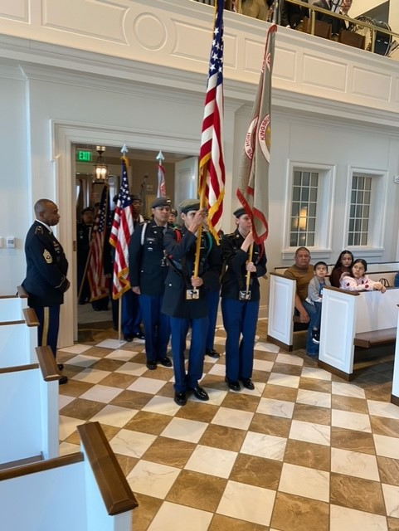
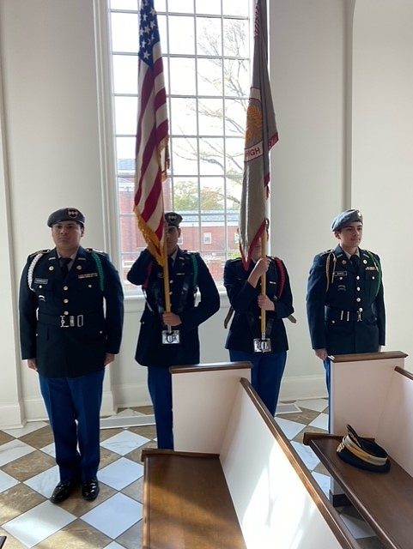
Kingsbury HS JROTC NOV-DEC 2023
Falcon Battalion Cadets Performed at the Mass of the Colors Ceremony
Kingsbury High School JROTC Cadets CPTs Josue Rodriguez, Alexis Arellano, C/SFC Lucile Stagner and C/LTC Samuel Benitez represent the Falcon BN at this year Mass of the Colors during Memphis veteran’s day celebrations. “The guest speaker remarks were very moving, and meeting a 100% war hero does not happen every day” said C/SFC Stagner.
C/ Arellano said “be able to performed in front of our families that were in the audience served as a huge motivation”. “My parents and siblings had the chance of observe what means to be a Cadet, as well as how we contribute to our community and show respect for the ones that sacrificed so much for our country”. It was a great day to be a Falcon, Go Falcons!
L/R: C/CPT Josue Rodriguez, C/CPT Alexis Arellano
C/SFC Lucile Stagner, C/LTC Samuel Benitez

Slide 3
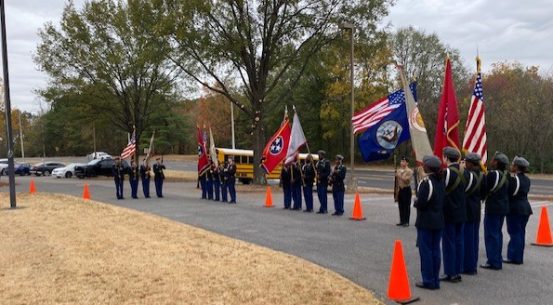
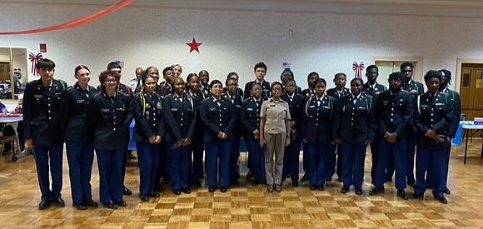
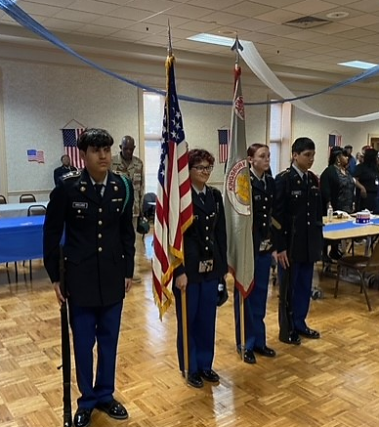
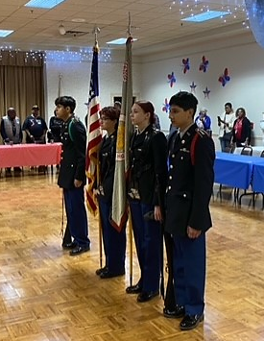
Kingsbury HS JROTC NOV-DEC 2023
Falcon Battalion Cadets Participated on the Frazier-Raleigh Senior Center Veteran’s Day Celebration
Kingsbury High School JROTC C/CPTs Reynaldo Chaidez, Alexis Arellano, C/SFC Lucile Stagner and Ledys Dormes represent the Falcon BN at this year Frazier-Raleigh Senior Center veteran’s day celebration. Our Cadets took part on facilitating this veterans and senior citizens to be recognized and celebrated in this great ceremony. Another great day to be a Falcon, Go Falcons!

