Slide 1
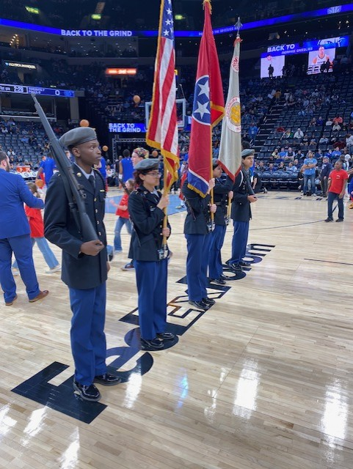
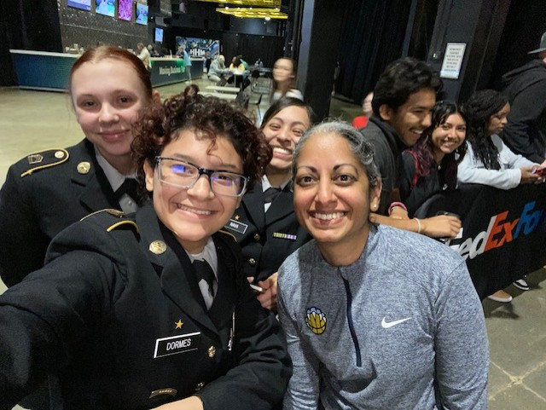
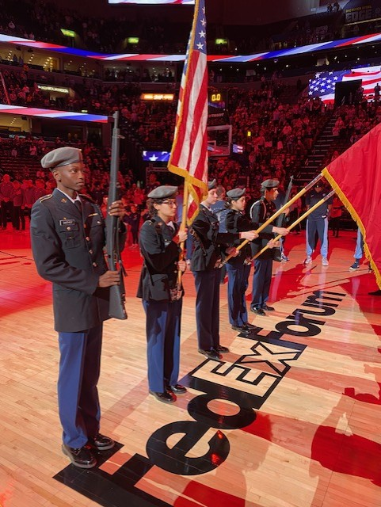
Kingsbury HS JROTC MAR-APR 2024
Falcon’s Battalion Color Guard at the NBA Grizzlies Game
Kingsbury High Schools Cadets were honor to represent our school at the FEDEX Forum during a NBA game of the Detroit Pistons vs Memphis Grizzlies. Our Cadets looked very professional and performed in front of thousands in attendance during this national televised event. Cadets Lucile Stagner, Ledys Dormes and Valeria Nava had the opportunity to take a picture with assistant coach Sonia Raman one of the six female active coaches in the league. Woman empowering was her message to our female Cadets. Additionally, Cadets Jakarius Mason and Alexis Arellano completed the roster of our color guard. Go Falcons!

