Slide 1
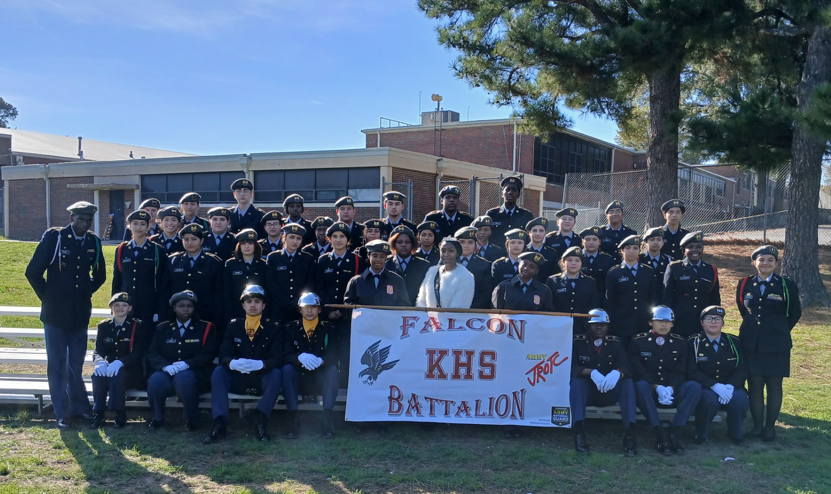
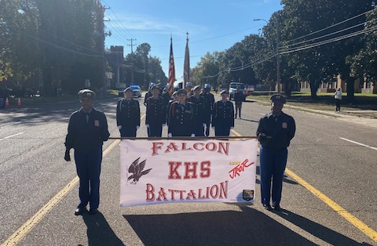
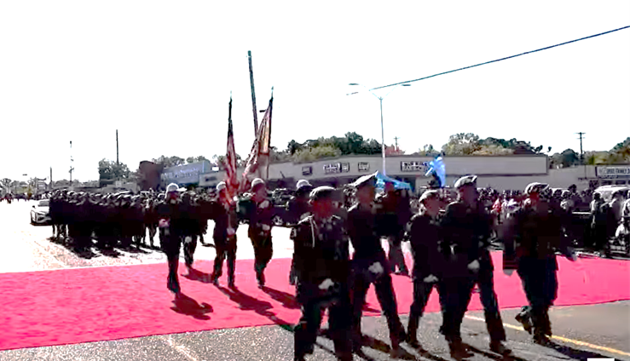
Kingsbury HS JROTC NOV-DEC 2024
Falcon Battalion Participated in the Whitehaven Chritsmass Parade
Kingsbury High School Falcon Battalion stand sharp in formation during this year Whitehaven’s Christmas Parade. “We had a full complement to represent our BN, and all Cadets performed to a high level of professionalism” said C/LTC Erieuna Johnson, Falcon BN Commander and this year JROTC Queen. C/CSM Jakarious Mason said “preparations, well discipline Cadets and their motivation resulted in a great day to be a Falcon”. Our Battalion definitely look to part. Go Falcons!
F/R: Banner, Commander and Staff, Color Guard, Troop Formation and Falcon BN Queen

