Slide 1




Kingsbury Elementary School
Session 6: Understanding What it Takes to be College-Ready

Slide 2
Welcome
Purpose: Learn about the steps you need to take so your child is college-ready. .
Objectives
  Gain knowledge about the exams required for college entry.
  Discuss different types of financial aids available to families.

Slide 3
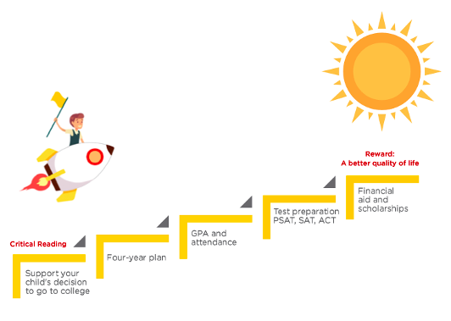
Discussion
Climbing the Academic Success Ladder.

Slide 4
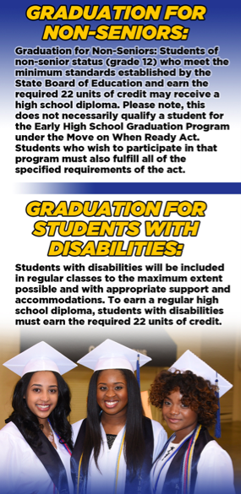
Shelby County Schools
Graduation Requirements
Notes:
1. Distribute copies of the handout “Creating a Positive Environment at Home,” taking a few
minutes to review and discuss the recommendations in each of the boxes.
2. Then, explain to parents that all of the activities that they will participate in today involve
creating a positive environment for their children at home.
3. Point out that you are well aware that there are many ways to go about this, and that you
are not having them participate in today’s activities because you think they are doing things
wrong at home. Being a parent is challenging and parents are not supposed to be perfect.
However, Padres Comprometidos believes that all parents can benefit from tools and resources
to do what they are doing well at home even better so that students and their families can
grow happily together and share in each other’s futures.

Slide 5
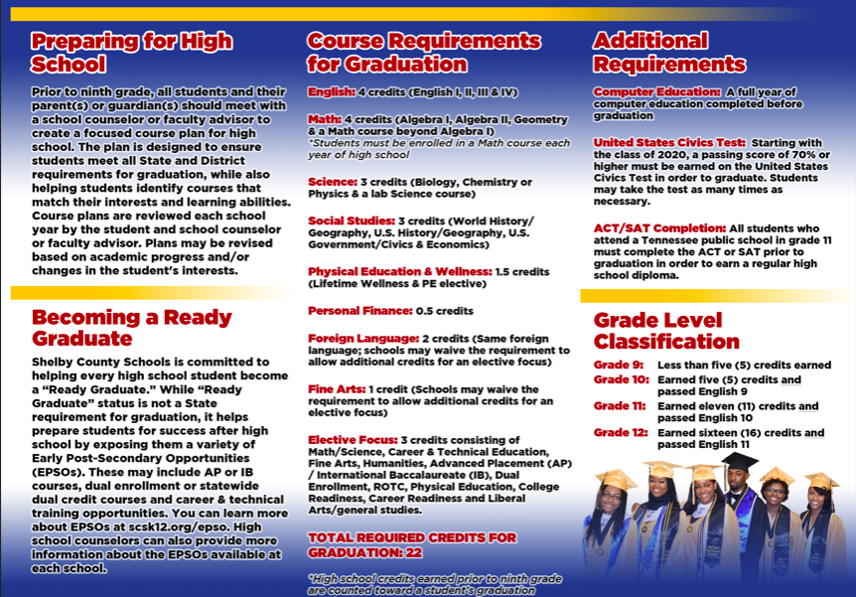
Notes:
1. Distribute copies of the handout “Creating a Positive Environment at Home,” taking a few
minutes to review and discuss the recommendations in each of the boxes.
2. Then, explain to parents that all of the activities that they will participate in today involve
creating a positive environment for their children at home.
3. Point out that you are well aware that there are many ways to go about this, and that you
are not having them participate in today’s activities because you think they are doing things
wrong at home. Being a parent is challenging and parents are not supposed to be perfect.
However, Padres Comprometidos believes that all parents can benefit from tools and resources
to do what they are doing well at home even better so that students and their families can
grow happily together and share in each other’s futures.

Slide 6
Activity
Start College Dialogue Early
College Readiness Checklist MS/HS
Recommended HS Classes

Slide 7

Homework
Begin putting into practice good parenting principles.

Slide 8
Closing
What are the three most important things you learned during this program?
Do you have an idea about how you will continue to stay involved in your children’s school and in their education?
Thank you!

