Slide 1




Kingsbury Elementary School
Elementary Level Session 4: ESSA & WIDA

Slide 2
Welcome
Purpose: To provide parents with an overview of ESSA (Every Student Succeed Act) and school accountability
Objectives
  Provide parents with an overview of ESSA
  Explain how English Learners are identified for service
  Explain the importance of the WIDA Screener
  Describe how the scores are uses to improve language development

Slide 3
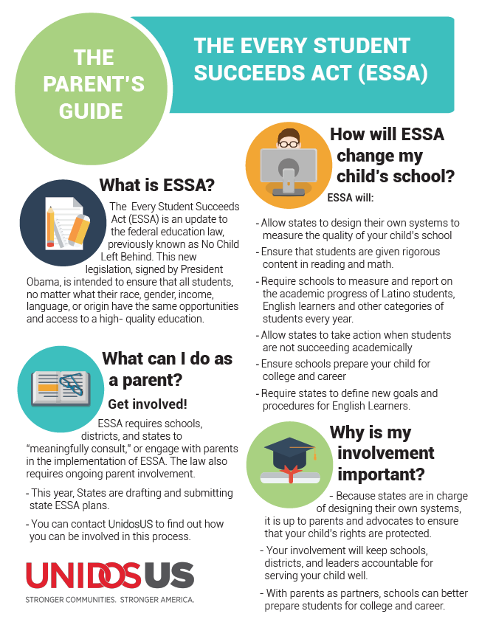
Group Activity
Divide into 4 groups and report out your question and your thoughts
1. What is ESSA?
2. What can I do as parent?
3. How will ESSA change my child's school?
4. Why is my involvement important?

Slide 4
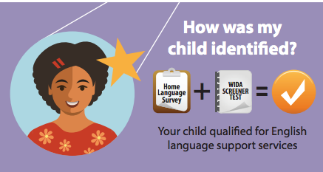
My Child is an English Learner
Notes:
All parents complete a home language survey when students are enrolled in school. If a parent indicates that the child speaks or is exposed to any language in the home other than English, then the child is given a test to determine English proficiency and qualification for ESL services.

Slide 5
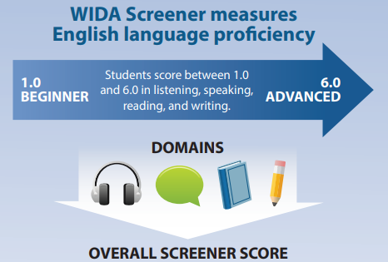
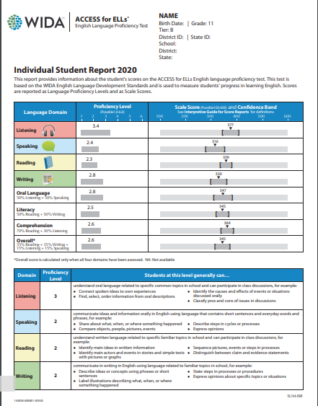
What is the WIDA Screener?
Notes:
WIDA Screener: Students in grades one through twelve (1-12) who are screened using the WIDA screener and who score below 4.5 composite or 4.0 or below on any domain shall be entered into the ESL program.
Kindergarten is given the WIDA Kindergarten WAPT screener and students who score 27 out a possible 30 points on the test qualify for ESL services.
If your child qualifies for services, then the ESL teacher will communicate information related to testing, placement, and ESL services to all parents of NELB students in the language and method that the parent can understand.

Slide 6

What does it mean to be an ELL?
Notes:
This video explains the different kinds of language students use and need to be successful in and out of the classroom, with a focus on academic language.

Slide 7
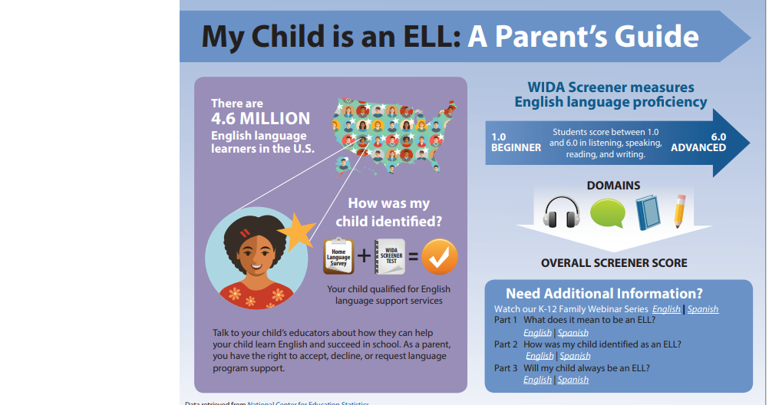
Need More Information? -
K-12 ELL Parent Webinar: English and Spanish

Slide 8
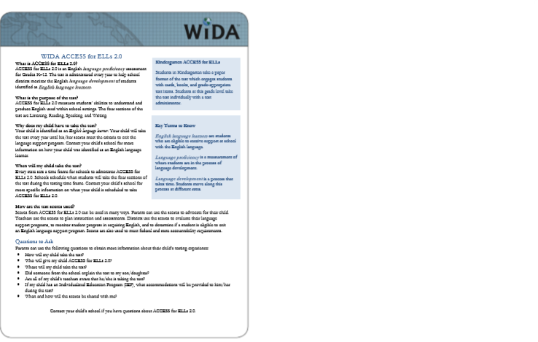
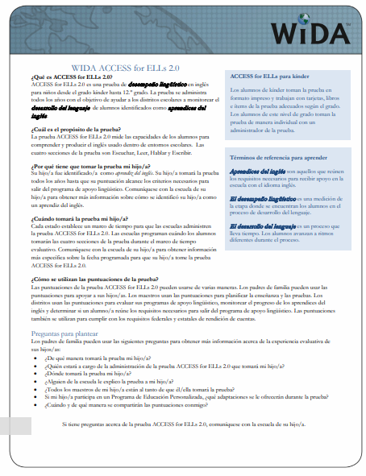
WIDA Flyer for Parents
Notes:
Flyer is offered in multiple languages and can be distributed to parents in their native language. The flyer also gives questions

Slide 9
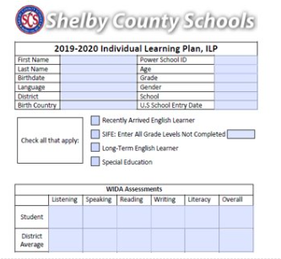
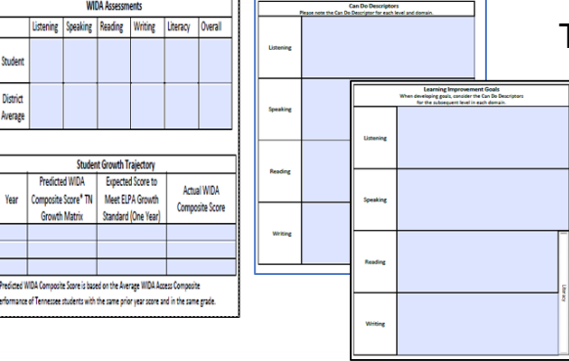
School Support: Individual Learning Plan
Notes:
Individual Learning Plan (ILP) is a document that is used by your child’s ESL teacher and general education teacher to make notes about your child’s academic and language progress. The ILP will also include list goals and accommodations (instructional supports) that the teachers will use to help English learners access the information being taught in the classroom.

Slide 10

Homework
Share your thought about what we learned in today's session.
Think of ways that we can you do to get other parents involved and engaged with the school?

Slide 11

Closing
Questions?
Next Meeting will be held….
Thank you!

