Slide 1




Kingsbury Elementary School
Session 2: School & Family Partnership

Slide 2
Welcome
Purpose: Learn about the role that parents play at school. Discuss the chain of command within schools and prepare for an open dialogue with the school staff.
Objectives
  Learn to use the chain of command
  Learn about and put into practice some of the basic, yet important steps parents can take at home to support their children’s education.
  Understand the teacher’s role and meeting with teachers regularly.

Slide 3
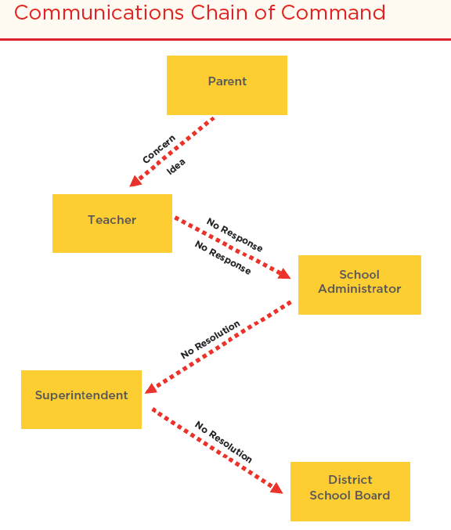
Who Do I Ask?
“Communication Chain of Command”-Is a hierarchy of authority. When we follow a chain of command, we follow the order of persons with different levels of authority.
Schools, organizations, companies, and governments establish chains of command to establish an effective process to respond to problems.

Slide 4
Chain of Command Questions
(Drop the answer in chat box or )
My child’s school is charging me for field trips, and it is not possible for me to pay I have voiced my concern at every level, and no one has been able to help me. Who do I turn to now?
My child is having trouble completing his math homework, and I don’t know what to do at home to help him. Who can help me with specific strategies to assist him at home?
I am interested in volunteering at my child’s school and would like to know if there are programs geared specifically to parents. Who can guide me with this?
My child is academically advanced, and I would like to see her enrolled in the district optional program. Where do I find information about enrolling her?
My child is struggling with reading. What tutoring programs are offered by the school to assist my child?
I am concerned that my child’s school doesn't receive enough funding to fix some of the school building issues. I want to support the school who do I need to speak with to advocate for my child's school?

Slide 5
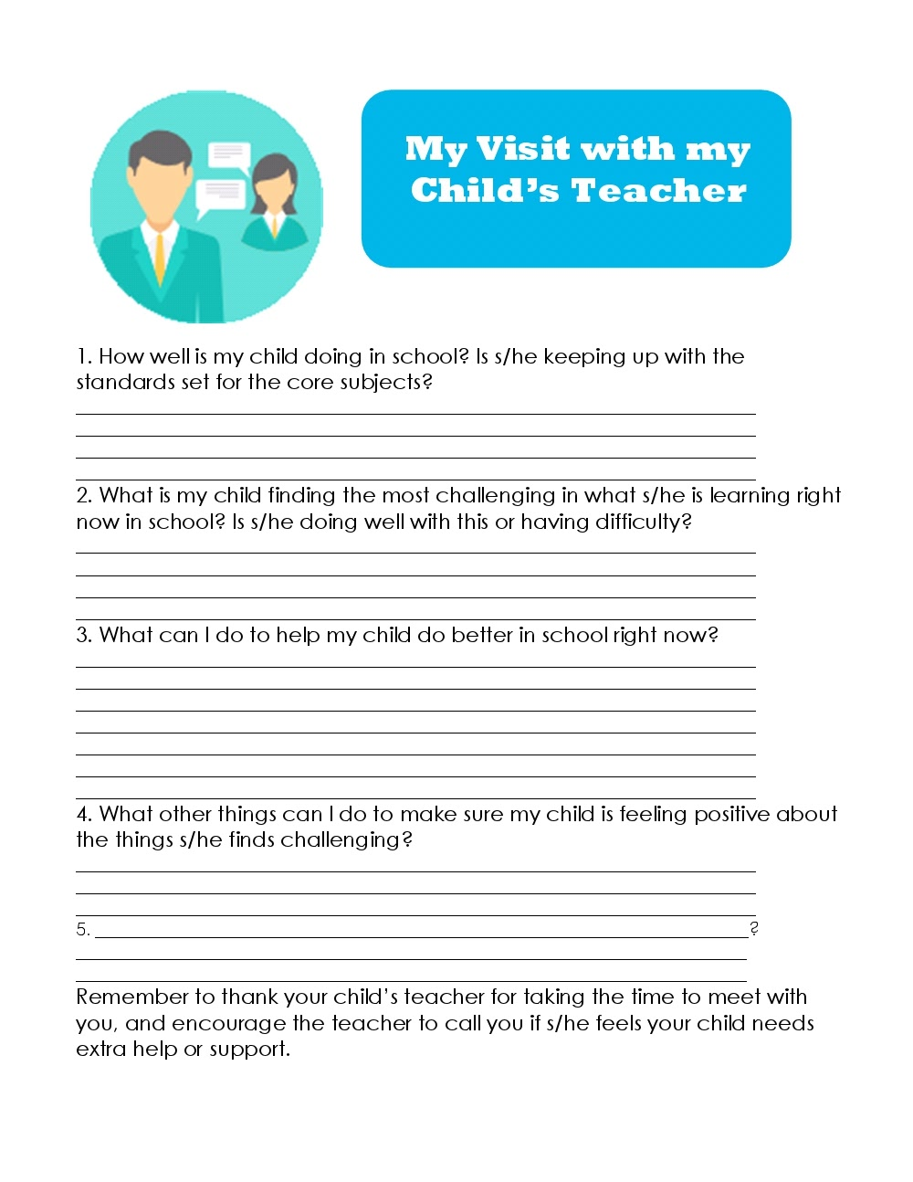
Overview
Always talk to your child’s teacher first when there is a question or concern about an issue affecting your child or other children. Ask for the teacher’s daily schedule or conference time so that can request the best time to meet and talk.
If the teacher does not respond within a reasonable amount of time, or is unable to resolve the issue, set up an appointment to speak to a counselor or with the viceprincipal to discuss the situation and request a response or resolution.
The school principal is the next person you can consult. If you receive no response or resolution. Make sure you have followed the previous steps in the chain of command.
If you have exhausted your efforts to get a resolution from the school staff, it is time to set up a meeting with the district staff or superintendent. o If the other staff in your school’s chain of command were unable to provide a resolution, your school board representative is the final person to address the issue at the district level.

Slide 6

Group Activity
Share two to three questions that you can ask the principal or school counselor next week in the chat box.
Vote on the most important five or six questions they can ask the principal next week.

Slide 7

Connect with your Child’s Teacher
Let's find ways we can connect with the teacher.......
Teams Meeting
Email
Phone Call
Class Dojo
PowerSchool
Notes:
It’s important to meet regularly with our children’s teacher because…
Our children’s teacher is usually the second most important person in their lives.
It shows our children that we care and that they can trust their teacher because we do.
We need information about what our children are learning and how they’re learning it so that we can help them at home and in our communities.
A positive parent-teacher relationship is a partnership that contributes to children’s academic success.

Slide 8

Homework
Assignment #1: If possible, schedule a meeting with your child’s teacher.
Share with you another parent about next week's meeting!

Slide 9
Closing
Questions?
Next Meeting will be held….
Thank you!

