Slide 1




Kingsbury Elementary School
Session 1: Welcome to Families Connect

Slide 2
Welcome
Purpose: Provide an overview of the Families Connect program and school's inventory of resources.
Objectives
  Acquaint parents with one another and goals of the Families Connect and the objectives of the curriculum.
  Familiarize parents with the different types of internet connections.
  Become acquainted with the resources available to parents at school and in their community to support their children’s education.
  Gather the necessary data.

Slide 3

Introduction
Introduce yourself
Share 2 two things about yourself (in person or the chat box.)

Slide 4
Program Overview
  1 ½ hour meetings
  Discussions
  Navigate the SCS school system
  You need to ….
Be an integral part of the program.
Attend all of the curriculum sessions.
Complete all of the tasks and activities.
Be positive of mind and spirit.

Slide 5




Important Video Conferencing Features
Camera
On and Off Button
Raise Hand /
Lower Hand
Chat Box
Microphone
On and Off Button

Slide 6
MS Toolbar
1. Time – This captures the how long the meeting has been active.
2. Camera Icon – Click on the camera to share your video! Check your background before you share.
3. Microphone – To speak to everyone you can unmute yourself.
4. Share Box – This allows you to share documents
5. ... More Action – Check the device settings, notes, and background effects.
6. Raise your Hand – Use this to let the presenters know that you wish to speak.
7. Chat Box – Join the conversation and answer questions.
8. Participants- Check out the meeting participants.

Slide 7



Types of Internet-Ready Technology
Personal Computer
Tablets
Smartphones

Slide 8


Virtual Learning Models
Synchronous
Asynchronous
Hybrid

Slide 9
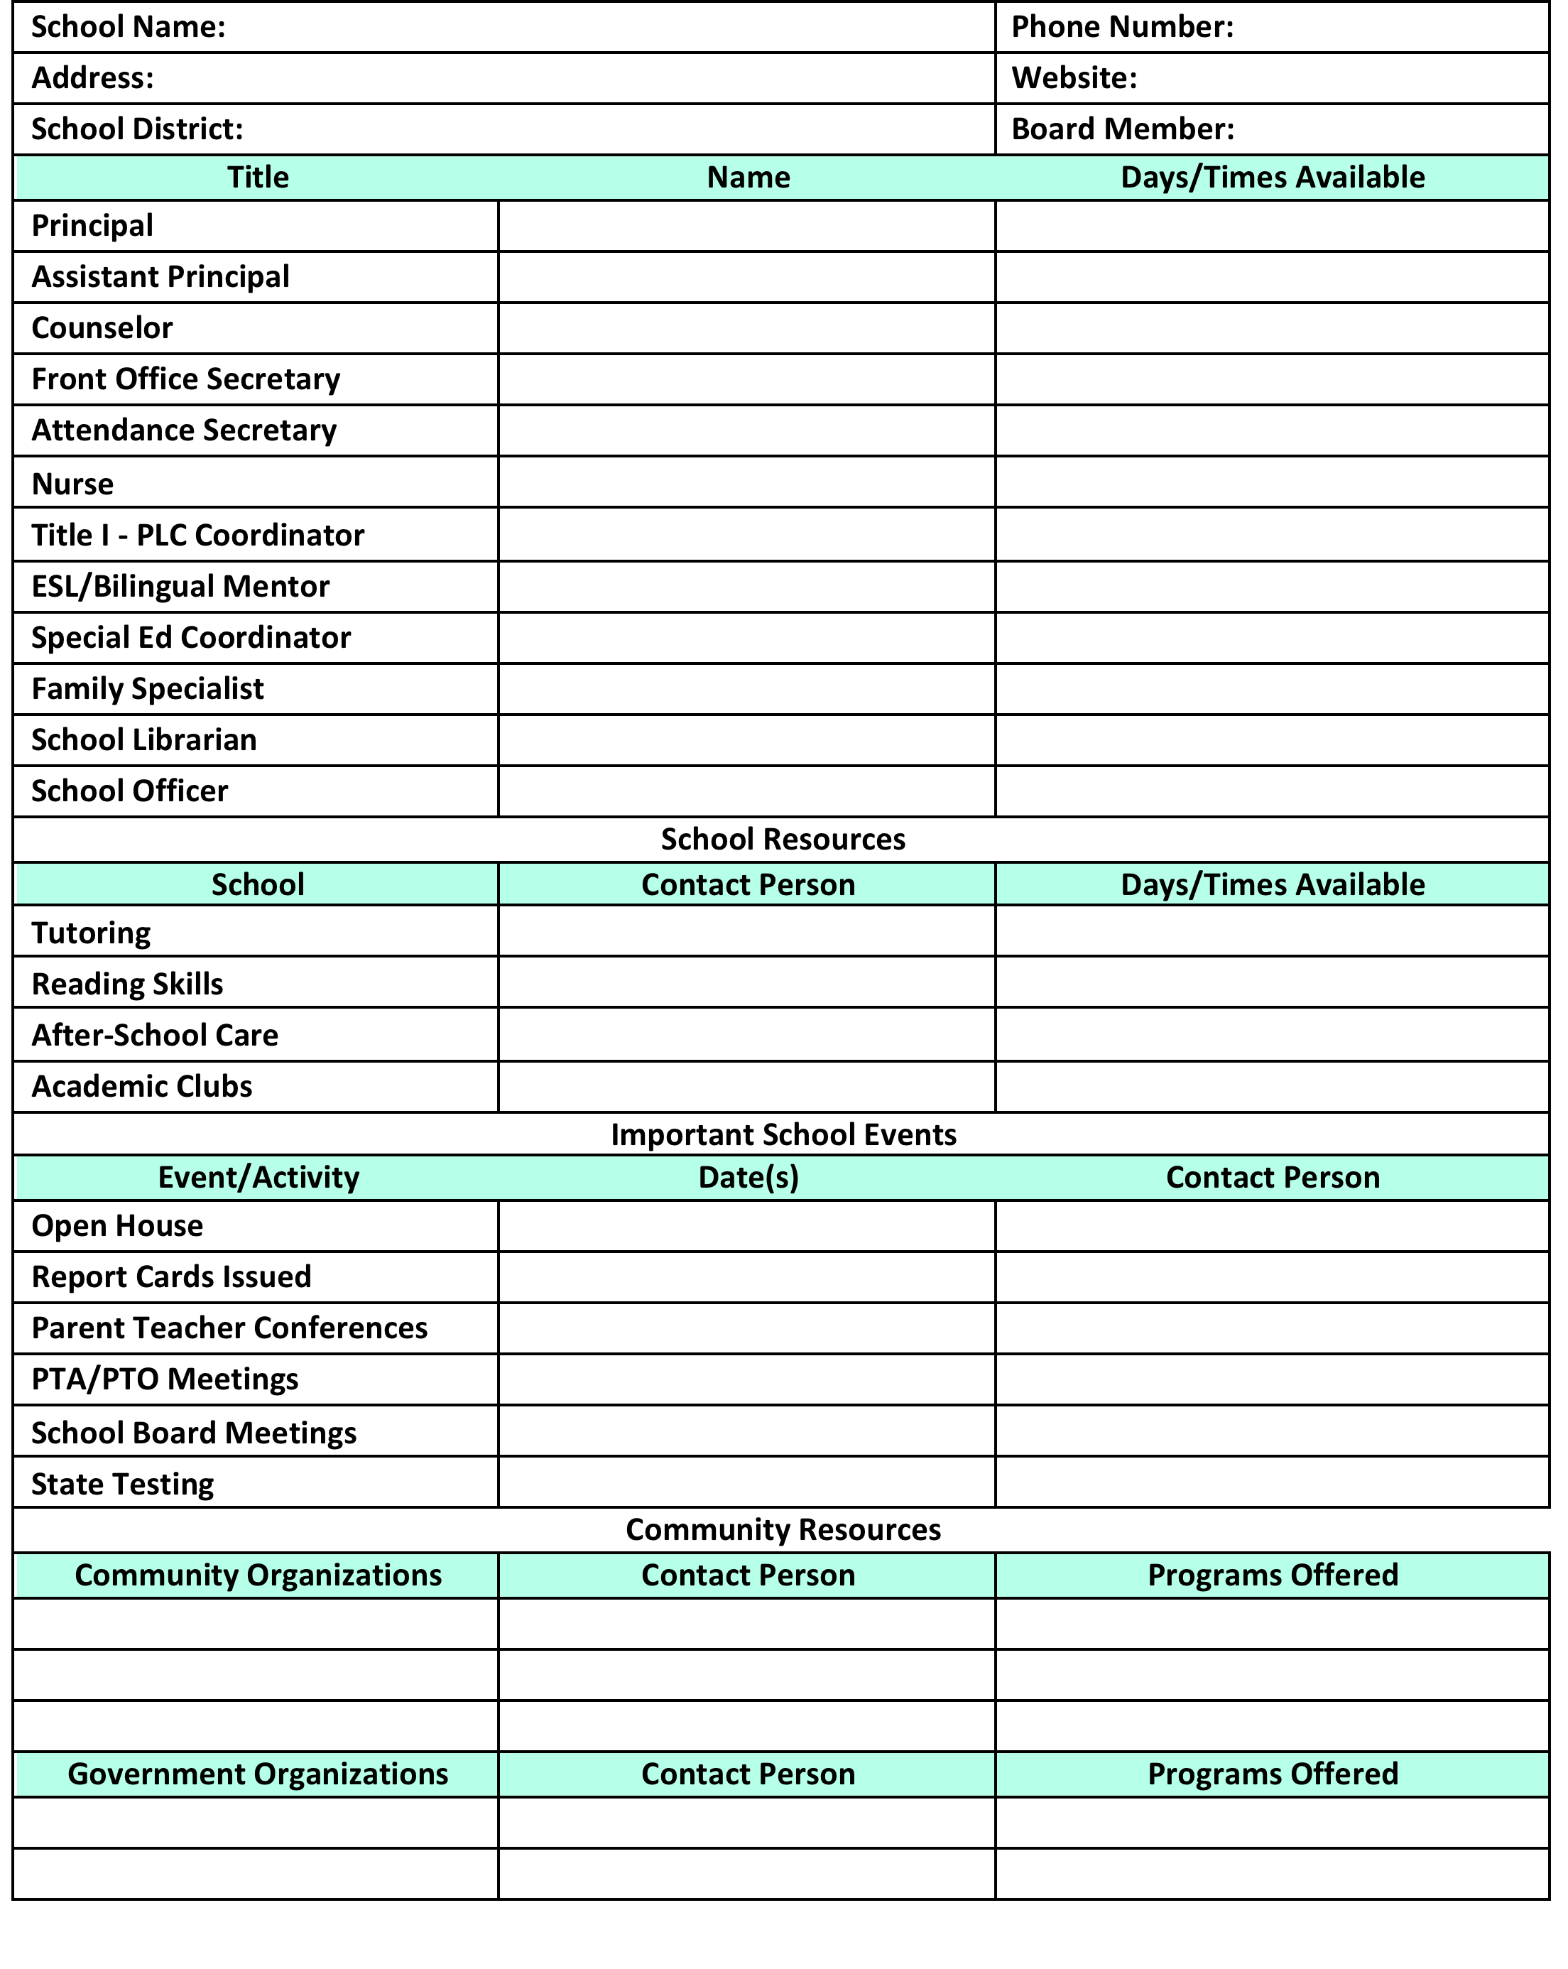
Homework
Complete the “Inventory of Parent Resources.” Find this in the Chat Box.

Slide 10
Title​ | Name​ | Phone Number​ | Email ​ | Days/Time Available to Parents​
Principal​ | ​ | ​ | ​ | ​
Vice-Principal​ | ​ | ​ | ​ | ​
Counselor​ | ​ | ​ | ​ | ​
Secretary​ | ​ | ​ | ​ | ​
Attendance Monitor​ | ​ | ​ | ​ | ​
Nurse​ | ​ | ​ | ​ | ​
Family Engagement Specialist | ​ | ​ | ​ | ​
Bilingual/ESL Mentor | ​ | ​ | ​ | ​
Special Ed Coordinator​ | ​ | ​ | ​ | ​

Slide 11
Event/Activity​ | Date​ | Contact Person ​ | Email/Phone #​
Meet the Teacher​ | ​ | ​ | ​
Report Cards Issued​ | ​ | ​ | ​
School Board Meetings​ | ​ | ​ | ​
WIDA Testing​ | ​ | ​ | ​
TCAP Testing ​ | ​ | ​ | ​

Slide 12
Meeting Date
Which day of the weeks works best for you?
What time would work best for our meetings?
Please vote in the Chat Room
Monday | Tuesday | Wednesday | Thursday | Friday

Slide 13
Closing
Questions?
Next Meeting will be on October 8
Thank you!

