Slide 1


LONGHORNS -
STAY CONNECTED!
Longhorn Staff
      Julia Callaway, Principal
      Benjamin Walker, Assistant Principal
      Dawn Inman, PLC Coach
      Carla Ross, Instructional Coach
      Angela Knox, Instructional Facilitator
      Shalifia Darden, Professional School Counselor
      Tamara Lewis, Communications Coordinator
      Stephanie Edwards, Media and Technology Specialist
      Ricky Richardson, Technology Lead
      Seniors: Class of 2021!

Slide 2

Senior Heads
College/Career/Military Preparedness
Transcript Review
Westwood High School
Class of 2021
Senior Information and Updates
Fall 2020

Slide 3

Senior Heads
Star Studio
5687 Mount Moriah Road
Memphis, TN 38115
901-366-9200
http://FACEBOOK.COM/STARSTUDIOINC.

Slide 4


Slide 5
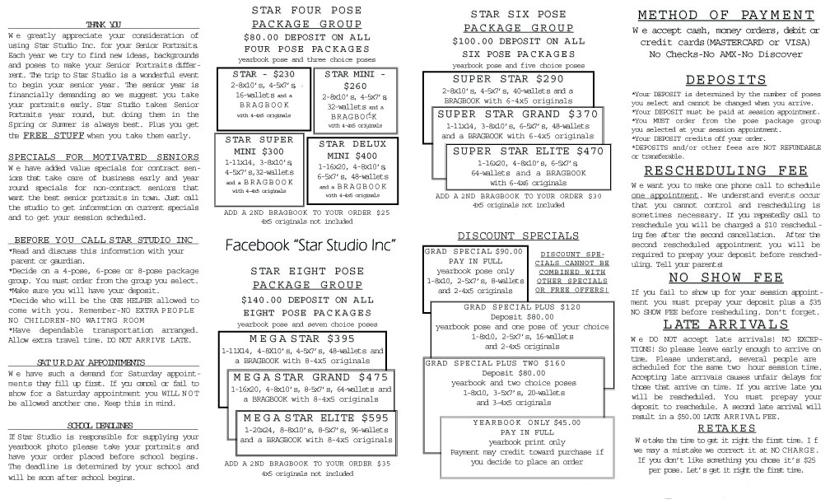

Slide 6


College/Career/Military Preparedness Fall Checklist!
(ACT/ASVAB/Dual Enrollment)
Create Federal Student Aid ID (FSA ID) at FSAID.ed.gov to complete Free Application for Federal Student Aid (FAFSA)
Complete the FAFSA as soon as possible after Oct 1
Use FSA ID to Access and electronically sign the FAFSA and Apply for grants and scholarships!
Meet with counselor (Ms. Darden) about concurrent (Dual) enrollment
Stay on track. Review courses (Transcipt) with counselor for meeting high school graduation and entrance requirements
Attend (virtual) college fairs, meet with recruiters (1st Sgt. Jones and Sgt. Sanford), and bring your parent/guardian to a virtual FAFSA night
Study! Keep making the effort to maintain your grades! These habits will come in handy during your college coursework!
Even if you’ve already taken the ACT, Register for the fall ACT (www.act.org); you might boost your score! For extra help, ACT Academy!
Look for the SAR. After you file the FAFSA, you will receive your Student Aid Report (SAR)
Review the SAR for accuracy; make corrections at FAFSA.gov or with college’s financial aid office.
Pick your top five post-secondary options (college, vocational/technical, military)!

Slide 7
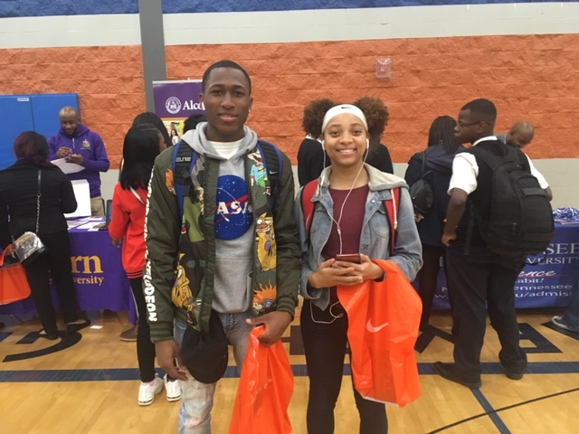

Help is Available!
Transcripts
Ms. Shalifia Darden, Professional School Counselor
Ms. Evelyn Lloyd, Records Specialist
Ms. Julia Callaway, Principal
Military Inquiries
1st Sgt. Pamela Jones
Sgt. Patricia Sanford

