Slide 1



Logging into Microsoft Teams

Slide 2
HOW TO LOG INTO MICROSOFT TEAMS
This video will give you step by step instructions on how to log into Microsoft Teams

Slide 3
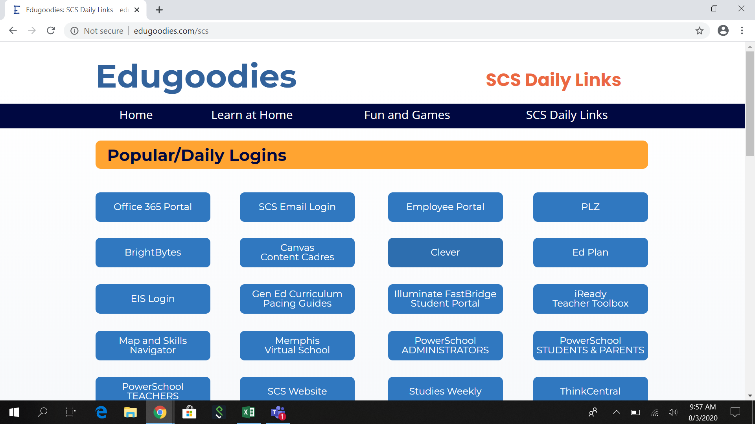
Click on Office 365

Slide 4
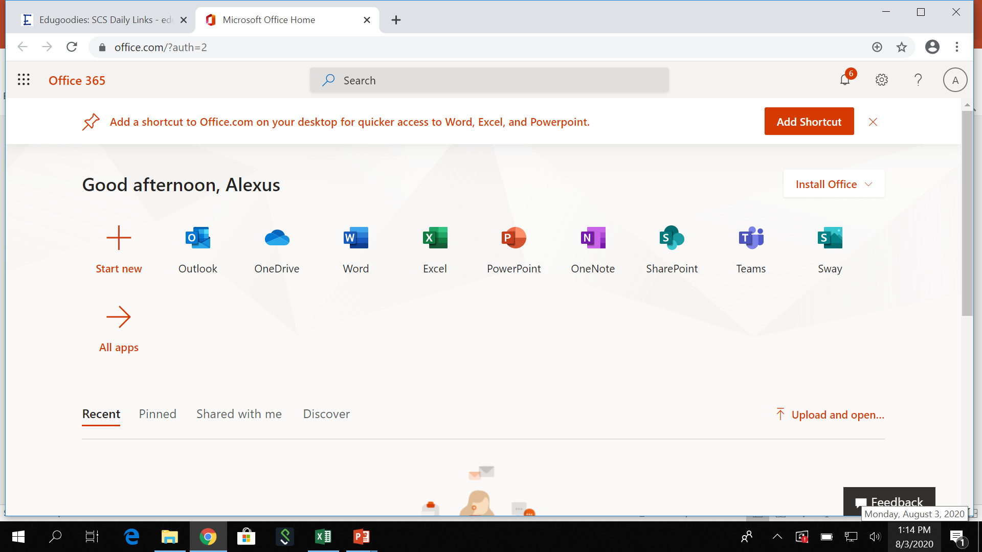
Choose Teams

Slide 5
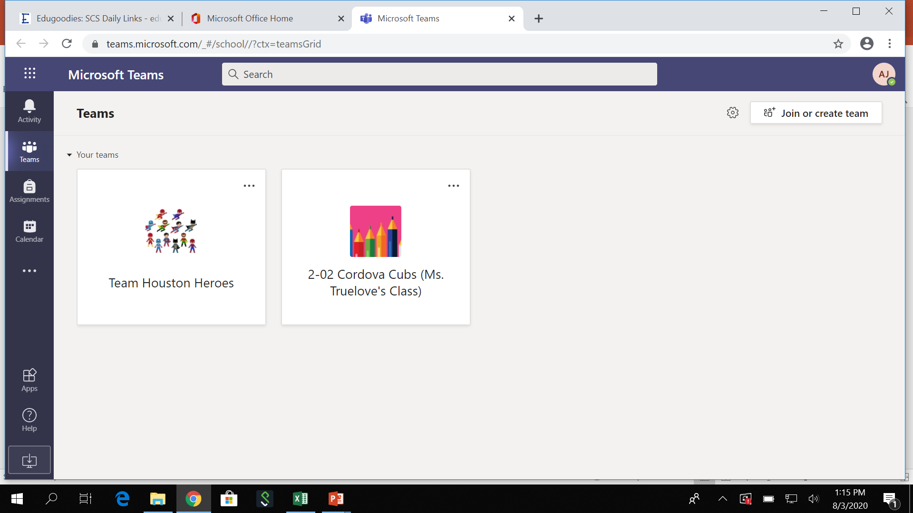
All of your teachers will appear

Slide 6
THANK YOU FOR YOUR ATTENTION TO THIS HOW-TO SESSION!
DON’T FORGET TO HAVE YOUR PARENTS SIGN UP FOR TEAMS TRAINING WITH SCS.
STAYING CONNECTED

