Slide 1




Academic Progress
LONGHORNS -
STAY CONNECTED!

Slide 2


Download Important Apps
Check your grades in PowerSchool weekly.
Class Dojo is the school communication app that allows teachers, students , and families to stay connected with upcoming events and class assignments.

Slide 3

Virtual Tutoring and Virtual Office Hours
Virtual Tutoring Hours and Virtual Office Hours will be held by teacher of record on a weekly basis .
Please communicate with the teacher of the course for his or her specific tutoring and office hours.

Slide 4
Academic Core
We believe all students can learn and excel.
Intervention
Small Groups
Tutoring
RTI2
Grade Results
Credit Recovery
Project Graduation
Class
ALL Academic Courses
The Arts
Athletics
Counselor
Advisory SEL Model
College and Career Readiness

Slide 5
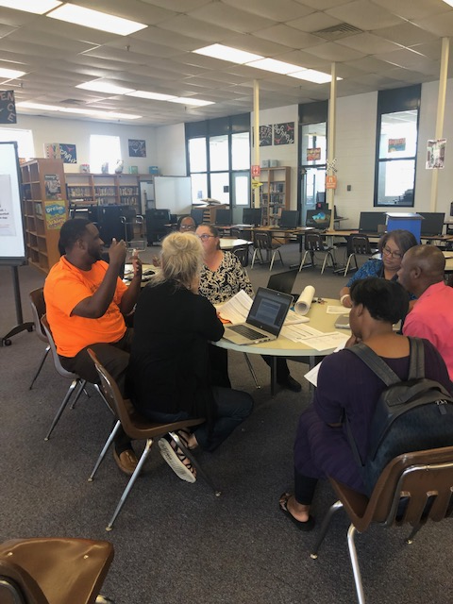
A school community that cares
We are Longhorns working together and providing our students a world class education because it’s what we do at Westwood High .
Learn … Live … Love… It’s the Longhorn way!

