Slide 1


Westwood High School College App Week
The Longhorn Way
September 21-27, 2020
Presented by Ms. S. Darden
Professional School Counselor

Slide 2
College Application Week
Every day between 3pm-4 pm each college and career bound student will apply to at least two- three colleges per day and at least 3 scholarship the entire week.
Monday 9-21-2020 | Tuesday 9-22-2020 | Wednesday 9-23-2020 | Thursday 9-24-2020 | Friday 9-25-2020
ACT PREPCrash Course | ACT Exam 7:30-12:00 a.m. Westwood High School | TN Promise Apply Day College Recruiter Tennessee State University 3:00 pm | College Recruiter TBA | FAFSA Webinar

Slide 3
Virtual College Fair Links
COALITION FOR COLLEGE
https://www.coalitionforcollegeaccess.org/fee-waiver
On Wednesday, Sept. 16 and Thursday, Sept. 17, attend a free, virtual college fair hosted by the Coalition for College. The event features 130+ colleges and universities all committed to access, affordability and student success. See which schools will be there, and choose your rooms.

Slide 4

Bethel University
Bethel University's Office of Recruitment & Admissions is excited to share that we will be participating in College App Week,
September 21-27, 2020!
During this time your students can apply online at www.BethelU.edu/apply or via paper application for FREE!!!
We encourage you to share this with your students, friends and neighbors! Come see what we are all about, schedule a visit today at www.BethelU.edu

Slide 5
https://external-atl3-1.xx.fbcdn.net/safe_image.php?d=AQCdID0MMHPRjHDk&w=476&h=476&url=https%3A%2F%2Fscontent-atl3-1.cdninstagram.com%2Fv%2Ft51.29350-15%2F119103100_145940420534280_8309365508701921417_n.jpg%3F_nc_cat%3D101%26_nc_sid%3D8ae9d6%26_nc_ohc%3Dxrfz2_58508AX_Ml475%26_nc_ht%3Dscontent-atl3-1.cdninstagram.com%26oh%3Df40794e3925b958ec781a9aad265cc9d%26oe%3D5F7F78B8&cfs=1&_nc_cb=1&_nc_hash=AQCSKQTICgznircv

Slide 6

College Board Opportunity Scholarship
College Board Opportunity Scholarship Link

Slide 7

Morehouse College
Click Here to apply and more information

Slide 8


Looking for a college and don’t know where to start? Attend a #NACAC Virtual College Fair! Sign up for this FREE event today at virtualcollegefairs.org! #NACACFairs #collegeadmissions

Slide 9

Talladega College
How to Apply
Complete and submit application for admission. The application can be obtained by downloading and printing the Application form (.pdf) or by contacting or visiting the Talladega College Office of Admissions, which will assist you in your application process or requesting via e-mail: admissions@talladega.edu. If you prefer, you can also use our Online Application.

Slide 10
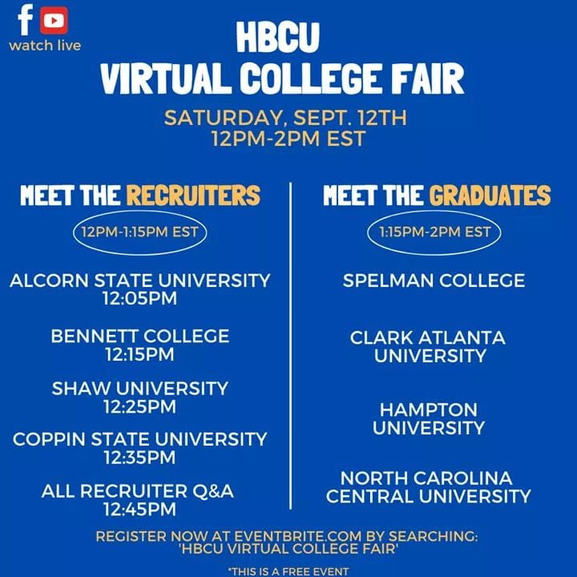
HBCU College Fair 9-12-20
Click Here

Slide 11

SPOTLIGHT
Two-thirds of all U.S. colleges and universities are test-optional or test-blind for fall 2021 applicants

Slide 12


Slide 13

Fisk University

Slide 14
Please register for the TN FAFSA Webinar
TNCollegeAppWeek. At the conclusion of next week, Kevin Edwards and Jason Seay will lead a webinar for school counselors fittingly titled #TNCollegeAppWeek ends and #TNFAFSAFrenzy begins where they will explore the resources curated on www.collegefortn.org for high school seniors and talk a bit about something known as the FAFSA. Please register for next Friday’s (9/25) 10:00 a.m. CDT webinar using the following link (https://bit.ly/2ZObg8q). I am also including the longer link for this site as well due to some schools’ systems block shorter links. https://tngov.webex.com/tngov/onstage/g.php?MTID=ea89b2985f72fda43f6ae2ce94cabec27

Slide 15


Slide 16
Westwood College Fair
More INFO coming soon on colleges attending!

