Slide 1


Slide 2

Agenda
• Meet the Teachers
• Class Schedule/Attendance
• Class Expectations
•Dress Code and Binders
• Parent Responsibilites/Website
• Grading
• Boost
• Questions

Slide 3

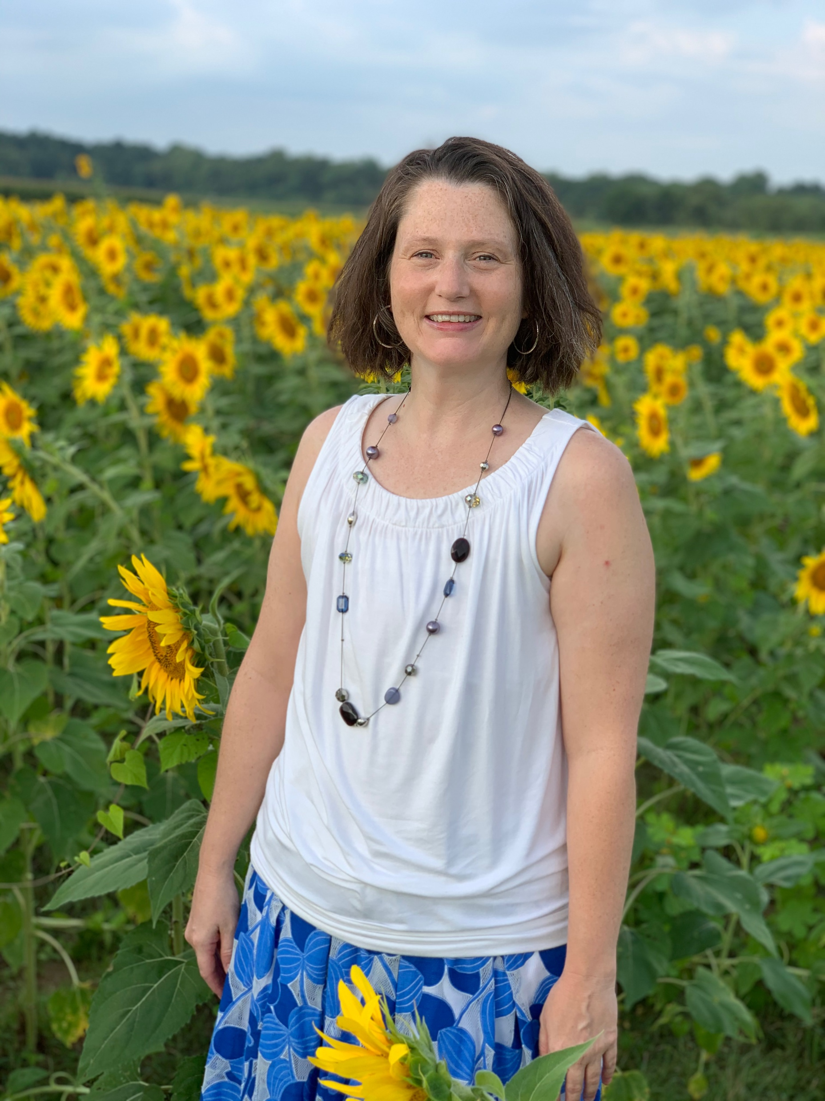
Mrs. Jamie Barber
Email Address
barberj1@scsk12.org

Slide 4
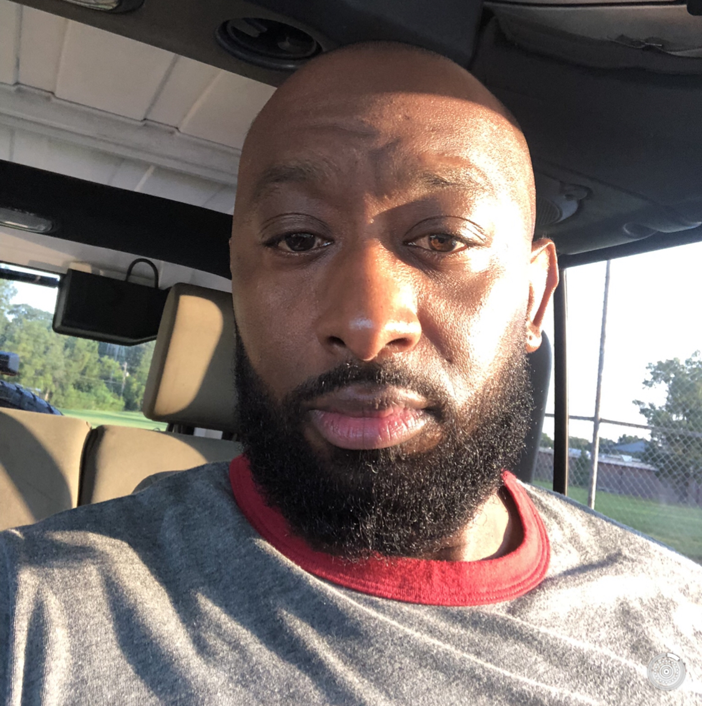
Mr. James Wardlow
Email Address
Wardlowj@scsk12.org

Slide 5

Mrs. Tricia Totty
Email Address
tottytr@scsk12.org

Slide 6
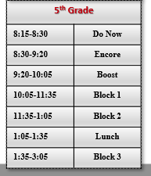
What does our day look like?
a/b??
Recess?
Snack?
Dismissal?

Slide 7
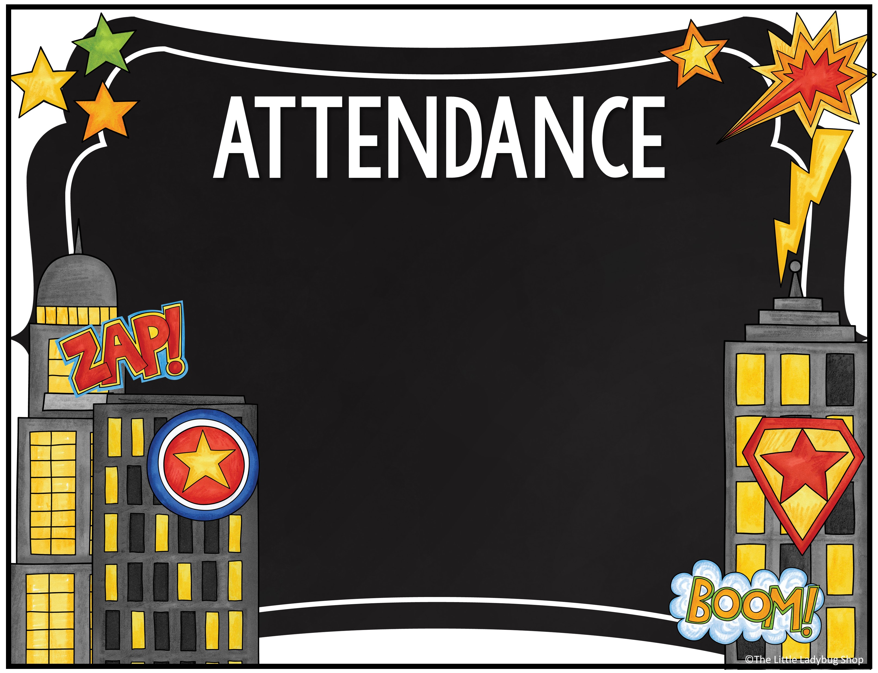
We will take attendance every day. The students will be marked tardy if they have not entered the classroom by 8:20.
Covid Reporting number
Text:
731-503-9797

Slide 8

Positive Attitude
Character Pledge
Fabulous Four
• A- act safely
• B- be responsible and respectful
• C- care for yourself, others and the environment
• D- do your best at all times

Slide 9
Follow directions, at all times
Keep your hands, feet, and objects to yourself
Be responsible and respectful
Raise your hand before speaking or getting up from seat
Be honest with yourself and others
CONSEQUENCES
Quiet warning/verbal reminder
Conference with teacher
Time out/reflection time
Conference with parent
Referral to guidance or administration
Weekly Conduct
E
G
S
N
U

Slide 10
Dress Code
Student Dress Code
• red, grey or white polo (no logos); Richland T-Shirt
• leggings cannot be worn as pants
• jeans on Fridays for students who have been in school M-Th
*jackets/ sweaters uniform colors

Slide 11
Binders
This is a great place for students to keep everything organized.
agenda book
pencil pouch
Folders
blank paper
passwords-log in information
class schedule
“white board” for math

Slide 12

Parent Responsibilities
• Review the Wednesday Folder for conduct and grades. Sign papers and send back each week.
• Check Power School for grades. Do not wait to the end of the quarter. (There is an app.)
• Contact teacher through Remind or email with questions

Slide 13
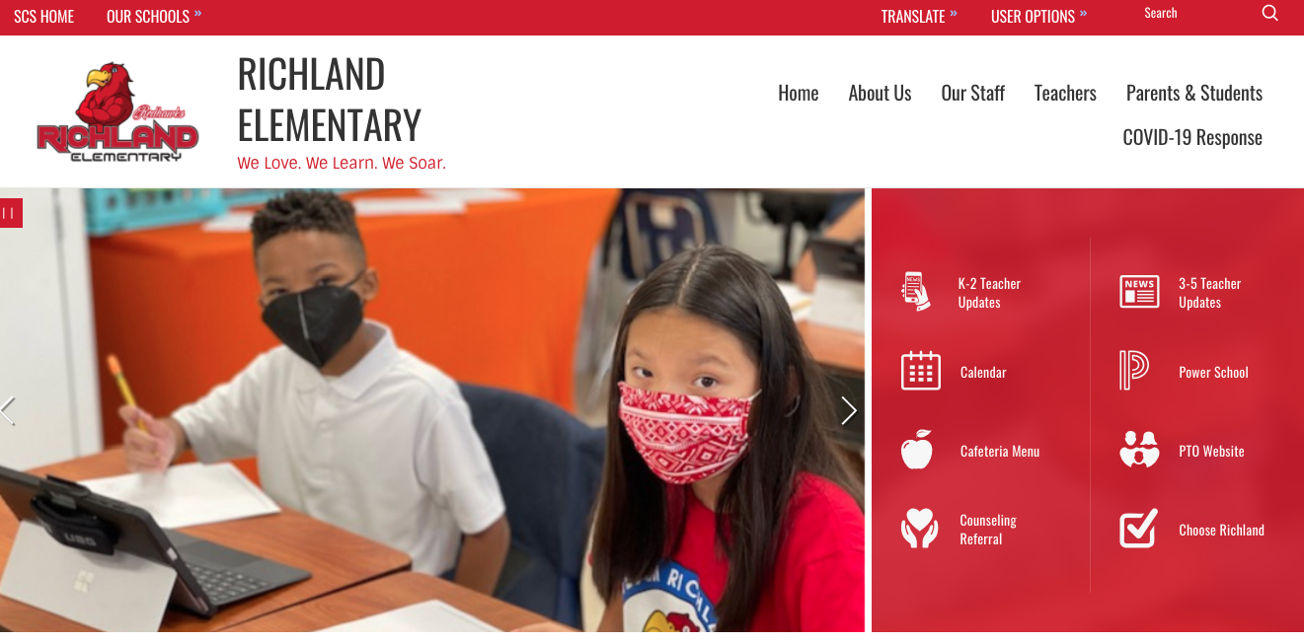
Teacher Updates
https://schools.scsk12.org/richland-es

Slide 14
Turning in Work
Students will turn in work in a variety of ways:
• Paper copies in the classroom
• Through Assignments on Teams
• Through the online Class Notebook in Teams
• No red ink, Kahoot, CommonLit, IXL, etc.

Slide 15
Grading Scale
A- 93-100
B- 85-92
C- 75-84
D- 70-74
F- Below 70
Weighted Grades
Tests 45%
Classwork 40%
Homework 5%
Participation 5%
Project 5%

Slide 16
Wednesday Folders
Wednesday folders will go home weekly. You will be able to review graded work and conduct. You will need to sign the Conduct and papers each week. Since grades are weighted, log in to Power School often to check your child’s overall grades.

Slide 17
Boost
This is a 45 minute period during which your child will receive differentiated instruction.
It is designed to create growth for all students.
Students may rotate between teachers to receive intervention or enrichment in ELA or Math.
Start date? We will start "Boost" after we have completed some placement tests.
iReady will be used to help facilitate intervention and enrichment.

Slide 18

9/9 Parent/Teacher Conference
2/15 Parent/Teacher Conference
***Conferences can be scheduled as needed through the year. Contact the teacher directly to schedule.

Slide 19
Remind App
You will only need to sign up for your Homeroom Teacher’s Remind Class.

Slide 20


