Slide 1
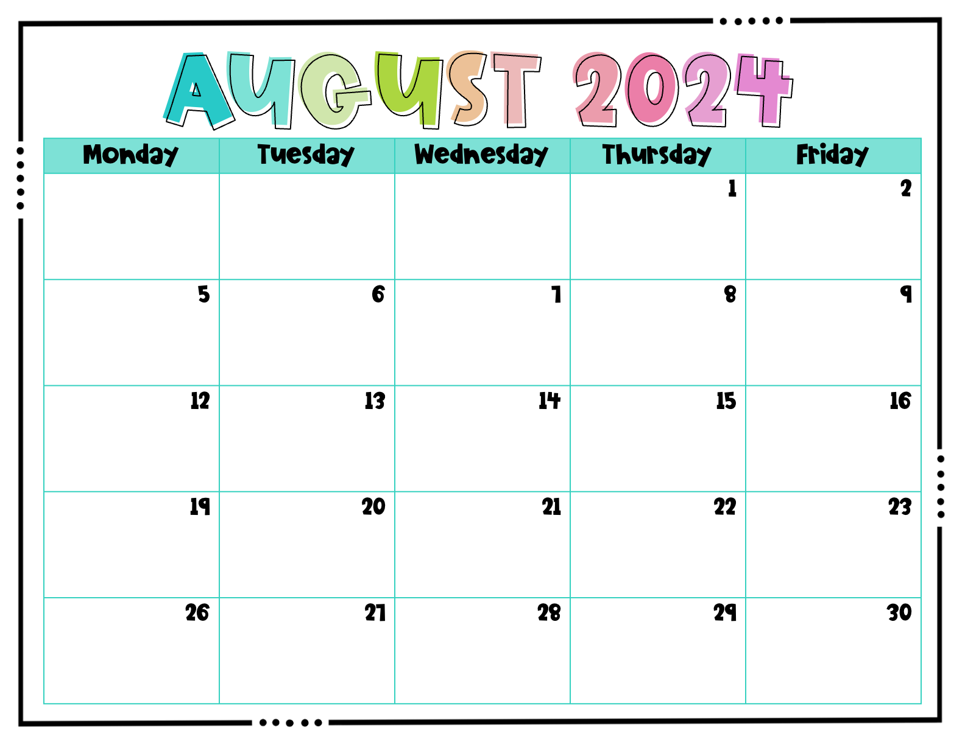
 |  | Evie | Wells | Cora
Camille | Marlei | Ehab | Ben | Addi
Kayleigh | Elizabeth | Carter | Caison | Myron
Karlee | Victoria | Jane | Josiah | Leo R.

Slide 2
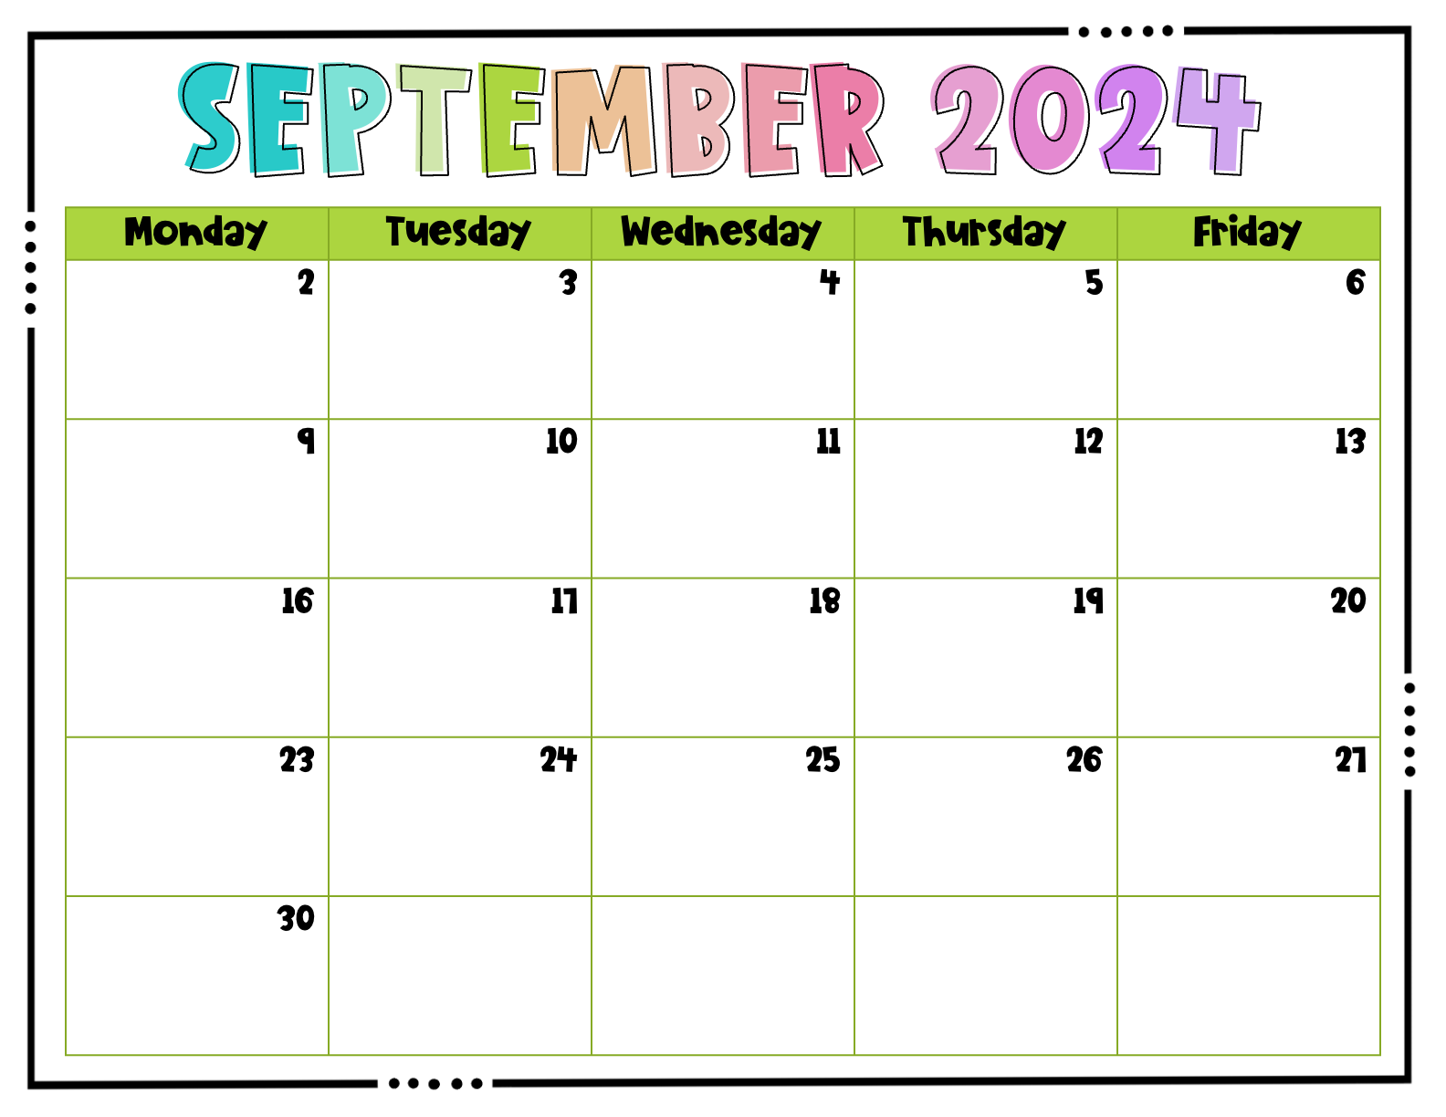
Labor Day – No School | Caroline | Leo V. | Ayla | Evie
Wells | Cora | Camille | Marlei | Ehab
Ben | Addi | Kayleigh | Elizabeth | Carter
Caison | Myron | Karlee | Victoria | Jane
Josiah

Slide 3
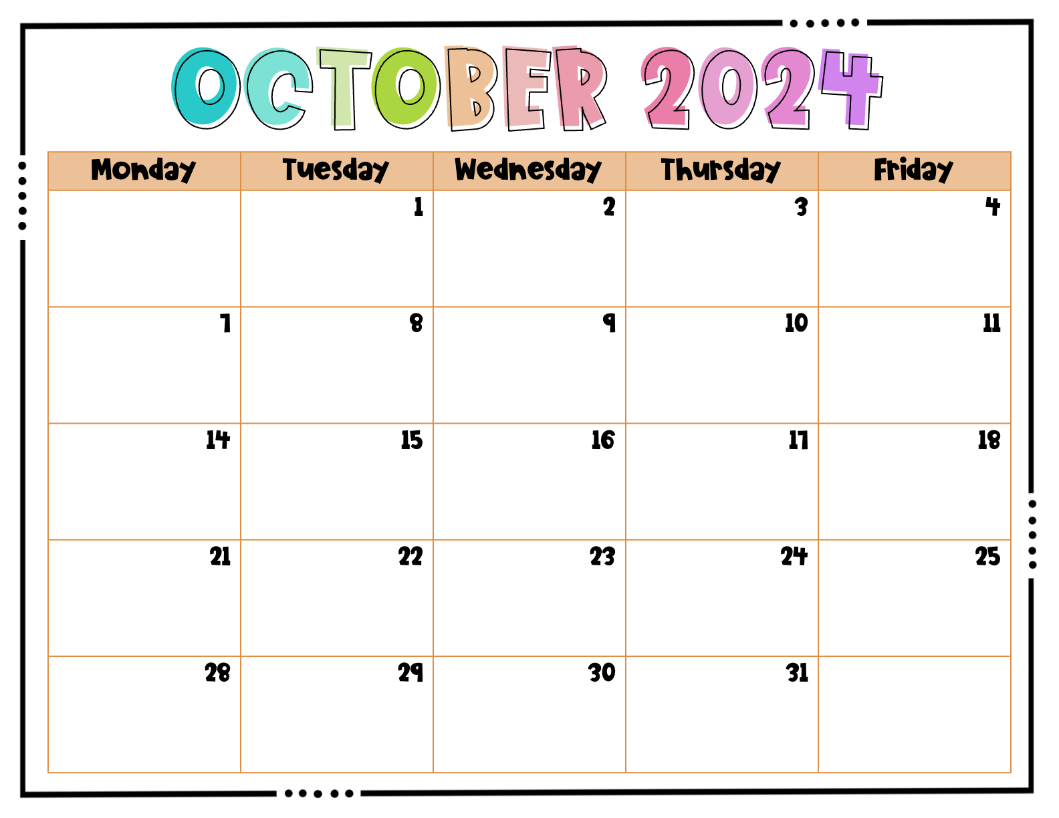
 | Leo R. | Caroline | Leo V. | Ayla
FALL BREAK | FALL BREAK | FALL BREAK | FALL BREAK | FALL BREAK
Evie | Wells | Cora | Camille | Marlei
Ehab | Ben | Addi | Kayleigh | Elizabeth
Carter | Caison | Myron | Karlee

Slide 4
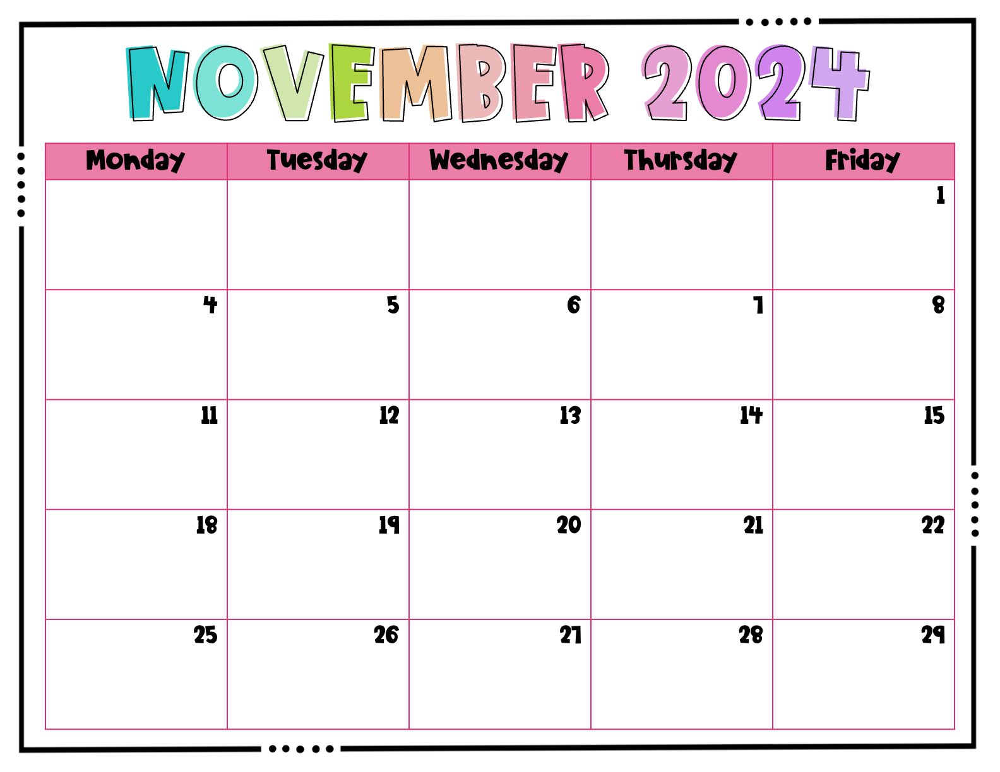
 |  |  |  | Victoria
Jane | Election Day – No school | Josiah | Leo R. | Caroline
Veterans Day – No school | Leo V. | Ayla | Evie | Wells
Cora | Camille | Marlei | Ehab | Ben
THANKSGIVING BREAK | THANKSGIVING BREAK | THANKSGIVING BREAK | THANKSGIVING BREAK | THANKSGIVING BREAK

Slide 5
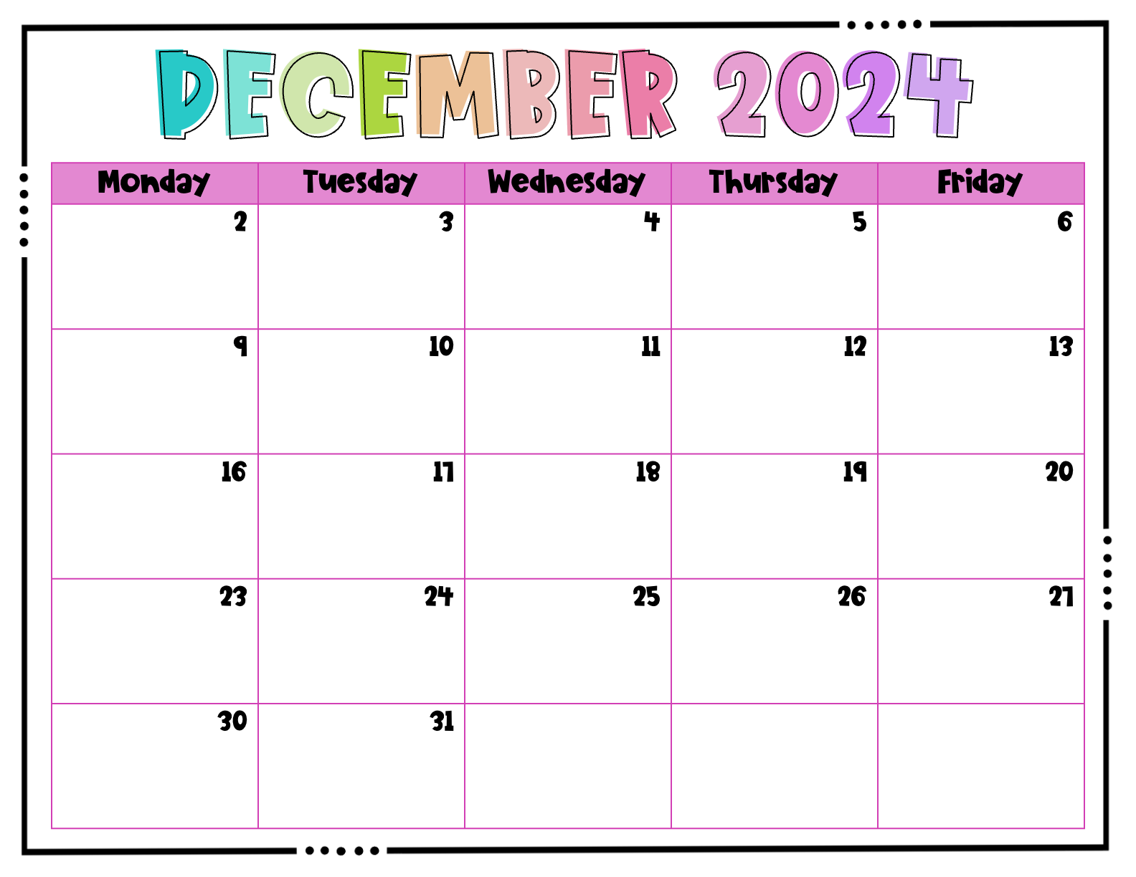
Addi | Kayleigh | Elizabeth | Carter | Caison
Myron | Karlee | Victoria | Jane | Josiah
Leo R. | Caroline | Leo V. | Ayla | HOLIDAY PARTY
WINTER BREAK | WINTER BREAK | WINTER BREAK | WINTER BREAK | WINTER BREAK
WINTER BREAK | WINTER BREAK

Slide 6
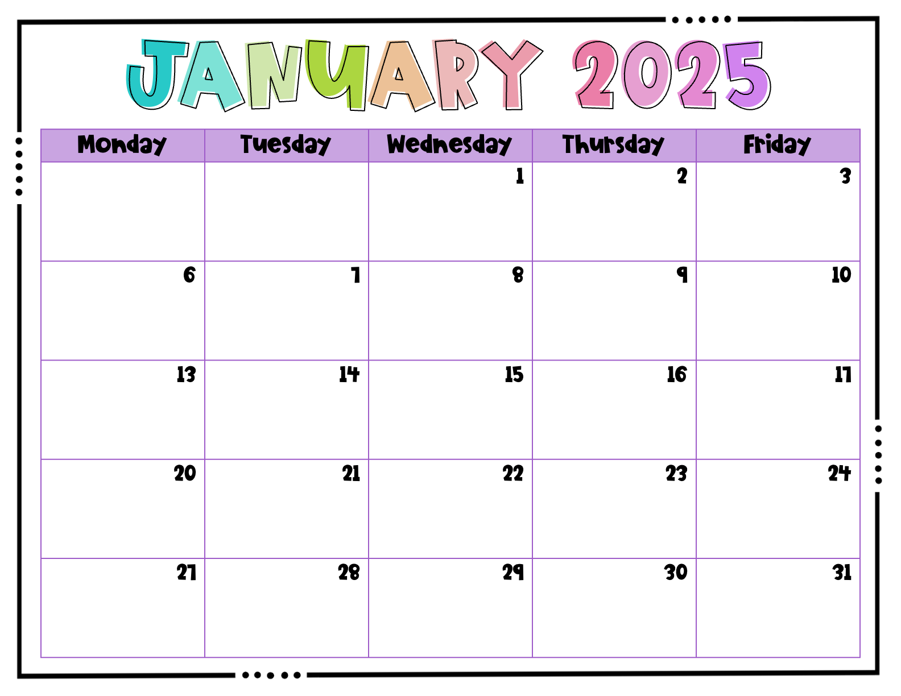
 |  | WINTER BREAK | WINTER BREAK | WINTER BREAK
Evie | Wells | Cora | Camille | Marlei
Ehab | Ben | Addi | Kayleigh | Elizabeth
MLK Day – No school | Carter | Caison | Myron | Karlee
Victoria | Jane | Josiah | Leo R. | Caroline

Slide 7

Leo V. | Ayla | Evie | Wells | Cora
Camille | Marlei | Ehab | Ben | Addi
Presidents Day – No school | Kayleigh | Elizabeth | Carter | Caison
Myron | Karlee | Victoria | Jane | Josiah

Slide 8
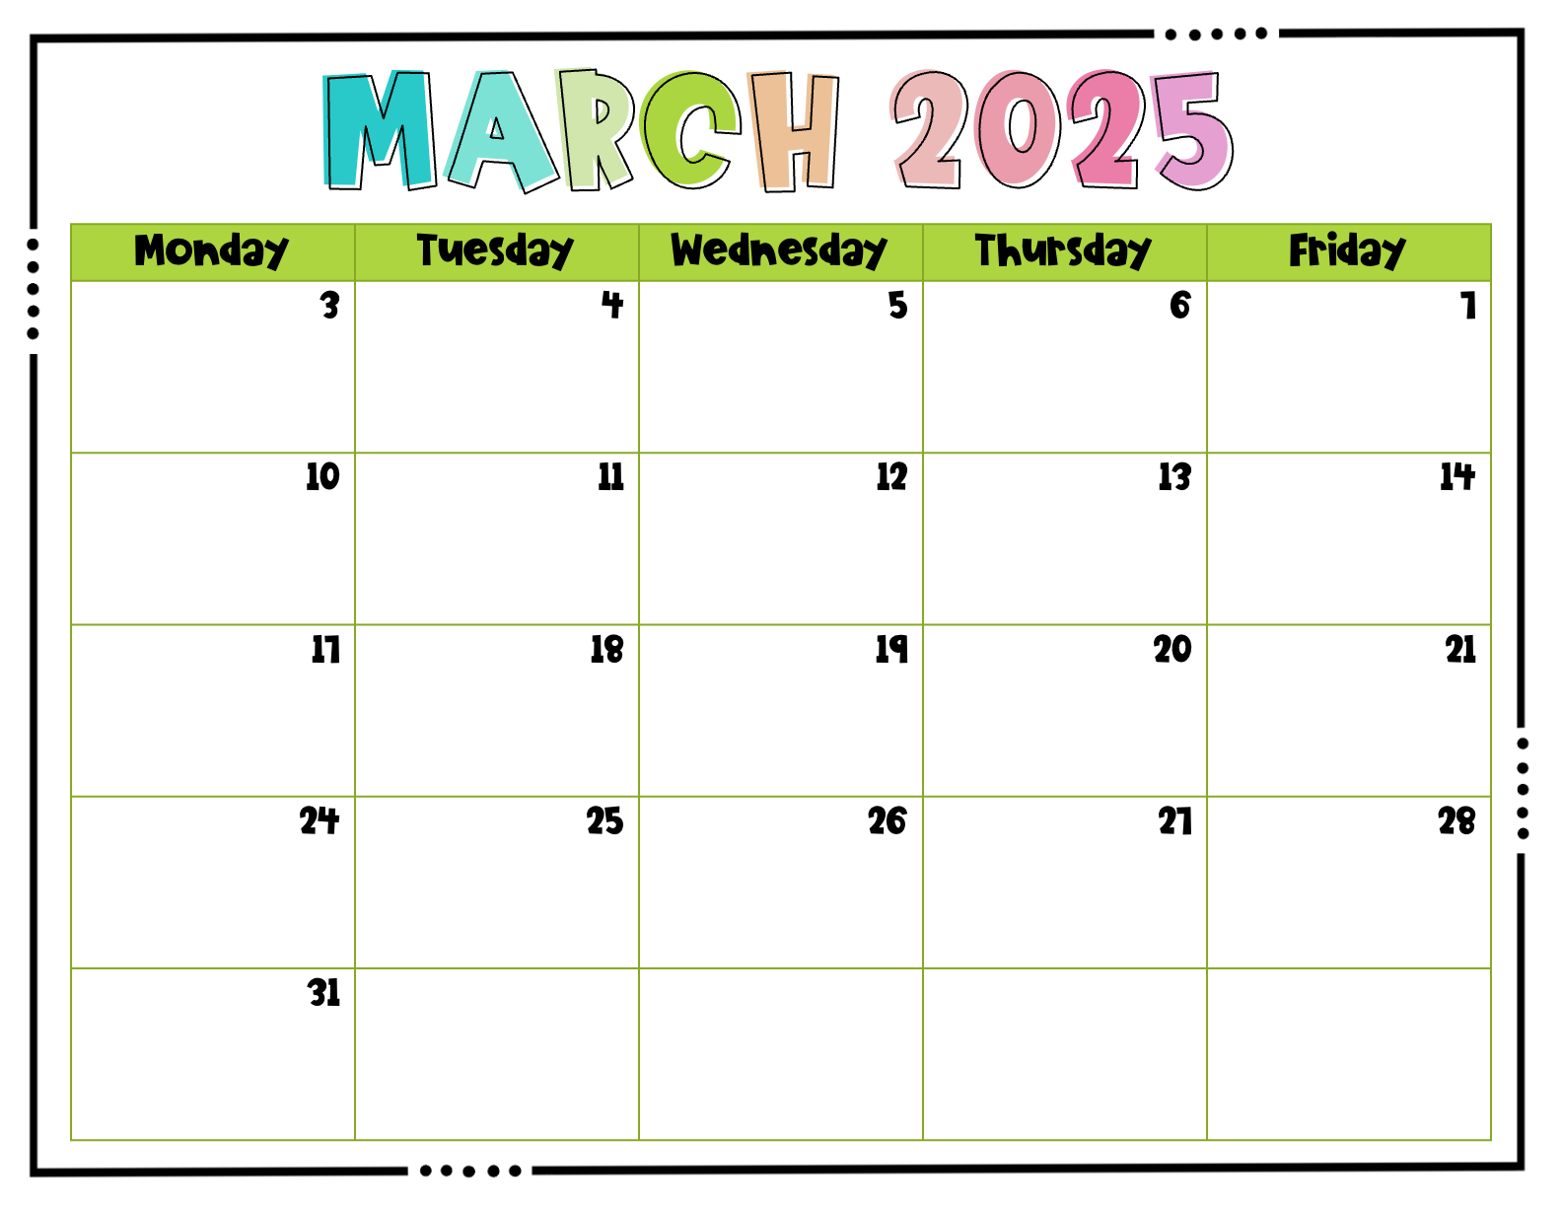
Leo R. | Caroline | Leo V. | Ayla | Evie
SPRING BREAK | SPRING BREAK | SPRING BREAK | SPRING BREAK | SPRING BREAK
Wells | Cora | Camille | Marlei | Ehab
Ben | Addi | Kayleigh | Elizabeth | Carter
Caison

Slide 9
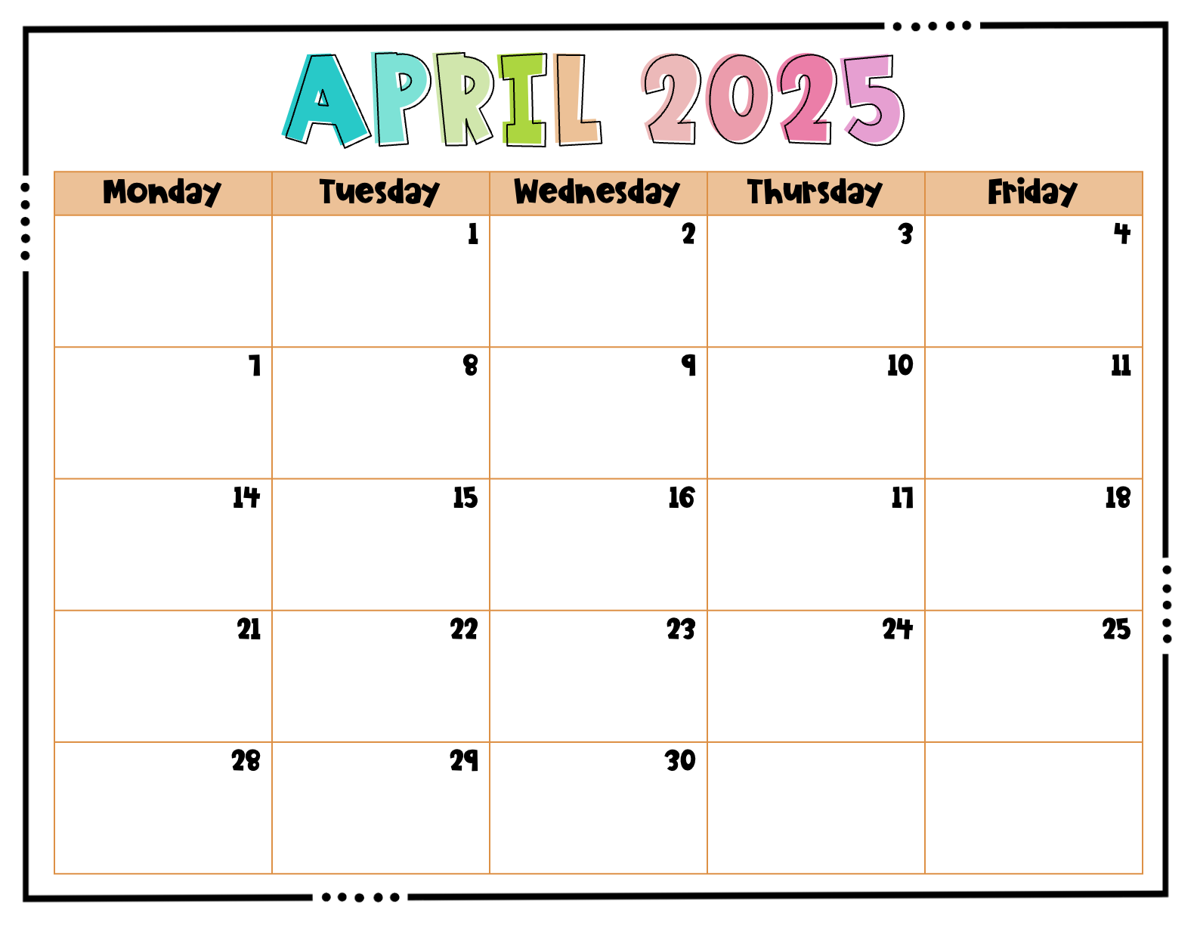
 | Myron | Karlee | Victoria | Jane
Josiah | Leo R. | Caroline | Leo V. | Ayla
Evie | Wells | Cora | Camille | Good Friday – No school
Marlei | Ehab | Ben | Addi | Kayleigh
Elizabeth | Carter | Caison

Slide 10
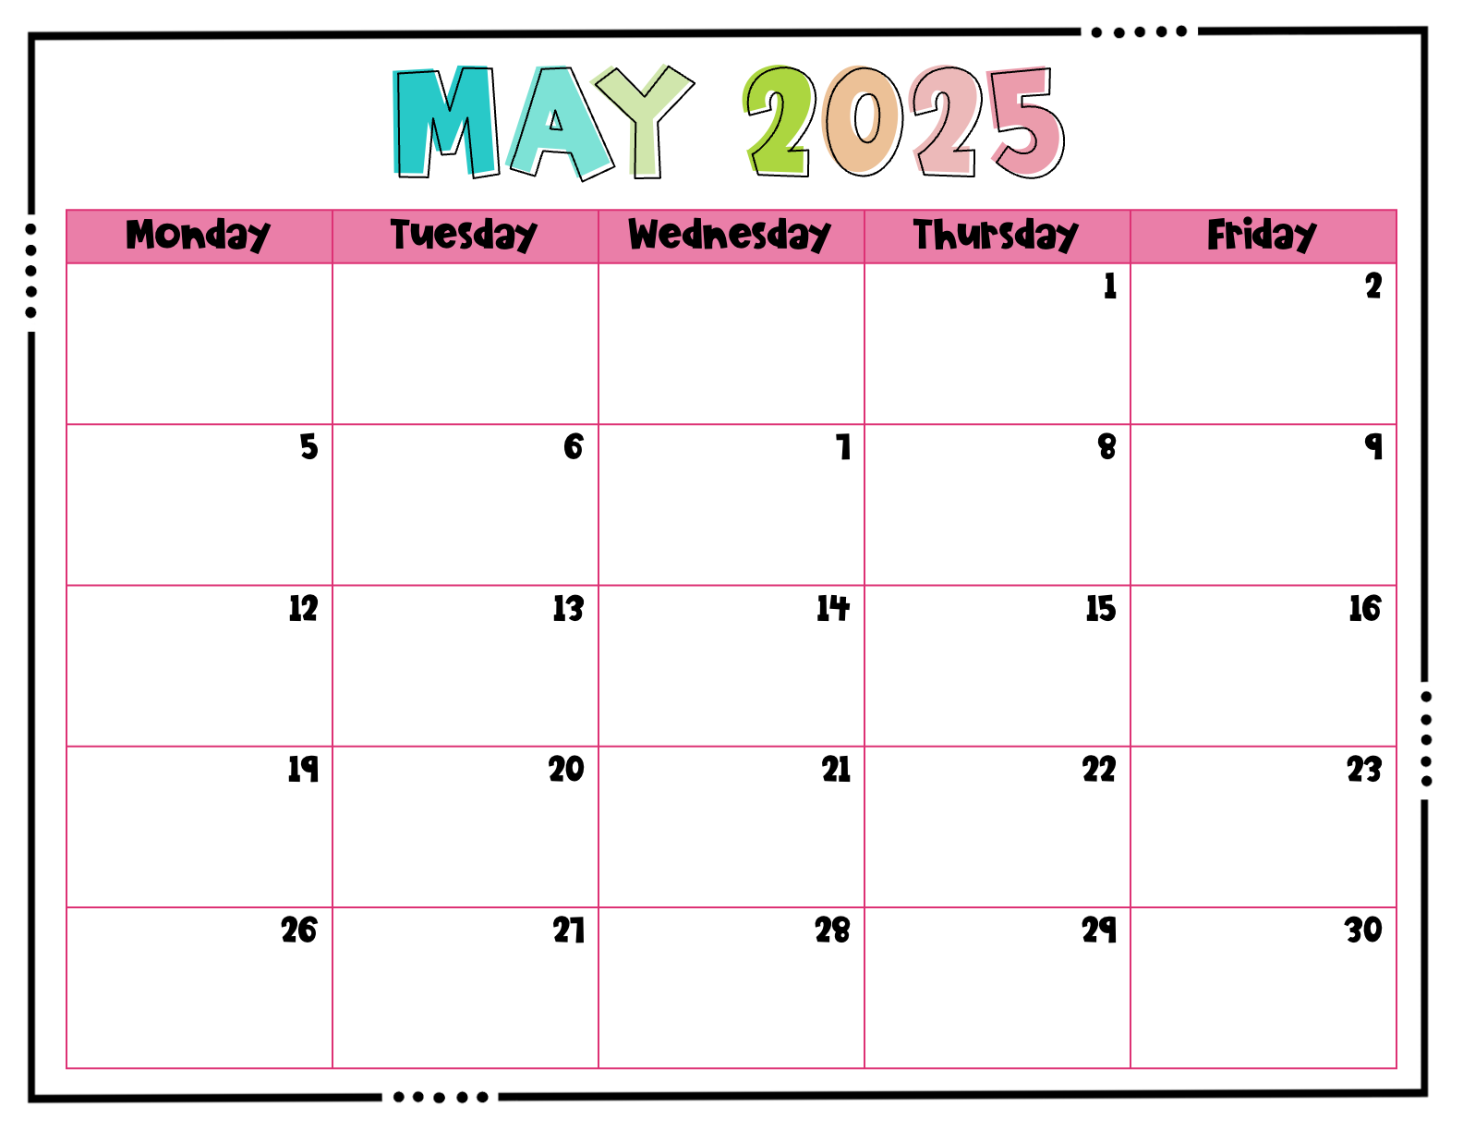
 |  |  | Myron | Karlee
Victoria | Jane | Josiah | Leo R. | Caroline
Leo V. | Ayla | Evie | Wells | Cora
Camille | Marlei | Ehab | Ben | Last Day of School Party

