Slide 1


Slide 2

Agenda
• Meet the Teacher
• Class Schedule
• Class Expectations
• Boost
• Grading and ”Wednesday Folders
• Questions

Slide 3

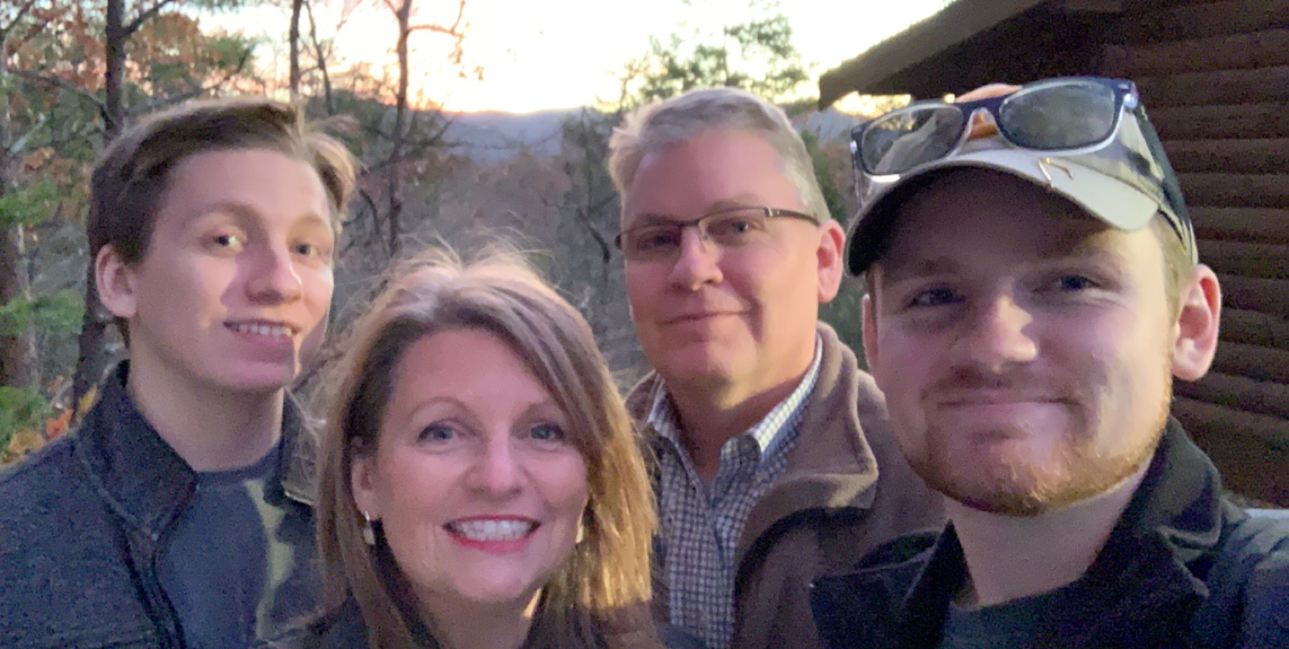
Mrs. Katherine Reed
Best Email Address
mrskreed505@gmail.com
ELA /Sci/- Mrs. Reed –reedka@scsk12.org
Math/Soc. St. - Mrs. McClusky
–mccluskya@scsk12.org

Slide 4
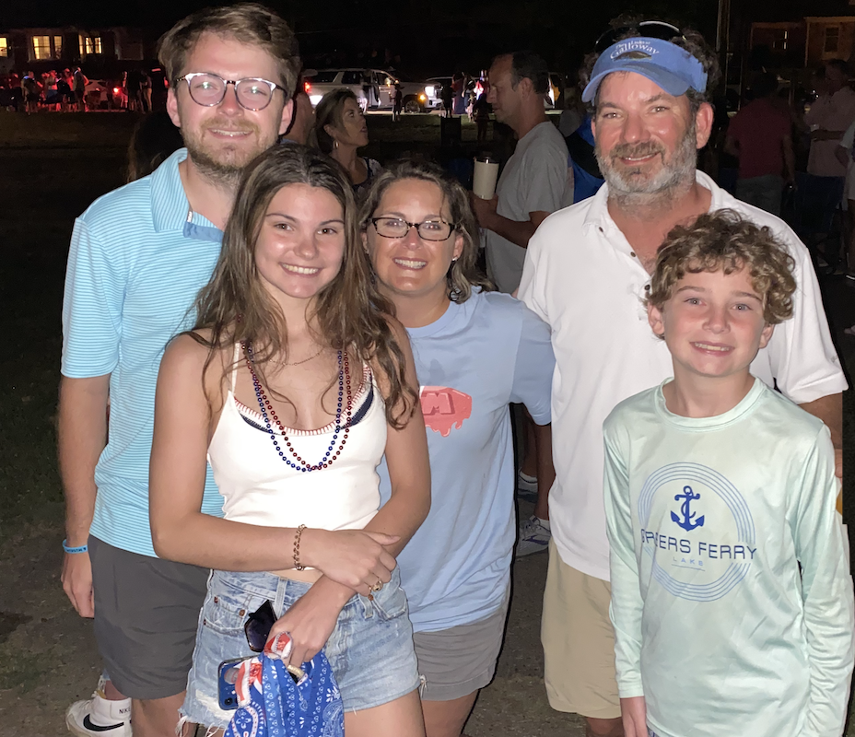
Mrs. Angela McClusky
Email Address
mccluskya@scsk12.org
Math/Social Studies Mrs. McClusky
ELA/Science- Mrs. Reed
Notes:
3 kids ages 23, 16 and 10 Charlie use to attend school here

Slide 5
Binders
This is a great place for students to keep everything organized.
agenda book-coming soon
homework
pencil pouch
study guides
blank paper
assignments
passwords-log in information
class schedule

Slide 6

5th Grade
8:15-8:25 | Homeroom
8:30-9:20 | Encore
9:20-10:00 | Boost*
10:00-11:40 | Block 1
11:45-12:15 | Lunch
12:20-1:45 | Block 2
1:45-2:05 | Recess
2:10-3:10 | Block 3

Slide 7
Boost
This is a 45 minute period during which your child will receive differentiated instruction.
It is designed to create growth for all students.
Students will rotate between teachers to receive intervention or enrichment in ELA or Math.

Slide 8

Grading Scale
A- 90-100 Test grades count 45%
B- 80-89 Daily Grades count 40 %
C- 70-79 Homework –5 %
D- 60-69 Projects—5%
F- Below 60 Participation 5%

Slide 9
Grading EXPECTATIONS
* For every day you are absent you will receive a day to allow make up assignments.
Example: absent 2 days, assignments will be due two days after the absence.
* Late work, excluding absences, will be marked with zeros until it is turned in.
10 points will be deducted per day until the assignment is turned in. Math study guides can not be turned in late. No exceptions.
* Starting second semester 20 points will be deducted for late work per day.

Slide 10

Homework
Expectations
Mon. -Science or Soc. Studies
Tues.- Math
Wed.-ELA (Common Lit. Com)
Thurs.-study for weekly tests
If classwork isn't completed,
it may be assigned for homework.

Slide 11
Homework
• Math homework will consist of IXL skill practice. Students will need to practice assigned skills for 15 minutes with 80% mastery or higher.
Students who do not finish classwork will need to complete it for homework that night

Slide 12
Positive Attitude
Character Pledge
Fabulous Four
• A- act safely
• B- be responsible and respectful
• C- care for yourself, others and the environment
• D- do your best at all times

Slide 13
“Wednesday Folders”
Wednesday folders will go home weekly. You may also log in to Power School often to check your child’s grades.

Slide 14
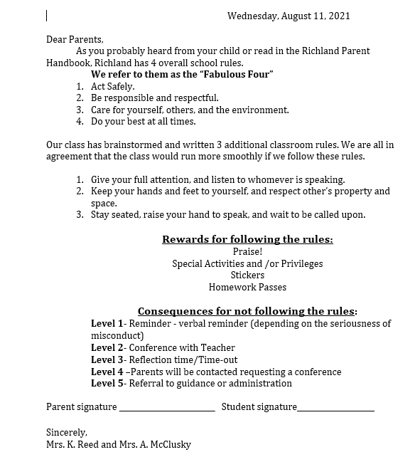

Slide 15
Weekly Conduct
E
G
S
N
U

Slide 16
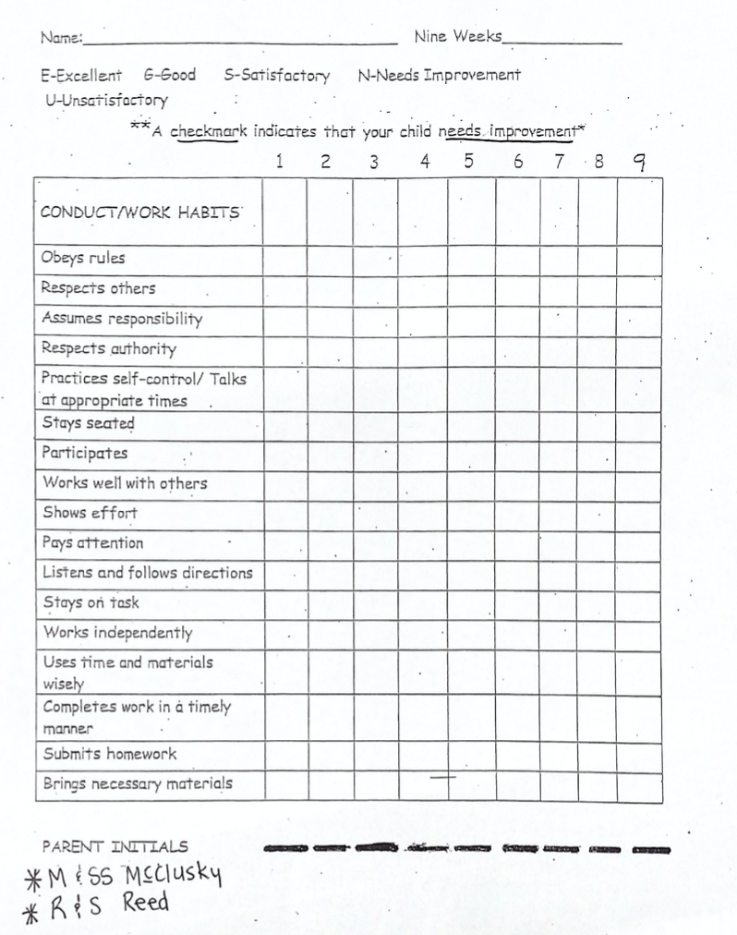
“Wednesday Folders”
Conduct /Behavior

Slide 17

All students will need to bring their devices and chargers to school everyday.
Please charge devices nightly.

Slide 18

We will provide a weekly update on the Richland website. Click on your homeroom teachers page and you can view our combined weekly update.

Slide 19

We will be taking 3 I-ready test throughout the school year.
TNREADY will be given at the end of April.
Please contact your chosen middle school to determine what test and cut score they are using for admission.
Also remember, some schools only accept one "B" on a student's 5th grade transcript.

Slide 20

9/8 Parent/Teacher Conference 3:30-6:30
(Teacher Selected Conferences only)
2/16 Parent/Teacher Conference 3:30-6:30
You will be able to sign up through
Sign Up Genius
***Conferences can be scheduled as needed through the year. Contact the teacher directly to schedule.

Slide 21

We will have field trips this year. One in town and one out of town. Chaperones for the out-of-town trip must have a current 2022, Level 3 background check.

Slide 22

Each class will need two parents to be our room parents.
Duties: Parents will help with class parties and activities throughout the year.
Note went home yesterday.

Slide 23
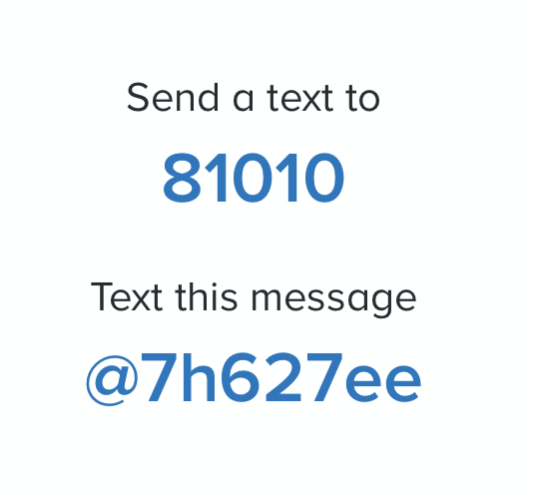
Remind App for
Mrs. Reed
@b633c4

Slide 24
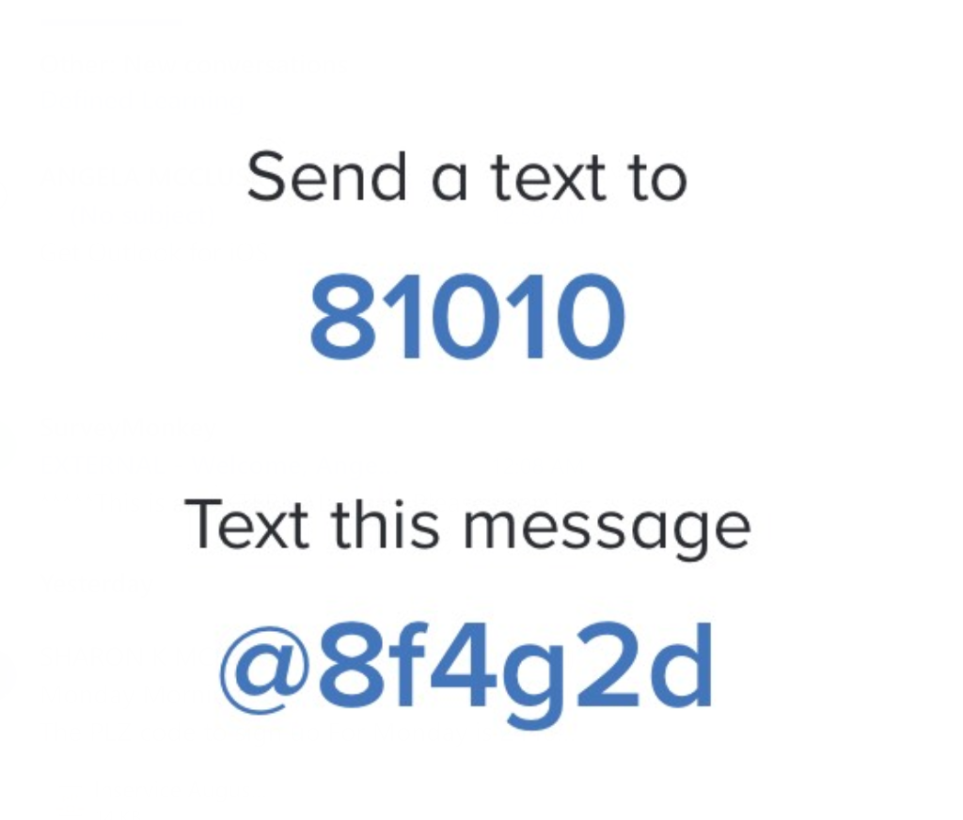
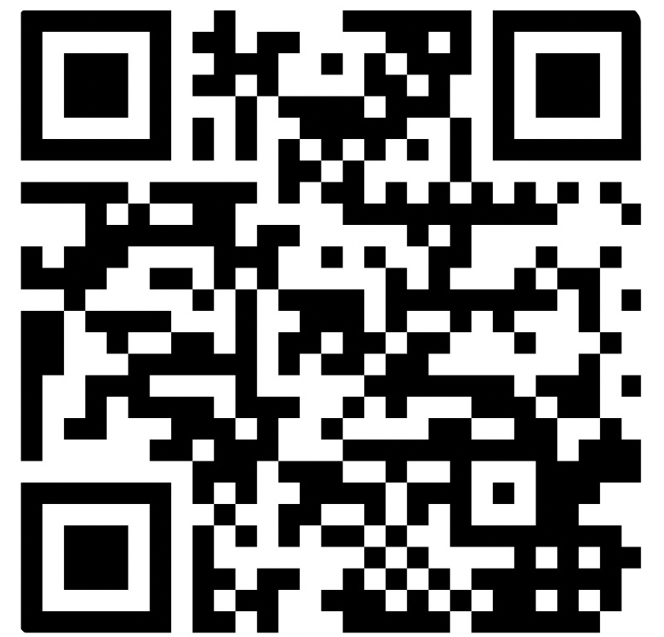
Remind App for
Mrs. McClusky

Slide 25


Slide 26


