Slide 1

Annual Title 1 Parent Meeting
Wednesday, August 14, 2024 @ 4:45 pm
Thursday, August 15, 2024 @ 9:30 am
Dr. Isaac Robinson, Principal
Kevin Jordan, Dean of Students
Denise Robinson, PLC Coach
RBM…..A Place to Soar

Slide 2
Meeting Agenda Items
Welcome & Opening
Dr. Isaac Robinson, Principal
Meeting Purpose
ESSA & Title I Status
24-25 Family Engagement Plan
24-25 School Home Compact
District & School’s Progress/Status
Q & A
Thanks & Closing
Denise Robinson, Professional Learning Coach
Kevin Jordan, Dean of Students
Teacher Meet and Greet will follow the 8/14/2024 Title I Meeting

Slide 3
Meeting Purpose
As a result of this meeting, you should have a clear understanding of the following:
Title I Program Requirements
  Family Engagement Policy
  Reporting Pupil Progress
  Parental Involvement
  Availability of Parent Training
  District/School Progress
  Opportunities for Additional Parent Meetings
  Teacher Qualifications
  Parents’ Right to Know
  Notice of Title I School Status
  School/Parent Compact
  Student Code of Conduct
Each school served under Title 1, Part A must convene an annual meeting, at a time convenient for families, to inform them of their school’s participation in Title 1 programs and to explain the Title 1 requirements and the right of families to be involved in those programs. Schools must invite and encourage all families of children participating in Title 1, Part A programs to attend the annual meeting. [P.L. 114-95, Section 1116 (c)(1) and (2)].

Slide 4

RBM’s Parental Involvement/Family Engagement Mission/Vision
Mission
Empower parents and families to support their children’s cognitive and social-emotional development
Create community partnerships through support and training
Vision
To ensure that students become productive and responsible citizens by working collaboratively and cooperatively to increase and strengthen family and school partnerships.

Slide 5
Family Engagement Plan
Shelby County Schools’ Family Engagement Policy speaks to the following goals:
  To provide meaningful two-way communications
  To provide meaningful and varied participation by families to support student achievement
  To eliminate or reduce barriers to greater family participation
  To provide training opportunities and informational seminars for families

Slide 6
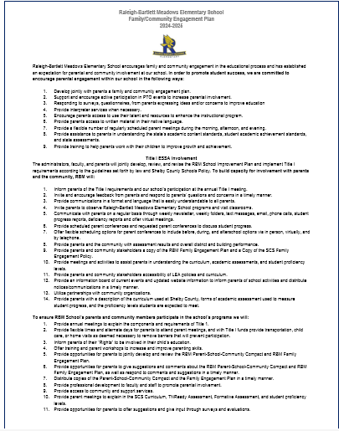
Family Engagement Plan
A copy is listed on our website
Copies are available here today
Copies are available in the Parent Resource Room
Copies also available in Spanish. Other languages can be translated upon request.

Slide 7
How Do We Report Pupil Progress?
PowerSchool (Parent-Connect)-parents can log in at any time for updates in your PowerSchool account.
Class Media Outlets
Parent-Teacher Conference
  September 5, 2024 (4-7pm)
  February 13, 2025 (4-7pm)
  Parents may request conferences at anytime
Quarterly Progress Report
End of Nine-Week Report Card

Slide 8
Parental Involvement Requirements
Develop a plan jointly with parents
Notify parents of the policy in a uniformed format provided in a language parents can understand
Made available to local community and updated periodically to the changing needs of the parents and school
Invitation to the Annual Title I Parent Meeting
Opportunities for regular meetings relating to students’ education
Provide opportunities to assist parents with helping their children to improve student learning and achievement

Slide 9
Opportunities for Parental Involvement and Family Engagement
Annual Title I Parent Meeting
Data Night Meetings
Muffins with Moms
Donuts with Dads
Project Showcase Nights
Family STEM (Science, Technology, Engineer, and Math) Night
Help with homework or utilize the Homework Help Hotline
Communicate effectively with teachers
Ensure students are present and on time to school every day (if not ill)

Slide 10
How Do We Communicate with Our Stakeholders
School’s Website
Flyers (when in the building)
School Messenger (phone text)
Virtual Teacher Newsletters
Class Media Outlets (Class Dojo, Classtag, Remind.com)
Emails and phone calls
Social media sites:
  Like us on Facebook: https://facebook.com/RBMFalcons
  Follow us on Instagram: @RBMFalcons

Slide 11
Parent Training
Additional Annual Title 1 Meeting Thursday, August 15, 2024 @ 9:30
Various parent training/workshops will be held throughout school year
Parent conducted training for staff (TBA)
Pre-recorded parent training materials uploaded to school website on a variety of topics.
Parent training literature available in Parent Resource Room

Slide 12

RBM’s Progress and Status
Where do we stand with the state’s tnready 2024?

Slide 13
2024 TNReady Data
 | 2023 | 2024
ELA | 17.8% | 14.8%
Math | 12.9% | 9.3%
Science | 23.2% | 17.6%

Slide 14
2025 TNReady Goals
 | AMO | Double AMO
ELA | 20.0% | 23.0%
Math | 15.0% | 18.0%
Science | 23.0% | 29.0%

Slide 15

School Improvement Plan

Slide 16
School Improvement Plan
The school improvement plan is an indepth data analysis that includes a review of early literacy, reading and math performance and student attendance, and behavior. The data is analyzed and reviewed to determine areas that impacted student learning and overall performance.
The 2023-2024 document can be found on our school website.
The new 2024-2025 plan is being prepared for submission for approval by the TDOE.

Slide 17
Teacher Qualifications
Many of our teachers at Raleigh-Bartlett Meadows Elementary are highly qualified as mandated by section 1119 of ESSA (Every Student Succeeds Act)
A teacher’s highly qualified status is public record and may be accessed on the TN Department of Education website: www.tn.gov
Some teachers have permits and they are completing requirements necessary to gain highly qualified status.

Slide 18
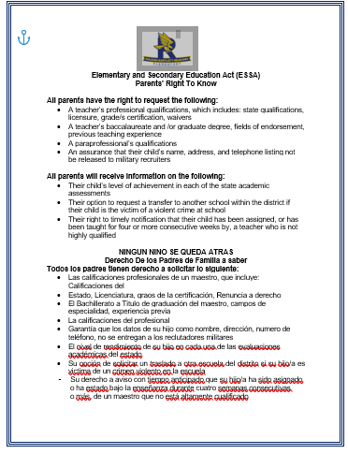
Parents Right to Know
This document can be found on our school website.
There are copies available here today.
Copies are available in our Parent Resource Room.

Slide 19
Parent’s Right to Know
All parents have the right to request the following:
Teacher’s professional qualification, licensure, grade certification, waivers
Highly qualified status
Paraprofessional’s qualification
Notice of Student Education Records Privacy/Disclosure of School Directory Information
Assurance that your child’s name, address and telephone listing will not be released to military recruiters
Child’s level of achievement on TNReady
Right to transfer to another school in the district if the child becomes a victim of violence, or is assigned to an unsafe school
District Family Engagement/Parent Involvement Policy
Right to public school choice, supplemental educational services, and more effective involvement if their child’s school is identified for school improvement.

Slide 20
What is ESSA?
The Every Student Succeeds Act (ESSA) is the newest federal legislation to address the need for consistent and measurable support for all American school children. This act maintains the federal government’s deep-rooted support for fair and equal opportunity for all students and supports the Elementary and Secondary Education Act (ESEA).

Slide 21
Notice of Raleigh Bartlett Meadows’ School Status
Title I School
Because we have a high percentage of economically disadvantaged students, we receive funds from the United States Department of Education.
These funds allow us to be in compliance with ESSA to provide support and equal opportunity for all students.

Slide 22
How are Title I Funds Used?
Identify students who are experiencing academic difficulties
Provide timely assistance to help students master the challenging and more rigorous TN State standards.
Purchase supplemental programs, materials, and supplies
Conduct parental involvement activities and meetings
Recruit, hire, and retain highly qualified teachers
PLC Coach’s salary
1 Teacher’s Assistant salary
1 School Interventionist’s salary

Slide 23
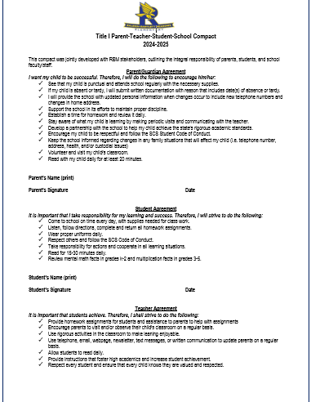
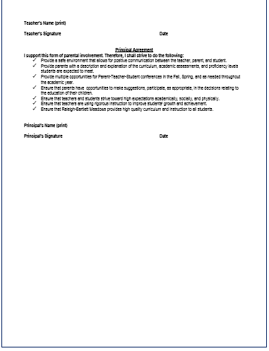
2024-2025 School Home Compact
Copies are provided here today for your signatures.
It is posted on our website.
Additional copies are located in the Parent Resource Room.
Copies also available in Spanish. Other languages can be translated upon request.

Slide 24
SCS Student Code of Conduct
In accordance with the SCS Student Conduct Policy #6022, the Code of Conduct speaks to the shared responsibility of children’s conduct by the:
  District/School
  Parent
  Student
  Self-discipline being the long-term goal for all SCS students
  Gives notice of infractions as well as strategies and/or disciplinary measures for levels of offenses
May be located in the Student Handbook located on the District Website: www.scs.k12.org
and the RBM School’s website: https://schools.scsk12.org/raleighbartlett-es/

Slide 25


Questions?

Slide 26


Join Us on
Social Media
Like us on Facebook @RBMFalcons
Follow us on Instagram
@RBMFalcons
RBM Falcons are FOCUSED!

Slide 27


