Slide 1

LESSON PLAN SEPT 3 - 6

Slide 2
DO NOW:
ON A SHEET OF PAPER WHAT IS SOMETHING YOU LEARNED FROM THE LESSON LAST WEEK?

Slide 3
AGENDA OF THE DAY:
Do Now List of motives(8min)
Review Learning Objective (5 minutes)
Item 3 Share (10min)
Item 4 introduction (10min
Item 5 Evaluate(5min)
Item 6 close(8min)

Slide 4
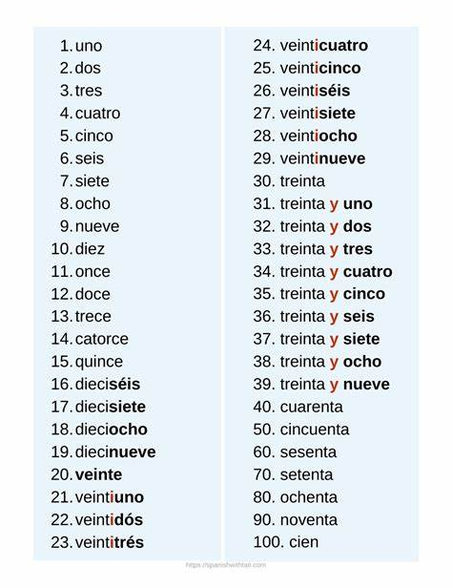
I DO:

Slide 5
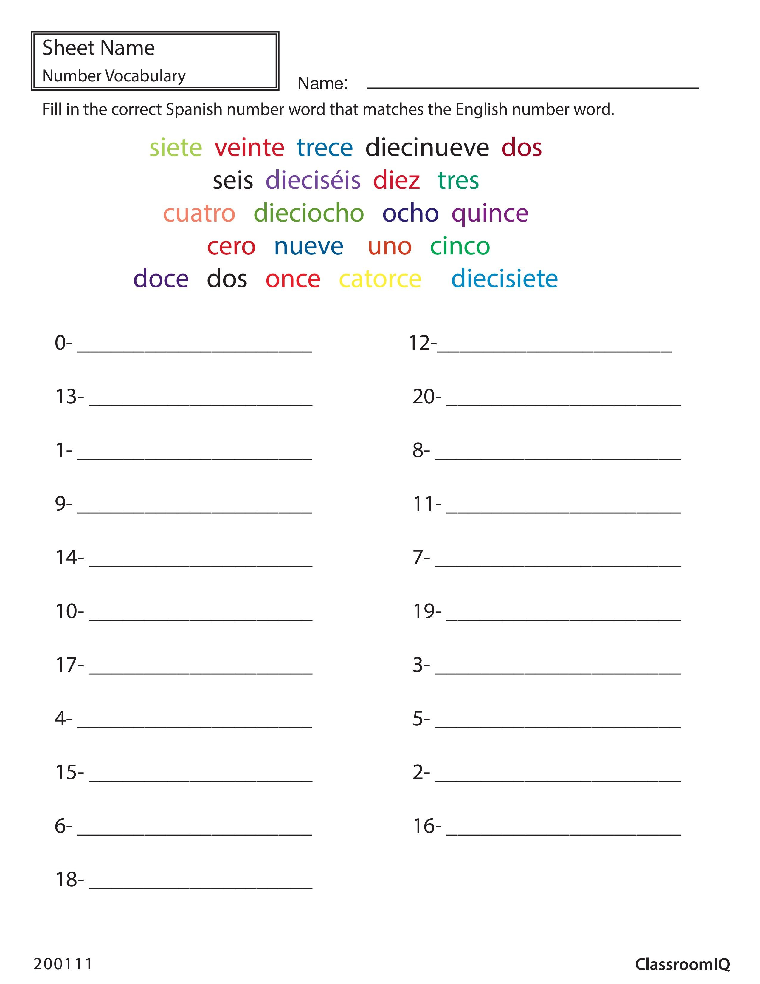
We do:

Slide 6
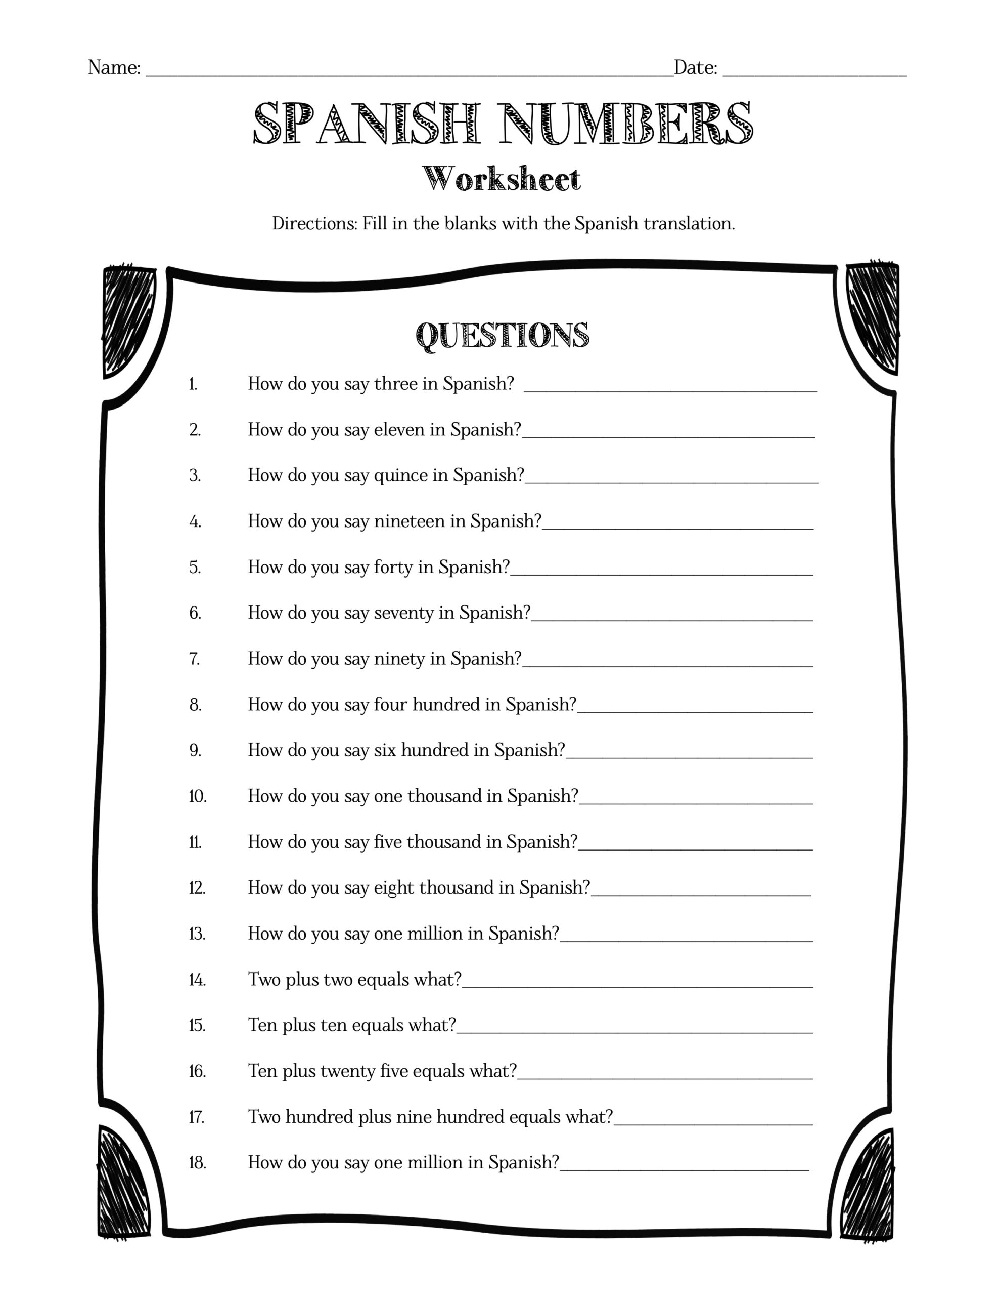
You do:

Slide 7
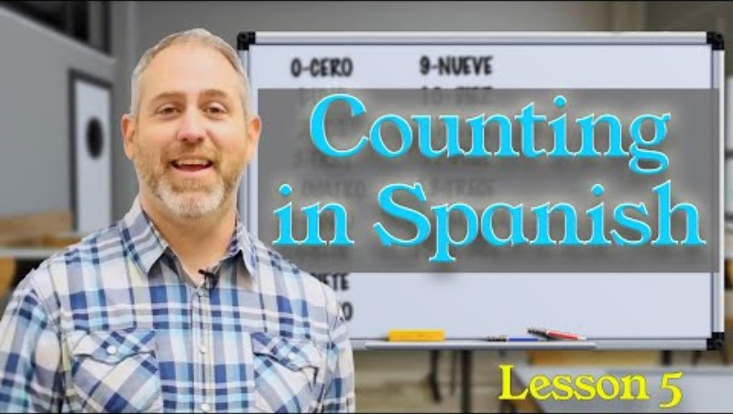
Exit ticket:

Slide 8
DO NOW:
ON A SHEET OF PAPER WHAT IS SOMETHING YOU LEARNED FROM THE LESSON YESTERDAY?

Slide 9
AGENDA OF THE DAY:
Do Now List of motives(8min)
Review Learning Objective (5 minutes)
Item 3 Share (10min)
Item 4 introduction (10min
Item 5 Evaluate(5min)
Item 6 close(8min)

Slide 10
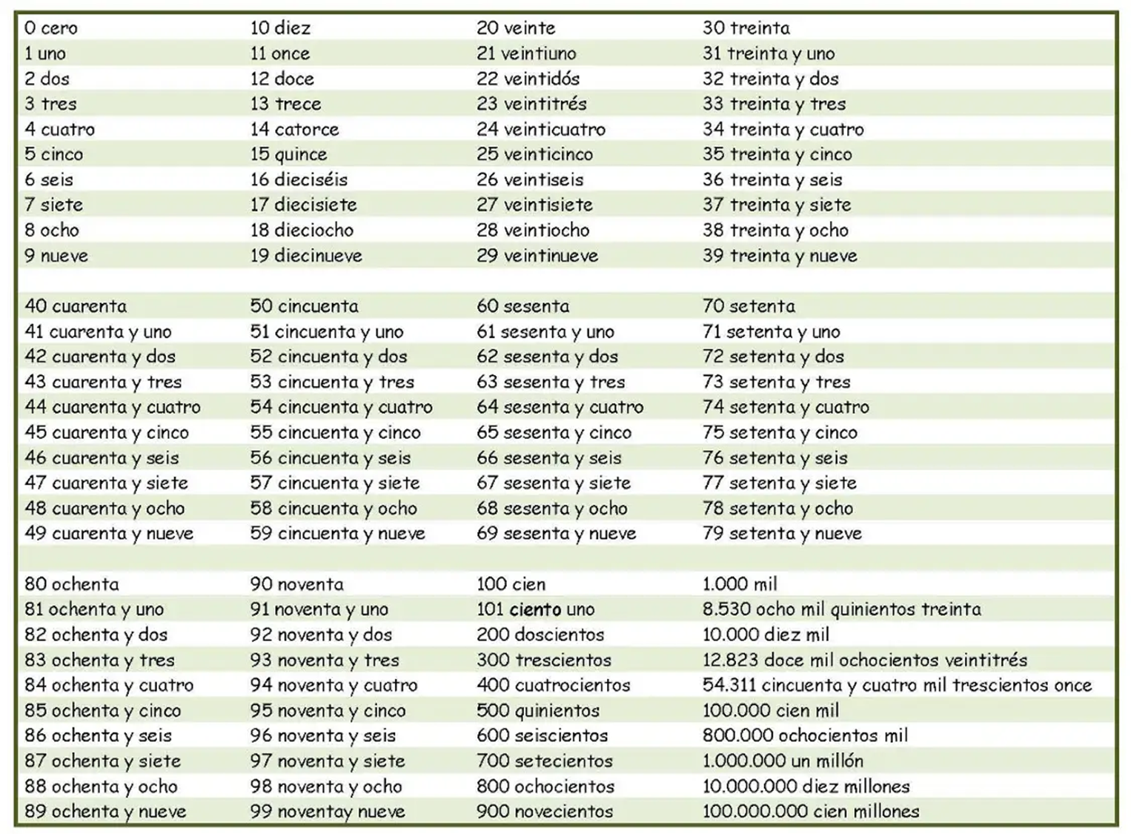
I DO:

Slide 11
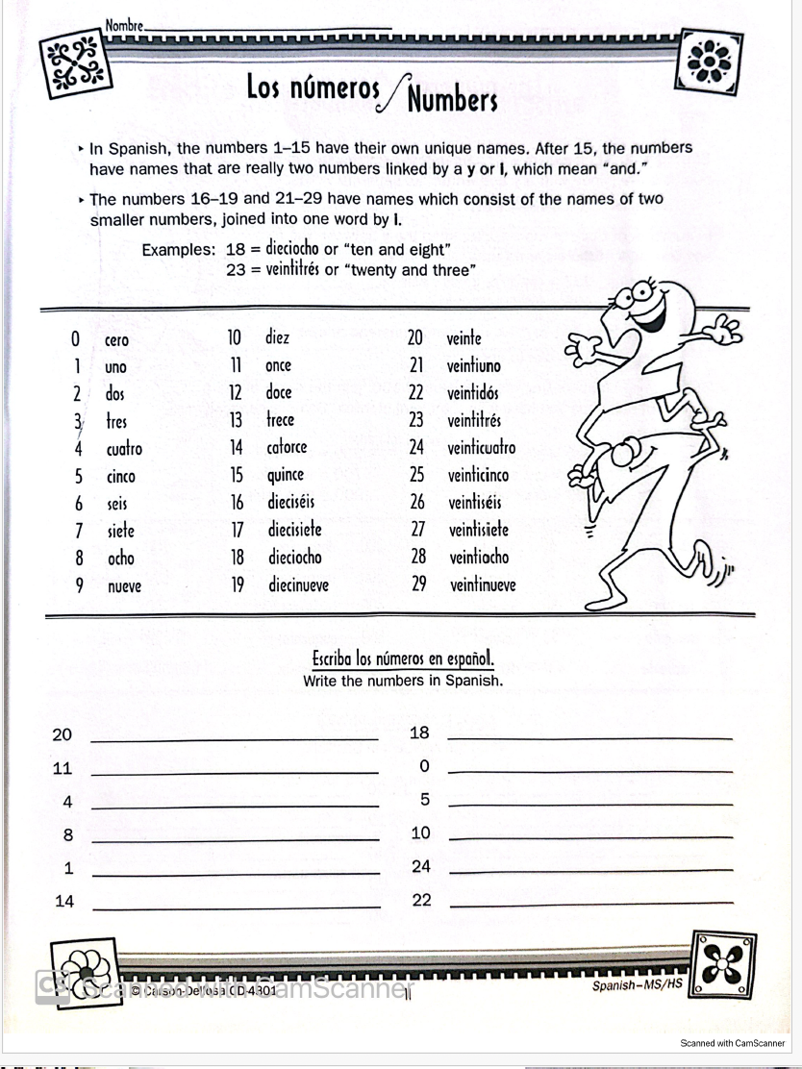
We do:

Slide 12
You do:
On a piece of paper write as many numbers as possible in Spanish on your own

Slide 13
Exit ticket:
NO exit ticket today quietly chill till the end of class!

Slide 14
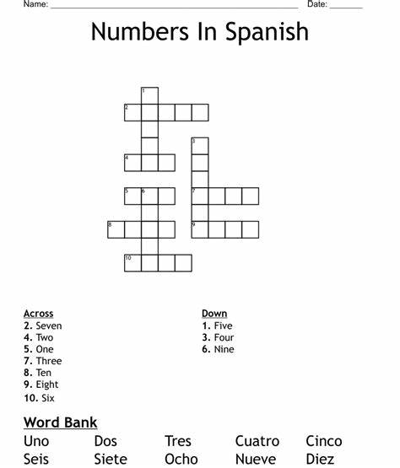
DO NOW:

Slide 15
Do now:
No do now test day

Slide 16
AGENDA OF THE DAY:
Do Now List of motives(8min)
Review Learning Objective (5 minutes)
Item 3 Share (10min)
Item 4 introduction (10min
Item 5 Evaluate(5min)
Item 6 close(8min)

Slide 17
I DO:

Slide 18

STUDY THESE NUMBERS BEFORE THE TEST!!

Slide 19
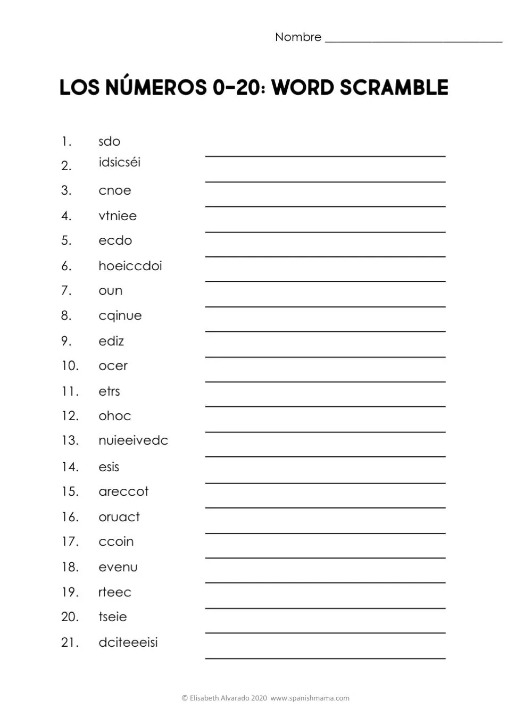
YOU DO: TEST
TRY YOUR BEST!!! THE NUMBERS ARE NOT IN ORDER

Slide 20
Exit ticket:
NO exit ticket today quietly chill till the end of class!

Slide 21
DO NOW:
ON A SHEET OF PAPER WHAT IS SOMETHING YOU LEARNED FROM THE LESSON YESTERDAY?

Slide 22
AGENDA OF THE DAY:
Do Now List of motives(8min)
Review Learning Objective (5 minutes)
Item 3 Share (10min)
Item 4 introduction (10min
Item 5 Evaluate(5min)
Item 6 close(8min)

Slide 23
I DO:

Slide 24
We do:
One by one each one of you all are going to count in Spanish up until you can’t anymore

Slide 25
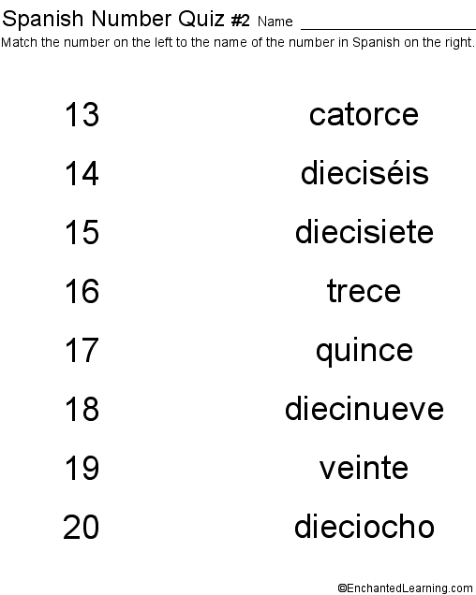
You do:

Slide 26
Exit ticket:
NO exit ticket today quietly chill till the end of class!

