Slide 1
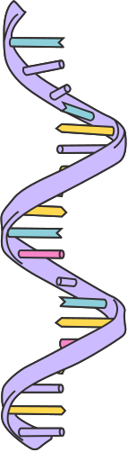
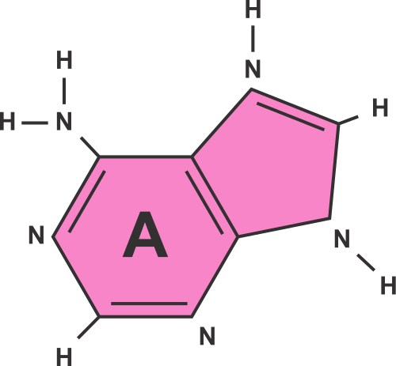
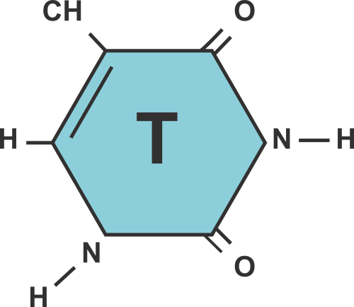
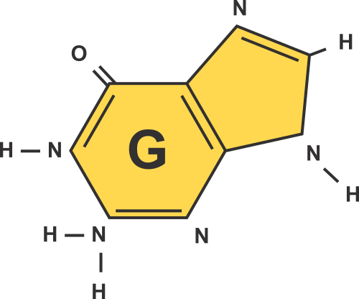
PHOTOSYNTHESIS
Cellular Energyy and Processes

Slide 2
ESSENTIAL
QUESTIONS
At the end of this lesson, you will be able to answer:
1
What is the function of ATP?
How is energy transferred from light energy into stored energy in the cell?
2
3
What factors affect photosynthesis?
4
How is it possible for trees to grow and get heavier, given that they are not consuming matter by eating other organisms?

Slide 3
QUICK RECALL:
  Energy is the ability to do work ( lights, to run, to grow, computers, etc)
  Different forms: light, heat, and electrical
  Energy is stored in bonds for all livinng things.
    Metabolism is when we break down chemical bonds from the food we eat to make energy

Slide 4
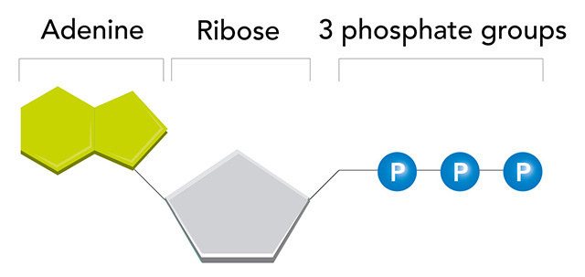
ADENOSINE TRIPHOSPHATE (ATP)
  Energy is stored in the bonds between the phosphate groups
  It takes energy to add a phosphate and energy is released when a phosphate group is broken off
  ATP can release and store energy by breaking and reforming P-groups

Slide 5

HOW IS ATP USED
1
2
3
TO SUPPLY ENERGY TO MOVE MUSCLES, AND BLOOD CIRCULATION
ACTIVE TRANSPORT
ALLOW CELLS TO MOVE/ FUNCTION

Slide 6
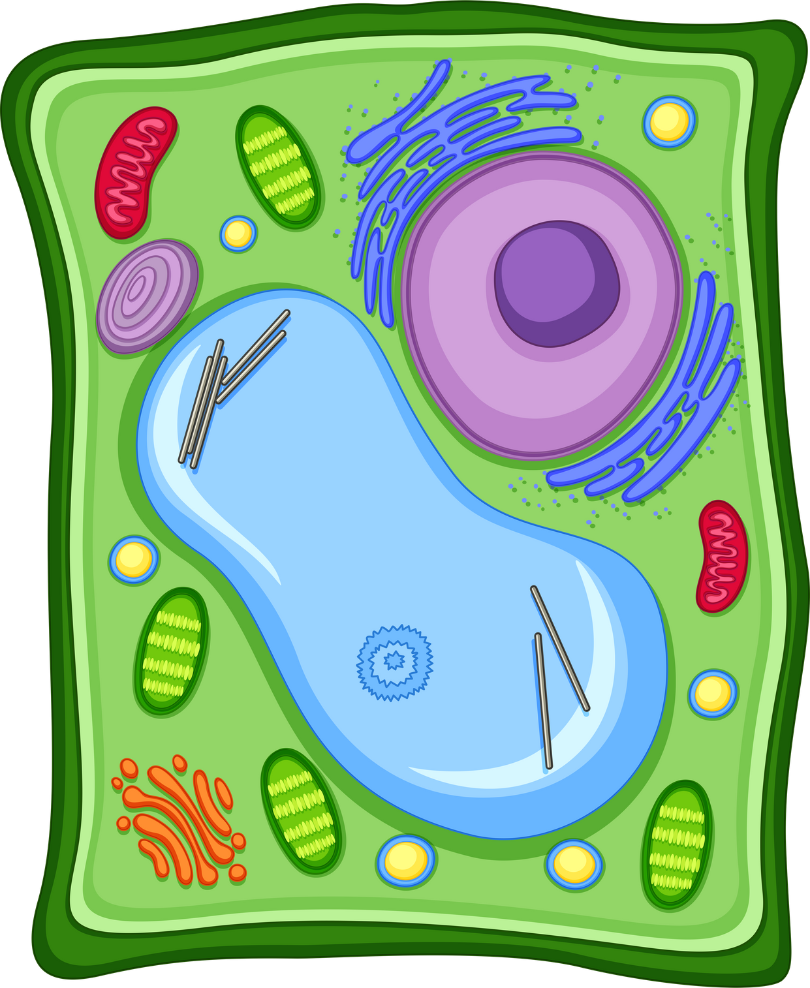
PHOTOSYNTHESIS:
  Photosynthesis: process of converting the energy of sunlight into chemical energy stored in the bonds of carbohydrates
  happens in the chloroplasts of plant cells

Slide 7
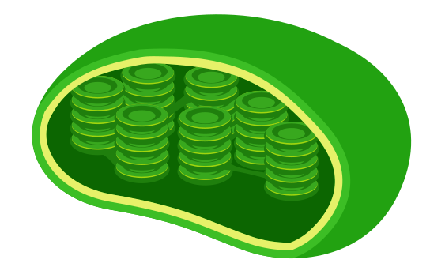
PIGMENTS AND CHLROROPHYLL:
  Plants use pigments to capture the energy in sunlight.
  Pigment: a molecule that absorbs light
  Chlorophyll: the main pigment involved in photosynthesis
    it absorbs blue and red light but reflects green, which is why plants are green
    found in thylakoid membrane
[
Thylakoid
Granum

Slide 8
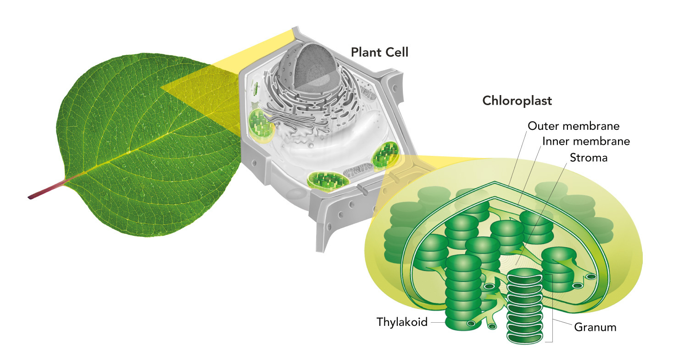
PHOTOSYNTHESIS OCCURS IN..
  Thylakoid: disc-shaped plates inside the chloroplasts, where light dependent reactions occur.
  Stroma: fluid filled space where light-independent reactions occur

Slide 9
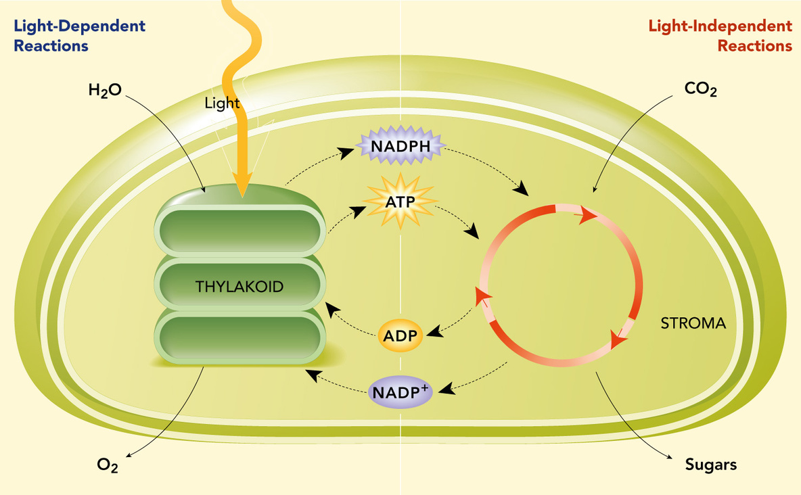
PHOTOSYNTHESIS:
  happens in 2 stages: Light-dependent and light independent (Calvin Cycle).

Slide 10
LIGHT DEPENDENT REACTIONS:
https://youtu.be/SltE4zP8-9w?si=exX7TKHJWRaQrOI9
  uses energy from sunlight to create ATP and NADPH
  Happens in thylakoid membrane
  uses an electron transport chain(ETC) made of proteins to create a high concentration of hydrogen

Slide 11
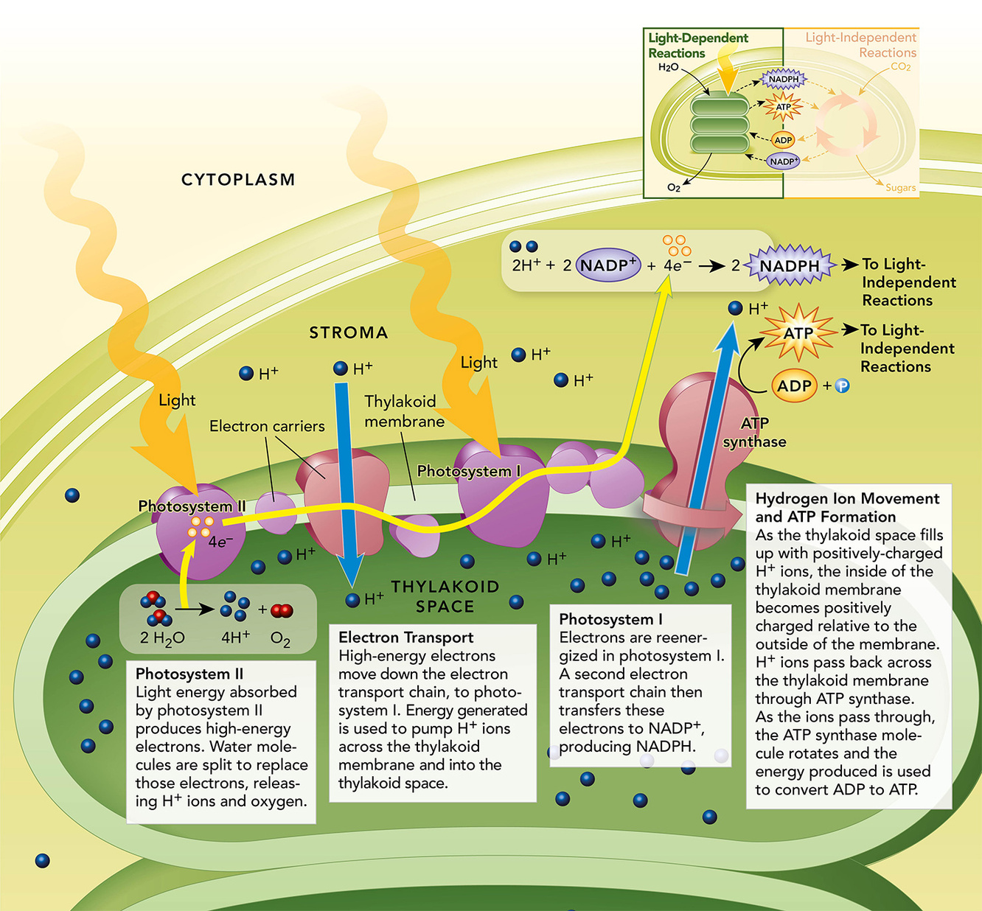

Slide 12
LIGHT INDEPENDENT REACTIONS
  also called “Dark Reactions” or Calvin cycle
  In the Calvin cycle, ATP and NADPH from the light dependent reactions are used to synthesize high-energy sugars for the plant to use.
  occurs in the stroma

Slide 13
LIGHT INDEPENDENT REACTIONS
  Key Idea: The Calvin cycle is like a factory that takes in carbon dioxide, and using energy (ATP and NADPH from light dependent reactions) turns it into sugar.
    Step 1: Carbon dioxide combines with a molecule called RuBP to form two 3-carbon molecules
    Step 2: The new molecule is reformed using ATP and NADPH (this reaction required energy)
    Step 3: Some molecules are used to make energy/ food for the plant

Slide 14
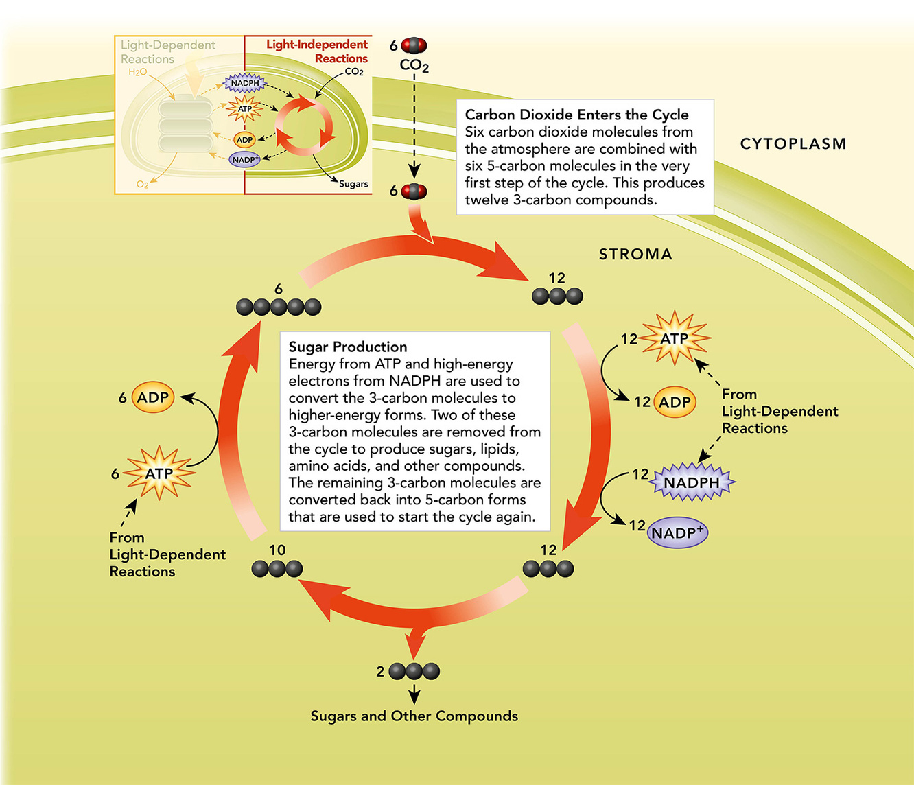
LIGHT INDEPENDENT RXNS

Slide 15
PHOTOSYNTHESIS:
  6CO2​+6H2​O+lightenergy→C6​H12​O6​+6O2​
    carbon dioxide(from the air) water (from the soil) and sunlight come together into the thylakoid.
    oxygen is released in the air. NADPH and ATP is released in the stroma
    Carbon dioxide from the air is reformed by enzymes, ATP, and NADPH to make glucose and other sugars for the plant to use.

Slide 16
VIDEO: GUIDED NOTES

