Slide 1
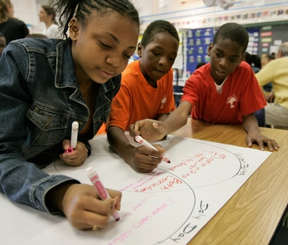
RTI2 Behavior Implementation Manual Overview
JULY
31,
2019
LaRose Elementary School

Slide 2
KUDOS
KNOW
Teachers will know and become familiar with the LaRose’s RTI2-B/PBIS Implementation Plan and 2019-2020 climate and culture expectations.
UNDERSTAND
Teachers will understand the importance of RTI2-B/PBIS and how it will drive and influence the daily climate and culture of LaRose Elementary.
DO
Teachers will modify specific RTI2-B/PBIS expectations to align with the desired culture and climate for the 2019-2020 academic school year.

Slide 3
What Is RTI2-B?
Response to Instruction and Intervention-Behavior (RTI²-B) is a Multi-Tiered System of Supports (MTSS) that offers a powerful, evidence-based approach for meeting the behavioral and social needs of students in Tennessee schools.
RTI²-B is a promising framework for prevention and intervention within an integrated, three-tiered approach. Each tier of the framework involves careful reflection on the needs of students, the design of interventions matching those needs, and the collection of data to evaluate progress (individually for students and collectively as a school). These efforts require a shared school-wide commitment to teach and reinforce positive behavior.

Slide 4
What Is RTI2-B?
The purpose of RTI²-B is to empower educators to equip all students with the opportunity to meet high expectations regarding behavior and the support to reach every student. Also, students, families, and educators can work together to develop and contribute to a shared school vision. Tennessee Behavior Supports Project can help schools meet that goal.

Slide 5
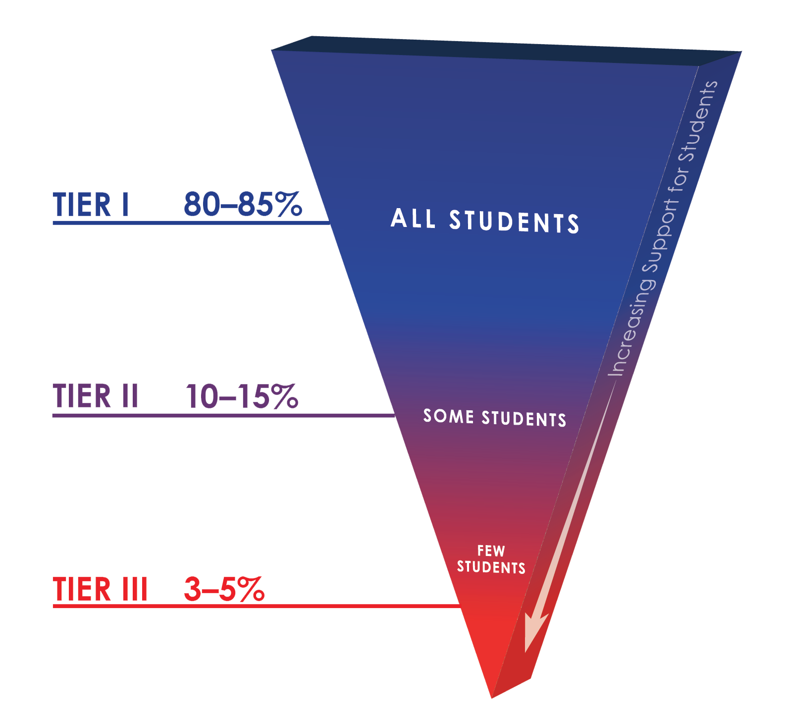
The LaRose Layout
School-Wide Expectations
P- Positive Attitude
R- Respect for All
I- Integrity
D- Do the Right Thing
E- Effort Towards Learning

Slide 6
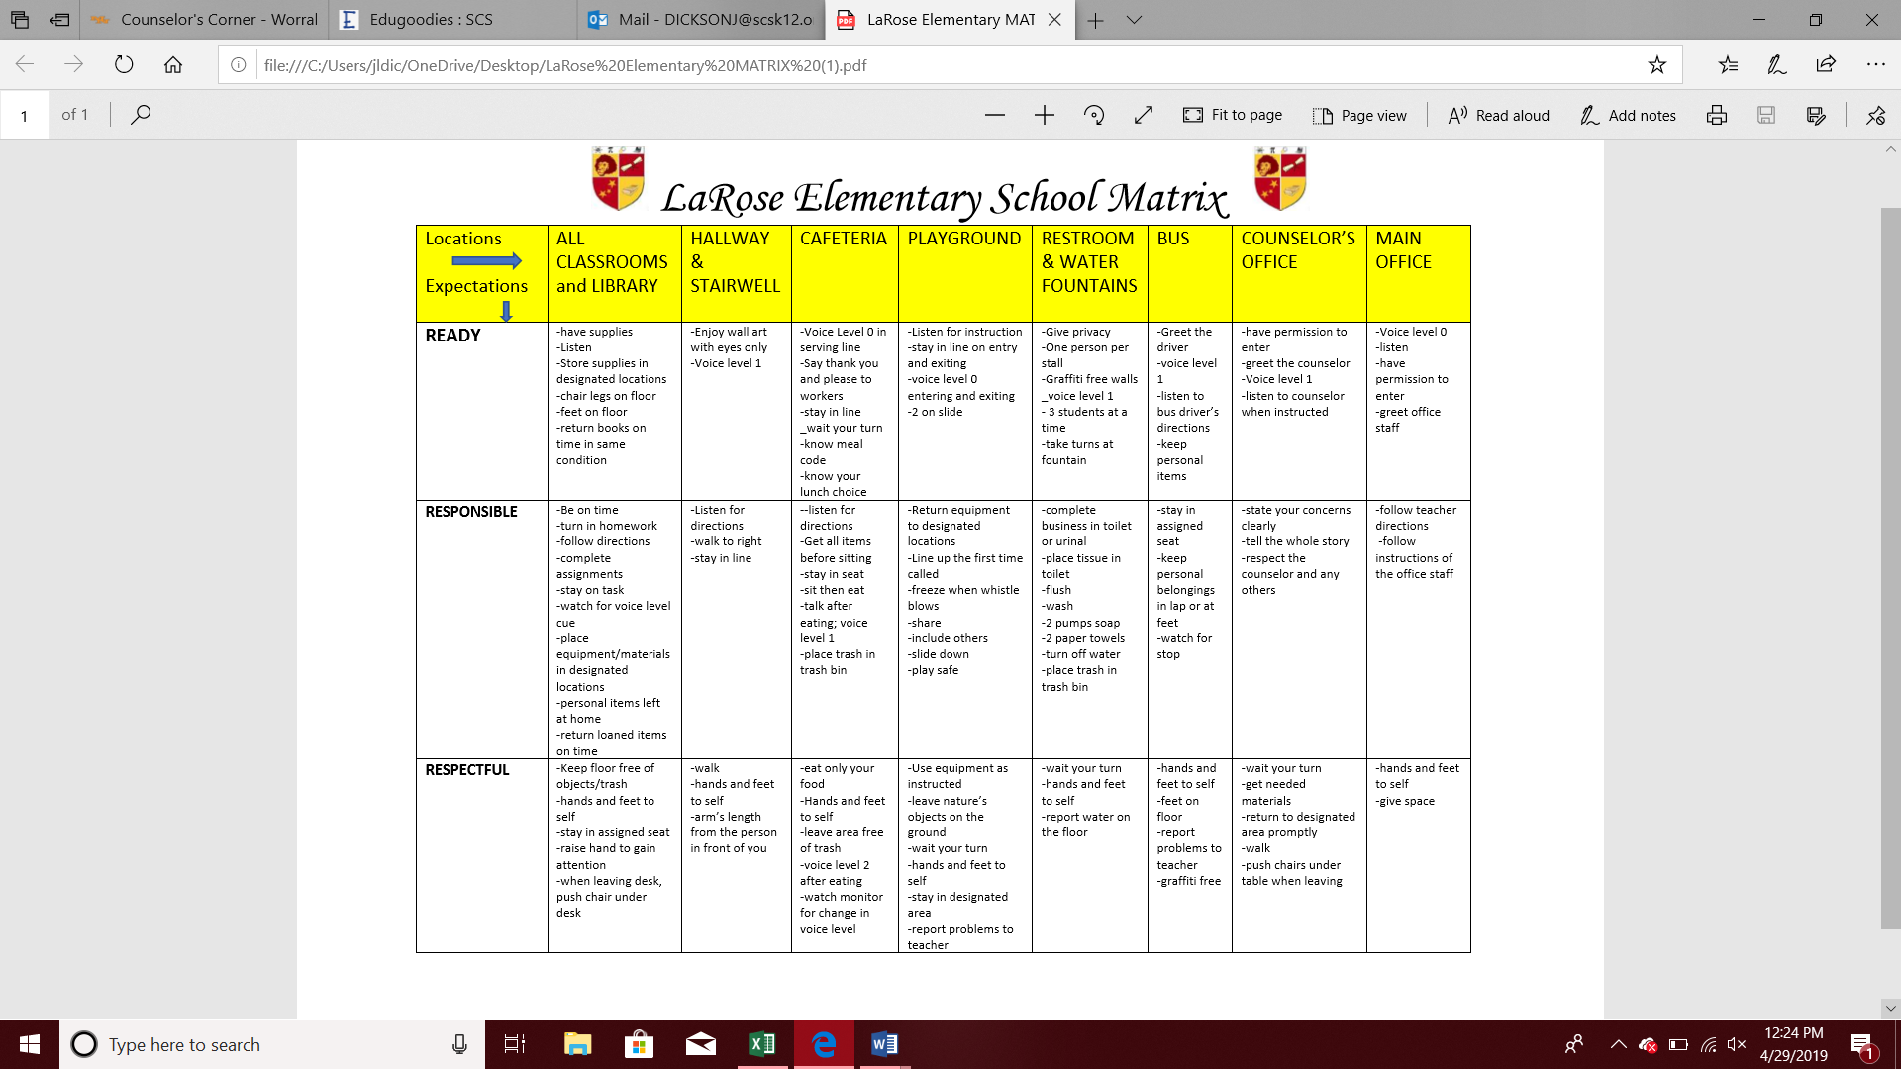

Slide 7
The LaRose Layout
School-Wide Acknowledgement System
Students | Teachers | Family/Community
Lion’s Pride The Best in the Land Lion Bucks | Lion/Lioness King Award Raffles Lion Keeper Breakfast | Busy Lions School Website Thanking Members of the Lion’s Pride

Slide 8
Class Dojo
Class Dojo is an online behavior management system intended to foster positive student behaviors and classroom culture. Students earn ‘Dojo Points’ based on their classroom conduct. Teachers use Class Dojo to keep parents up to date on student progress and classroom happenings. Class Dojo is completely free for users.
Class Dojo’s primary goal is to encourage positive student behaviors and to provide a means for teachers and parents to communicate frequently and effectively about student development. According to the company, the product’s approach is less about ‘classroom management’ and more about ‘classroom culture’, in other words, encouraging the positive instead of discouraging the negative.
Class Dojo is fully accessible on computers, tablets, smartphones, and can even be used on interactive whiteboards and projectors.

Slide 9
Class Dojo Setup
Navigate to the ClassDojo homepage or download the app
Select “Teacher” from the screen
Enter your email address and create a login password, then tap "Create Account"
Enter your title, first name, and last name, then tap "Next"
Enter your LaRose Elementary in the search field, tap on the school's listing, then on "Join this school.“
Use the “Demo Class” to practice adding and deleting skills as well as issuing dojo points

Slide 10
Breakout Groups
Location Focus | Members
All Classrooms & Library | 1st & 4th
Hallway & Stairwell | 2nd & Resource
Cafeteria | KK & 5th
Playground | Counselor & Behavior Tech
Restroom & Water Fountain | Pre-k & 3rd
Bus | Support
Counselor’s Office | Counselor & Behavior Tech
Main Office | Support
Review the assigned behavior matrix area.
Discuss with your team items listed under the expectations of Ready, Responsible, and Respectful that can be removed, kept, revised, or even items that should be added.
Ask yourself the following questions as you complete the assignment:
Is the item clear and concise?
Is the item stated in a student friendly manner?
Is this an item that is redundant or closely similar to another item in this category?
What do we want the climate and culture of LaRose to be for 2019-2020?

Slide 11
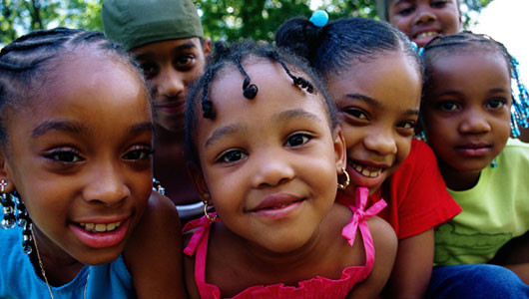
Thank You!
Brittany N. Williams, M.Ed.

