Slide 1

Annual Title I Family Meeting September 28, 2023 5:30-6:30 p.m. Pete Johnson, Principal Mattie D. Smith, Assistant Principal Rica M. Davis, PLC Coach

Slide 2
Grahamwood Vision Grahamwood Mission
Grahamwood Elementary School is an exemplary student-centered educational community with an exceptional team of stakeholders who create a nurturing environment where all students achieve academic excellence, exhibit good character, and where hopes and dreams are encouraged.
The mission of Grahamwood Elementary School is to prepare our students to become productive citizens by providing a positive, safe, diverse, and academically challenging environment that develops the cultural, social, and physical skills of our students.

Slide 3
Agenda
Welcome
Title 1 Information
Choir Performance
District/School Updates
Literacy Commitment
Closing Remarks

Slide 4
Grahamwood is a Title I School.
Being a Title I school means that Grahamwood receives federal funding (Title I Dollars) to supplement the school’s existing programs. These funds can be used to:
Identify students experiencing academic difficulties and providing timely assistance to help these students meet the State’s challenging content standards.
Purchase supplemental staff/programs/materials/supplies
Conduct parental involvement meetings/activities
Recruit/Hire/Retain Highly Qualified Teachers

Slide 5
Family Engagement Plan - MSCS Policy 5010
The school and home have a shared goal
of promoting success in our children.
Our parents will act as advisors, resource persons and coordinators in the following ways:
Attend and participate in school events
Serve with the Parent Teacher Organization
Become school supporters and advocates
Respond to memos, surveys, and questionnaires

Slide 6

Grahamwood’s Family Engagement Plan

Slide 7
Reporting Pupil Progress
Families have access to track pupil progress.
Student Agenda Books
Weekly Folder
Progress Reports every 4 ½ weeks
Report Cards every 9 weeks
Testing Data
Class Dojo

Slide 8
Parent-Teacher Conferences
Parent-teacher conferences are an integral part of maintaining communication between home and school.
There are two district-wide conferences in September and February; however, if you need to have a conference with your child’s teacher, please call the school office or email the teacher to set up an appointment before or after the school day.
September 7, 2023 4-7 p.m.
February 15, 2024 4-7 p.m.

Slide 9
Parental/Family Involvement Policy
The purpose of this policy is to establish expectations for parental involvement and comply with all pertinent mandates of state and federal regulatory standards which require that all parents have access to various levels and types of parental involvement activities.

Slide 10

Family Involvement Activities
Including, but not limited to:
Grahamwood Parent Association
Volunteer in the Classroom
Annual Title I Night
Open House
Family Reading Night
Family Math/Science Night
Family Data Night
Tutoring
Music & Art Events
Field Days
TN Ready Volunteers
Promotion Ceremonies

Slide 11
Parent Training
MSCS Parent Welcome Center provides the following training:
Bilingual assistance
Online registration assistance
Information about District programs and services
Support with family and community services
Assistance with individual student concerns

Slide 12
School Improvement Plan
All Tennessee schools are required to have an annual School Improvement Plan which indicates a comprehensive needs assessment for the entire school.
-----------------------------------------------------------------------------------------------------------------------------------------------------------------------------------------------------------------------------------------
Each plan must:
Indicate its specific goals for improvement
Identify areas of strengths and growth
Give a breakdown of how funds will be used to address these areas
Parents have the right to view the school’s plan upon request AND the plan is available on Grahamwood's website.

Slide 13
School Improvement Plan
Grahamwood's Goals
R/LA: increase proficiency rates from 46.1 % to 50.1 %.
Math: Increase proficiency rates from 45.5% to 49%.
Attendance: Increase attendance rate from 93% to 98%.

Slide 14
Parent's Right to Know
Teacher's Qualifications
Non-instructional Staff Member's Qualifications
Right to withhold information from military recruiters
Your child's achievement level

Slide 15

Home/School Compact
This compact is jointly developed by parents and school staff.
This compact outlines how parents, the entire school staff, and students will share the responsibility for improving student academic achievement.
The school’s compact is available on Grahamwood's website.

Slide 16
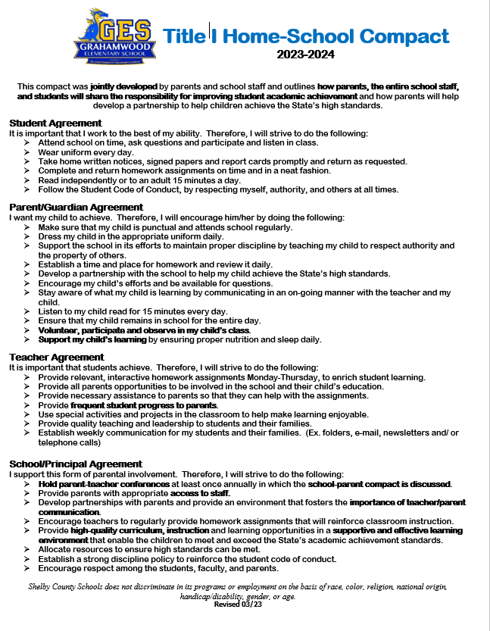
Grahamwood's Home/School Compact

Slide 17



Slide 18

MSCS Literacy Commitment
2023 -2024
Dr. Angela M. Whitelaw,
Deputy Superintendent of Academics

Slide 19

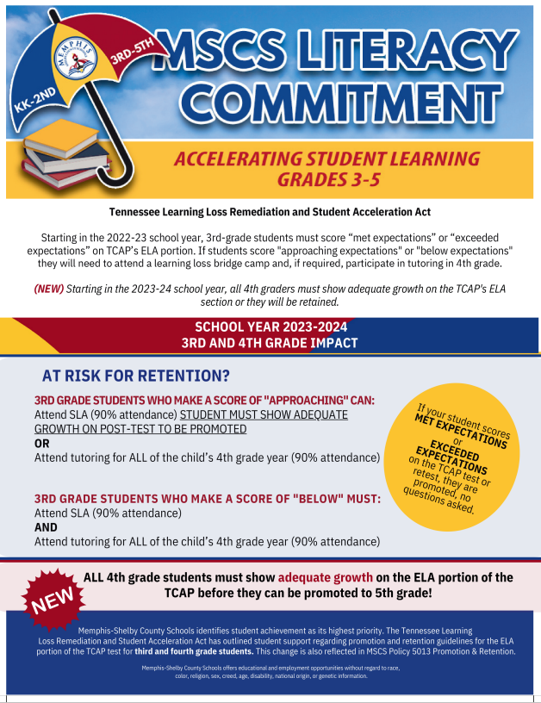
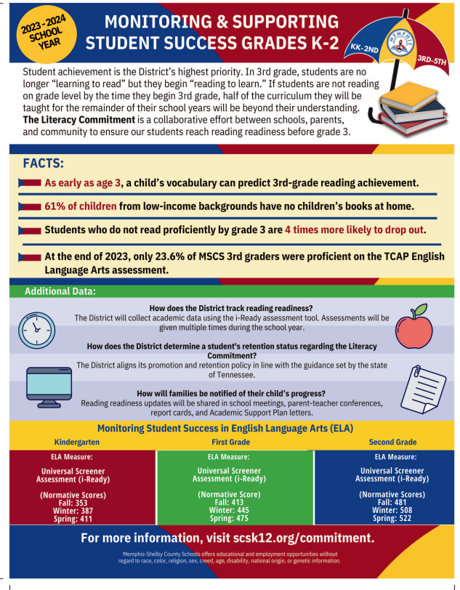
MSCS Literacy Commitment

Slide 20

Tennessee Learning Loss Remediation and Student Acceleration Act
Rising 3rd Grade Students​​
Focus: “Accelerating Student Learning”​
​
“Beginning with the 2022-2023 school year, a student in the third grade shall not be promoted to the next grade level unless the student is determined to be proficient in English Language Arts (ELA) based on the student's achieving a performance level rating of "on track" or "mastered" on the ELA portion of the student's most recent Tennessee comprehensive assessment program (TCAP) test.”​

Slide 21
Mandatory Tutoring for "Approaching Students”
The student attends a learning loss bridge camp before the beginning of the upcoming school year, maintains a ninety percent (90%) attendance rate at the camp, and the student's performance on the post-test administered to the student at the end of the learning loss bridge camp, demonstrates adequate growth, as defined in the State Board’s Promotion and Retention Policy 3.300; OR
The student receives high-dosage, low-ratio tutoring for the entirety of the upcoming school year from a Tennessee accelerating literacy and learning corps (TALLC) tutor. For the purposes of this rule, “high-dosage, low-ratio tutoring” means a minimum of two (2) thirty (30) minute sessions per week with a one to three (1:3) teacher to student ratio. TALLC high dosage, low ratio tutoring may be provided through the following options,

Slide 22
Mandatory Tutoring “Below Students”
The student attends a learning loss bridge camp before the beginning of the upcoming school year and maintains a ninety percent (90%) attendance rate at the camp, and receives high-dosage, low-ratio tutoring for the entirety of the upcoming school year from a Tennessee accelerating literacy and learning corps (TALLC) tutor.
For the purposes of this rule, “high-dosage, low-ratio tutoring” means a minimum of two (2) thirty (30) minute sessions per week with a one to three (1:3) teacher to student ratio. TALLC high dosage, low ratio tutoring may be provided through the following options:
(I) A tutor recruited and trained through the department TN ALL Corps grant program.
(II) District recruited tutor who has completed the department’s TN ALL Corps training

Slide 23

Appeal Process for Approaching students in 3rd Grade
Based on the student's achieving a performance level rating of "approaching" on the ELA portion of the student's most recent TCAP test.
The rules must provide, for the 2023-2024 school year and each school year thereafter:
That if an appeal is filed, the filing must be made by the student's parent or guardian unless the student's parent or guardian consents, in writing, to a principal, guidance counselor, teacher, or other administrator of the student's school filing the appeal, in which case the appeal may be filed by such individual; and
(B) The process by which a principal, guidance counselor, teacher, or other administrator of the student's school must obtain the written consent of a student's parent or guardian for purposes of filing an appeal on behalf of the student's parent or guardian.

Slide 24
Tennessee Learning Loss Remediation and Student Acceleration Act
2023 – 2024 school year​
A student who is promoted to the 4th grade must show adequate growth on the fourth (4th) grade ELA portion of the TCAP test as further defined in State Board Promotion and Retention Policy 3.300 before the student may be promoted to the fifth (5th) grade. ​

Slide 25
Parent Acknowledgement Form
2023 – 2024 school year​
Please log into PowerSchool on your phone.

