Slide 1

MSCS Literacy Commitment
Frayser-Corning Elementary
11.21.24 @ 2:15 p.m.

Slide 2

Agenda
TN Learning Loss Remediation and Student Acceleration Act
Pathways to Fourth Grade
Additional Opportunities
Notifications

Slide 3

TN Learning Loss Remediation and
Student Acceleration Act
What does the TN law say about 3rd graders?
Focus: “Accelerating Student Learning”
“Beginning with the 2022-2023 school year, a student in the third grade shall not be promoted to the next grade level unless the student is determined to be proficient in English Language Arts (ELA) based on the student's achieving a performance level rating of ”meets" or ”exceeds" on the ELA portion of the student's most recent Tennessee comprehensive assessment program (TCAP) test.”

Slide 4

Pathways to 4th Grade for Approaching and Below Proficient Scores

Slide 5

Approaching
What does the law say about students who score “approaching” on the TCAP assessment?

Slide 6

Tennessee Learning Loss Remediation and Student Acceleration Act
A student in grade three (3) who is not proficient in ELA, as determined by the student's achieving a performance level rating of “approaching” on the ELA portion of the student's most recent TCAP test, may be promoted to the fourth (4th) grade if:
The student attends a learning loss bridge camp before the beginning of the upcoming school year, Maintains a ninety percent (90%) attendance rate at the camp, AND the student's performance on the post-test administered to the student at the end of the learning loss bridge camp, demonstrates adequate growth (5 percentage points), as defined in the State Board’s Promotion and Retention Policy 3.300; OR The student receives high-dosage, low-ratio tutoring for the entirety of the upcoming school year from a Tennessee accelerating literacy and learning corps (TALLC) tutor. For the purposes of this rule, “high-dosage, low-ratio tutoring” means a minimum of two (2) thirty (30) minute sessions per week with a one to three (1:3) teacher to student ratio. TALLC high dosage, low ratio tutoring may be provided through the following options, (I) A tutor recruited and trained through the Department’s TN ALL Corps program. (II)A district recruited tutor who has completed the Department’s TN ALL Corps training.

Slide 7
Below Proficient
What does the law say about students who score “below proficient” on the TCAP assessment?

Slide 8

Tennessee Learning Loss Remediation and Student Acceleration Act
A student in grade three (3) who is not proficient in ELA, as determined by the student's achieving a performance level rating of “below” on the ELA portion of the student's most recent TCAP test may be promoted to the fourth (4th) grade if:
The student attends a learning loss bridge camp before the beginning of the upcoming school year AND Maintains a ninety percent (90%) attendance rate at the camp, AND Receives high-dosage, low-ratio tutoring for the entirety of the upcoming school year from a Tennessee accelerating literacy and learning corps (TALLC) tutor. For the purposes of this rule, “high-dosage, low-ratio tutoring” means a minimum of two (2) thirty (30) minute sessions per week with a one to three (1:3) teacher to student ratio. TALLC high dosage, low ratio tutoring may be provided through the following options, (I) A tutor recruited and trained through the Department’s TN ALL Corps program. (II) A district recruited tutor who has completed the Department’s TN ALL Corps training.

Slide 9
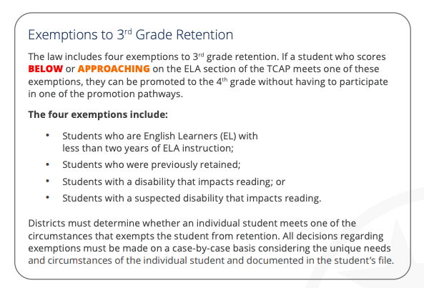
Tennessee Learning Loss Remediation and Student Acceleration Act
Exemptions to 3rd Grade Retention
Any 3rd grade student can be exempt if they fall within any of these categories.

Slide 10

Additional Opportunities

Slide 11
Retake/Retest Opportunities
If a student scores approaching OR below proficient, he/she will be given the opportunity to retake the ELA portion of the TCAP assessment, which excludes the writing.
This retake will be administered on the computer.
The retake dates have not been released as of yet from the state department.

Slide 12
Tennessee Learning Loss Remediation and Student Acceleration Act
Appeals to the Department
The Commissioner’s designee(s) may overturn the identification of a student as at risk for retention in third (3rd) grade pursuant to paragraph and allow the student to be promoted to the fourth (4th) grade if one (1) or more of the following grounds is met: Ground 1: The student demonstrated growth above the national norm as demonstrated in the student’s composite score from a State Board-approved universal reading screener or the Tennessee universal reading screener administered by the LEA or public charter school Students will be administered the aimsWeb plus universal screening in ELA Spring 2025; if students score within the 50th percentile on this assessment, they will be eligible to appeal. Schools can appeal on the parents behalf, if parents consent to do so. Ground 2: The parent or legal guardian of the student identified as at risk for retention in third (3rd) grade pursuant to paragraph documents that a catastrophic situation occurred during the days leading up to the third (3rd) grade ELA TCAP test administration that impacted the student and impeded the student’s ability to perform on the test. Examples of a catastrophic situation include, but are not limited to, a death in the immediate family, loss of a family home, or significant medical diagnosis.

Slide 13

All 3rd grade students will be administered the aimsWeb plus universal screening in ELA Spring 2025;
If an APPROACHING student scores within the 50th percentile on this assessment, they are eligible to appeal the process.

Slide 14
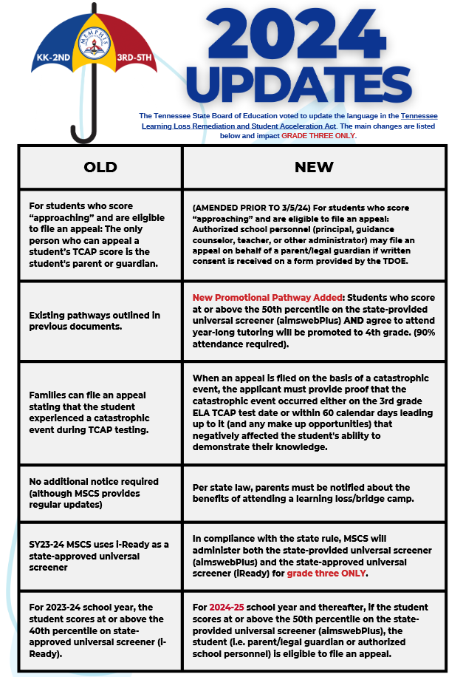
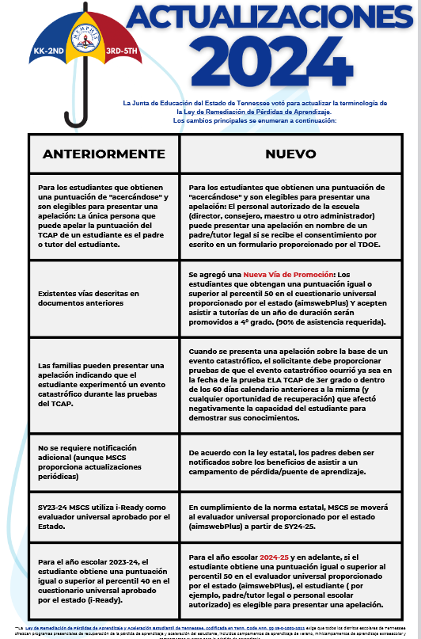

Slide 15
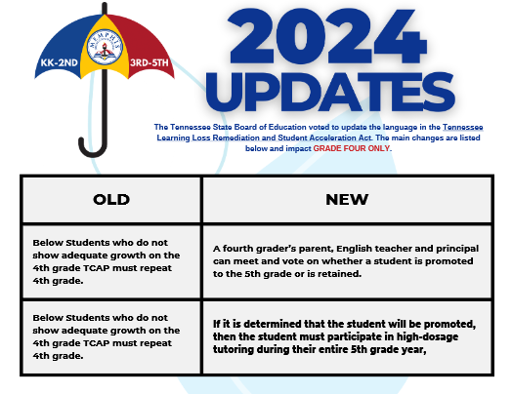

Slide 16
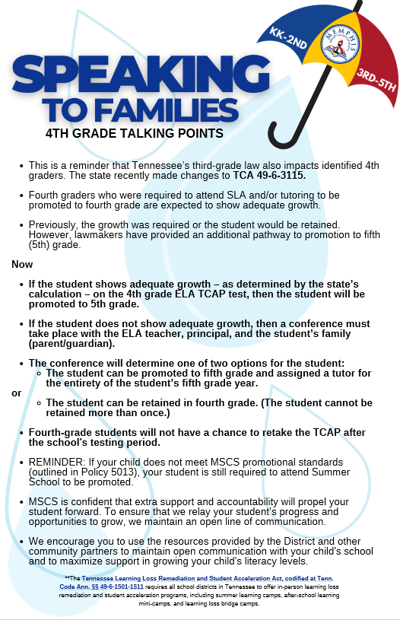

Slide 17

Notifications

Slide 18
Parent Notification
By February 1 of each year, parents must be informed if their child is “at risk” of being retained. It is required by the state and letters must be sent home. Your child's teacher will contact you after the winter IReady assessment if your child has been identified as "at risk".
“At risk” students are identified if they score below the 65th percentile on the ELA winter universal screener.

Slide 19
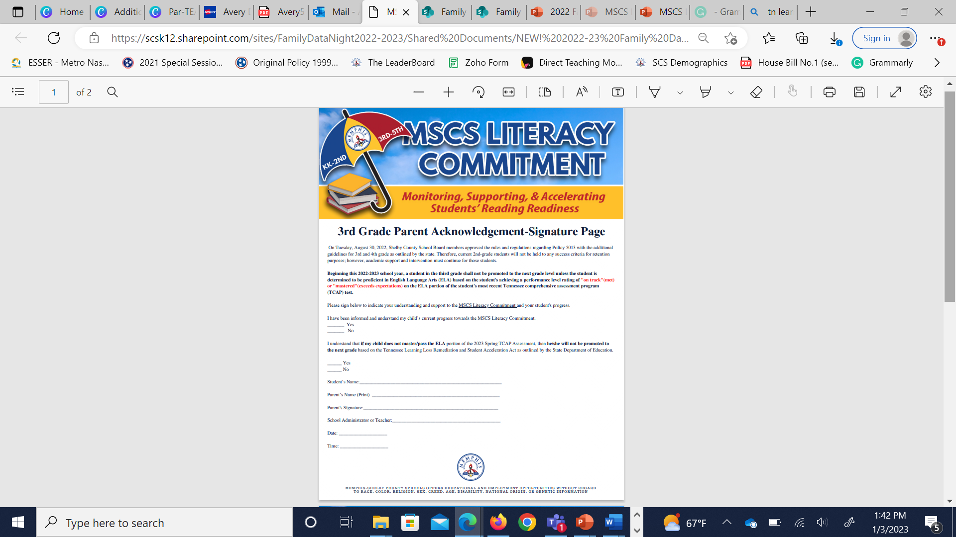
Electronic Parent Acknowledgement-Signature Page in PowerSchool
The purpose of the Parent Acknowledgment- Signature Page is to:
Indicate your understanding and support to the MSCS Literacy Commitment and your student's progress.
Acknowledge that you have been informed and understand your child’s current progress towards the MSCS Literacy Commitment.
Acknowledge that you understand that if your child does not master/pass the ELA portion of the 2025 Spring TCAP Assessment, then he/she will not be promoted to the next grade based on the Tennessee Learning Loss Remediation and Student Acceleration Act as outlined by the State Department of Education.

Slide 20

Dr. DeAngela Graham, Principal
Dr. D’Kendrick Williams, Assistant Principal
Hunter Bethea, PLCC
Gloria Smith, PSC

