Slide 1

Douglass K-8
When: Thursday, September 5, 2024
4:00pm-7:00pm
*Teachers will schedule times

Slide 2
Douglass K-8
Cuándo: jueves 5de septiembre de 2024
4:00pm-7:00pm
*Los maestros programarán horarios

Slide 3
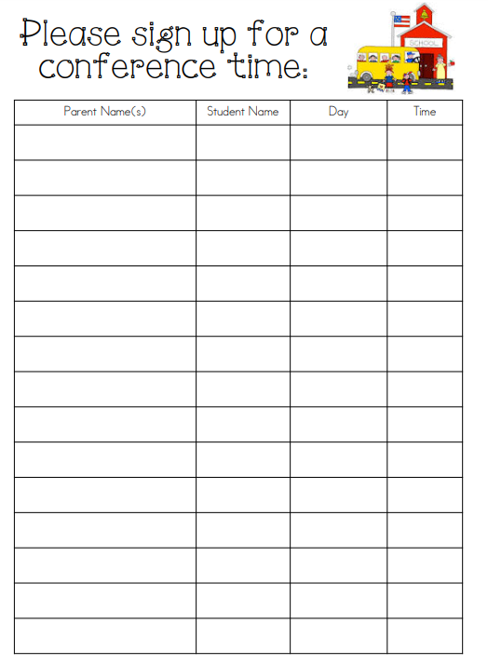
Por favor regístrese para una hora de conferencia
4:00pm
5:15pm
4:05pm
5:20pm
4:10pm
5:25pm
4:15pm
5:30pm
4:20pm
5:35pm
4:25pm
5:40pm
4:30pm
5:45pm
4:35pm
5:50pm
4:40pm
5:55pm
4:45pm
6:00pm
4:50pm
6:05pm
4:55pm
6:10pm
5:00pm
6:15pm
5:05pm
6:20pm
5:10pm
6:25pm

Slide 4
Por favor regístrese para una hora de conferencia
6:30pm
6:35pm
6:40pm
6:45pm
6:50pm

