Slide 1

Douglass K-8 Optional School
2022-2023
Notes:
Dedicate this entire slide to the thesis statement. It is the reason the speech is being given. Use this time to reveal the three main points of the speech (slides 4,5,6) as an overview for the direction of the speech:
-[type main point #1 here]
-[type main point #2 here]
-[type main point #3 here]
Be sure to transition to the first main point and the next slide.

Slide 2


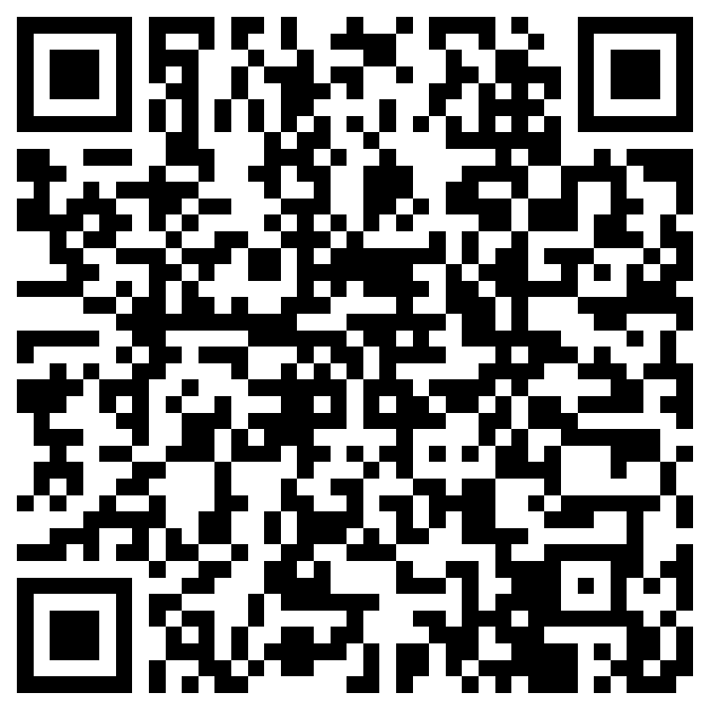

SIGN IN…
https://forms.office.com/r/PygT8kREHg
Notes:
Use the background points to post details that are not common knowledge, or that the audience will need to understand the context of the speech.
-Do not read these main points from the PowerPoint, instead elaborate on these points during the speech.

Slide 3

SIGN IN FOR A Dress Down Pass

Slide 4

Douglass K-8 Optional School
2022-2023
Notes:
Dedicate this entire slide to the thesis statement. It is the reason the speech is being given. Use this time to reveal the three main points of the speech (slides 4,5,6) as an overview for the direction of the speech:
-[type main point #1 here]
-[type main point #2 here]
-[type main point #3 here]
Be sure to transition to the first main point and the next slide.

Slide 5
Douglass K-8 Optional School
Administrative Team
Principal: Mrs. Causey
Vice Principal: Mr. Greenwood
Vice Principal: Alisheia Scott
PLC Coach: Mrs. Long
Optional School Coordinator: Mrs. Colvin
Literacy Laureate-ELA: Mrs. Newson
GOS: Mrs. Dance/Ms. Johnson
Building Engineer: Ms. Jones
Cafeteria Manager: Ms. Mayes
Notes:
Use the background points to post details that are not common knowledge, or that the audience will need to understand the context of the speech.
-Do not read these main points from the PowerPoint, instead elaborate on these points during the speech.

Slide 6
PRE-K, KK, 1ST, AND 2ND GRADE
Pre-K
Kindergarten
1st Grade
2nd Grade
Ms. Lester
Mrs. Boucher
Ms. Kennedy
Ms. Stitts
Ms. Fluellen
Mr. E (Kpuinen)
Ms. Satchell
Ms. Knox
Notes:
Use the background points to post details that are not common knowledge, or that the audience will need to understand the context of the speech.
-Do not read these main points from the PowerPoint, instead elaborate on these points during the speech.

Slide 7
3RD, 4TH, AND 5TH GRADE
3rd Grade
4th Grade
5th Grade
Mr. Willis
Ms. Townsend
Ms. Jackson
Ms. R. Smith
Ms. Reed
Ms. Ward
Notes:
Use the background points to post details that are not common knowledge, or that the audience will need to understand the context of the speech.
-Do not read these main points from the PowerPoint, instead elaborate on these points during the speech.

Slide 8
6TH , 7TH, AND 8TH GRADE
6th Grade
7th Grade
8th Grade
Mrs. Arnold
Ms. Banks
Ms. Blessings
Mrs. Brown
Mr. Weir
Mrs. Tate
Mr. Carroll
Mrs. Haidar
Notes:
Use the background points to post details that are not common knowledge, or that the audience will need to understand the context of the speech.
-Do not read these main points from the PowerPoint, instead elaborate on these points during the speech.

Slide 9
CLUE/SUPPORT
CLUE/ELA
ESL
Creative Writing
Art
Ms. Tagavilla
Ms. Grooms
Mr. P. Williams
Ms. O’Hara
Orff Music
CCTE/STEM
ISS
Behavior Specialist
Ms. McClain
Mr. Woods
Mr. M. Williams
Mr.J. Smith
Reset Room Coordinator
Mr. Bobo
Notes:
Use the background points to post details that are not common knowledge, or that the audience will need to understand the context of the speech.
-Do not read these main points from the PowerPoint, instead elaborate on these points during the speech.

Slide 10
Douglass K-8
“Where Excellence is the Expectation”
How can you help?
We need your support as we work hard to give our scholars a quality education!.
  Review this information with your scholars so that we are all on one accord to make this a successful school year.
Notes:
The title of main point #1 should be clear and concise. Each piece of evidence should be summarized for clarity and cited correctly. Do not simply read the pieces of evidence, but elaborate where needed.
[type notes for elaboration here]
Be sure to transition to main point #2 and the next slide.

Slide 11

SCHOOL POLICY REMINDERS
Notes:
Dedicate this entire slide to the thesis statement. It is the reason the speech is being given. Use this time to reveal the three main points of the speech (slides 4,5,6) as an overview for the direction of the speech:
-[type main point #1 here]
-[type main point #2 here]
-[type main point #3 here]
Be sure to transition to the first main point and the next slide.

Slide 12

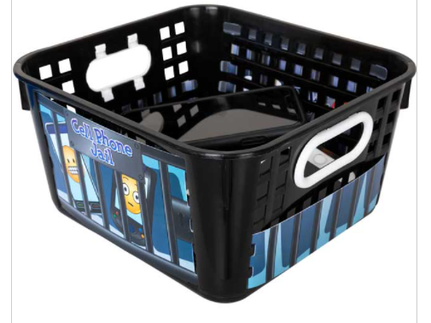

Metal Detection/
Cell Phones
Cell phones that are not turned in will be confiscated
and kept in the office for 3 days.

Slide 13




Scholars can wear white, navy, black, and burgundy/maroon polo shirts
K-8 Uniforms
Shoes must be closed toe and MUST have a back on them
Notes:
The title of main point #2 should be clear and concise. Each piece of evidence should be summarized for clarity and cited correctly. Do not simply read the pieces of evidence, but elaborate where needed.
[type notes for elaboration here]
Be sure to transition to main point #3 and the next slide.

Slide 14



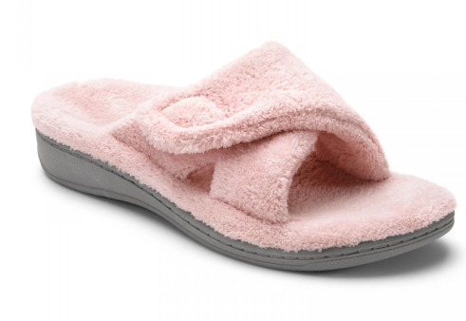




What students DON’T wear

Slide 15
Reminders & FAQ
All Teachers have Emails and contact numbers. Parents, please use one of these options to speak with teachers about your scholars' individual concerns.
  Note: Some teachers use Remind-App and Class Dojo to send out personal class reminders.
PowerSchool is the easiest way to keep track of Scholars Grades. Get the app and stay abreast. Please allow 3-5 days for grade changes or updates in PowerSchool. See Office Staff for further information

Slide 16
Title I
Parent Meeting
Anita Long, PLC Coach longah@scsk12.org

Slide 17
AGENDA
What is Title I?
Parent’s Rights Under Title I
Parent Involvement Plan
School-Parent Compact
Student Achievement Data

Slide 18
Title I Law
PURPOSE:
“…To ensure that all children have a fair, equal, and significant opportunity to obtain a high-quality education…”

Slide 19
TITLE I
Our goals are...
  To increase academic achievement.
  To provide direct instructional support to students.
  To provide professional development for teachers.
  To promote parent education and involvement

Slide 20
ESSA (Every Student Succeeds Act)
What is the main purpose of ESSA?
The main purpose of ESSA is to make sure public schools provide a quality education for all kids. ESSA gives states more of a say in how schools account for student achievement. This includes the achievement of disadvantaged students.

Slide 21
Title I and the ESSA law gives the parents the right to know:
The school’s status according to the ESSA standards
A teacher’s professional qualifications, licensure, or certification
A paraprofessional’s qualifications
Academic services available for your child

Slide 22
Principles Behind the Law
Closing
Closing the achievement gap
Improving
Improving literacy by putting reading first
Improving
Improving teacher quality
Promoting
Promoting more choices for parents and making more information available for parents
Increasing
Increasing collaboration of all federal, state, and local programs

Slide 23
Douglass K-8 Parent Communication/
Reporting Student Progress
Phone Calls/Emails
MSCS District Progress Report
Formative Assessment Results
I-ready/Mastery Connect Reports
Report Cards sent home at the end of each nine-week grading period
Parent Memos/Updates via calling system
Power School & App
Parent-Teacher Conferences throughout the school year
Remind App/Class Dojo
Progress Reports available during each quarter via Power school

Slide 24
MSCS District Goals
Destination 2025-Strategic Plan for Student Success
80% of our students will be college or career ready
90% of seniors will graduate high school on time
100% of graduates will enroll in a post-secondary experience

Slide 25
School and Parent Compact
A written agreement that outlines how the parents, the entire staff and the students will share the responsibility for improved student academic achievement, as well as describes how the school and parents will build and develop a partnership that will help children achieve the state’s high standards.

Slide 26

2021-2022 Mastery Connect Data

Slide 27
ON TRACK + MASTERY

Slide 28
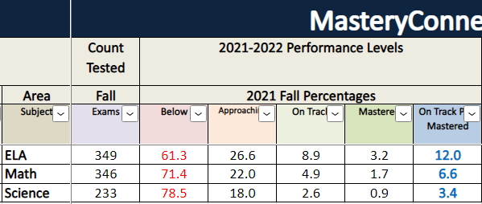
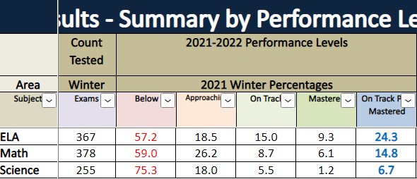
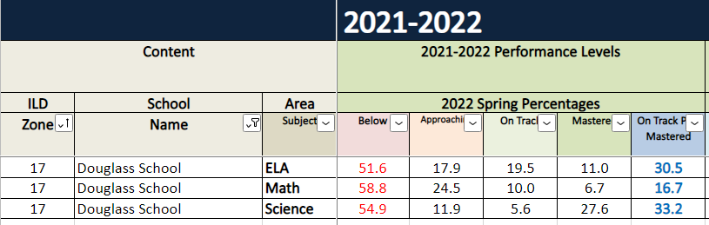
On-Track Plus Mastery % -ELA, Math , Science
SUBJECT | GRADE | F-% OT/M | W-% OT/M | SPR-% OT/M | % Change F to SPR
ELA | K-8 | 12.0% | 24.3% | 30.5% | +18.5%
MATH | K-8 | 6.6% | 14.8% | 16.7% | +10.1%
SCIENCE | K-8 | 3.4% | 6.7% | 33.2% | +29.8%

Slide 29


District Mastery Connect – 09/26 – 10/2
Report period ends 10/7/22
Fall Break 10/10-10/14
Report cards issued October 26, 2022
Book Blast Launch-October 24, 2022!!!
Grandparents Day! COMING SOON!

Slide 30


Slide 31



Keep up with DOUGLASS K-8
Follow us on >>>
Douglass K-8 Optional School
@wearedouglassk8
Website:
https://schools.scsk12.org/Domain/129

Slide 32

Thank You Parents!
Thank you for your continued support and encouragement

Slide 33
SIGN IN…
longah@scsk12.org
School Office: 901-416-5946
https://forms.office.com/r/PygT8kREHg
Notes:
Use the background points to post details that are not common knowledge, or that the audience will need to understand the context of the speech.
-Do not read these main points from the PowerPoint, instead elaborate on these points during the speech.

