Slide 1


Zone 12
Cummings K8 Optional School
Schoolwide Title I Open House
Presented by Jacqueline Lang, PLC Coach
Notes:
Be specific and direct in the title. Use the subtitle to give the specific context of the speech.
-The goal should be to capture the audience’s attention which can be done with a quote, a startling statistic, or fact. It is not necessary to include this attention getter on the slide.

Slide 2

iZone Vision Statement
We are committed to inspiring broad ownership and innovation towards advancing a model of transformation that increases student learning equitably and prepares every student to be globally competitive.​
Notes:
The counterargument should be the most common argument against the topic. The goal for this slide is to address the counterargument in such a way as to actually strengthen the original topic. Be sure to address each piece of evidence against the topic. As you address each piece of evidence elaborate on the text found on the slide. Remember to transition to the final slide, the action step.

Slide 3
What Will You Learn
What does it mean to be a Title I school?
What is a SIP (School Improvement Plan)?
What is the School-Parent Compact?
Parent’s Right to Know
How do I request the qualifications of my child’s teacher(s)?
How will I be notified if my child is taught by a teacher who is not Highly Qualified?
How can I be involved in all of these things I’m learning about?
Notes:
The counterargument should be the most common argument against the topic. The goal for this slide is to address the counterargument in such a way as to actually strengthen the original topic. Be sure to address each piece of evidence against the topic. As you address each piece of evidence elaborate on the text found on the slide. Remember to transition to the final slide, the action step.

Slide 4
What Does It Mean to Be a Title I School?
Being a Title I school means receiving federal funding (Title I dollars) to supplement the school’s existing programs. These dollars are used for…
  Identifying students experiencing academic difficulties and providing timely assistance to help these student’s meet the State’s challenging content standards.
  Purchasing supplemental staff/programs/materials/supplies
  Conducting Parental Involvement meetings/trainings/activities
  Recruiting/Hiring/Retaining Highly Qualified Teachers
Being a Title I school also means parental involvement and parents’ rights.
Notes:
The counterargument should be the most common argument against the topic. The goal for this slide is to address the counterargument in such a way as to actually strengthen the original topic. Be sure to address each piece of evidence against the topic. As you address each piece of evidence elaborate on the text found on the slide. Remember to transition to the final slide, the action step.

Slide 5
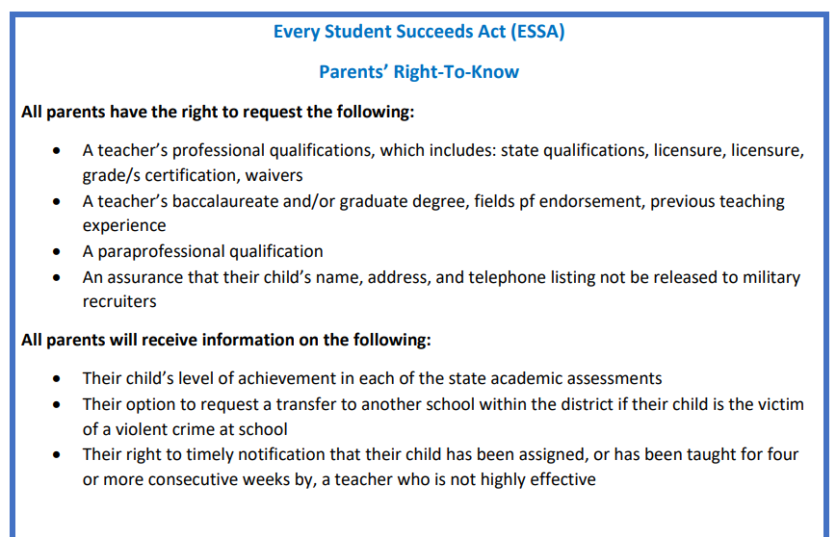
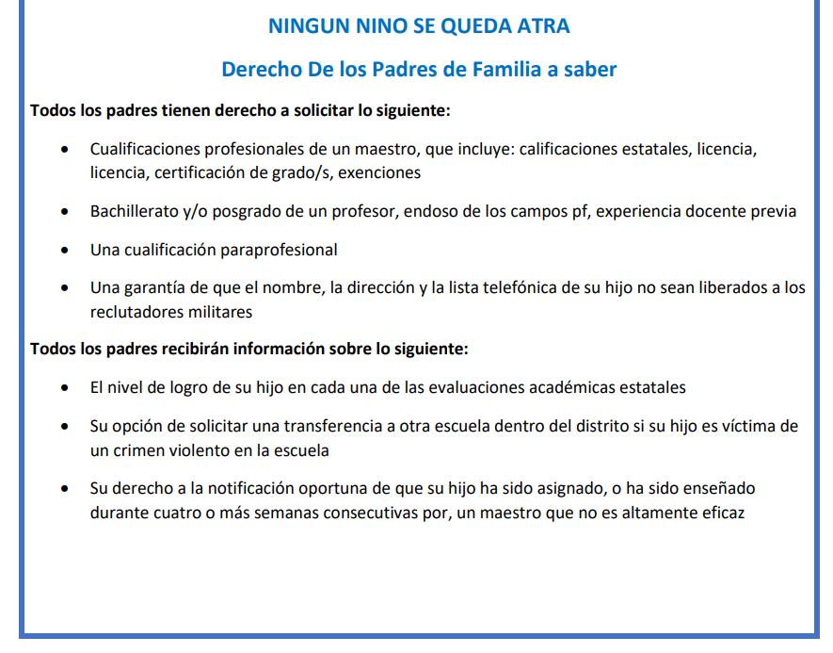
Notes:
Use the background points to post details that are not common knowledge, or that the audience will need to understand the context of the speech.
-Do not read these main points from the PowerPoint, instead elaborate on these points during the speech.

Slide 6
How is Our School Using This Funding
Parental Involvement/Parent Engagement has a budget. $2,,604.88
  Parent Involvement Meetings:
    September 19th, 2023– Annual Title 1 Meeting
    November 15th, 2023 – Family Literacy Night
    March 7th, 2024– Math March Madness Night
    April 4th, 2024 – TN Ready Parent Night
    May 29th, 2024 – Summer Reading Night
  Materials/Supplies:
    Light refreshments will be provided at many of the events if In-Person; virtually we will give away prizes for your presence
    We will provide the following materials for you to take home & use with your child @ these meetings:
      Books/Reading Resources
      Math Games/Take Home Activities
Notes:
Use the background points to post details that are not common knowledge, or that the audience will need to understand the context of the speech.
-Do not read these main points from the PowerPoint, instead elaborate on these points during the speech.

Slide 7
What does This Mean for Parents
  Development of our…
    School Improvement Plan
    90 Day Plan
    Parental Involvement Policy/Plan
    School/Parent Compact
  Title 1 funding allocations for parent involvement
Notes:
Use the background points to post details that are not common knowledge, or that the audience will need to understand the context of the speech.
-Do not read these main points from the PowerPoint, instead elaborate on these points during the speech.

Slide 8
School Plans
School-Parent Compact
  The compact is a commitment from the school, the parent, and the student to share in the responsibility for improved academic achievement
School Improvement Plan
  A Needs Assessment and Summary of Data
  Goals and Strategies to Address Academic Needs of Students
  Professional Development Needs
  Coordination of Resources/Comprehensive Budget
  The School’s Parental Engagement Plan
Parental Involvement Plan This plan addresses how the school will implement the parental involvement requirements of the Elementary and Secondary Education Act (ESEA). Components include:
  How parents can be involved in decision-making and activities
  How parental involvement funds are being used
  How information and training will be provided to parents
  How the school will build capacity in parents and staff for strong parental involvement
Notes:
Use the background points to post details that are not common knowledge, or that the audience will need to understand the context of the speech.
-Do not read these main points from the PowerPoint, instead elaborate on these points during the speech.

Slide 9

Parent Notification of School Status
Notes:
Use the background points to post details that are not common knowledge, or that the audience will need to understand the context of the speech.
-Do not read these main points from the PowerPoint, instead elaborate on these points during the speech.

Slide 10
Data TVAAS
Composite Literacy Numeracy Science Social Studies
3 3 4 2 3
Notes:
Use the background points to post details that are not common knowledge, or that the audience will need to understand the context of the speech.
-Do not read these main points from the PowerPoint, instead elaborate on these points during the speech.

Slide 11

Data TVAAS
Notes:
Use the background points to post details that are not common knowledge, or that the audience will need to understand the context of the speech.
-Do not read these main points from the PowerPoint, instead elaborate on these points during the speech.

Slide 12
Volunteers Needed
Request to join the School Leadership Team
  Contact our office at 901-416-7810 to volunteer
Join the Cummings K8 Optional School PTSO (Newly created by Ms. Smith)
Volunteer for to be a Proctor for TN Ready Testing
Volunteer to contact other parents regarding important school information.
  Ex. – 100% Compact completion
  Talk to your neighbors and let them know what events and activities are going on here @ Cummings K8
    Also: stuff envelopes, cut lamination, donate supplies, etc.
Notes:
Use the background points to post details that are not common knowledge, or that the audience will need to understand the context of the speech.
-Do not read these main points from the PowerPoint, instead elaborate on these points during the speech.

Slide 13
Data TVAAS
Composite Literacy Numeracy Science Social Studies
3 3 4 2 3
Notes:
Use the background points to post details that are not common knowledge, or that the audience will need to understand the context of the speech.
-Do not read these main points from the PowerPoint, instead elaborate on these points during the speech.

Slide 14
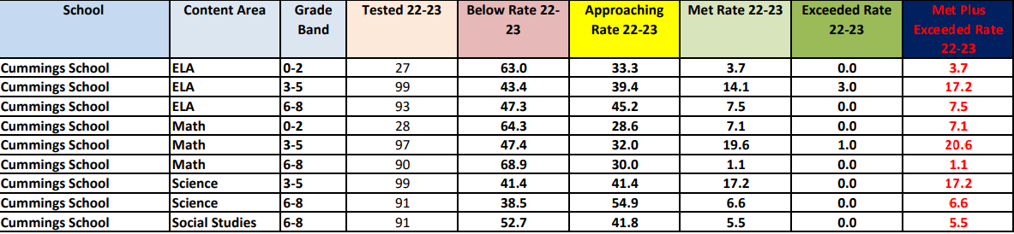
22-23 Grade Band Results
Notes:
The counterargument should be the most common argument against the topic. The goal for this slide is to address the counterargument in such a way as to actually strengthen the original topic. Be sure to address each piece of evidence against the topic. As you address each piece of evidence elaborate on the text found on the slide. Remember to transition to the final slide, the action step.

Slide 15
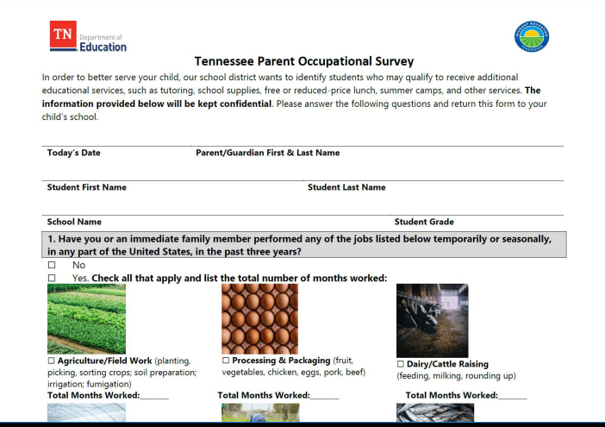
Look out for Surveys
Notes:
Use the background points to post details that are not common knowledge, or that the audience will need to understand the context of the speech.
-Do not read these main points from the PowerPoint, instead elaborate on these points during the speech.

