Slide 1

The Virtual Bolton Way
August 2020
Bolton High School

Slide 2
We Love You Here At Bolton!
2 Major Goals That Guide Our Family Here At
Bolton High School
Safety
Teaching & Learning
(Be College & Career Ready)

Slide 3
Bolton Virtual School Day Schedule
A Day
1st Period 8:00-9:35
Break 9:35-9:40
3rd Period 9:40-11:10
Break 11:10-11:15
5th Period 11:15-12:15
Lunch 12:15-12:45
Huddle 12:45-1:30
7th Period 1:30-3:00
B Day
2nd Period 8:00-9:35
Break 9:35-9:40
4th Period 9:40-11:10
Break 11:10-11:15
5th Period 11:15-12:15
Lunch 12:15-12:45
Huddle 12:45-1:30
6th Period 1:30-3:00
Support Huddle for Students: What is it? It’s an opportunity for students to meet with counselors, receive Social Emotional Learning support (SEL), & receive teacher support. Students must schedule an appointment and/or be recommended by teacher or support staff. This will also provide an opportunity for club/organization meetings to occur.
Virtual Support Huddle: (Designated Activities)
Monday-Intervention/Teacher Support, SEL, and Counselor
Tuesday-Intervention, Club/Organization Meetings (bi-weekly)
Wednesday-Intervention, Virtual Walk-in Wednesday (Juniors & Seniors ONLY)
Thursday-Intervention, Club/Organization Meetings (bi-weekly)
Friday-Intervention/Teacher Support, SEL, and Counselor

Slide 4
Student Virtual Work Setting
Working stations must be free of foreign objects that are not being utilized for instruction.
The recording device being used for instruction must be positioned to allow teachers to observe both the working space and student, especially during testing.
Eating and drinking are not allowed during virtual courses. This is hazardous to electronic devices and can also be distracting during instruction.
When possible, students are encouraged to work in areas that are isolated from other individuals and pets. If circumstances exist that do not allow complete seclusion, the parent will need to share this information separately with the instructor. Instructors will only require what the parent can reasonably provide.

Slide 5
Student Virtual Work Setting
Continued
Additional electronic devices should not be kept or used within the visible working area, unless they are being utilized for instruction/are teacher approved. This includes the use of speakers, phones, and other devices that may provide distractions from teacher lead instruction.
Students will follow daily guidance from their teachers regarding best methods of communicating and participating during virtual schooling. Instructions regarding when and how to interact verbally and how to use audio and camera options will be dependent on the design of instruction and direction of the teacher.

Slide 6
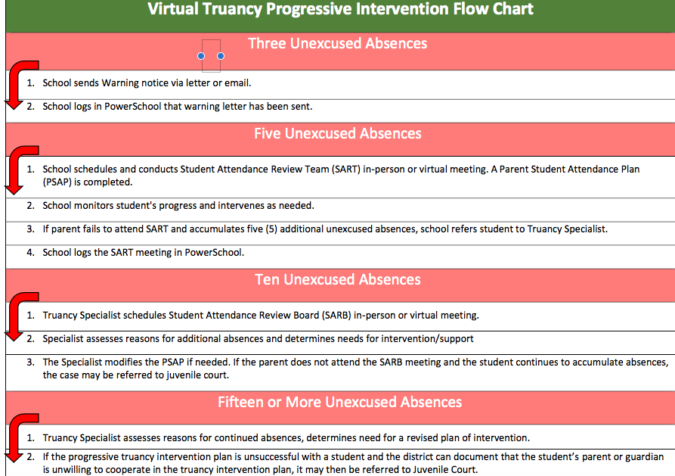
Virtual Attendance
The law requires that parents ensure that students attend school regularly. The truancy law requirements have not changed and still apply for the Virtual Schooling settings. Absences (i.e., doctor’s appointments, sickness, funerals etc.) must continue to be reported to the school, just as before.

Slide 7
Attendance Secretary Information
Contact Mrs. Stephens @
901-416-2311
or
stephensc@scsk12.org

Slide 8
Grades & Credits
Grading Scale
A 93-100
B 85-92
C 75-84
D 70-74
F Below 70
Awarding Units of Credit
Credits will be awarded in .5 increments upon successful completion of a semester. A student will receive one full credit in the course if he/she receives a passing yearly/final grade in the course.

Slide 9
Microsoft TEAMS Login Instructions
In order to access instructions for Microsoft TEAMS Login copy the following URL into your browser
shorturl.at/ahvGK

Slide 10
Virtual Conduct Expectation
VIRTUAL DISCIPLINE CATEGORIES
In order to maintain positive virtual schooling climates, students are prohibited from engaging in the misconduct outlined in Policy 6022. The Student Code of Conduct’s progressive categories (in their entirety) will continue to be used when defining and responding to virtual misconduct. Please see SCS Policy 6022 pages 13-21, for a comprehensive list of the Discipline Categories A-E.
For the purposes of specifically addressing “virtual” conduct expectations, please give special attention the prohibited Category C, D, E and A behaviors below.
Category C (Moderate-Serious)
#1. Threatening bodily harm to school personnel, including transmitting by an electronic device any communication containing a credible threat to cause bodily injury or death to a school employee and the transmission of such threat creates actual disruptive activity at the school that requires administrative intervention;
#7. Malicious destruction of or damage to school property, including electronic media, or the property of any person attending or assigned to the school;
#8. Stealing or misappropriation of school or personal property (regardless of intent to return);
Consequences for these behaviors can result in
Parent-Principal Conference (Virtual/in-person/phone)
Virtual Supervised Study/Detention
Virtual In-School Suspension
In-School Suspension
Out-of-school Suspension
Remand to Alternative School

Slide 11
Virtual Conduct Expectation
Continued
Category D (Minor- Moderate)
#4. Threatening bodily harm to another student, including transmitting by an electronic device any communication containing a credible threat to cause bodily injury or death to a student and the transmission of such threat creates actual disruptive activity at the school that requires administrative intervention;
#7. Inappropriate use of electronic media, including, but not limited to, all calls (land line, cellular or computer generated), instant messaging, text messaging, video/audio recording devices, IPods, MP3s or any type of electronic music or entertainment device, and cameras and camera phones;
#9. Bullying/cyberbullying, intimidation, and harassment
#11. Inciting, advising or counseling of others to engage in any acts in Categories A, B or C using any means to send or receive spoken or written messages, including, but not limited to, notes, letters, texts, online or in-person group chats or conferencing, electronic messaging, audio messaging, video messaging, social media posts/streams, or other similar forms of communication;
Consequences for these behaviors can result in
Parent-Principal Conference (Virtual/in-person/phone)
Virtual Supervised Study
Virtual In-School Suspension
In-School Suspension

Slide 12
Virtual Conduct Expectation
Continued
Category E (Minor)
#1. Habitual and/or excessive tardiness
#2. Class cutting*
#3. Intentional disturbance of class, cafeteria or school activities
#8. Possession of and access to beepers, cellular phones or other electronic communication devices during school hours without permission of the principal or in violation to district/school policy
#10. Dress code violation, including wearing, while on school grounds during the regular school day, clothing that exposes underwear or body parts in an indecent manner that disrupts the learning environment
Consequences for these behaviors can result in
  Parent-Principal Conference (Virtual/in-person/phone)
  Virtual Supervised Study/Detention
  Virtual In-School Suspension

Slide 13
Virtual Conduct Expectation
Continued
CATEGORY A OFFENSES
Note: Any student who commits a Category (A) offense must receive a mandatory 180 day suspension. Category (A) offenses include: possession of drugs, aggravated assault of staff and possession of a firearm on school property/event. Notification will be made to law enforcement authorities. Any modification of this penalty can only be made by the Superintendent.
CYBER-BULLYING
As previously mentioned in Category (C), Bullying, Cyber-bullying and harassment of any kind are strictly prohibited and can result in disciplinary action (up to suspension). In addition to reporting directly to staff, victims of bullying may also report bullying using the Safe-School Web Tips reporting process, which can be found in SCS Policy 6046 .
Any complaints of harassment, intimidation or bullying should include the following information:
Identity of the alleged victim and the person accused;
Location, date, time and circumstances surrounding alleged incident;
Description of what happened;
Identity of witnesses; and
Any other evidence available.
EXCLUSIONARY DISCIPLINE MEASURES
For the purposes of virtual schooling, exclusionary consequences will be considered as:
  any direct removal from the virtual schooling process, long-term remands to the virtual
  alternative school setting and failure to provide IEP approved services during virtual schooling (i.e., OSS, removal from virtual class without assigning Virtual ISS, etc.).
  Exclusionary consequences should only be used as a last resort and after implemented interventions have failed, unless otherwise dictated by policy categories.

Slide 14
Dress Code For Virtual Learning Environment
Students are expected to look presentable regardless of location in which learning occurs. To ensure continuity of expectations for appropriate dress while participating in virtual learning environment, dress code requirements outlines (see policy #6021), for Elementary, Middle, and High shall apply. However, when video of a student’s full body will not be captured, reasonable flexibility is provided for bottoms (e.g. pants, shorts, skirts) and footwear.

Slide 15
Social Emotional Learning
The vision for Shelby County Schools is to provide equitable support to all students to build their emotional, social and cognitive development through the use of research-based strategies grounded in trauma-informed practice that leads to improved school climate and attendance, decreased suspensions, expulsions, drop-out rates, and reduced stress for staff and students. Addressing Adverse Childhood Experiences in Tennessee and Shelby County Chronic childhood trauma, or what experts call adverse childhood experiences (ACEs), can affect a child's brain- building process. ACEs are toxic to brain development and can compromise the brain’s structural integrity. Left unaddressed, ACEs and their effects make it more difficult for a child to succeed in school, live a healthy life and contribute to the state’s future prosperity — our communities, our workforce, and our civic life. Schools that build cultures of understanding and support can be an extraordinarily protective factor in the lives of students coping with trauma.
(SCS CHESS/SEL Manual, 2019).
-Bolton High School Counselors Available:
12th Grade Counselor-Jeremy Smith 901-416-1438 smithjc@scsk12.org
11th Grade Last Name A-L & 10th Grade Counselor-Carnell Mitchell 901-416-1439 mitchellcd2@scsk12.org
11th Grade Last Name M-Z & 9th Grade Counselor-Deonna Pirtle 901-416-1436 pirtledj@scsk12.org
Social Worker Darna Davis davisdl@scsk12.org

Slide 16
Bolton High School Office Staff
Contact List
Shanda Gnintedem, Principal youngsl@scsk12.org
James Bacchus, Assistant Principal bacchusjq@scsk12.org
Sherry McKinney, Assistant Principal mckinneysc@scsk12.org
Ebony Johnson, PLC Coach johnsonen@scsk12.org
Kenya Reid, PLC Coach reidkw@scsk12.org
Sandra Young, General Office Secretary 901-416-1435 youngsk@scsk12.org
Joy Wright, Financial Secretary 901-416-1677 wrightj3@scsk12.org
Cristi Stephens, Attendance Secretary 901-416-2311 stephensc@scsk12.org
Janice Holliday, Records Secretary 901-416-1873 hollidayjm@scsk12.org
Jeremy Smith-12th Grade Counselor smithjc@scsk12.org
Carnell Mitchell-11th Grade Last Name A-L & 10th Grade Counselor mitchellcd2@scsk12.org
Deonna Pirtle-11th Grade Last Name M-Z & 9th Grade Counselor pirtledj@scsk12.org
Martavious James, Building Engineer jamesm1@scsk12.org
Martel King, Cafeteria Manager kingm1@scsk12.org
Pam Parker, Athletic Director parkerps@scsk12.org

Slide 17
Virtual Celebrations
Attendance Celebrations-Certificate
Virtual Party
Virtual Oscar Night
Virtual Student Appreciation Day
Virtual Honors Programs every 9 Weeks
Virtual Home Work Credit Waivers
Sunshine Phone Calls/Emails
Virtual Homecoming Court
Student Suggestions ALWAYS WELCOMED!

Slide 18
Bolton Clubs & Sport Organizations
Band
Orchestra
DECA
The Club-Cinema Literature and mUsic Bunch
Student Government Association
FFA
Drama Club
Chess Club
Golf
STEAM
FCCLA
NAHS
National Honor Society
Football
Basketball
Cheerleading
Book Club
Softball
Baseball
Wrestling
Links of Luv
Bowling
Track & Field
Beta Club
Journalism (Year Book Club)

Slide 19
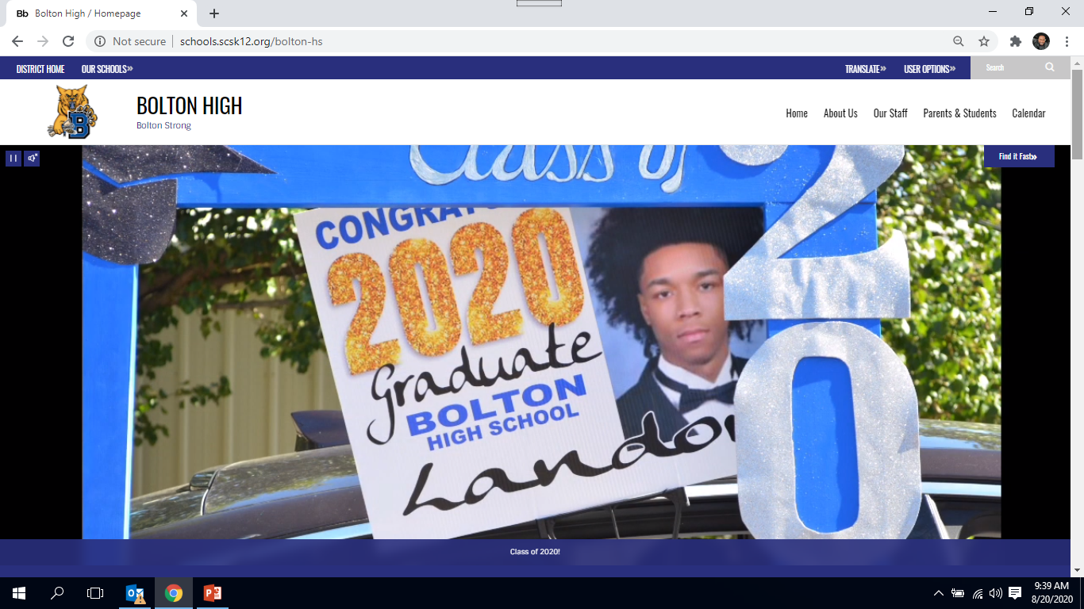
Bolton High School Website
Visit our Bolton HS Website for information and school updates! The website will serve as the MAJOR hub for all information and communication for our parents, students, and community. https://schools.scsk12.org/bolton-hs

Slide 20
Upcoming Important Dates!
August 31- Students 1st Day of Virtual School
August 31- Distribution of Student Resources
3:00 P.M. – 6:00 P.M.
Bolton Breezeway (outside the attendance office)
September 1- Distribution of Student Resources
3:00 P.M. – 6:00 P.M.
Bolton Breezeway (outside the attendance office)
September 7- Holiday-No School
September 15- After School Tutoring Available From ALL Bolton Teachers!
Tutoring is every Tuesday & Thursday 3:00 – 4:00
October 1- Parent/Teacher Conference Day
November 10- End 1st Nine Weeks

Slide 21
Bolton Food Distribution Dates
Please view the meal distribution video below
Anyone that has a student in Shelby County Schools can receive 5 days of food FREE each week.
Food distribution will be at Bolton High School, outside of the cafeteria (drive pass the tennis court, go all the way to the back to the cafeteria)
Food distribution will begin on September 3
Date & time of food distribution
Thursdays 9:00 A.M. – 12:00 Noon
1:00 P.M. – 5:00 P.M.
Fridays 7:00 A.M. – 9:00 A.M.

Slide 22
MANDATORY-All Bolton HS Students MUST Use A SCS District Laptop
The laptop that our SCS District is giving to EVERY student is VERY helpful, please look over what the laptop provides:
-brand new device
-has been downloaded with the Microsoft TEAMS needed information
for virtual instruction
-has content filtering software blocking access to harmful online
content
-has software to locate/lock device & delete files when necessary
-has antivirus protection software to prevent malicious viruses

Slide 23
Meet Our
Bolton High School Family!
(Staff)

Slide 24
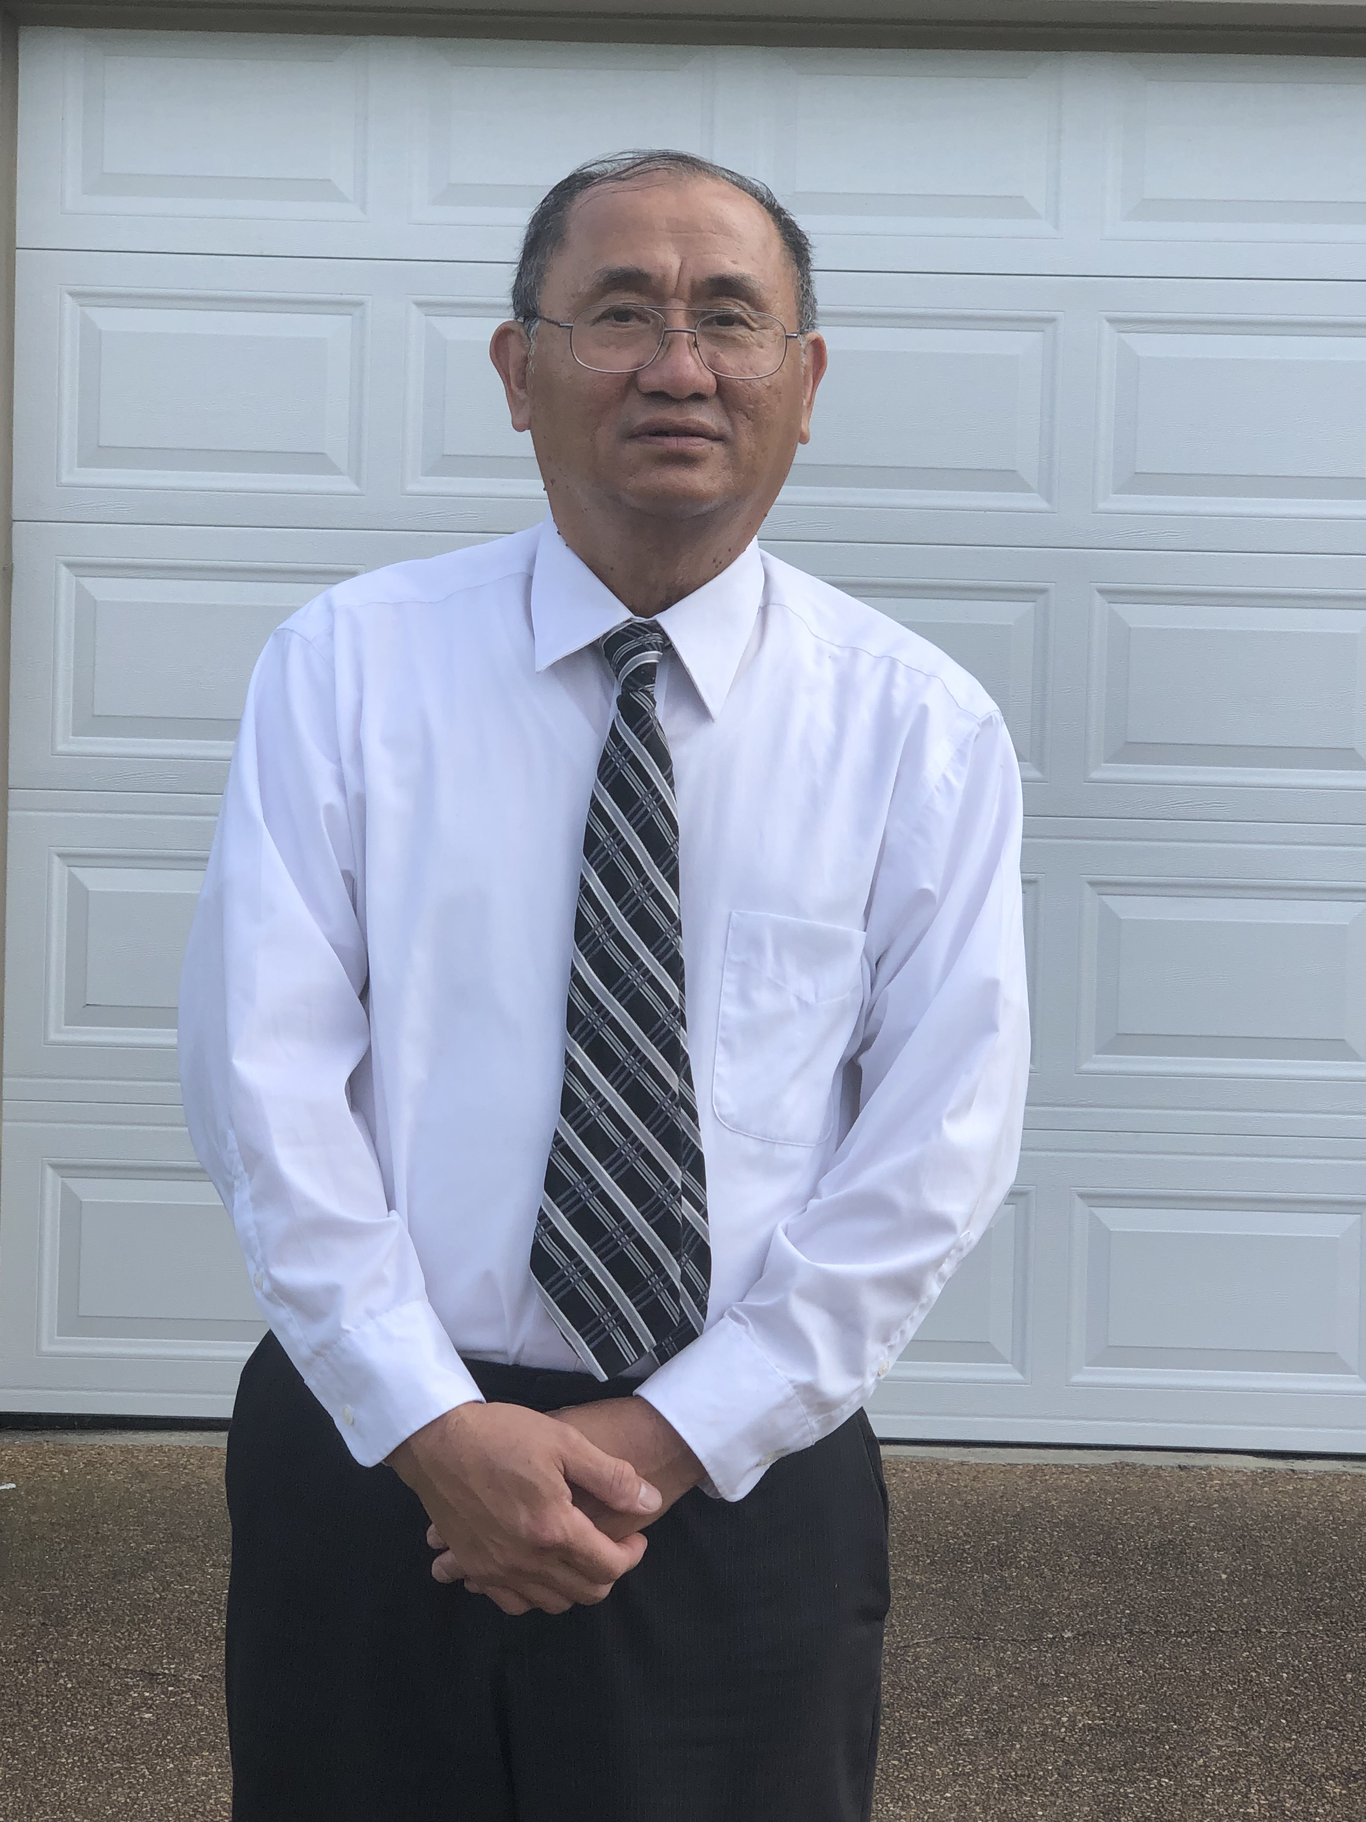
Loc Hong
Teacher: Loc Hong
Subject: Math
Brief Bio: I am from Vietnam. I am an experienced teacher and I
have been teaching since 2008 and I love to teach Math!
Email address: honglr@scsk12.org

Slide 25
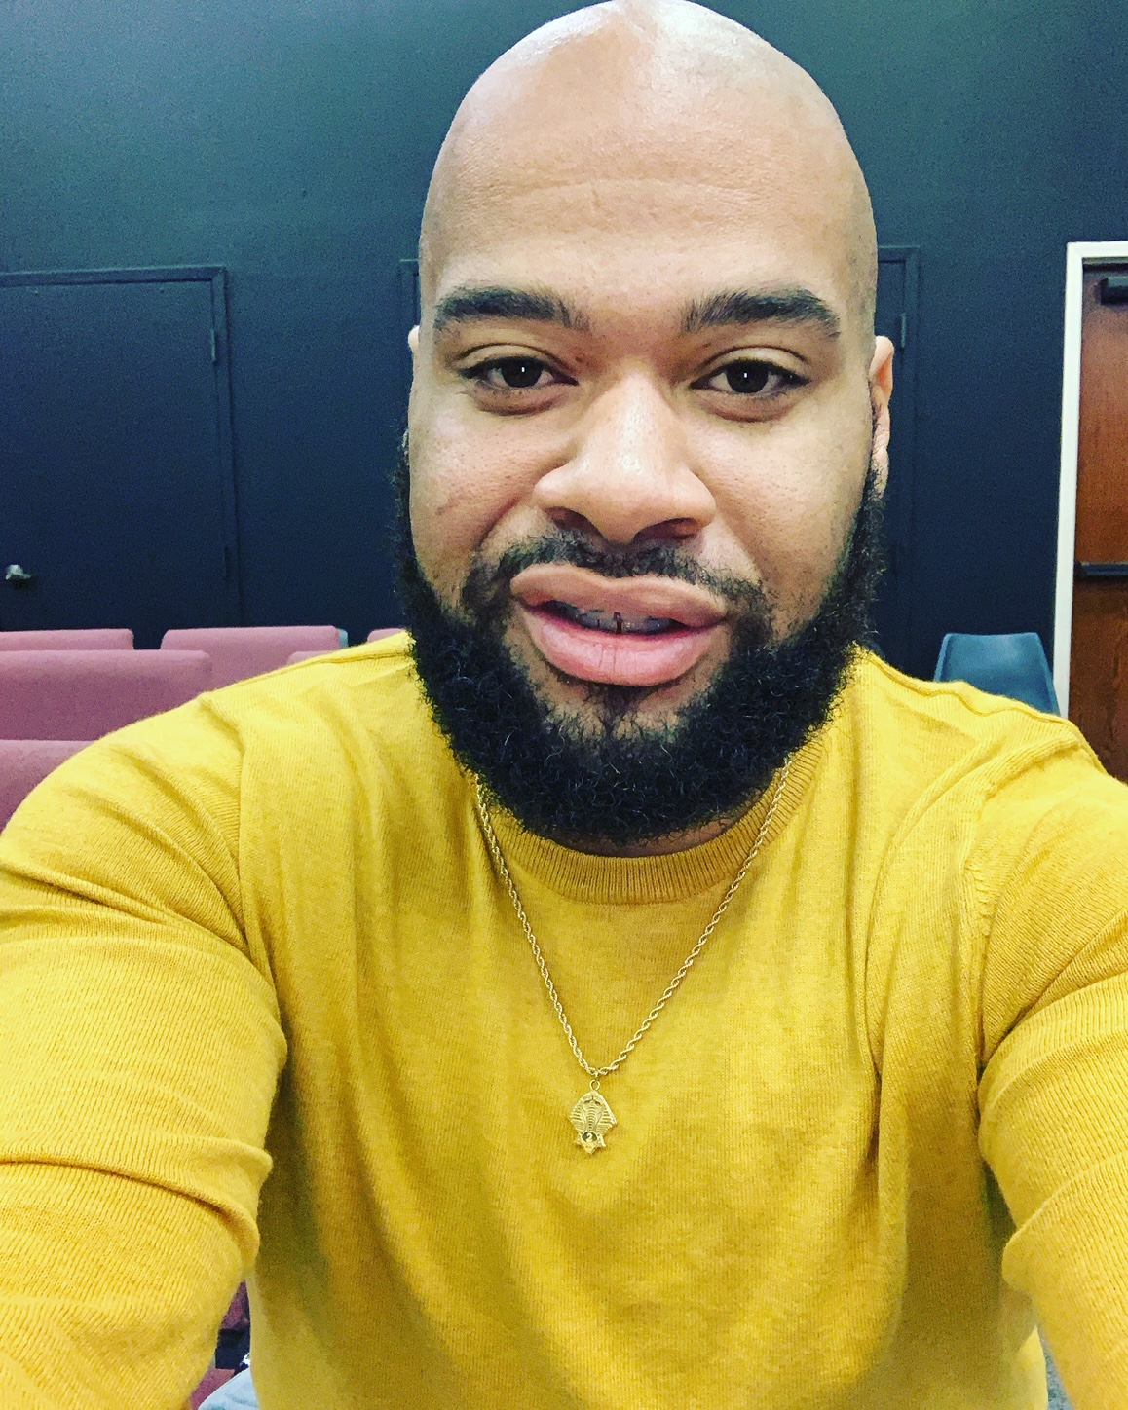
Ramone Smith
Teacher: Dr. Ramone Smith
Subject: Clue Teacher
Brief Bio: Dr. Ramone Smith has been an educator for 12 years and is new to Bolton High School. He serves as the CLUE instructor. One fun fact about Dr. Smith is that he loves DIY projects.
Email address: smithr7@scsk12.org

Slide 26
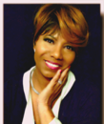
Cheryl Burton
Teacher: Cheryl Burton
Subject: Math Teacher
Brief Bio: Ms. Burton is a graduate of the University of Mississippi and has worked for SCS 30 years. She currently teaches Algebra 2. Her favorites include worship time, family time, crafting, traveling and shopping.
Email address: burtoncv@scsk12.org

Slide 27
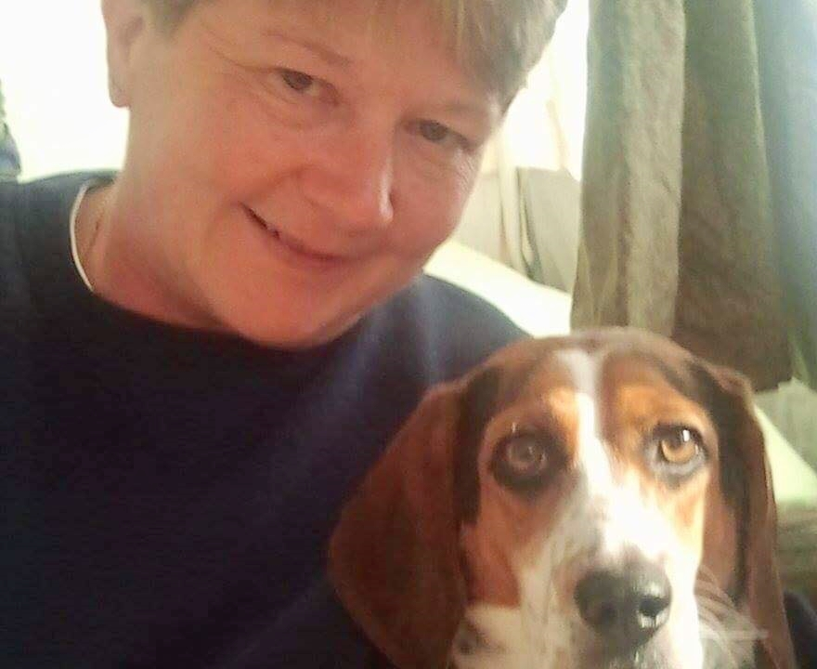
Pam Parker
Teacher: Pam Parker
Subject: Science
Brief Bio: Teacher at Bolton High School for 25 years. Currently Athletic Director. Coaching experience-Bolton Varsity Softball Head Coach for 16 years; Freshmen Girls Basketball Head Coach & Volleyball Assistant Head Coach. I am pictured with my beagle Winnie. My favorite pass time is camping.
Email address: parkerps@scsk12.org

Slide 28
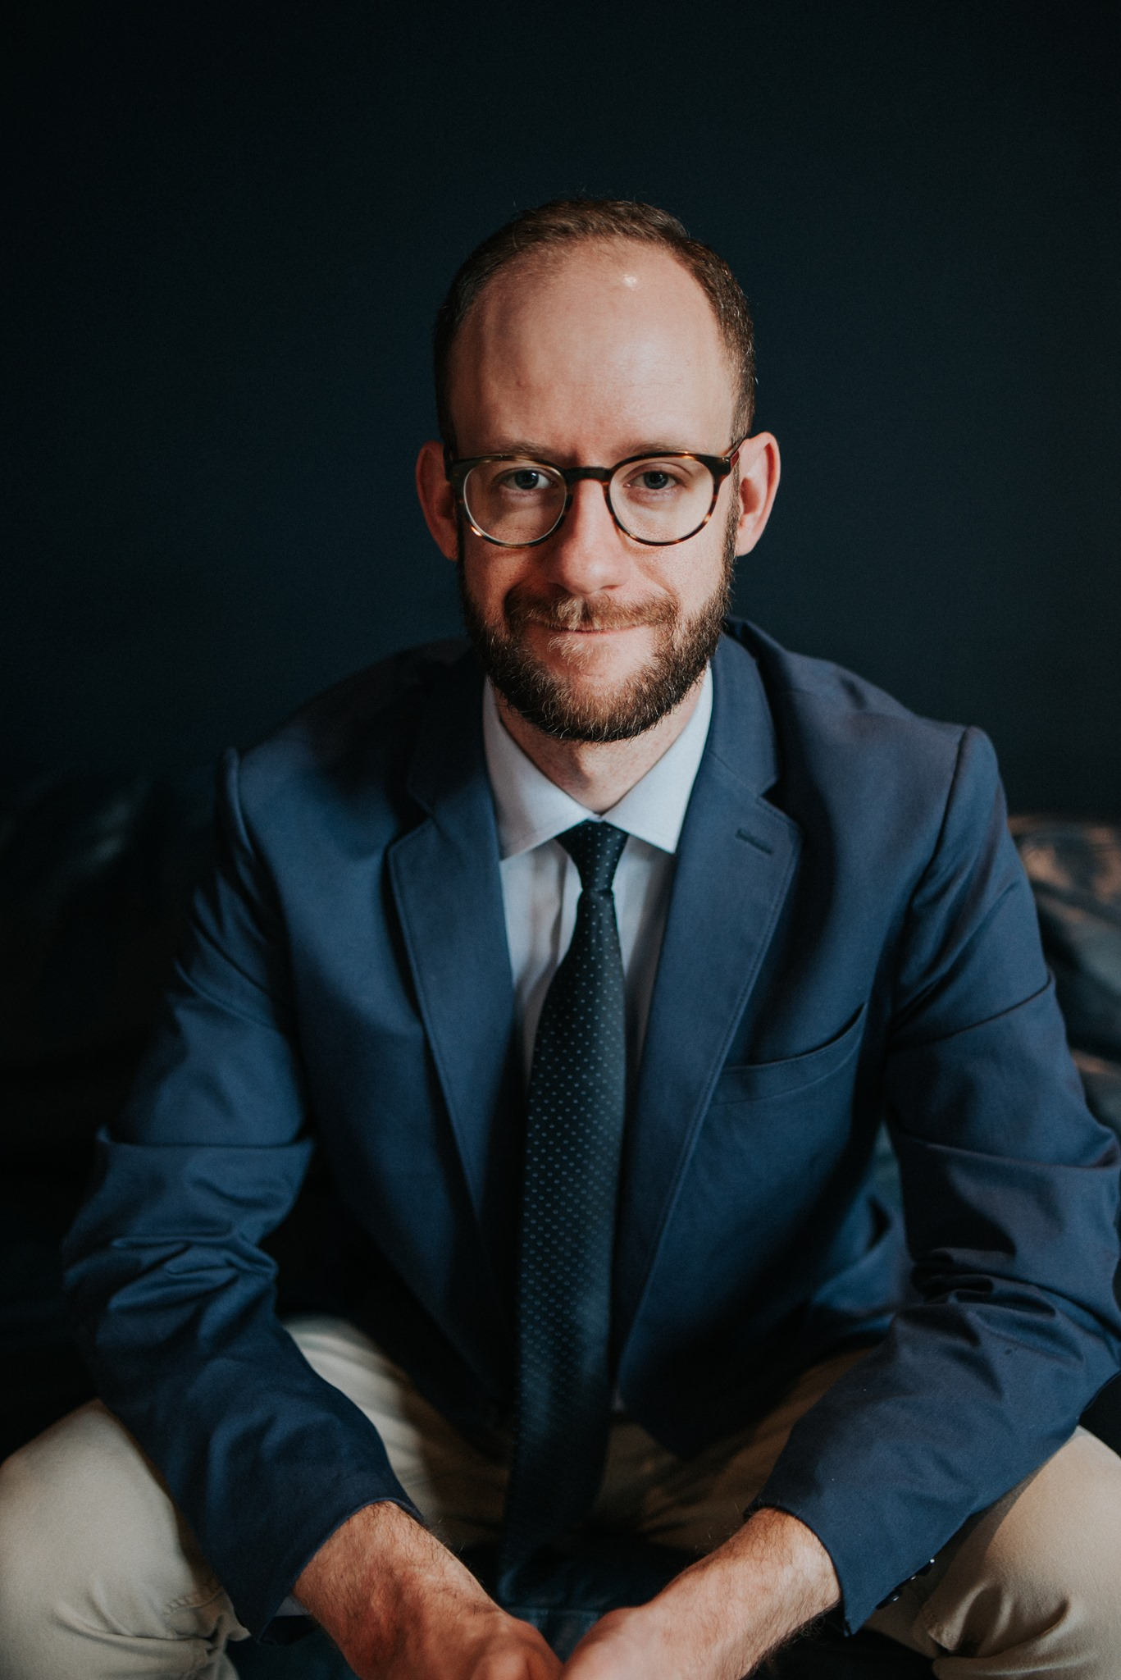
Chad Hoy
Teacher: Chad Hoy
Subject: Drama Teacher
Brief Bio: Chad Hoy is returning for his 2nd year as the Drama Teacher at Bolton High School. This will be his 7th year teaching for Shelby County Schools. Mr. Hoy is married to Tiffany, and they have a 1 year old named Whit. Chad is also an active member of the Memphis Theatre Community.
Email address: hoyc@scsk12.org

Slide 29
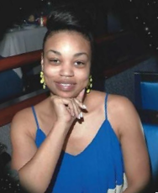
Erica Washington
Teacher: Erica Washington
Subject: Math Teacher
Brief Bio: My name is Mrs. Washington and I am a Math teacher with 6 years of experience. I love to travel, spend time with my family, and shopping. My hobbies include crafts and ceramics.
Email address: lewise@scsk12.org

Slide 30
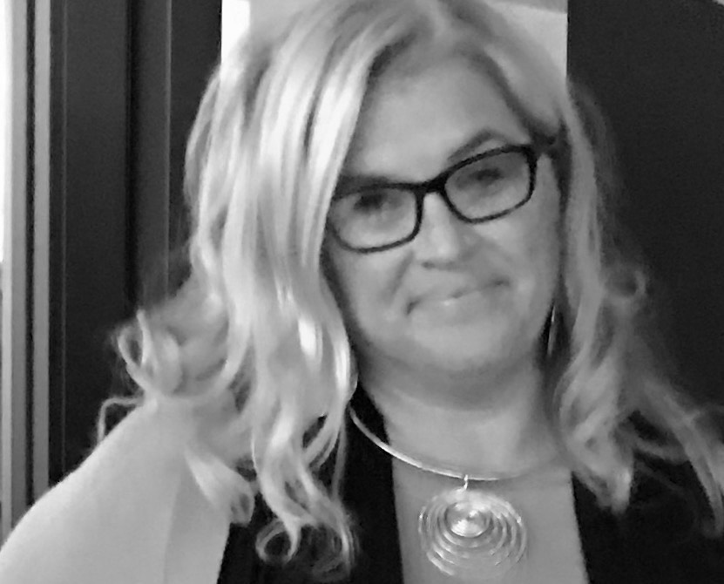
Paige Hassel
Teacher: Paige Hassel
Subject: Early Childhood Development
Brief Bio: Hi, my name is Paige Hassel. This is my fifth year as the ECEC teacher in the CCTE department at Bolton HS. I have taught various age and grade levels for the last 25 years, high school is definitely my favorite. When not at Bolton, I enjoy watching and attending sporting events and spending time with my family. Looking forward to a great year! Go BHS Wildcats!
Email address: hasselms@scsk12.org

Slide 31
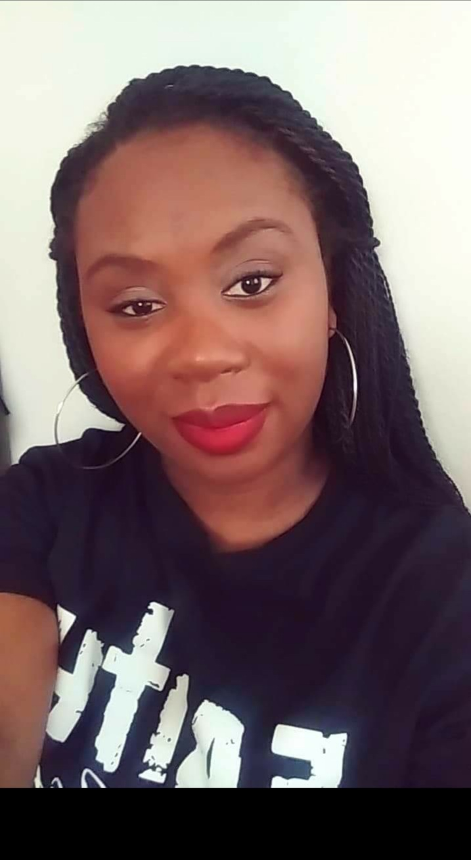
Charmeka Arnold
Teacher: Charmeka Arnold
Subject: Exceptional Education
Brief Bio: Charmeka Arnold, better known as "Miss A", is a Special Education Paraprofessional, where she works alongside the teacher with 9 through 12th grade functional skills students. She believes every child can ,so, everyday she passionately assist in creating a safe, comfortable, and healthy environment for learning. Miss A is one of the Head Basketball Cheer Coaches and has been at Bolton for four years. Go, Wildcats, Go!
Email address: arnoldc5@scsk12.org

Slide 32
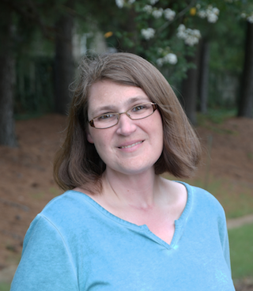
Jamie Seek
Teacher: Jamie Seek
Subject: Speech Pathologist
Brief Bio: Jamie Seek has been a school speech-language pathologist for 22 years. My undergraduate degree was completed at Rhodes College where I studied Greek and Latin and then I went on to The University of Memphis for my graduate degree where I studied Audiology and Speech-Language Pathology. I love spending time outside with my super rescue dog, Tilly, who must go walking every day!
Email address: seekj_ec@scsk12.org

Slide 33
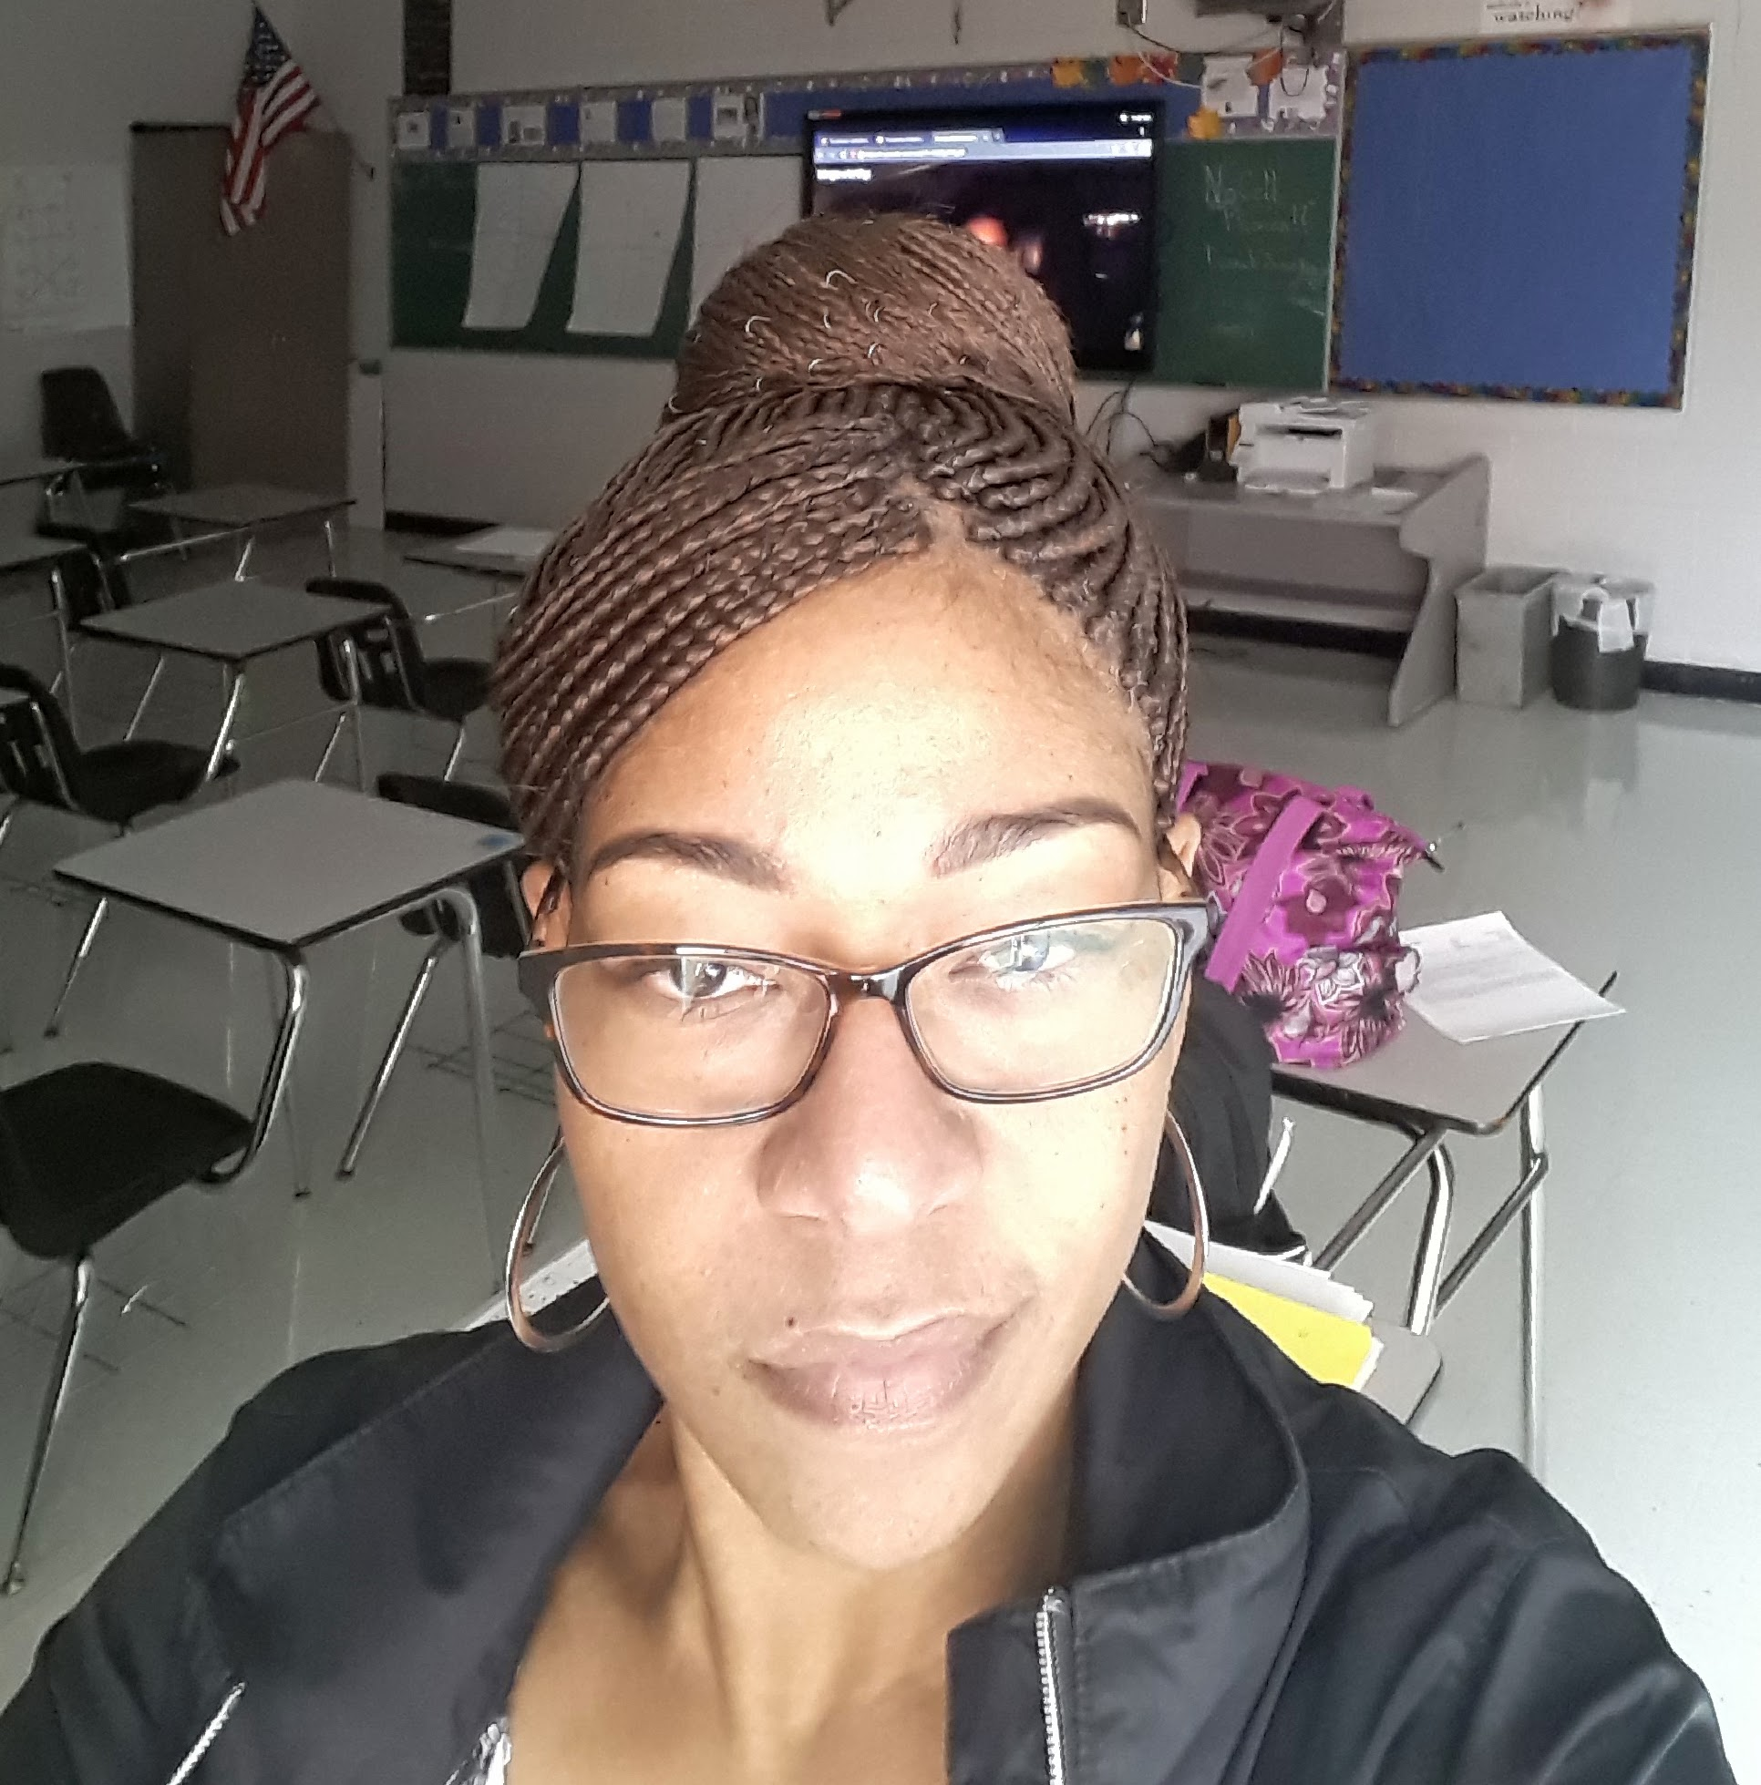
Candace Jones
Teacher: Candace Jones
Subject: Algebra 1 & Intervention
Brief Bio: Candace Jones graduated from the University of Memphis and she has been in the teaching Profession for 18 years.
Email address: jonesca2@scsk12.org

Slide 34
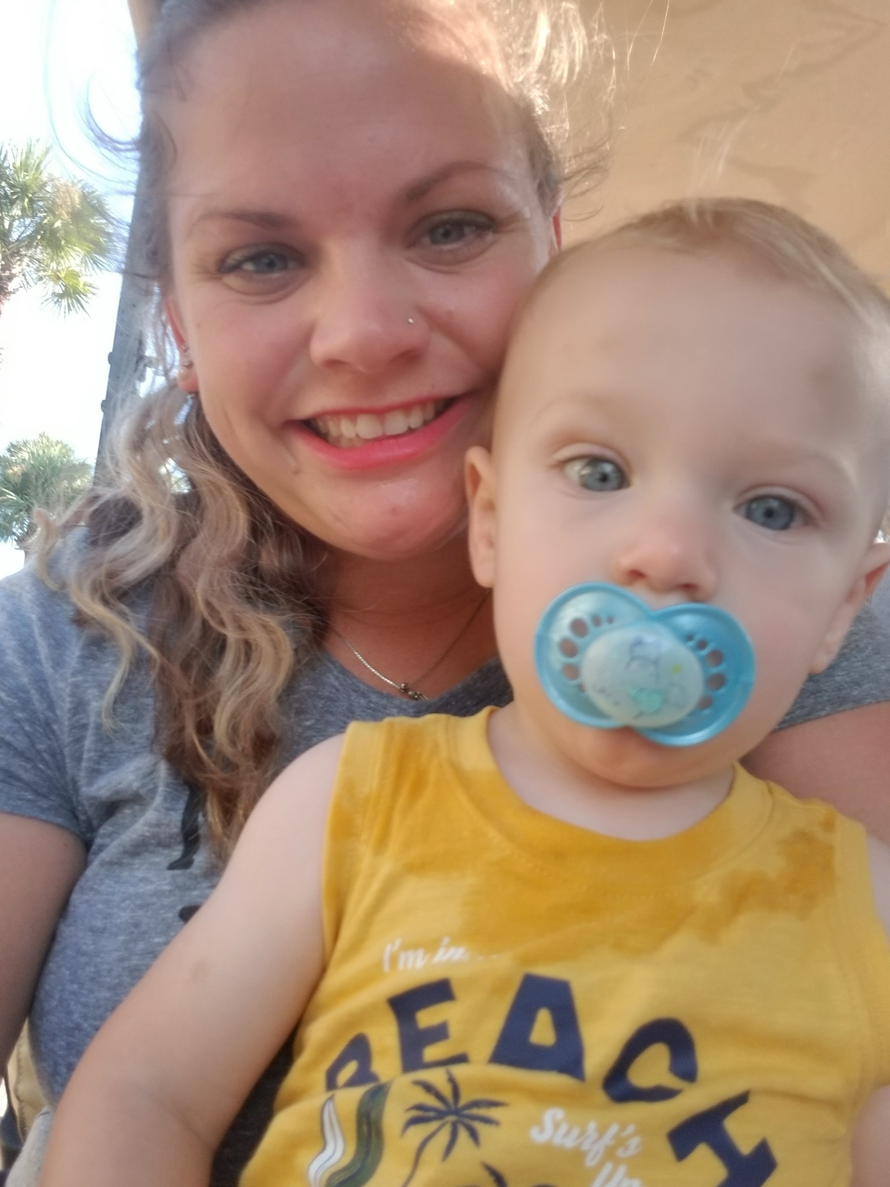
Meredith Smith
Teacher: Meredith Smith
Subject: Intervention
Brief Bio: My name is Meredith (Smith) Gladney! This will be my 7th year of teaching and 6th year at Bolton! I’m a Mom to the best little boy I could imagine, he is a year on the 25th! Make good choices!
Email address: smithm11@scsk12.org

Slide 35
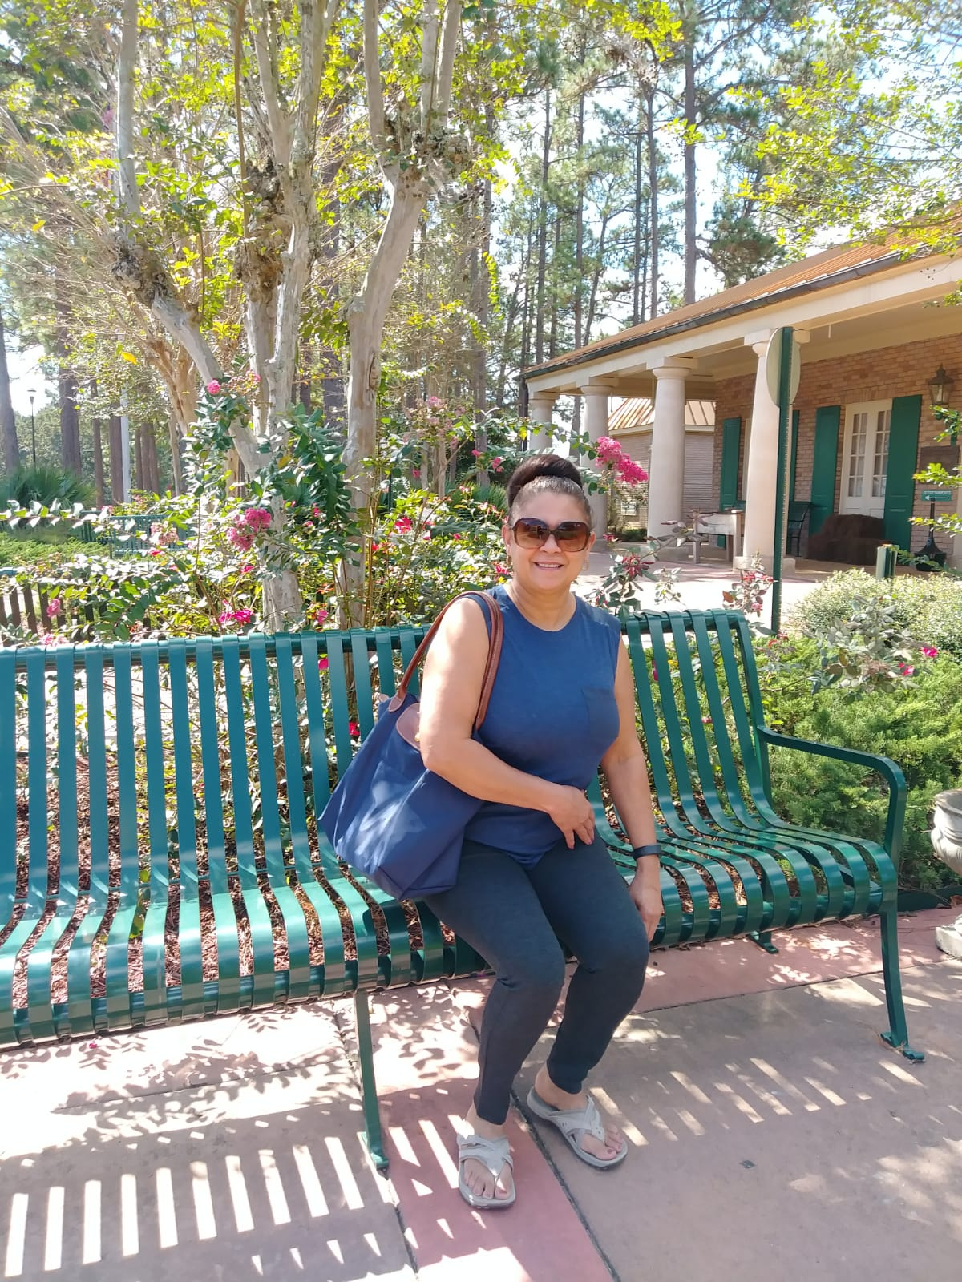
Pascuala Martin
Teacher: Pascuala Martin
Subject: Spanish
Brief Bio: Hello. I’m Pascuala Martin. I’m from the Dominic Republic, I speak Spanish and teach Spanish. I’m married, and I have two daughters. My favorite thing to do is to help people when they are in need. I love my profession and enjoy seeing how my students can understand and communicate in Spanish.
Email address: martinp1@scsk12.org

Slide 36
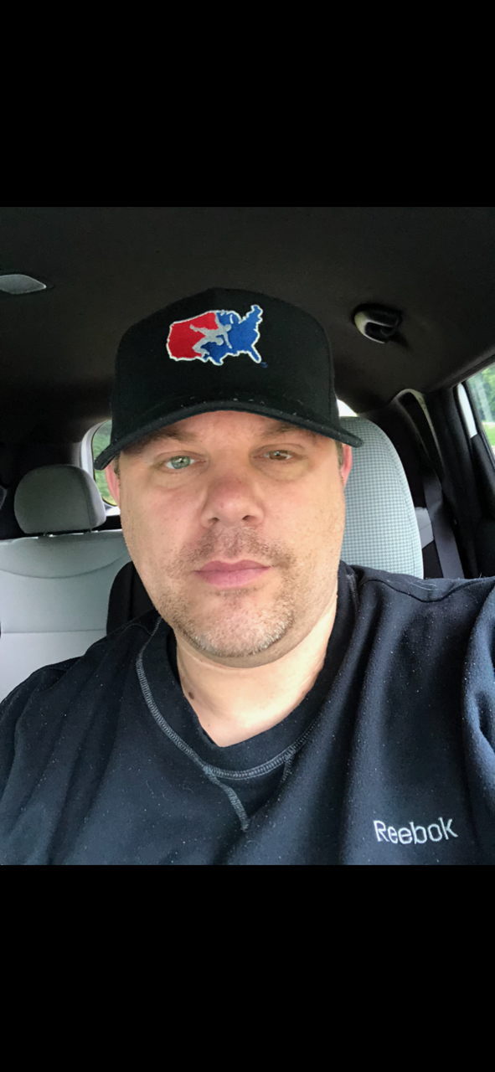
Rodrigo Galvan
Teacher: Rodrigo Galvan
Subject: Math
Brief Bio: This will be my 21st year teaching and 13th year at Bolton High School. I teach English and also serve as the school’s head Wrestling Coach. Our program is one of the MOST SUCESSFUL in all of Shelby County year in and year out. A personal fun fact about me is, I am the matchmaker for Cage Fury Fighting Championship (CFFC) which is one of the top MMA promotions in the world and the lead feeder system for the UFC.
Email address: galvanrd@scsk12.org

Slide 37
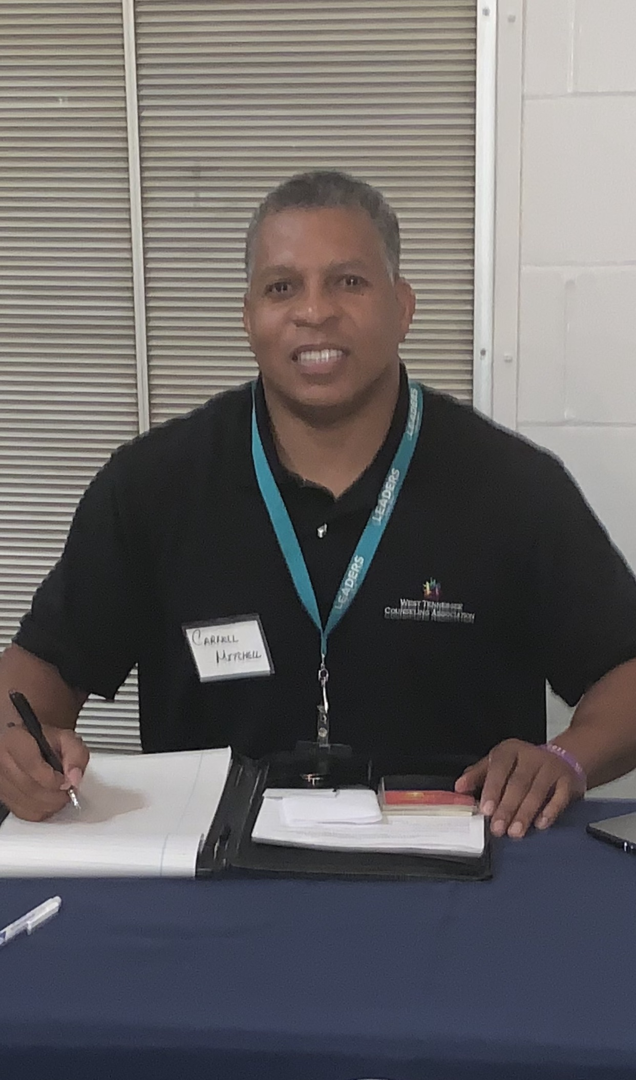
Carnell Mitchell
Teacher: Carnell Mitchell
Staff: Counselor (11th Grade Last Name A-L & 10th Grade)
Brief Bio: My name is Carnell D. Mitchell and I am very proud to serve as your 10th Grade & partial 11th Grade (A-L) Professional School Counselor. This will be my 2nd year here at Bolton High School as your school counselor. I am a huge Philadelphia Eagles fan (Go Birds); avid traveler; & father of two of the most amazing children that I know.
Email address: mitchellcd2@scsk12.org

Slide 38
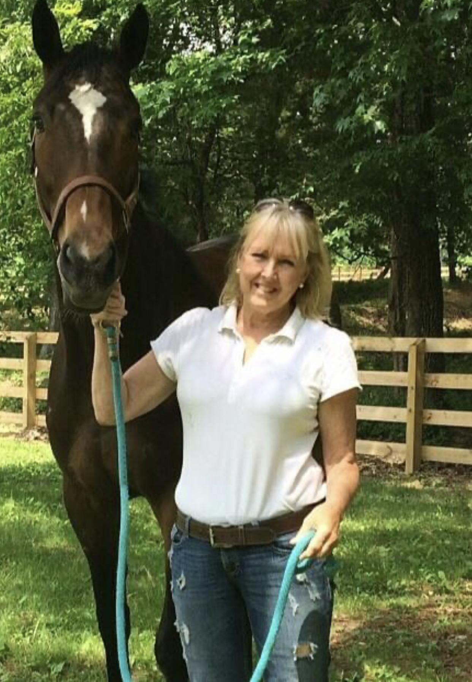
Nancy Stephenson
Teacher: Nancy Stephenson
Subject: Intervention
Brief Bio: This will be my 21st year with Shelby County Schools. I live on a farm about 60 miles East of Memphis and spend my spare time riding my horses and doing some three day cross country eventing when time permits.
Email address: stephensonnf@scsk12.org

Slide 39
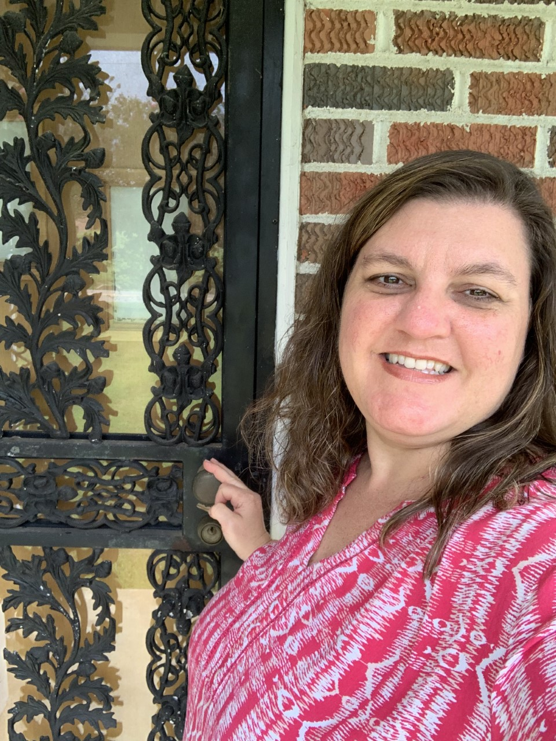
Kathryn Henke
Teacher: Kathryn Henke
Subject: History
Brief Bio: My name is Kathy Henke. I teach mostly Social Studies Electives. I am starting year 10 of teaching at Bolton. I have four kids, ages 26, 23, 22, & 19-two girls and two boys (all but the eldest went to Bolton). I actually graduated from Bolton in 1990 so my blood runs, Blue, Gray, & White! Ready to take on this year and continue #BoltonStrong with that #WildcatPride!!!
Email address: henkekr@scsk12.org

Slide 40
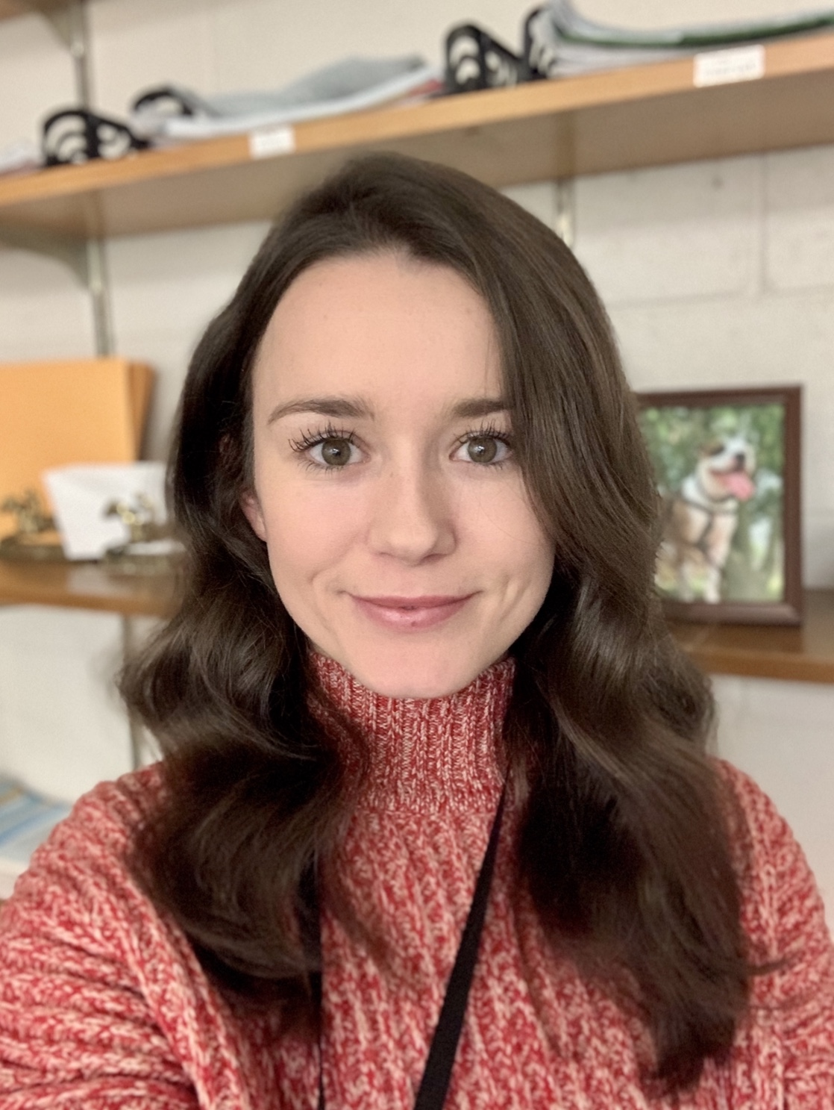
Barbara Merryman
Teacher: Barbara Merryman
Subject: Intervention
Brief Bio: I am eager to begin my fourth year as a Case Manager & C0-Teacher at Bolton! Originally from Baltimore, Maryland, I moved to Memphis after graduating from John Hopkins. In my free time, I enjoy going horseback riding, helping dogs in need, and teaching yoga.
Email address: merrymanba@scsk12.org

Slide 41
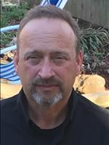
Robert Bates
Teacher: Robert Bates
Subject: Marketing & Supply Chain Management
Brief Bio: This will be my 14th year teaching with Shelby County Schools. It is my 6th year at Bolton & I was at Millington HS for 8 years. I am teaching Marketing & Management as well as Intro to Supply Chain Management. I am the Golf coach & in my career I am an Umpire for College & High School Baseball. My wife, Deanna, & I just celebrated our 36th Anniversary & we have proudly raised 3 children, 5 Labrador Retrievers & a Pound Puppy. Now we are working on finding time to be involved with our 4 grandchildren.
Email address: batesrm@scsk12.org

Slide 42
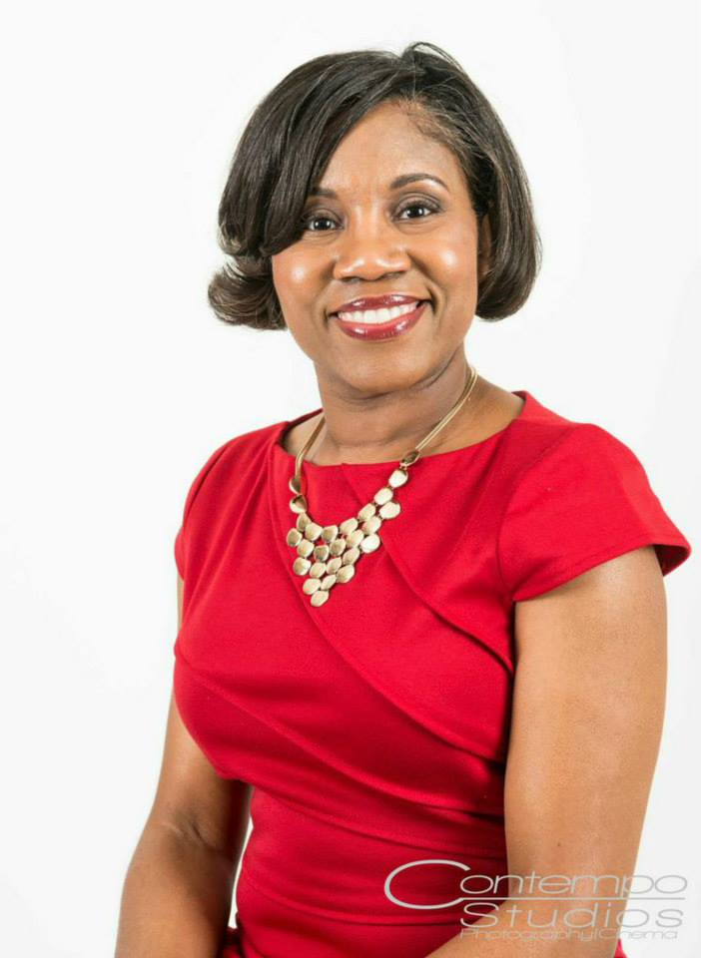
Fredricka Vaughn
Teacher: Fredricka Vaughn
Subject: English
Brief Bio: My name is Fredricka Vaughn, and this will be my 24th year of teaching. I have always taught High School English. A fun fact about me is that my last name will change before the school year ends. I am “Vaughn” now but it will be “Johnson” before the first semester ends. However, I will answer to both in order to not confuse everyone.
Email address: vaughnfy@scsk12.org

Slide 43
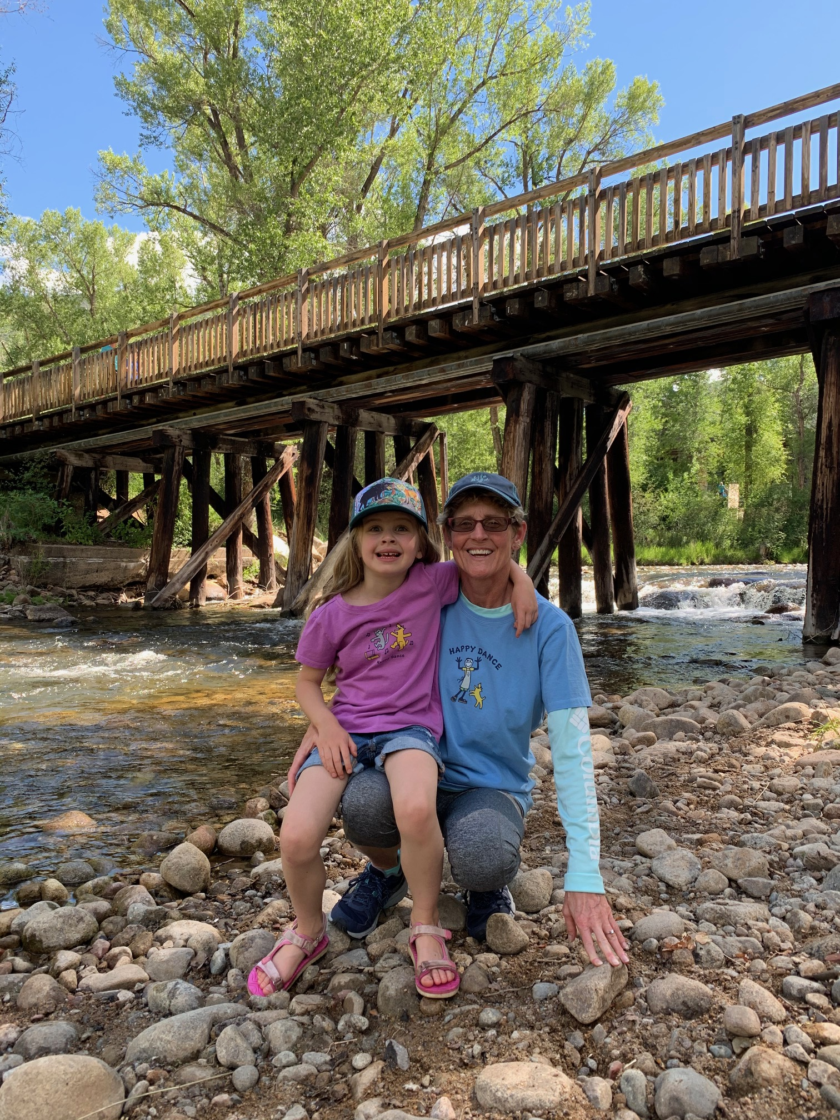
Deborah Williams
Teacher: Deborah Williams
Subject: History
Brief Bio: Ever since I was a teenager, I have wanted to be a High School Teacher. I teach Government, History and the ACAD dual enrollment classes. This is my 20th year at Bolton High School and I hope to teach here until I retire. I love my students and hope to inspire them to always do their best and be good citizens.
Email address: williamsdc@scsk12.org

Slide 44
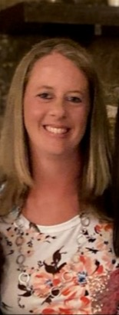
Kathryn Dotson
Teacher: Kathryn Dotson
Subject: Physical Education
Brief Bio: I am Coach Kay Dotson, this will will begin my 19th year teaching in Shelby County Schools. I enjoy Memphis Tigers Basketball and spending time outdoors. I look forward to a fun and successful year!
Email address: dotsonk@scsk12.org

Slide 45
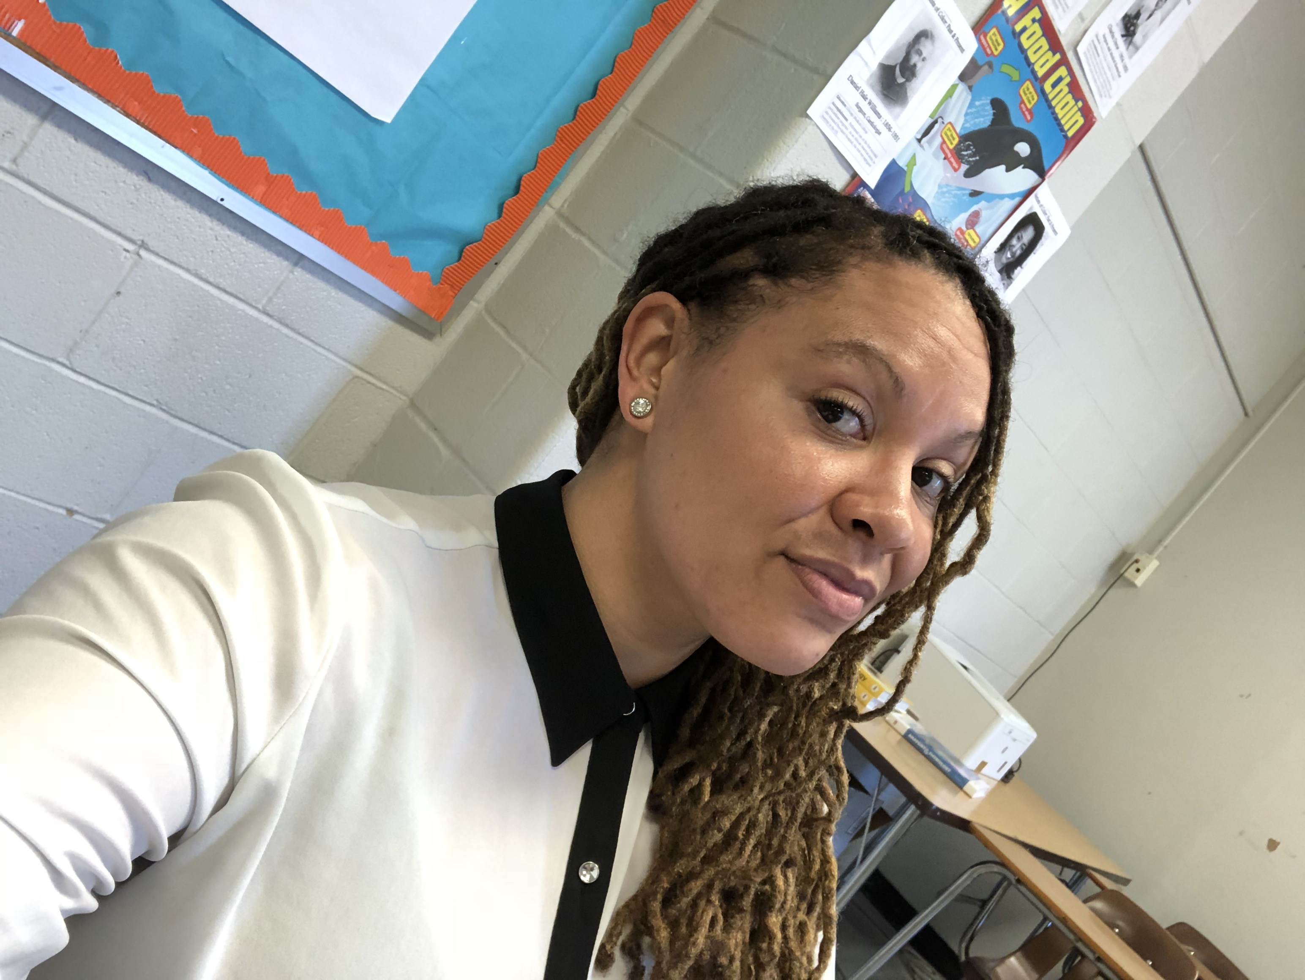
Veronica Woodard
Teacher: Veronica Woodard
Subject: Science
Brief Bio: I am originally from the San Francisco Bay area in California. I moved to Memphis five years ago. This school year begins my 10th year teaching Middle and High School Sciences. I love animals, including my two, and I enjoy going for runs after school!
Email address: woodardvm@scsk12.org

Slide 46
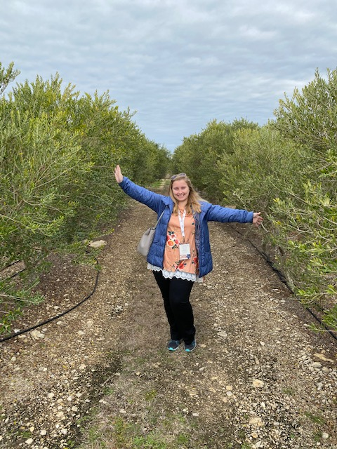
Kayla Fisher
Teacher: Kayla Fisher
Subject: Agri-Stem
Brief Bio: This is my third year teaching Agriculture Education. I have a broad background in Agriculture, including in areas of soil science, plant science, and animal science. I help farm 3,000 acres of row crops (mainly, corn, soybeans, and wheat), 5 acres of vegetables, and we raise livestock as well.
Email address: fisherk@scsk12.org

Slide 47
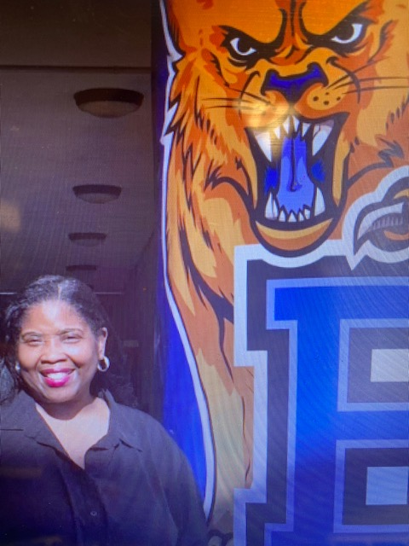
Deonna Pirtle
Counselor: Deonna Pirtle
Staff: Counselor-11th Grade Last Name M-Z & 9th Grade Counselor
Brief Bio: I received my education from Fisk University and the University of Arkansas at Fayetteville. My first profession was in mental health, and after my discovery of working mostly with children, I made my transition to education. I am the parent of two beautiful daughters pursing their education in college. I love to read and enjoy watching movies!
Email address: pirtledj@scsk12.org

Slide 48
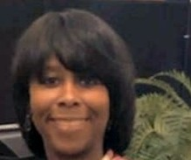
Katrina Smith
Teacher: Katrina Smith
Subject: Science
Brief Bio: My name is Katrina Smith. I have been teaching 15 plus years. I enjoy helping others, spending time with my family and traveling.
Email address: smithkl3@scsk12.org

Slide 49
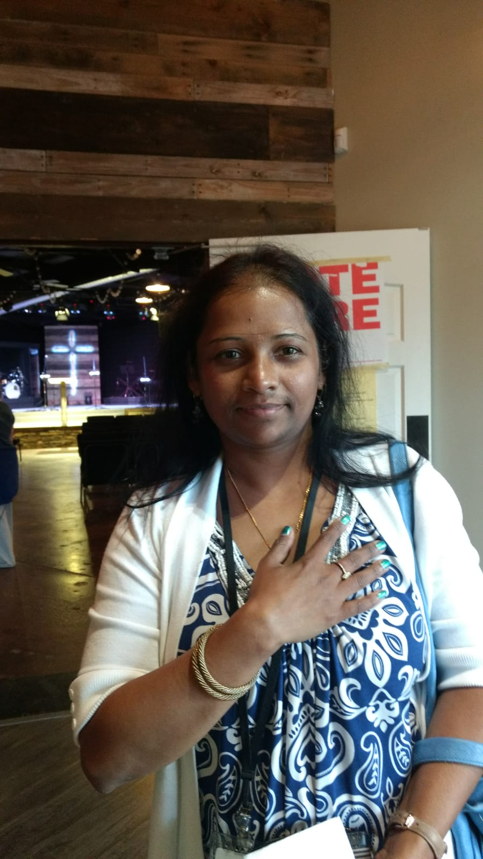
Vaideki Krishnan
Teacher: Vaideki Krishnan
Subject: Math
Brief Bio: I am Mrs. Krishnan and this is my fourth year with Shelby County. I got my Master’s Degree in Mathematics in India. I am married to my wonderful husband for 21 years and we have two beautiful children. I have a strong desire to see my students excel and achieve their full potential. To achieve success, I believe in an encouraging and engaging classroom-so that is what I strive to provide. There is one successful formula to succeed in math, and that is to practice. I am excited to be a part of Bolton High and I am looking forward to a great year.
Email address: rajagopalaknishv@scsk12.org

Slide 50
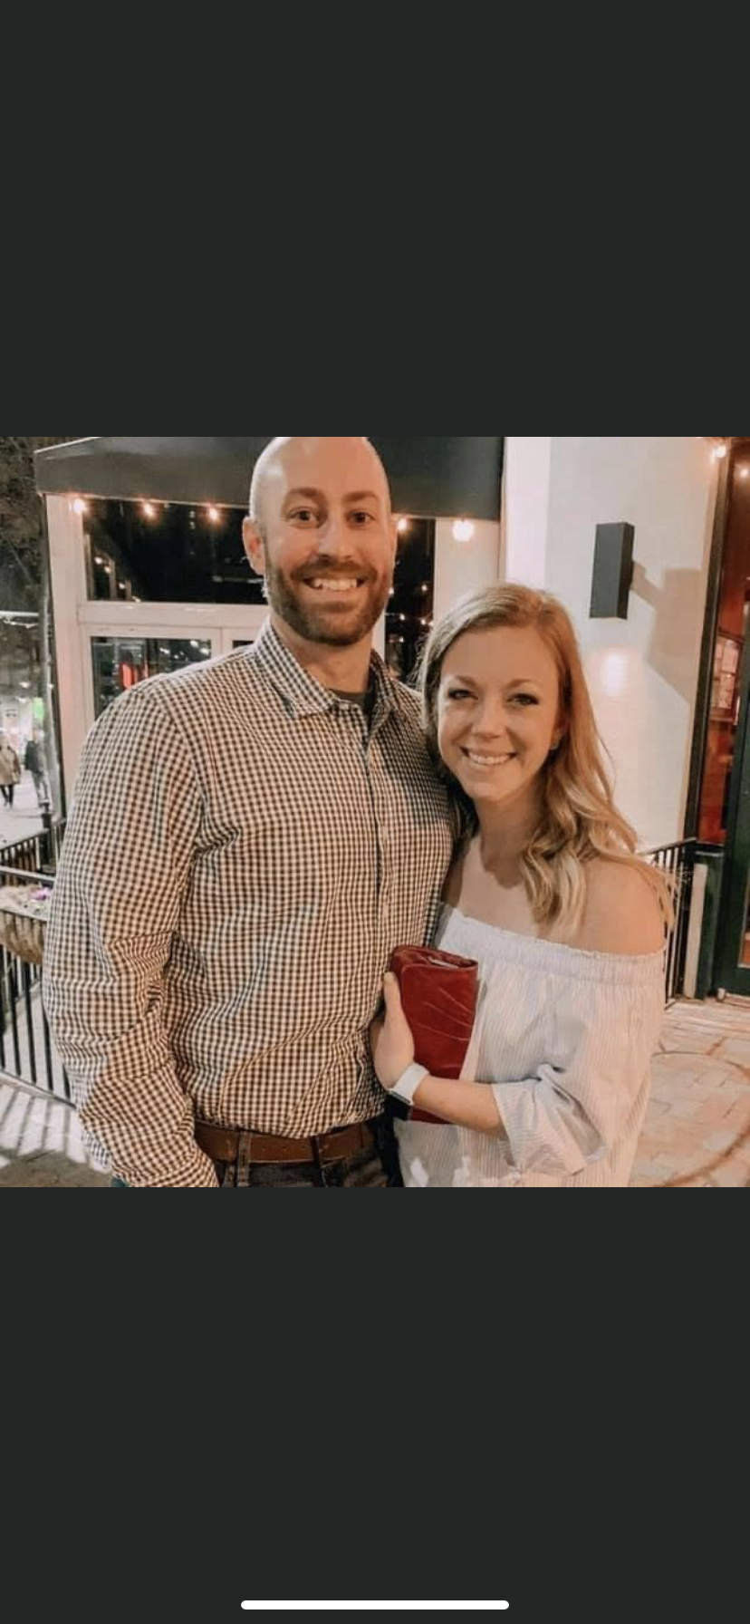
Gene Traynom
Teacher: Gene Traynom
Subject: History
Brief Bio: My name is Gene Traynom and I have been teaching for 10 years. I teach US History, Pre-AP World History and Geography, and IB History of the Americas. I graduated from the University of Memphis and I love to play golf. I have three wonderful children and one amazing wife.
Email address: traynomg@scsk12.org

Slide 51
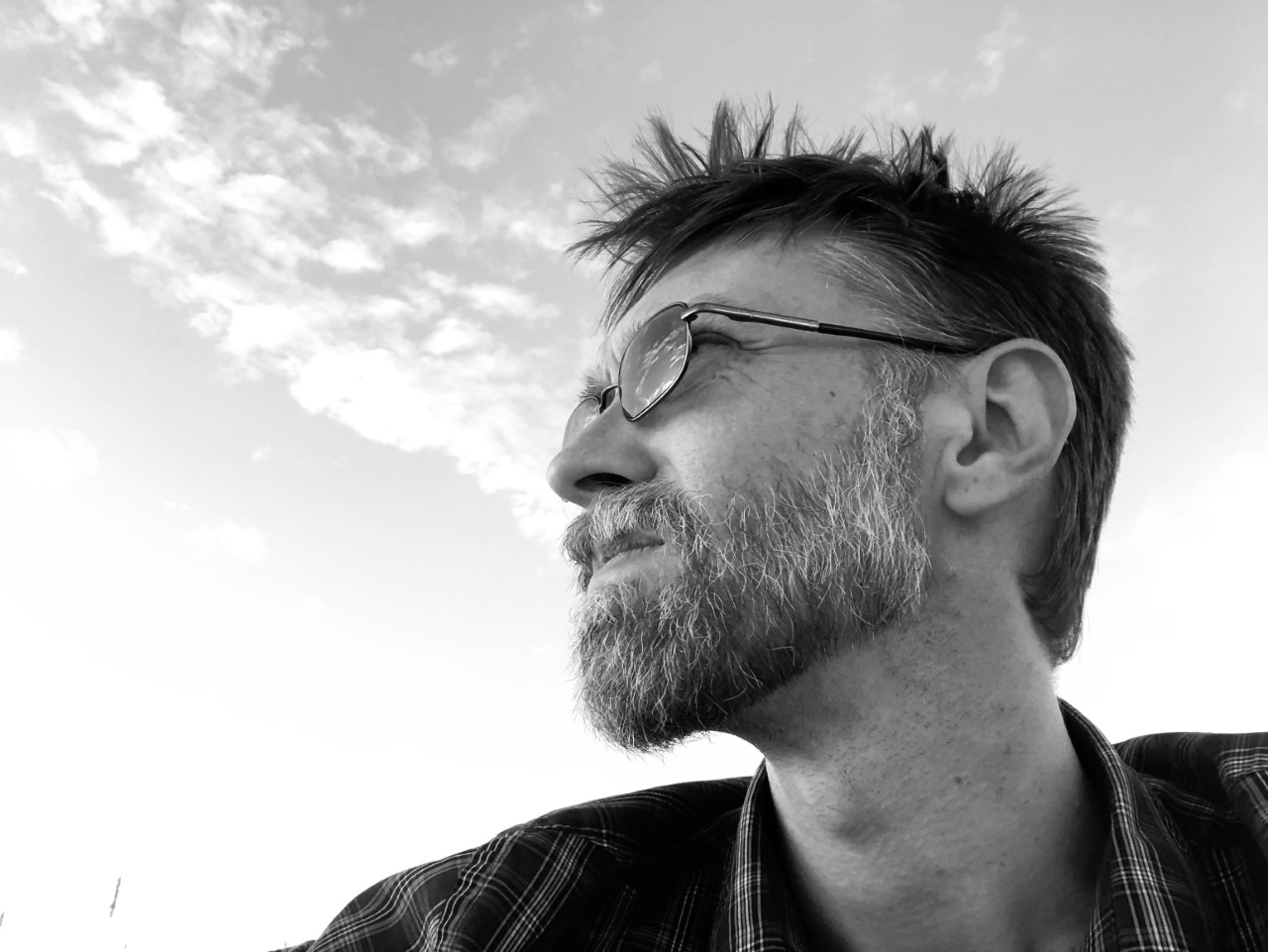
Jeremy Luno
Teacher: Jeremy Luno
Subject: History & Psychology
Brief Bio: Jeremy Luno is a member of Bolton’s Social Studies Department, and teaches AP Psychology, IB Psychology, Intro. To Psychology, and World History. His Undergraduate Degree is a BFA in Filmmaking from Florida State University, and his graduate degree is a MS in Psychology from the sponsor for Bolton’s ‘The CLUB’ (the Cinema, Literature, and mUsic Bunch).
Email address: lunoj@scsk12.org

Slide 52
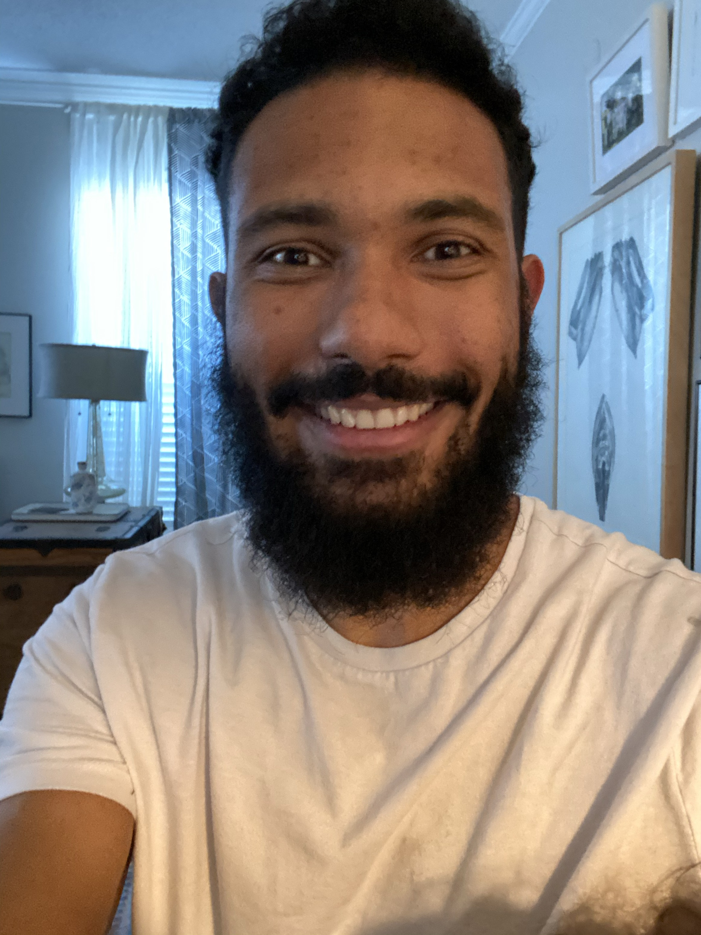
Nikita Hardrick
Teacher: Nikita Hardrick
Subject: Maintenance & Automotive Repair
Brief Bio: Hello Bolton Family I am Nikita Hardrick the Maintenance and Light Repair (Automotive) teacher. I started teaching October of 2019 and I am excited to grow with this school! I have been in the automotive industry for 7 years and hope to one day build a race car from the ground up! Bolton Strong! Go Wildcats!
Email address: hardrickn@scsk12.org

Slide 53
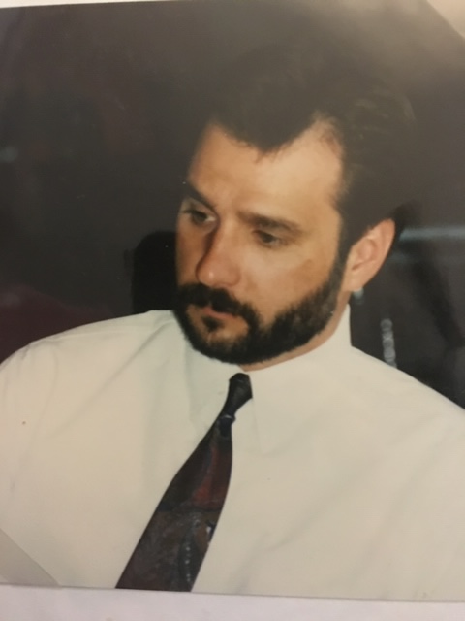
Robert Young
Teacher: Robert Young
Subject: History
Brief Bio: Robert Young was born and raised in the Shelby County area. His work experience includes a stint with the PRCA, FedEx, KRAFT Foods & teaching with Shelby County Schools.
Email address: youngvr@scsk12.org

Slide 54
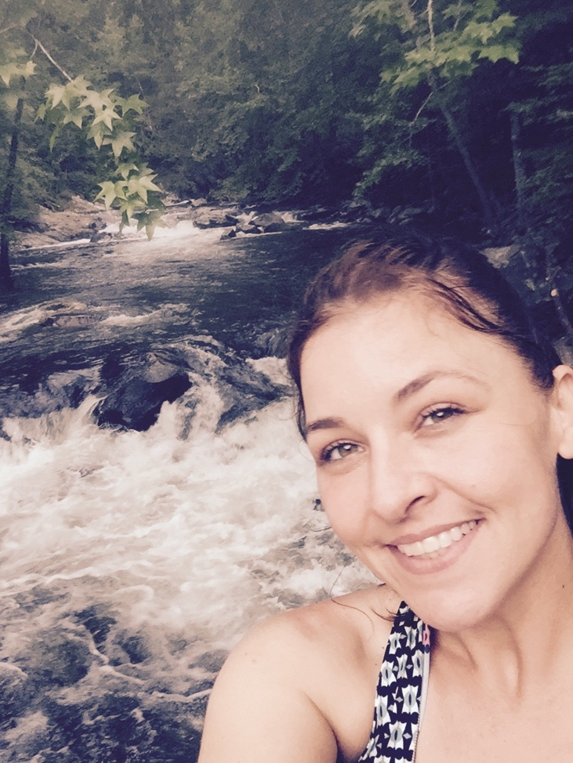
Nicole McClanahan
Teacher: Nicole McClanahan
Subject: Art
Brief Bio: Hello, I have been teaching Visual Art at Shelby County Schools for 16 years!! I am passionate about creating, whether it’s a painting, a garden, or a meal. I love the outdoors and often find inspiration in nature. My approach to the Arts is classical-Is it good, it it true, is it beautiful??
Email address: mcclanahannc@scsk12.org

Slide 55
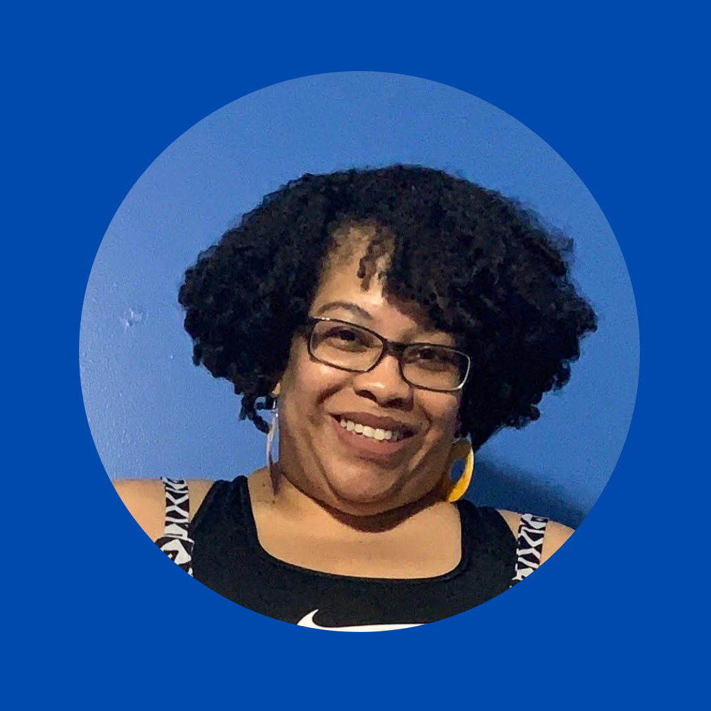
Zina Henry
Teacher: Zina Henry
Staff: Librarian
Brief Bio: I’m Zina Henry. I started teaching with Shelby County Schools in 2000 and later became a librarian/media specialist. I left teaching in 2011 to work at the board as a teacher recruiter and returned to teaching in 2019. Fun Fact: I used to teach step aerobics at French Riviera Spa.
Email address: henryzs@scsk12.org

Slide 56
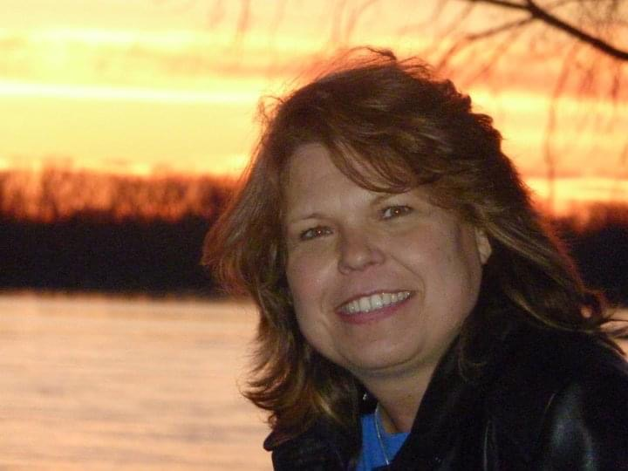
Melody Buss
Teacher: Melody Buss
Subject: Band
Brief Bio: Melody Buss is the band and music teacher @ Bolton High School. She is starting her 23rd year of teaching and 3rd year at Bolton High School. She teaches concert Band, Piano, and Music History
Email address: bussm@scsk12.org

Slide 57
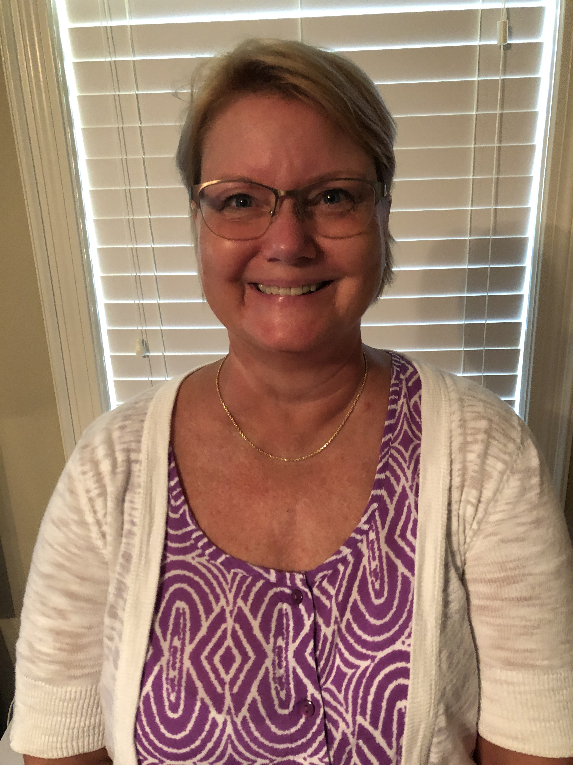
Kathryn Denk
Teacher: Kathryn Denk
Subject: English
Brief Bio: This year Mrs. Denk will be teaching English III. AP Lang, AP Lit, IB Sr. English and IB Theory of Knowledge. This is her 6th year at Bolton, but her 38th year of teaching Secondary English. In 2015, she and her husband moved from Green Bay, Wisconsin (Go Packers & Bucks!) Her oldest daughter is a Music Professor at Auston Peay University in Clarksville, TN and her younger daughter is a graphics producer for the NBA/WNBA on ESPN.
Email address: denkkm@scsk12.org

Slide 58
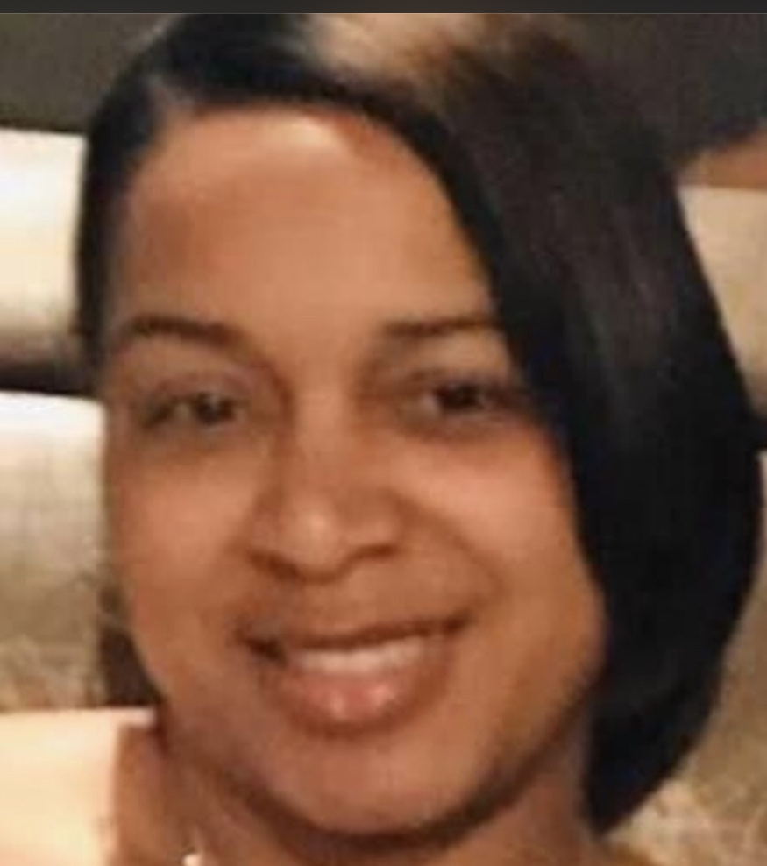
Kahreesha Edwards
Teacher: Kahreesha Edwards
Subject: Exceptional Education
Brief Bio: My name is Kahreesha Edwards. My husband and I have been married for 16 years. We have 2 girls, one son, and a god son. I graduated from THE Tennessee State University with a Bachelor’s Degree in Elementary Education and a Master’s Degree in Education (M.Ed). I received my MBA in Applied Management from Indiana Wesleyan University. I taught Pre-Algebra and Science in Nashville and Indiana for a total of 5 years before becoming a stay at home mom for 12 years. I later joined the Bolton family in 2017, where I am currently employed as a SPED Paraprofessional. I am a certified Online Teacher as well as a Grant Writing Specialist.
Email address: edwardsk6@scsk12.org

Slide 59
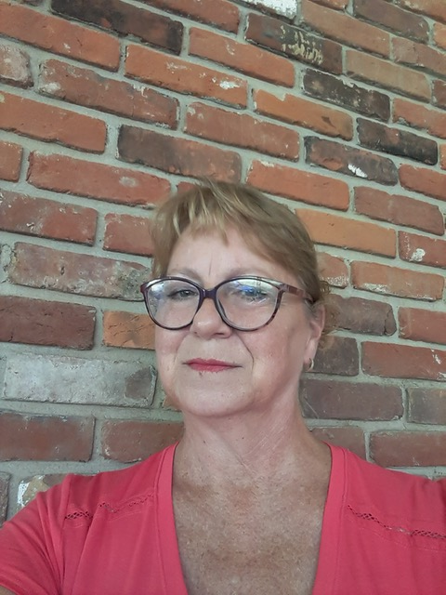
Mary Unsell
Teacher: Mary Unsell
Subject: Exceptional Education
Brief Bio: My name is Mary Unsell and I am a proud graduate of Germantown High School and the University of Tenneseee, Knoxville. This is my 33rd year teaching students with disabilities and they are my joy. For the majority of my career, I have had the pleasure of being a Wildcat!
Email address:

Slide 60
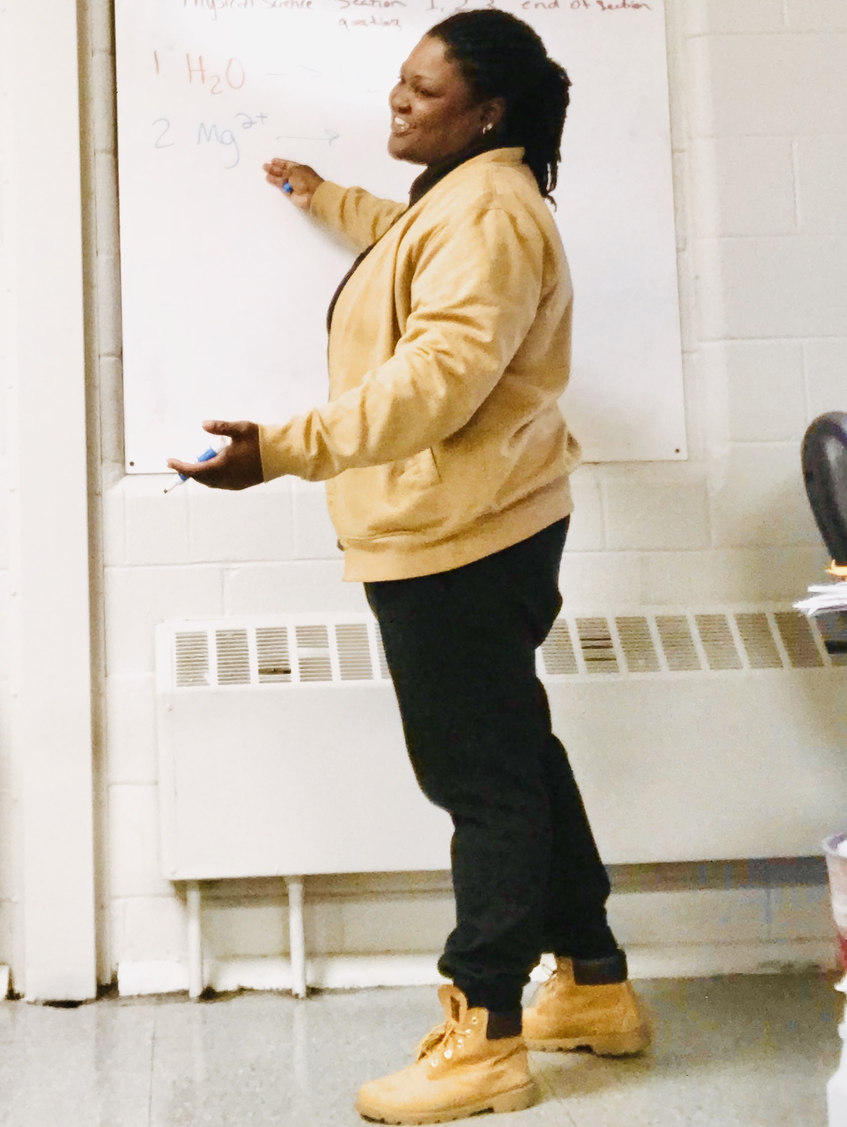
Tieka North
Teacher: Tieka North
Subject: Science
Brief Bio: Ms. Tieka North. I am from AL. I graduated from The Alabama State University. This is my fourth year teaching, my third at Bolton High. I teach Chemistry.
Email address: northt@scsk12.org

Slide 61
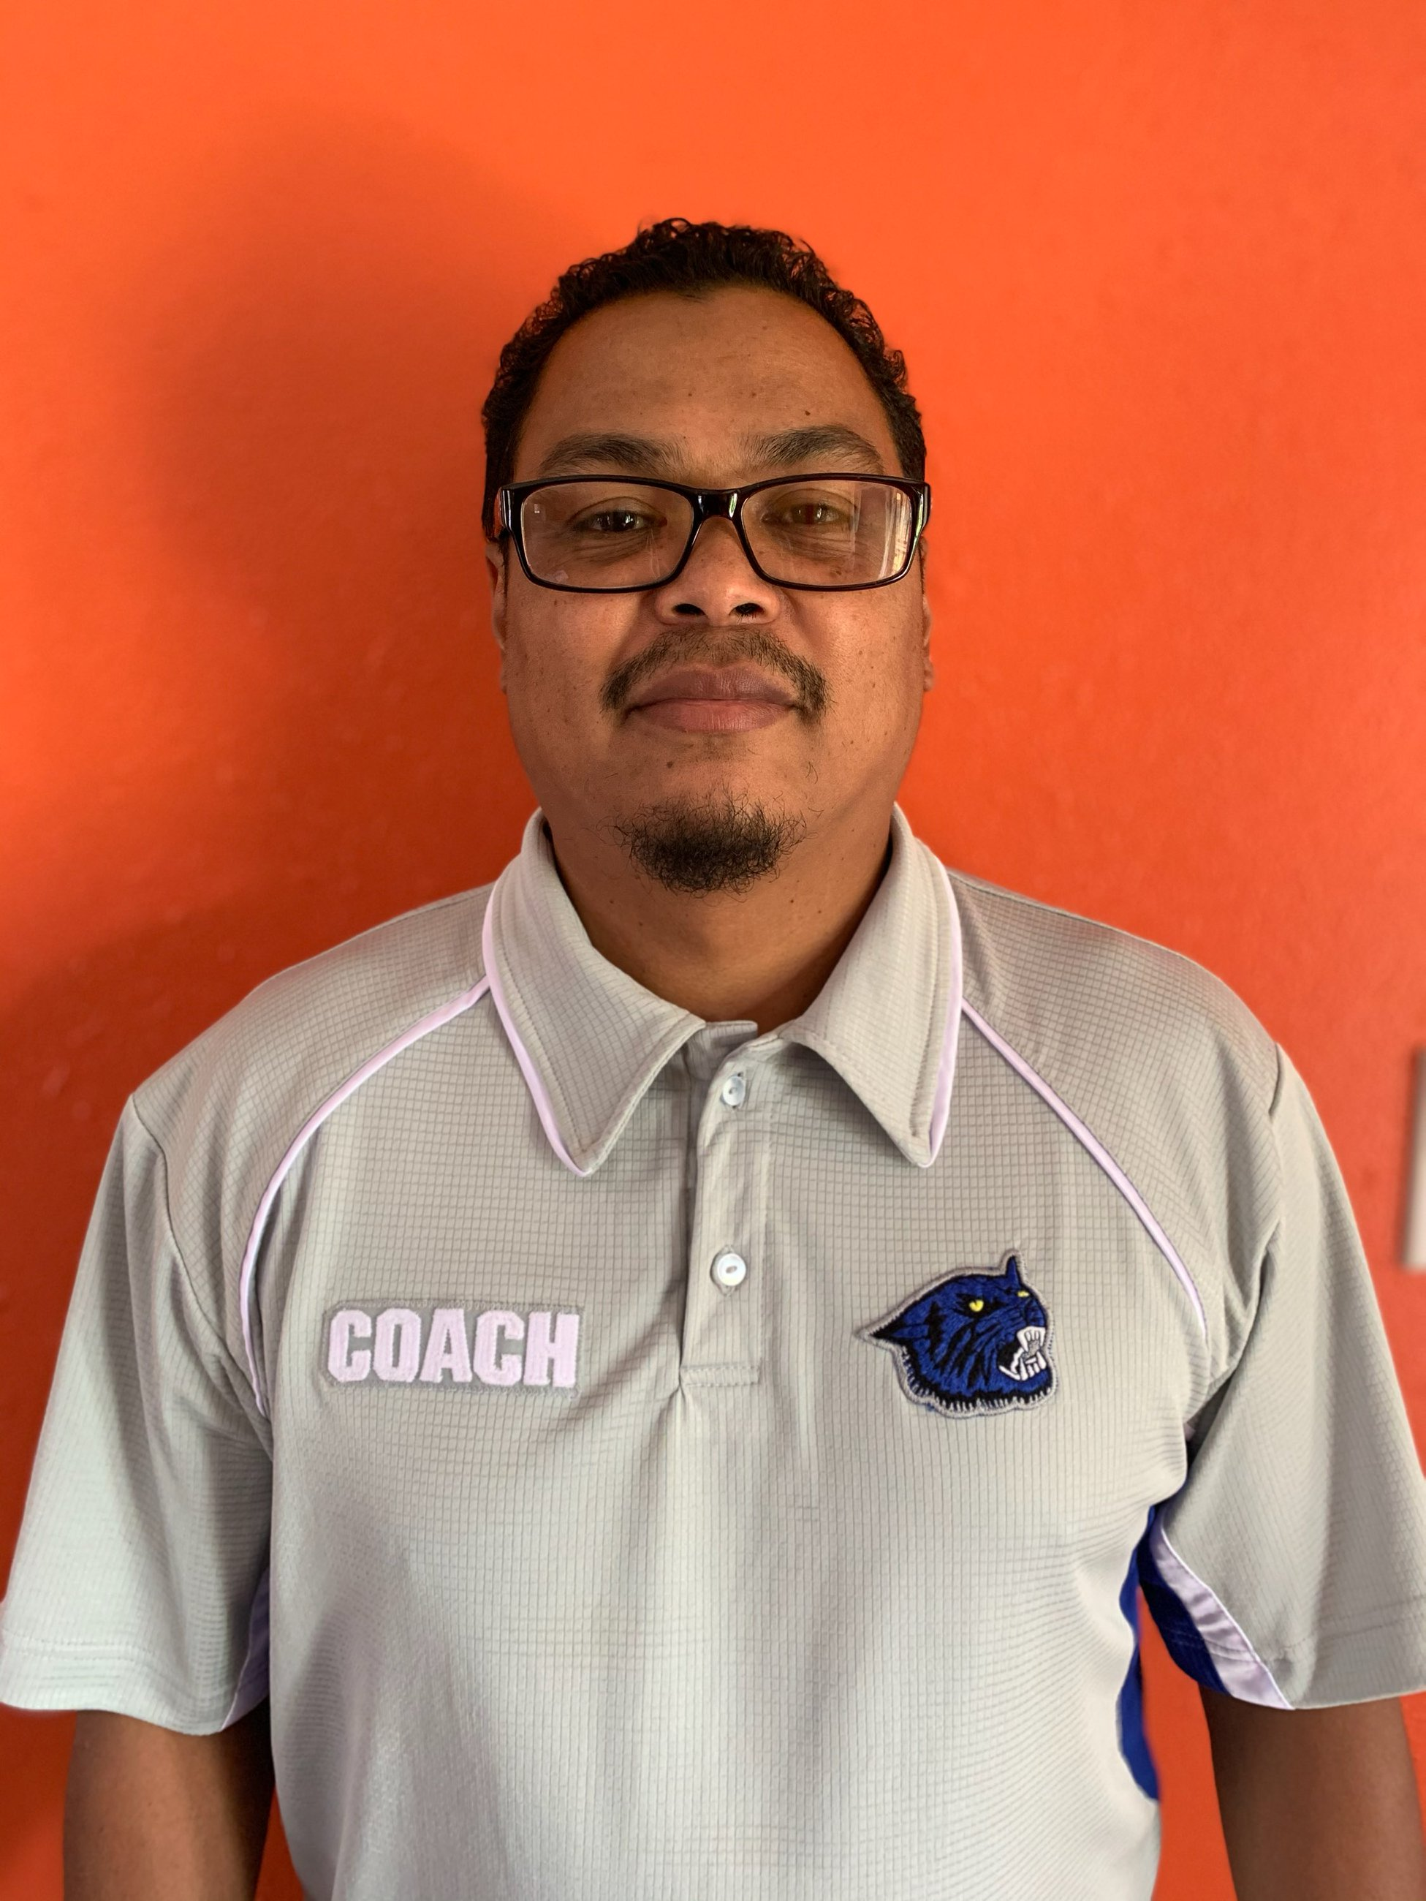
Harold Scott
Teacher: Harold Scott
Subject: Exceptional Education
Brief Bio: I have been teaching at Bolton for 13 years and this will be my 14th year teaching at Bolton. I am currently the Boys’ Basketball Coach and will be coaching the Girls’ Basketball team for the first time this year.
Email address: scotthg@scsk12.org

Slide 62
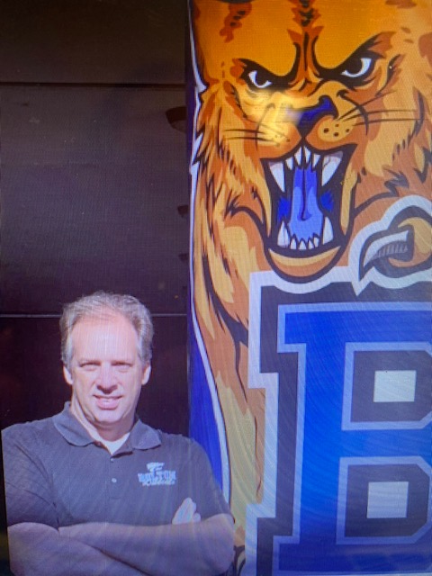
Jeremy Smith
Teacher: Jeremy Smith
Staff: Counselor 12th Grade Counselor
Brief Bio: My name is Jeremy Smith and this year I will be the 12th grade/College and Career Counselor. This will be my 24th year in education, 14th as a high school counselor and I taught English/Language arts for 10 years on the middle school level. My oldest son is starting his freshman year at Middle Tennessee State University majoring in aviation, and I also have a daughter in 10th grade and a son in 8th. My favorite teams are the Memphis Tigers and St. Louis Cardinals. GO WILDCATS!!
Email address: smithjc@scsk12.org

Slide 63
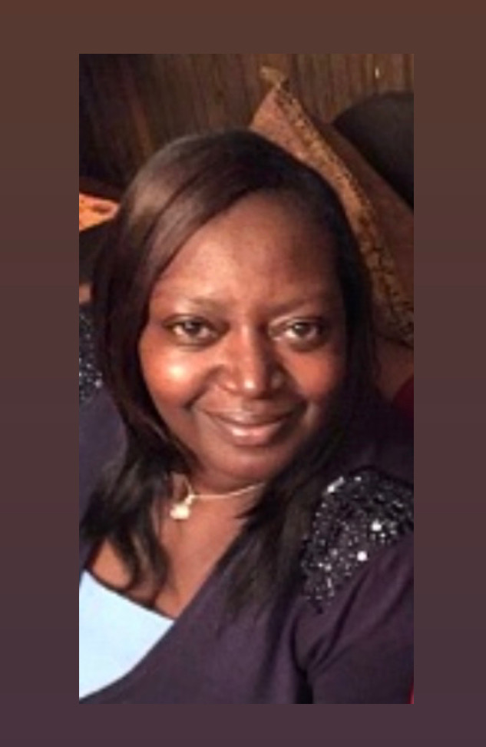
Beverly Davis
Teacher: Beverly Davis
Subject: Exceptional Education
Brief Bio: My name is Beverly Davis. I have been working for Shelby County Schools for 19 years. I am a Special Education Paraprofessional. A fun fact about me is that I love to laugh and have fun!
Email address: davisbd@scsk12.org

Slide 64
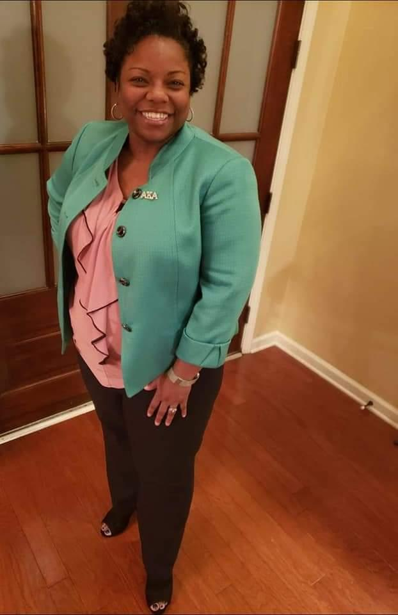
Kenya Reid
Staff: Kenya Reid
Position: Professional Learning Coach-Math
Brief Bio: I graduated from the University of Tennessee with a Bachelor’s in Mathematics and a Master’s Degree in Secondary Education. I have a total of 22 years of teaching experience. My husband and I have a four-year old son named Dalton.
Email address: reidkw@scsk12.org

Slide 65
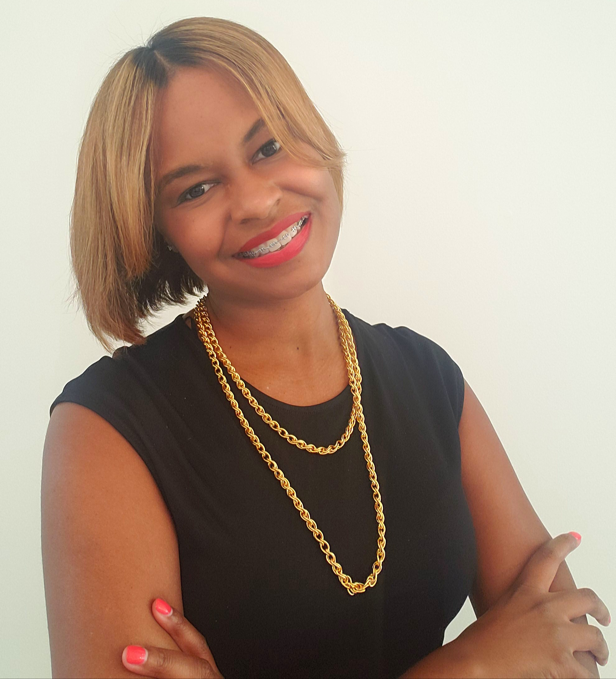
Ebony Johnson
Staff: Ebony Johnson
Position: Professional Learning Coach-English
Brief Bio: Ebony Johnson, is a native of Greenwood, MS, has fifteen years of educational experience. She earned a Bachelor of Science Degree in English Education from Rust College and a Master of Science Degree in Educational Leadership from Christian Brothers University. During her leisure, she enjoys reading, shopping, traveling, and most importantly, spending time with loved ones.
Email address: johnsonen@scsk12.org

Slide 66
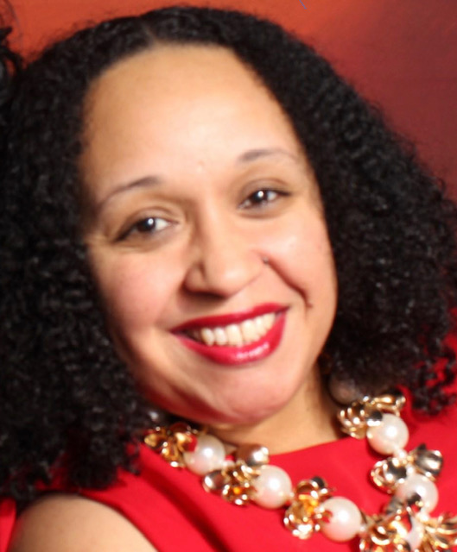
Sherry McKinney
Staff: Sherry McKinney
Position: Assistant Principal
Brief Bio: Mrs. McKinney possesses a strong work ethic, where she works purposefully with all staff members, parents, and students- listening, motivating, and modeling high expectations for all. She is the product of a “Grandmother’s loving, nurturing, and inspirational rearing. Mrs. McKinney is married to a loving, caring and self sacrificing husband, but her greatest “Masterpiece” is her son, other wise know as her “Sweetie Puddin’”!
Email address: mckinneysc@scsk12.org

Slide 67
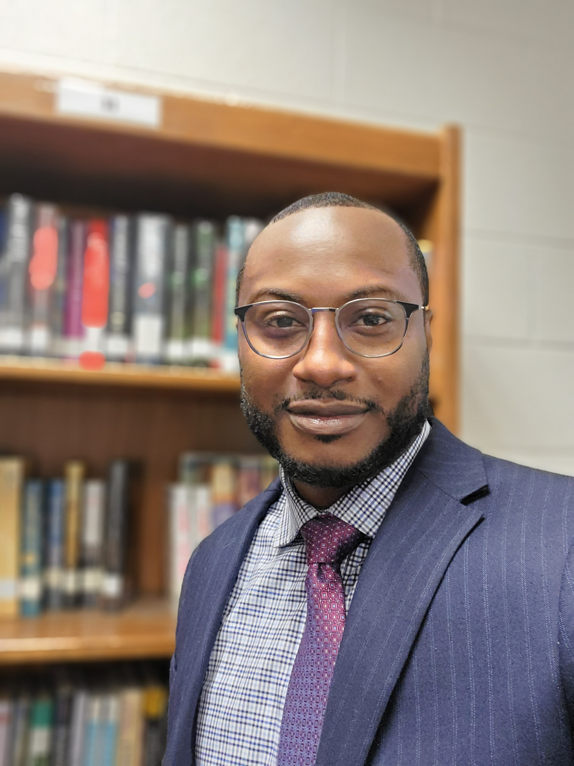
James Bacchus II
Staff: James Bacchus II
Position: Assistant Principal
Brief Bio: Mr. Bacchus began his teaching career in Metro Nashville Public Schools as a Business Education teacher. After serving a year, he decided to relocate back home to Memphis, TN. He then began teaching at American Way Middle in 2007 and since then he has served this district as an assistant principal at alternative, traditional, and interbaccalaurate high schools for 10 years. He has received certificates from the National Urban Education Center for Urban Education Leadership, Harvard for turnaround schools and aspiring principals, and Shelby County Schools Principal Fellows’ program. His hobbies include exercising, sports, traveling, and spending time with his family.
Email address: bacchusjq@scsk12.org

Slide 68
Shanda Gnintedem
Staff: Shanda Gnintedem
Position: Principal
Brief Bio: My name is Shanda L. Gnintedem, affectionately known as Mrs. G. I taught Biology for 11 years. I worked at the SCS District Office of Professional Development for 1 year prior to becoming an administrator. This will be my 8th year of service as an administrator at Bolton High School. I am blessed to have an amazing and supportive husband and family. I am also equally blessed to be able to serve with my Bolton family. I am dedicated to being a positive force in ensuring that ALL students receive the high quality education they deserve!
Email address: youngsl@scsk12.org

Slide 69
Do You Have Any Questions?
If you have any questions or concerns please e-mail Mrs. Gnintedem, Principal at
youngsl@scsk12.org
FAQs will be posted to the Bolton High School website

