Slide 1



Log into Clever and Schoology
International Newcomers Academy
@ Thomas Jefferson
Serving all PK-12

Slide 2
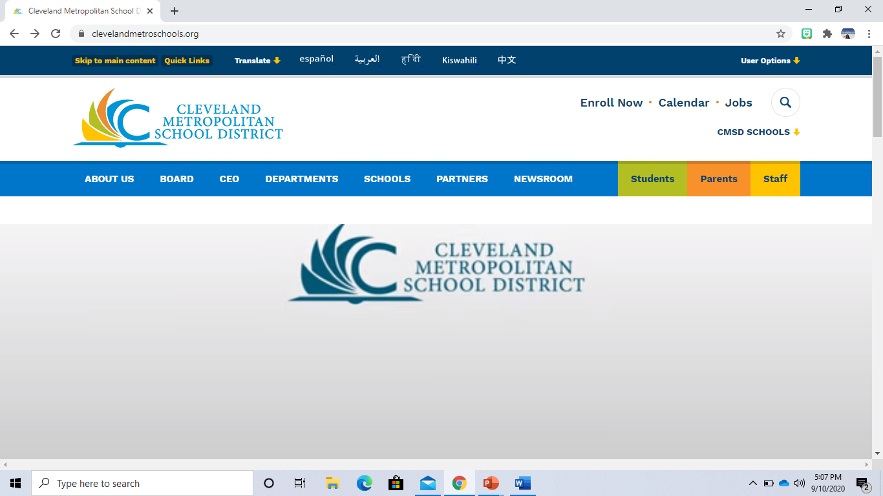
1. Search for Cleveland Metropolitan School District or type https://www.clevelandmetroschools.org/

Slide 3
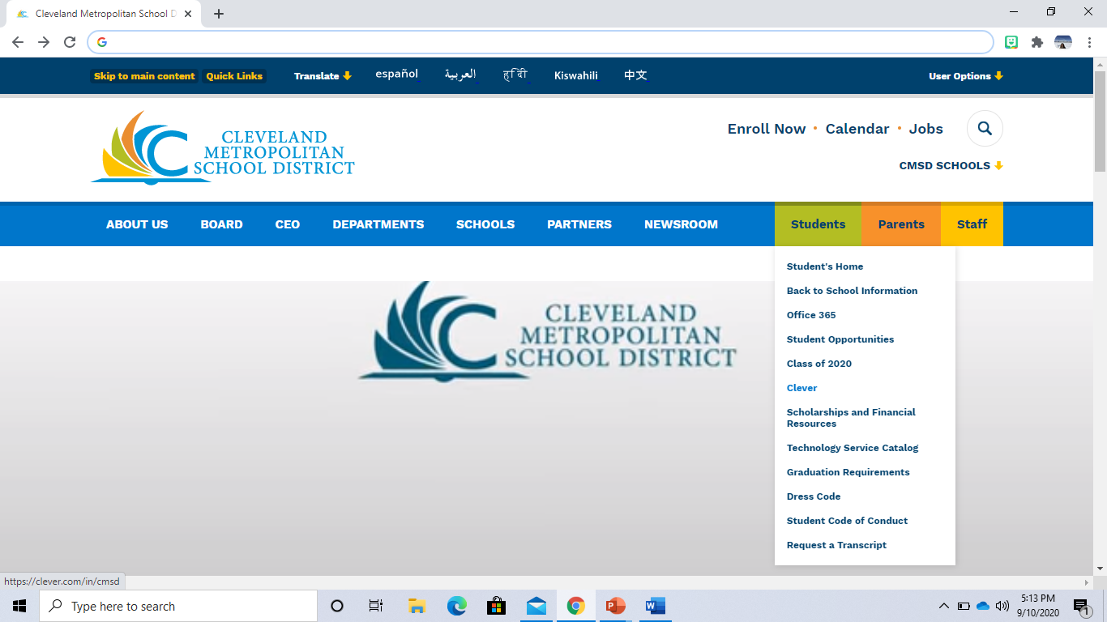
Students
2. Place your cursor on
Clever
3. Highlight
and click.

Slide 4
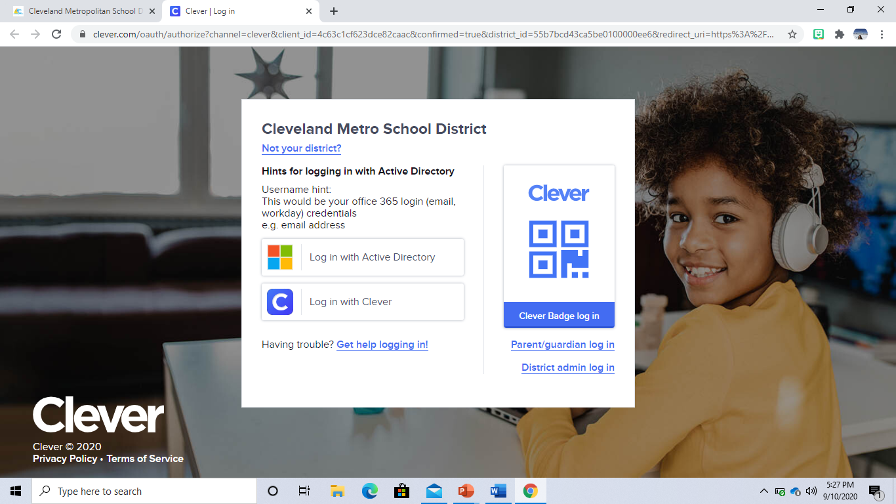
4. Click on Log in
with Clever

Slide 5
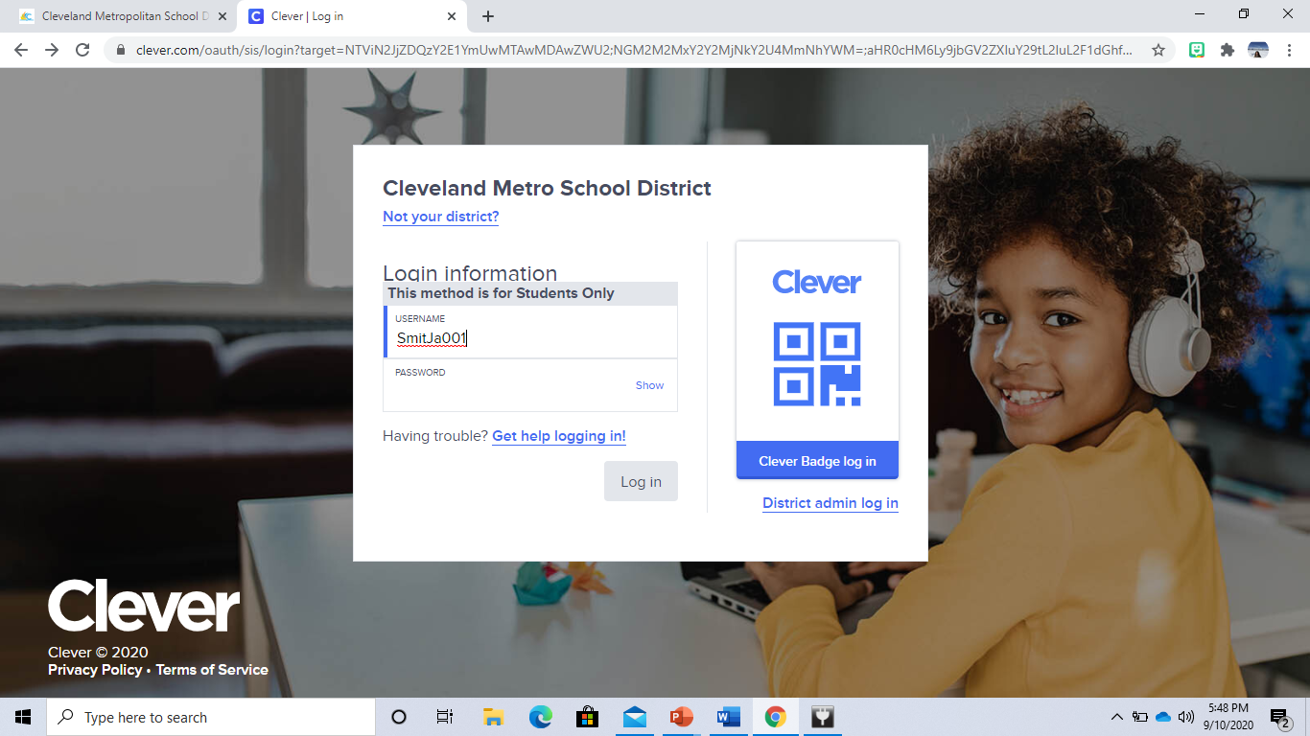
5. Type your username; example for Jack Smith

Slide 6
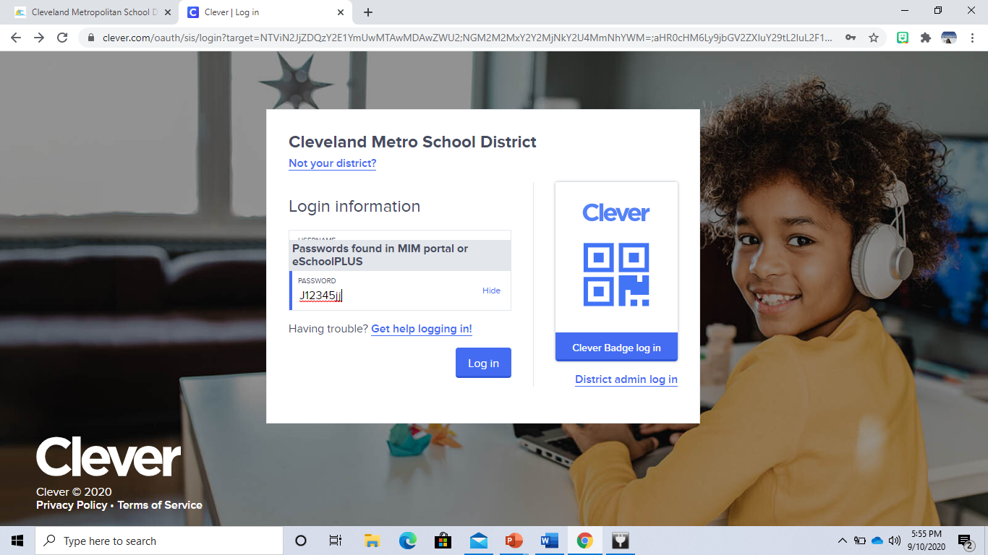
6. Type your password

Slide 7
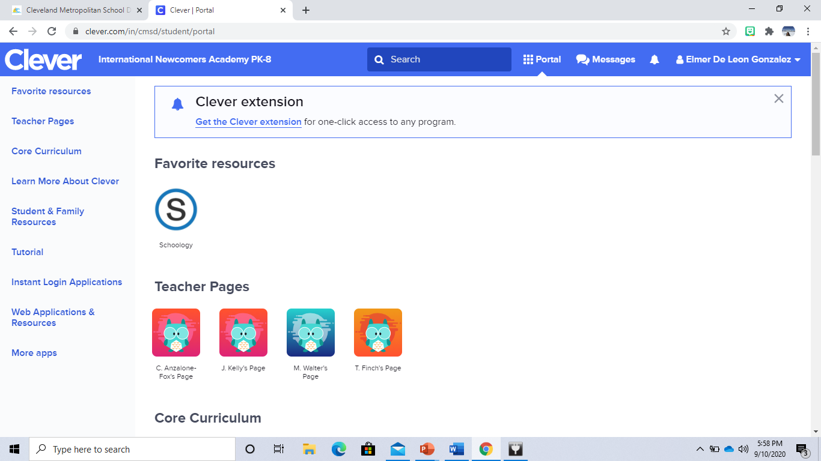
Jack Smith
7. Click on the
to get into the Schoology platform.

