Slide 1
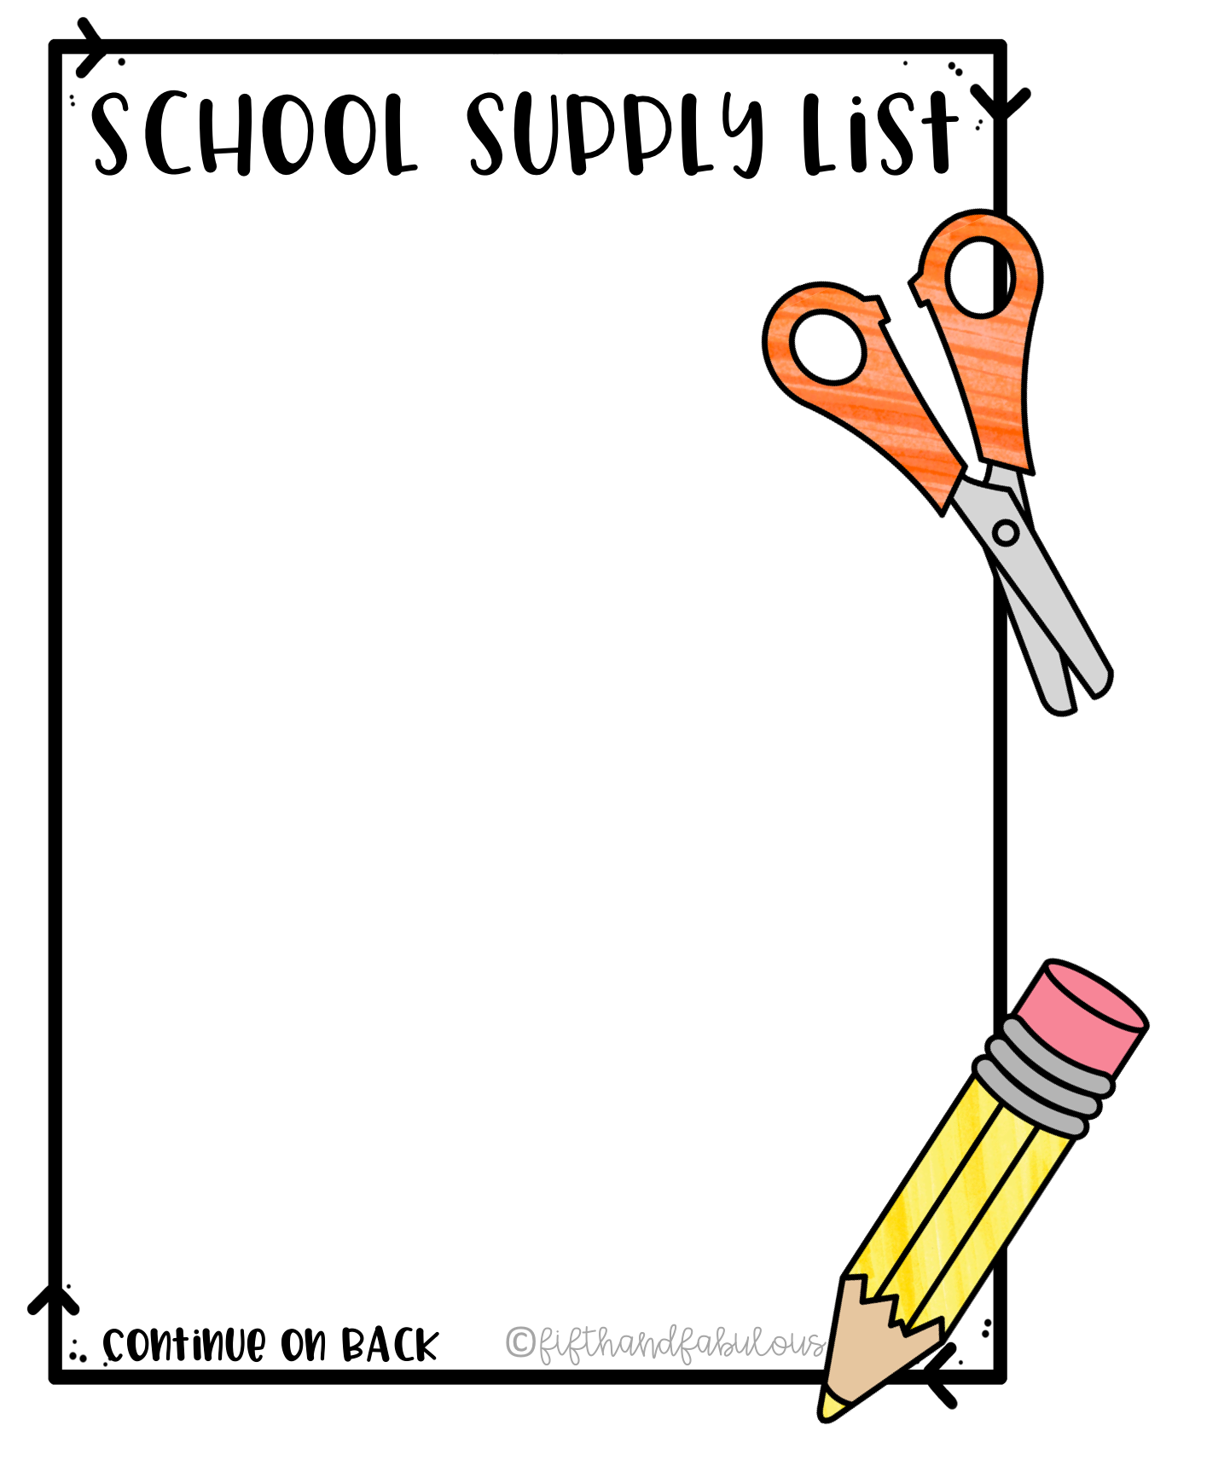
Mary M Bethune PreK-8
Room 121
24 pack Crayons
Pink Erasers
1 Pair of Headphones (to be kept in classroom)
1 – 24 pack yellow pencils
Backpack
Scissors
1 Pack Markers
1 Pack Wide Ruled Paper
Fidgets (if needed)
XL Paint Shirt or Apron
Box of Tissues

