Slide 1
IF OUR THINGS COULD TALK…
PERSONA POEMS BY THE 4TH GRADE
This fall, Ms. Ardis’s students explored personification using nearpod.
This slideshow is the result.
Don’t be scared! It’s all imagination.

Slide 2
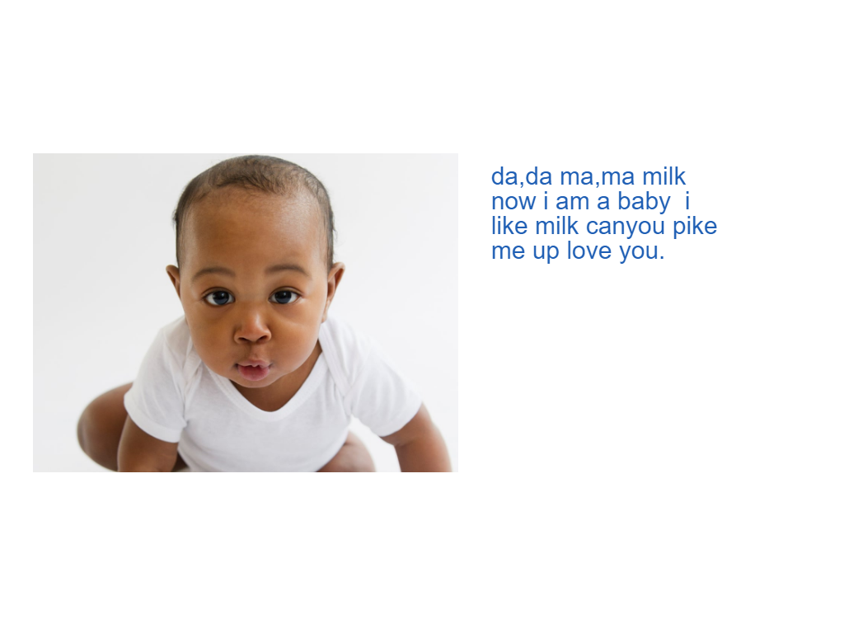
By Angelina

Slide 3
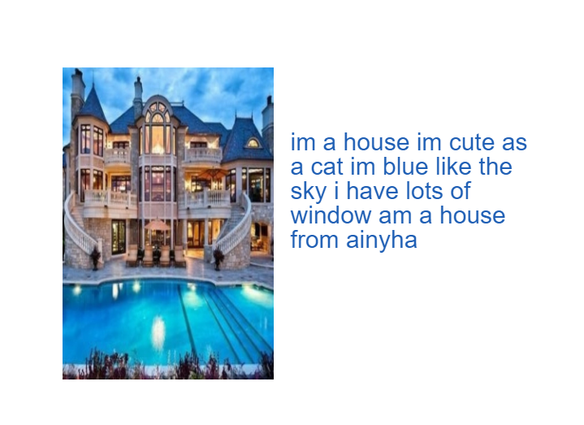
By Aniyha

Slide 4
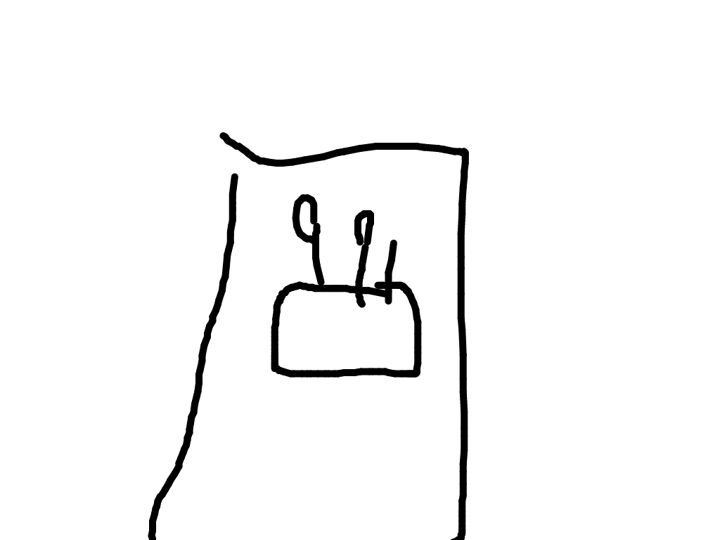
My doll she came to life
I got scared but she was nice to me
she said I don't want to be scary
so I mean her look cute
and she not scary no more
and we came best friends
By Autumn

Slide 5
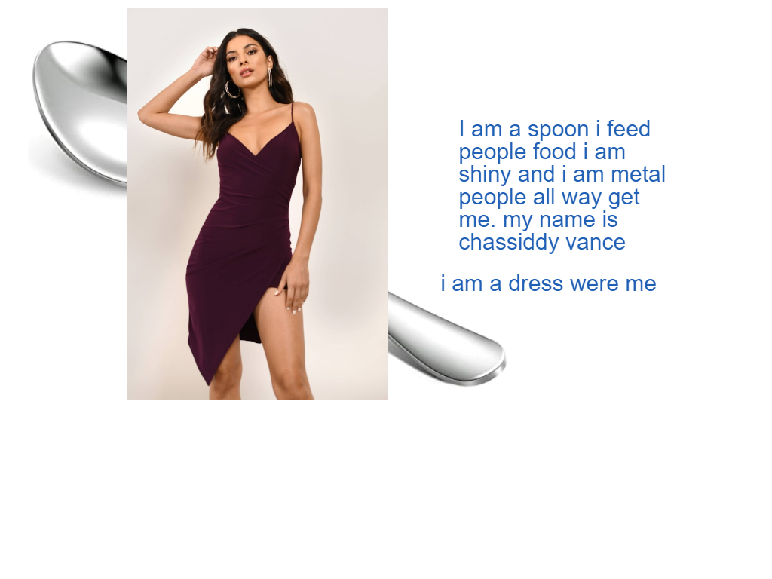
The Lifelike Doll
My poem is about a lifelike doll
a lifelike doll is not real
it is fake
it entertain you
it helps you get better in better for when you have a baby brother or a baby sister.
By Chassidy

Slide 6
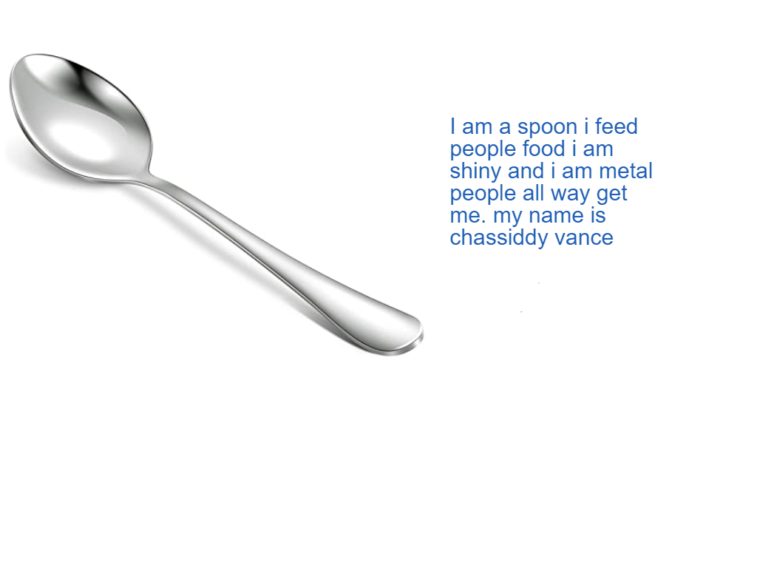
By Chassidy

Slide 7
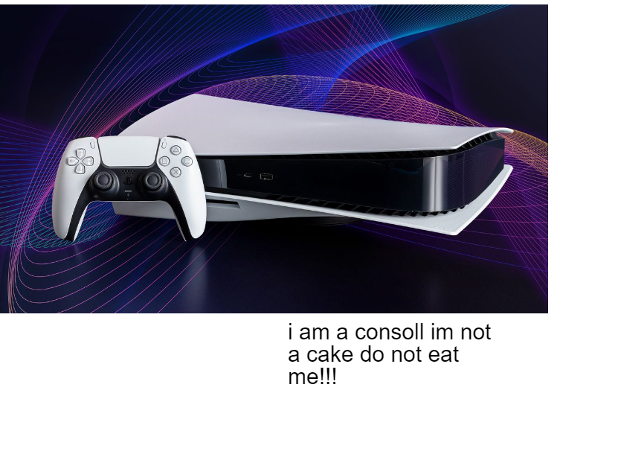
a ps5 is not a human
because it's a console obviously
By Devilin

Slide 8
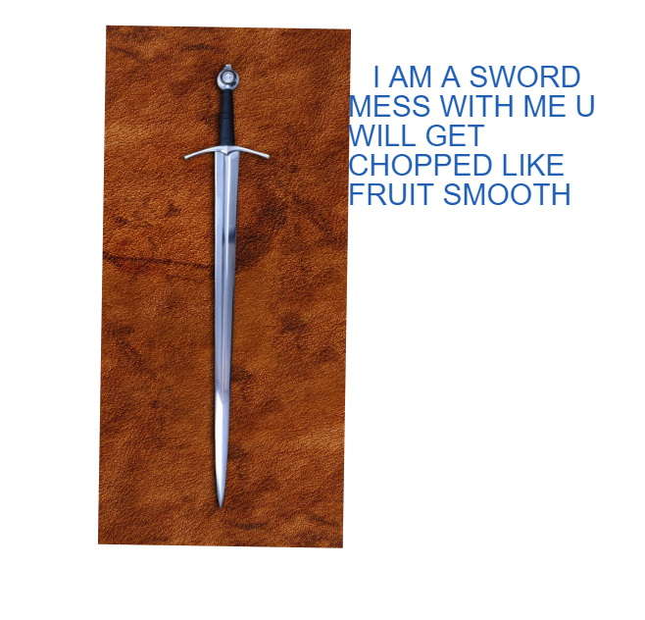
By Jaileon

Slide 9
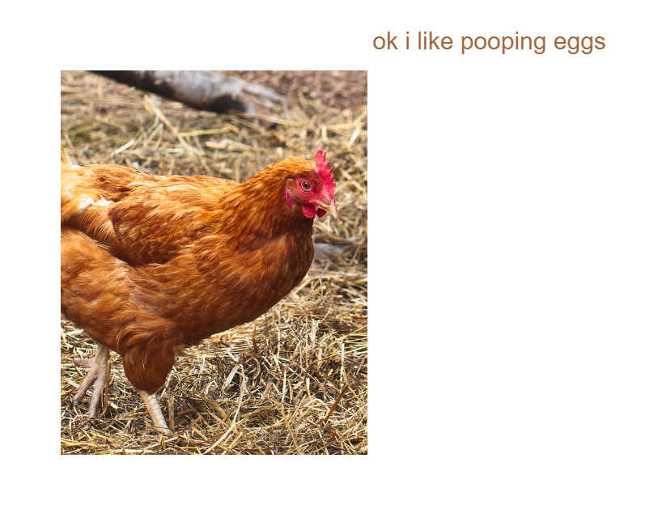
What the Chicken Says
I’m a little Chicken
and i like to poop eggs
By Jibreel

Slide 10
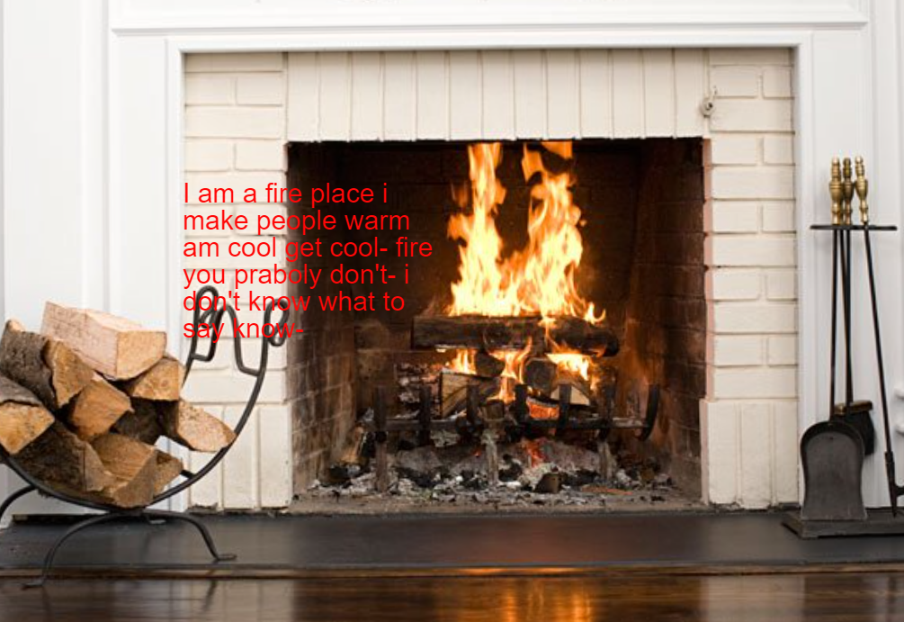
By Kay

Slide 11
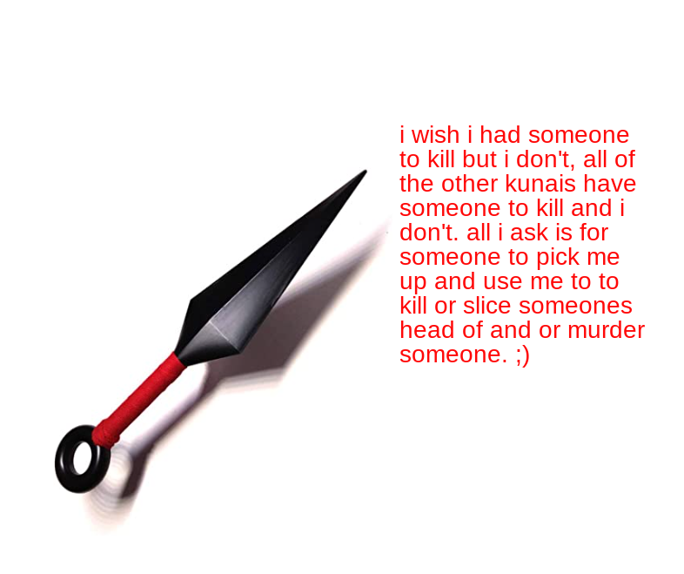
kunai: i wish i had someone to kill but no, every other kunai in the world has someone to kill but i don't
all i ask is for someone to pick me up and use me to kill someone or murder someone
i would love if someone picked me up and kill someone
that is all i ask.
By Kenneth

Slide 12
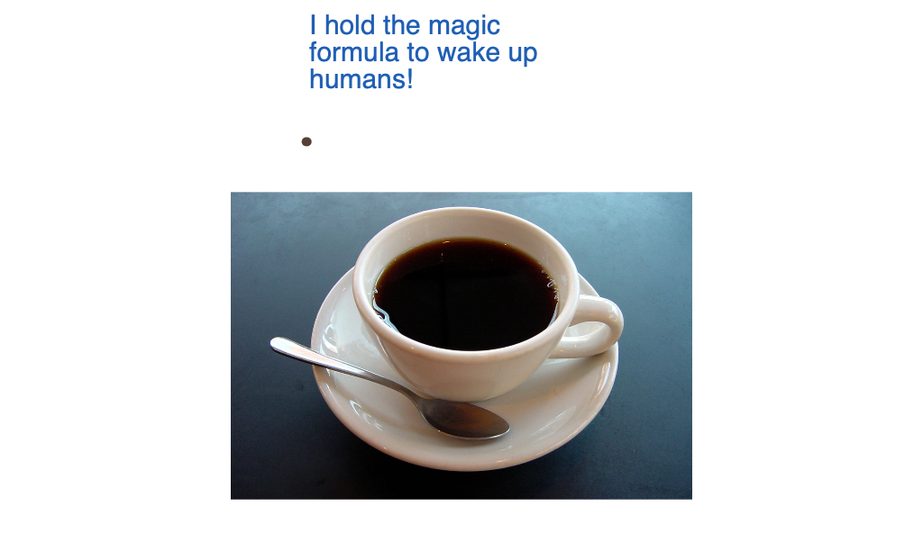
I am a cup
so please fill me up.
Coffee is hot-
except when it's not.
When coffee is cold
we dump it cause it's old.
I always have a stain
and I don't have a brain.
By Ms. Ardis

