Slide 1
Nutrition Education
Lisa Burleson-Longino, M.Ed.
PEP Grant Manager

Slide 2
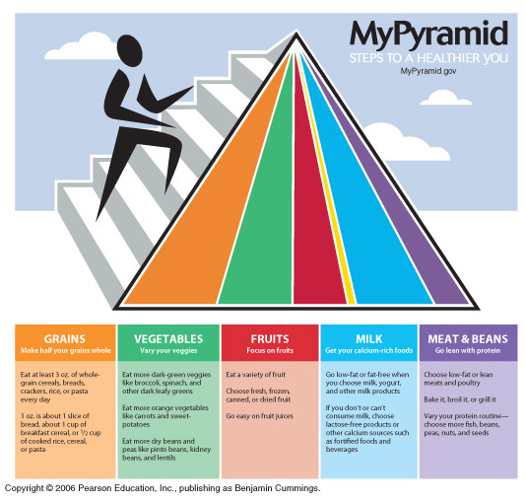
My Pyramid -- Outdated Logo

Slide 3
MyPlate – Current Logo

Slide 4
Compare/Contrast
Food Pyramid
MyPlate

Slide 5
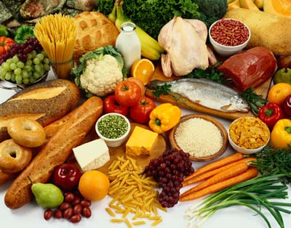
Food Groups
Fruits
Vegetables
Grains
Proteins
Dairy

Slide 6
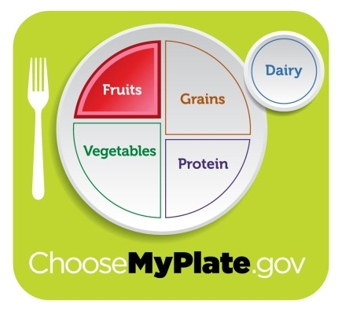
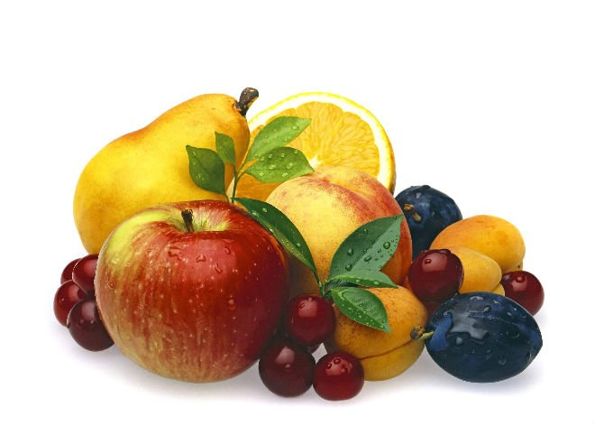
Fruits
What are some examples of foods in this food group?

Slide 7
Fruits
Any fruit or 100% fruit juice counts as part of the Fruit Group
Fruits may be fresh, canned, frozen, dried, whole, cut-up or pureed.
Key Consumer Message: Make half your plate fruits and vegetables!

Slide 8

Nutrients In Fruit
Most fruits are naturally low in fat, sodium and calories.
None have cholesterol.
Fruits are sources of many essential nutrients including: potassium; dietary fiber, vitamin C, and folate.

Slide 9
Health Benefits of Fruit
As part of a healthy diet fruit may reduce risk for heart disease, protect against certain types of cancers, reduce the risk of obesity and reduce the risk of type 2 diabetes.
Student version = Fruits help heal our bodies.

Slide 10
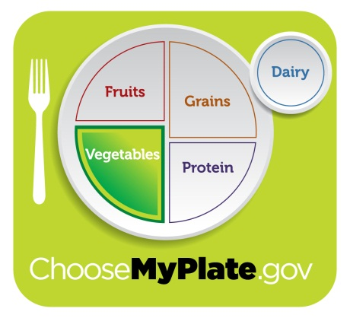
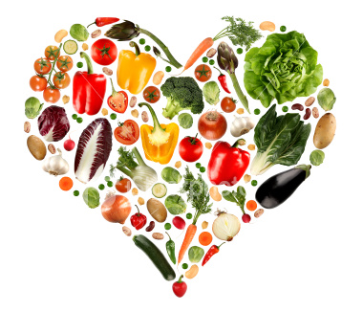
Vegetables
What are some examples of foods in this food group?

Slide 11
Vegetables
Any vegetable of 100% vegetable juice counts as a member of the Vegetable Group.
Vegetables may be raw or cooked; fresh, frozen, canned, or dried/dehydrated; and may be whole, cut-up, or mashed.
Key Consumer Message: Make half of your plate fruits and vegetables!

Slide 12
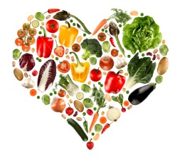
Nutrients in Vegetables
Most vegetables are naturally low in fat and calories.
None have cholesterol.
BUT SAUCES OR SEASONINGS MAY ADD FAT, CALORIES OR CHOLESTEROL!!!!
Vegetables may provide dietary fiber, potassium, Vitamin A, Vitamin C and potassium.

Slide 13
Health Benefits of Vegetables
As part of an overall healthy diet, vegetables may reduce the risk for heart disease, protect against certain types of cancers and may reduce the risk of obesity and the risk of type 2 diabetes.
Student version = Vegetables help our eyes see.

Slide 14
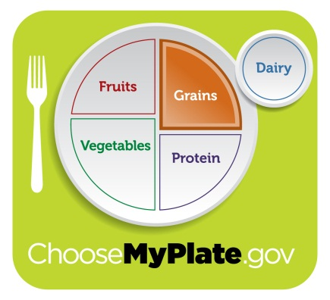
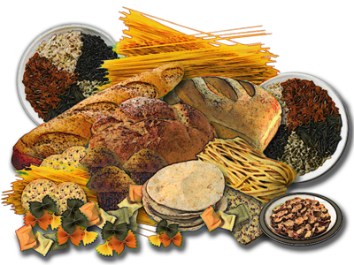
Grains
What are some examples of foods in this food group?

Slide 15
Grains
Any food made from wheat, rice, oats, cornmeal, barley or other cereal grains
Bread, pasta, oatmeal, breakfast cereals, tortillas, and grits
2 groups: Whole Grains and Refined Grains.
Key Consumer Message: Make at least half of your grains whole grains!

Slide 16
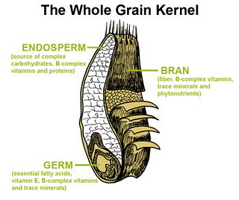
Whole Grains
Contain the entire grain kernel – the bran, germ, and endosperm.
Examples include: whole-wheat flour; bulgur (cracked wheat); oatmeal; whole cornmeal; brown rice.

Slide 17
Refined Grains
Refined grains
  Milled – remove bran and germ
  Gives grains finer texture
  Improves shelf life
  Removes dietary fiber, iron and many B vitamins
  Examples: white flour; de-germed cornmeal; white bread; white rice.
  Most are enriched – vitamins and minerals added back in, but NOT dietary fiber.

Slide 18
Nutrients in Grains
Dietary fiber (especially in whole grains)
B vitamins
Minerals – iron, magnesium and selenium

Slide 19
Health Benefits of Grains
Eating grains, especially whole grains as part of a healthy diet may reduce the risk of some chronic diseases: heart disease, obesity; neural tube defects during fetal development.
Student version = Grains give us energy and keep our digestive system healthy.

Slide 20
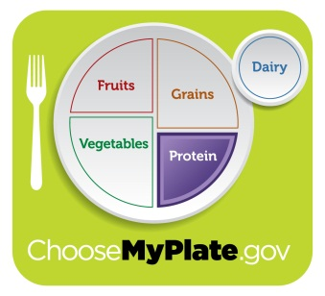
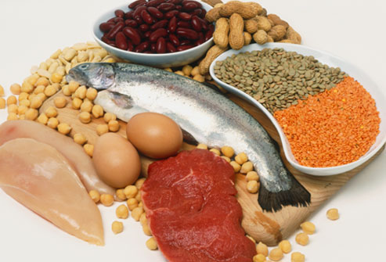
Proteins
What are some examples of foods in this food group?

Slide 21
Proteins
All foods made from meat, poultry, seafood, beans and peas, eggs, processed soy products, nuts and seeds are part of the Protein Foods Group. (Beans and peas are also part of the Vegetable Group.)
Select a variety of protein foods including at least 8 ounces * of cooked seafood per week.
Key Consumer Message: Meat and poultry choices should be lean or low-fat.

Slide 22

Nutrients in Proteins
Meats, poultry, fish, dry beans and peas, eggs, nuts and seeds supply many nutrients: protein, B vitamins, vitamin E, iron, zinc, and magnesium.
Omega-3 fatty acids which are found in seafood may help reduce the risk for heart disease.

Slide 23

Health Benefits of Proteins
Proteins serve as the “building blocks” for: bones, muscles, cartilage, skin, blood, enzymes, hormones and vitamins.
Proteins provide calories (energy).
The nutrients in proteins serve a variety of functions in the body: they help release energy; carry oxygen in the blood; help build tissues; and many more.

Slide 24
Health Benefits of Proteins
Student version = Proteins help build muscles in our body.

Slide 25
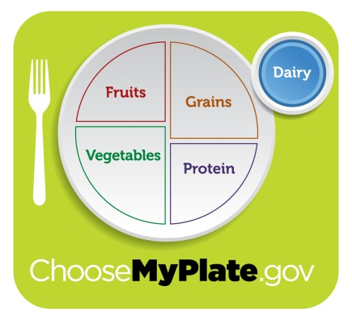

Dairy
All fluid milk products and many foods made from milk are part of this good group.
Key Consumer message: Switch to fat-free or low-fat (1%) milk.

Slide 26
Nutrients in Dairy Products
Calcium (bones, teeth);
Potassium (maintaining healthy blood pressure);
Vitamin D (helps to maintain proper levels of calcium and phosphorous.
In low-fat or non-fat form, provide little or no fat.

Slide 27
Health Benefits of Dairy Products
Eating/drinking dairy products is linked to improved bone health – especially during childhood and adolescence.
Eating/drinking dairy products may also reduce the risk of some diseases (osteoporosis; heart disease; type 2 diabetes).

Slide 28
Health Benefits of Dairy Products
Student version = Dairy foods help build strong teeth and bones.

Slide 29

Oils
Oils are fats that are liquid at room temperature. Although oils are NOT a food group, they do provide essential nutrients.
Examples: canola oil; corn oil; cottonseed oil; olive oil; safflower oil.
Some foods are naturally high in oils: nuts; olives; some fish; avocados.
Only small amounts of oils are recommended.

Slide 30
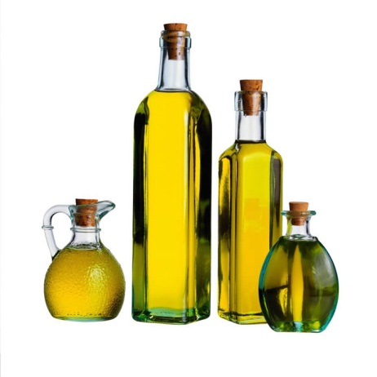
Health Benefits of Oils
Increasing energy and stamina;
Improving brain function;
Speeding up recovery and healing processes.
Assisting in many body processes.

Slide 31
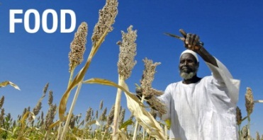
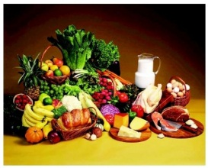


A Healthful Diet
A healthful diet is...
  Adequate
  Varied
  Balanced
  Moderate

Slide 32
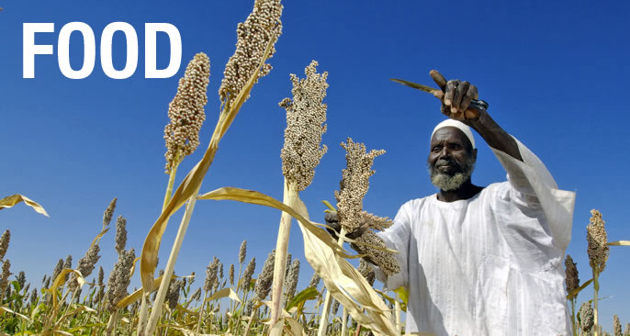
A Healthful Diet is Adequate
An adequate diet provides enough energy, nutrients, fiber, and vitamins to support a person’s health.

Slide 33

A Healthful Diet is Varied
Variety refers to eating many different types of foods each day -- a healthful diet is not based on only one or a few types of foods.

Slide 34

A Healthful Diet is Balanced
A balanced diet contains the right combinations of foods to provide the proper balance of nutrients.

Slide 35

A Healthful Diet is Moderate
A healthful diet is moderate and contains the right amounts of foods for maintaining proper weight – neither too much nor too little food.

