Slide 1

Five-Year Forecast
Board of Education (10/9/18)

Slide 2
Contents
Revenue & Expenditures
  Inputs and Assumptions
  Trends and Forecast
The Five-Year Forecast
Questions

Slide 3
The Five Year Forecast
Assumptions
Trends

Slide 4
Five Year Forecast Requirement
(OAC 3301-92-04)
(A) Upon the adoption of an annual appropriation measure but no later than October thirty-first of each fiscal year, a board of education shall submit to the department of education a five-year projection of revenues and expenditures for the current fiscal year and the ensuing four fiscal years.
(B) The projection and all updates shall contain information and be in a format as prescribed by the department of education and auditor of state.
(C) The department of education or auditor of state may require historical financial information as part of the report.
(D) The department of education shall examine, at no cost to the district, the five-year projections and determine whether any further fiscal analysis is needed to ascertain whether a district has the potential to incur a deficit during the first three years of the five-year period. The auditor of state may conduct further audits or analyses and shall notify the department of education of the district's fiscal condition. If after further analysis, the department of education finds that a potential deficit exists in any one of the first three years of the five-year period, the department of education shall notify the district and the auditor of state pursuant to section 5705.391 of the Revised Code. Notification shall consist of a letter from the department of education to the board of education, with a copy to the auditor, identifying the year in which the potential deficit begins.
(E) A board of education notified under division (A) of section 5705.391 of the Revised Code shall submit a district approved written plan in a timely manner as required to the department of education to eliminate any current deficits and avoid the projected future deficits.
(F) Effective with the fiscal year beginning July 1, 2002, a board of education shall update its five-year projection between April first and May thirty-first of each fiscal year and submit it to the department of education. Nothing precludes a board of education from filing other updates to its five-year projection at any time in addition to the filings required by paragraphs (A) and (F) of rule 3301-92-04 of the Administrative Code.
Notes:
Starting in FY 20, the district will not be required to submit the 5 year forecast until November of that year.

Slide 5
Revenue

Slide 6
Revenue Inputs & Assumptions
Property Valuations and Tax Collections
  Cuyahoga County is currently finalizing the reappraisal they performed this year. Currently we are projecting a 9.5% increase in total property values from last year. Values increased from $4.8B to $5.2B
  Our current property tax collection rate of 88.4% is utilized through 2022. Our current collection decreased 1% from the previous year.
  The forecast includes the 4-year, 15-mill levy renewed by voters on 11/8/16, but assumes its expiration on December 31, 2020.
State Foundation Formula
  The forecast utilizes the current foundation formula for all five years. We are currently in the last year of the current formula.
Enrollment
  In all five years, the enrollment forecast uses 52,319 student full-time equivalents (FTE), which is the current level reflected in the State Foundation Formula. This level is equal to amount students we were funded for in SY17-18.
 | May Forecast | Current Forecast
CMSD | 35,842 | 36,215
Community School | 15,462 | 14,437
Cleveland Scholarship | 1,366 | 1,414
Other | 250 | 253
Notes:
Total tax collection rate decreased 0.5%. Total Tax Collection rate is the combination of the current collection and delinquencies.
Decrease in Community School is largely result of the ECOT closure.
I am still determining whether is was residential or commercial properties that caused the decrease in collection rates, but I will have an answer by the board presentation

Slide 7
Revenue Sources
Notes:
PY State Aid 62.2%; Local Taxes 29.8%, Other 4.9%, Advance .7%, State Reimb 2.4%

Slide 8
State Aid
Notes:
We are projected to go on the Guarantee for FY 20-23. For SY 19 there was an increase of $10 per pupil in base funding by the state of Ohio. We are assuming the same base cost for the next five years.

Slide 9
State Formula Analysis
Notes:
The reason we are on the Guarantee is the State Share Index. The negative impact of the increase tax base is that in the state foundation calculation we will be considered richer on a per pupil bases since we are forecasting flat enrollment. There is a chance we do not take as big of hit on the state share index because we do not see the effect of all of the other districts that went through reappraisals this school year. (Lorain and Lake County’s went through reappraisals this year)

Slide 10
Local Property Tax Revenue
Notes:
Part of the $2m decrease we see from the previous year is partial due to the change in federal tax law where some people to advantage of paying taxes early to be able to claim on their taxes.

Slide 11
Historic Assessed Valuations
Notes:
In 2018 the county completed its reappraisal. The above charts show the net effect of the reappraisal, but is not full approved by the State of Ohio yet but we are not assuming any significant changes.
The overall assessed valuation in the district is $5.2 billion. This is first time the valuation was above $5B since 2011. Assessed value is 35% of the estimated true value.
This chart shows the last 10 years - the tax base has declined from $5.9 billion in 2008 to $5.2 billion in 2018 or $723.8 million
We have had a shift in our tax base over the last 10 years where we now have more commercial value than residential value.
Residential has declined 29.8 % since 2008
Commercial has increased 8.8% since 2008
TPP was phased out than eliminated
The districts assessed value has not been this low since 1991 – so in 25 years the tax base in Cleveland has not grown – yet something that cost $1.00 in 1991 costs $1.77 today

Slide 12
Property Tax Collection Rates
Notes:
Overall tax collections rate is 94.78% which is current collections plus delinquencies. Total collection rate decrease half a percent from py.

Slide 13
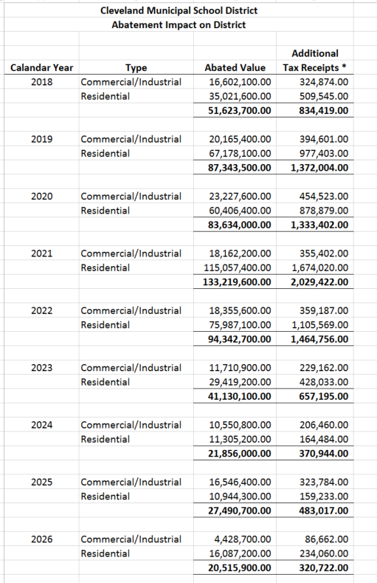
Property Tax Abatement Tracking
Notes:
This chart show the values of Tax Abatements coming off the books each calendar year

Slide 14
Other Sources & Advances
Notes:
Other
What is included in this? IRS Rebate/misc revenue, charter school sponsor fees
Other Taxes and Rebate
$4.6 million in rebates from the IRS – timing issue for rebate – received portion of anticipated FY18 amount in FY17
400 k admissions tax from the Rock Hall
$9.1 million from various Payment in Lieu of Taxes (e.g., Flats East Bank, VA Hospital, Third Federal, lower Euclid, Old Arcade, Colonial Arcade, Steelyard, Pierre's Ice Cream, etc.)
Interest
Interest rates continues to be historically low – the forecast includes a slight increase
Medicaid
CMSD received 24.7 million in FY16, which included back claims for the period 7/2005 - 9/2009.
This represents services provided between the old CAFS (Community Alternative Funding System) shutdown and the new MSP (Medicaid Schools Program) program startup. This is far more than what we thought we would ever receive. We were originally told that there was a possibility to go back all the way to 7/1/05 and receive this back claiming but the most likely back claiming period would be 10/1/07 - 9/30/09. In 20 years of Medicaid billing our consultant HBS had never seen a Federal Medicaid Program allow retroactive claiming back past more than 2 years.
In FY17 the district should receive $5.3 million which includes a settlement from FY14. The district is forecasting $3.5 million from FY18-FY21.
Advance In
Estimated at $4 mill per year

Slide 15
State Reimbursements

Slide 16
Revenue Forecast – General Fund
Notes:
1.
2. The reason for the slight increases from FY20 and beyond is because we assume Wealth Based Targeted Assistance will increase about $3.5M each year and small increases in Special Ed Funding from the state.
3. The increase in FY17 was that in August 2016, the District received a payment of $17,047,896.33 from the state for a FY16 adjustment due to inaccurate FTE counts.

Slide 17
Expenditures

Slide 18
Expenditure Inputs & Assumptions
General
  The forecast does not include any salary increases in SY19-20 through SY22-23.
  The forecast includes 1.13% for step increases and other incentive pay for teachers.
  The forecast projects an annual 7.5% increase in healthcare costs.
Department-Managed Budgets
  The forecast reflects declining bus lease payments in SY21 and SY22. The final payment is in SY22.
  The forecast reflects an annual increase in purchased services due to charter school transportation requirements.
“Fixed” Costs – Tuition / Community School Pass-Through
  The forecast reflects a decline in Community School pass through payments for SY18-19 through SY22-23. The forecast assumes no further decline in Community School enrollment.
  The forecast reflects slight annual increases in tuition and pass-through expenses for out-of-district placements.

Slide 19
Personnel Expenditures
Notes:
The Decline in Salaries between the SY17-18 and SY18-19, are unanticipated grievance costs (~$2M), that are not forecasted in the forthcoming years.

Slide 20
Non-Personnel Expenditures
Notes:
Purchased Services do not reflect decrease of Community School payment of $8 million
Increase in FY 19 are due to the following:
$8 million capital dollars have been allocated for maintenance
$3 million for South; falls off after FY 19
$1.4 million for Wilbur Wright and William Cullen Bryant; falls off after FY19
$1.5 million for new school build outs; drops $500K in future year
$2.1 million for Workday reduces to $750k in 19/20 $250k years following
$2.7 million for Student Transportation
$1.8 million for Cleveland Scholarship
$1.0 million for ERATE
Other Decreases for FY 19/20:
$1.0 Negotiations

Slide 21
Expenditure Forecast – General Fund

Slide 22
The Five Year Forecast

Slide 23
Five Year Forecast

Slide 24
Five Year Forecast w/ decline in Community School

Slide 25
Spend Category Comparison SY 17 – SY 18
 | Actual |  | Actual
 | SY 17 |  | SY 18 |  | Change | % Change
1xx | 328,868,011 |  | 355,131,628 |  | 26,263,618 | 7.99%
2xx | 116,721,046 |  | 129,164,484 |  | 12,443,439 | 10.66%
4xx | 66,760,383 |  | 66,960,135 |  | 199,751 | 0.30%
47x | 175,298,419 |  | 179,887,600 |  | 4,589,181 | 2.62%
5xx | 13,403,652 |  | 18,695,004 |  | 5,291,352 | 39.48%
6xx | 3,276,230 |  | 4,293,940 |  | 1,017,710 | 31.06%
8xx | 7,491,012 |  | 7,630,513 |  | 139,501 | 1.86%
9xx | 6,111,000 |  | 4,000,000 |  | (2,111,000) | -34.54%
 | 717,929,753 |  | 765,763,305 |  | 47,833,552 | 6.66%
1xx | Base Salaries increased by $11.6; Temporary Salaries increased $0.9; Supplementals increased $12.2; Overtime increased $0.9.
2xx | Total Medical benefits increased $7.8; Employer Portion of STRS/SERS increased $3.8
47x | Tuition payments increased $4.6, this was due to the Cleveland Scholarship increase and timing of old bill payments
5xx | Supplies increased $2.6; Textbooks increased $0.6; Maintenace on buildings/vehicles increased $2.4
6xx | Technology purchases increased $0.8 and vehicles purchases increased $0.2
8xx | Tax collection fees increased $0.6 from the previous year
9xx | District did not need to transfer monies to self insurance fund

Slide 26
Opportunities for Cost Savings – Need $28M
SY 18-19
Freeze open positions for Administration only; currently 52 requisitions open; estimated at $4.2 million
Limit/Monitor overtime usage - $6 million paid in FY 18
Reduce Travel, currently $2.3 million available on General Fund
Reduce Food for meetings, currently $285k available on General Fund
$4 million Catastrophic Aid from SY 17
SY 19-20
Stop vacation and sick time cash outs - $2.8 million paid in SY 18
Reduce travel $2.9 million budgeted for SY 19 on General Fund
Reduce food for meetings - $500k budgeted for SY 19 on general fund
Reduce stipends for Administration Staff only - $650k paid in SY 18
Limit investments made in Fiscal Year 18/19
Notes:
-

