Slide 1
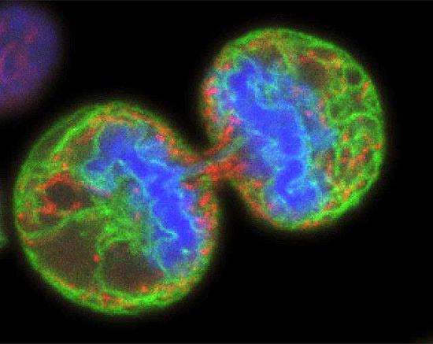
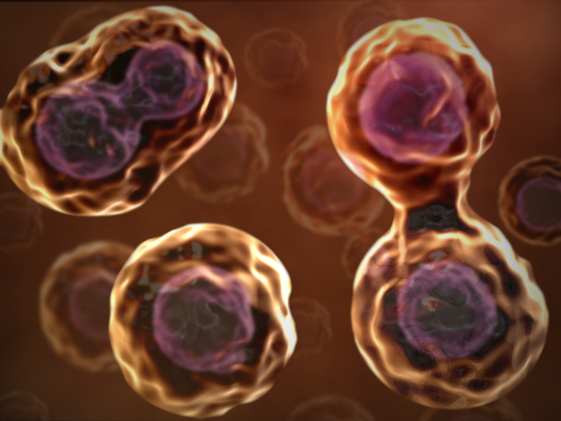
The Cell Theory
1.) All cells come from other cells!

Slide 2
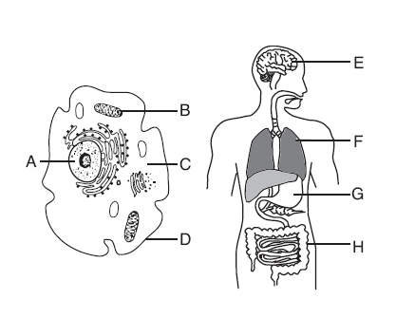
2.) Cells carry out all life functions.

Slide 3
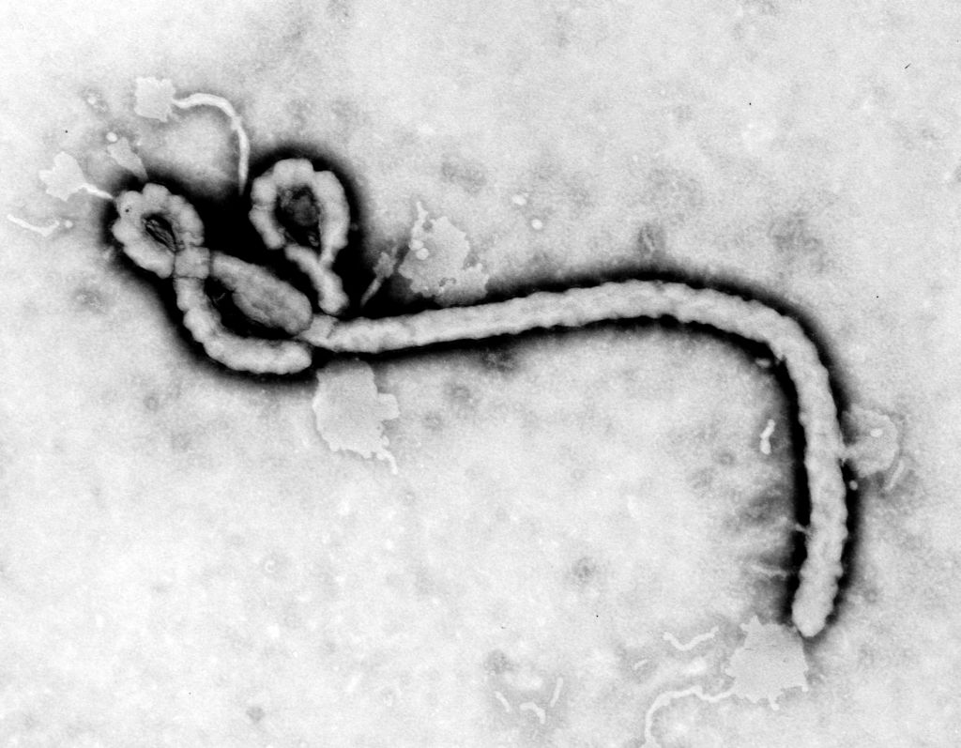
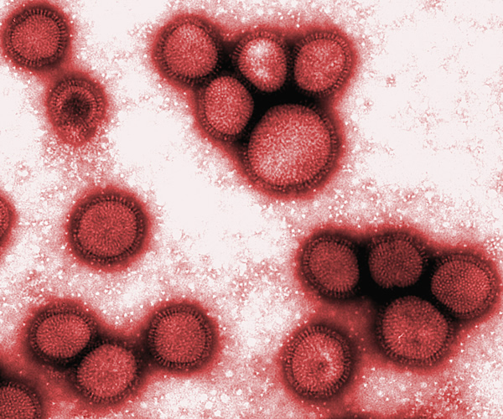
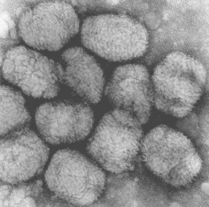
3.) All living things are made of cells.
FLU VIRUS
CHICKEN POX
EBOLA

Slide 4
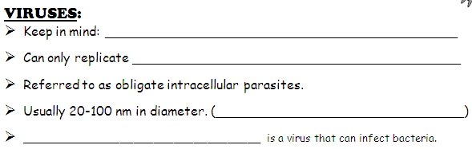
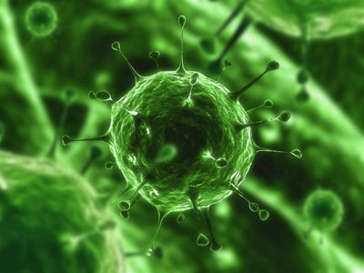
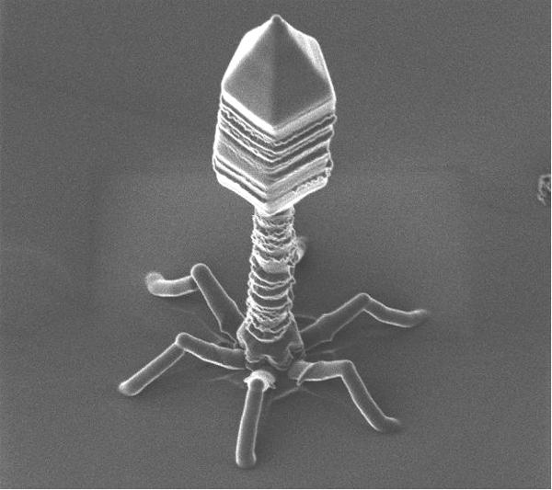

Slide 5
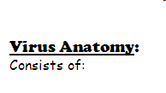
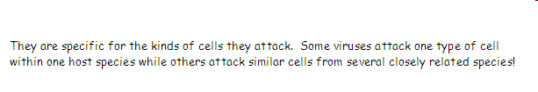

Slide 6
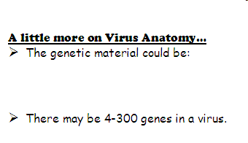

Slide 7
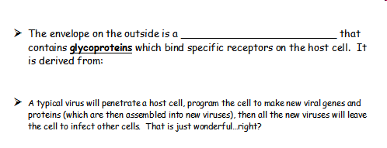

Slide 8
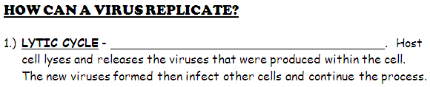
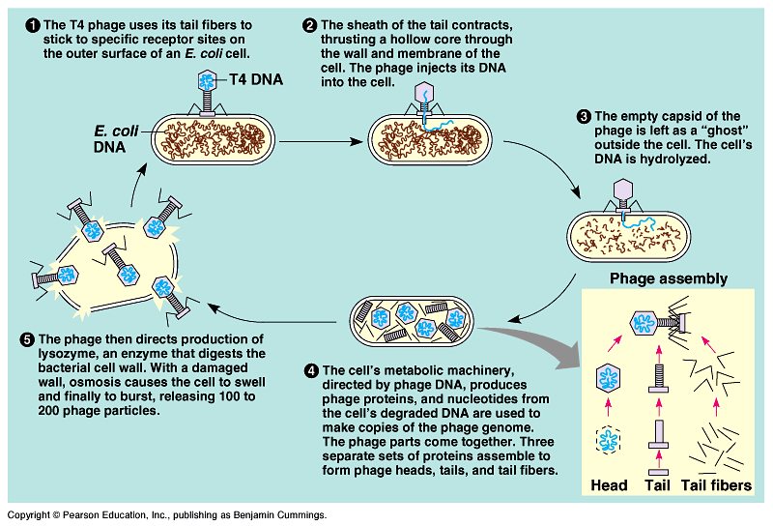

Slide 9


Slide 10

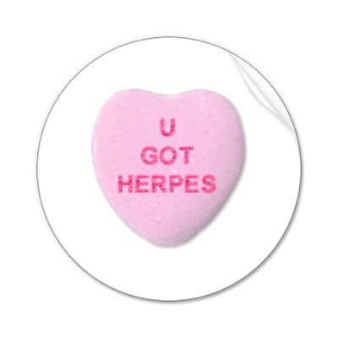


Slide 11

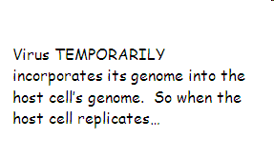
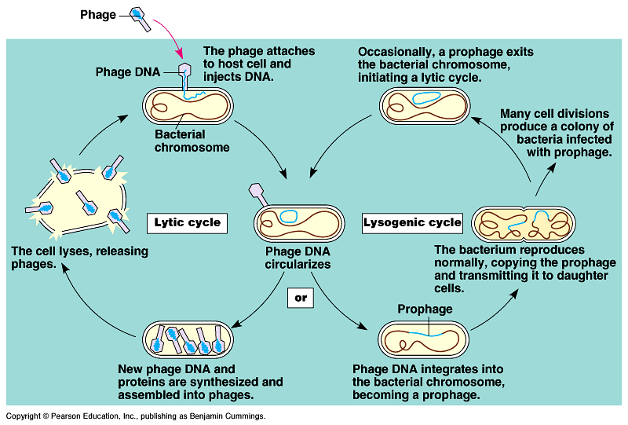

Slide 12
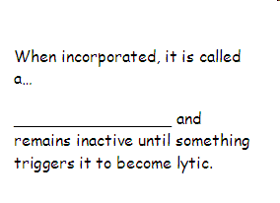
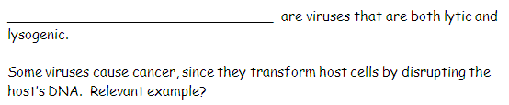

Slide 13
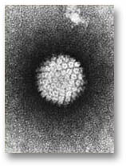
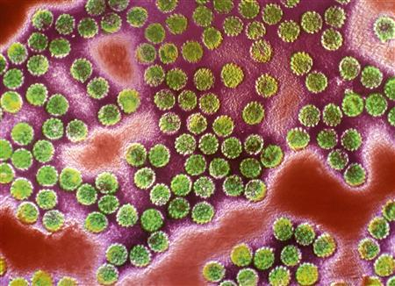
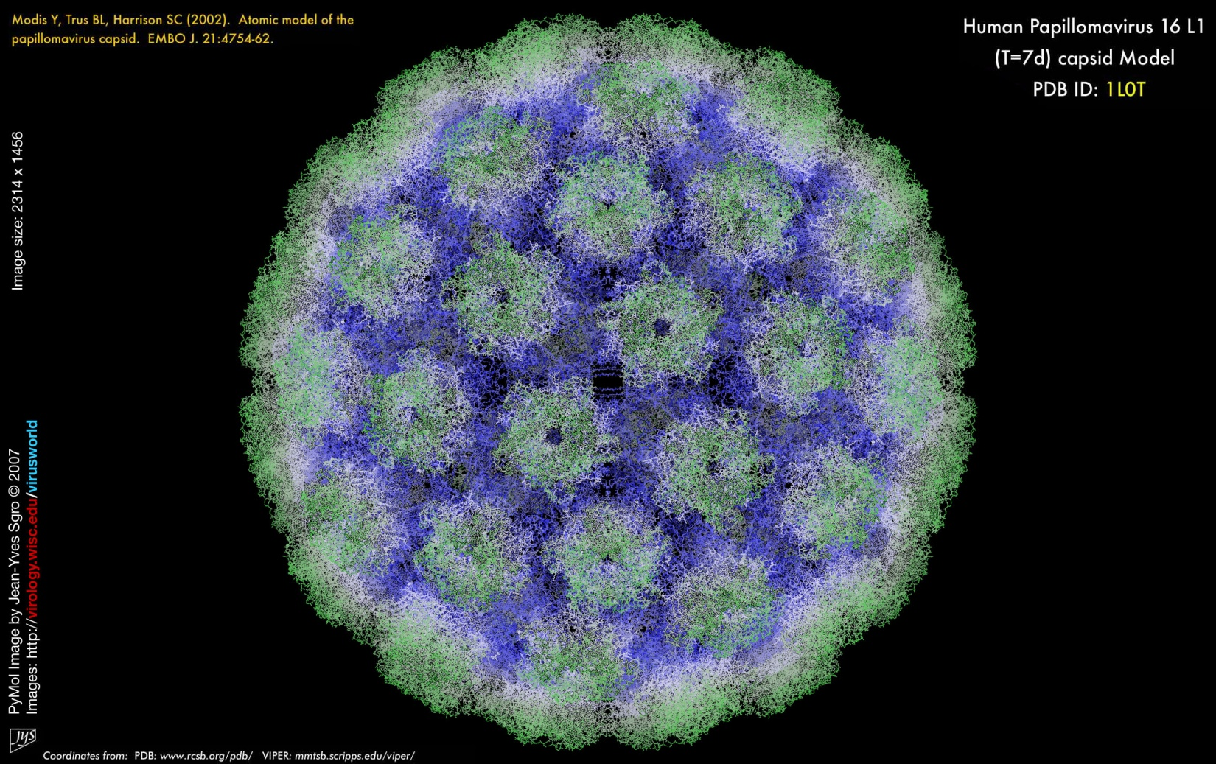
HPV

Slide 14
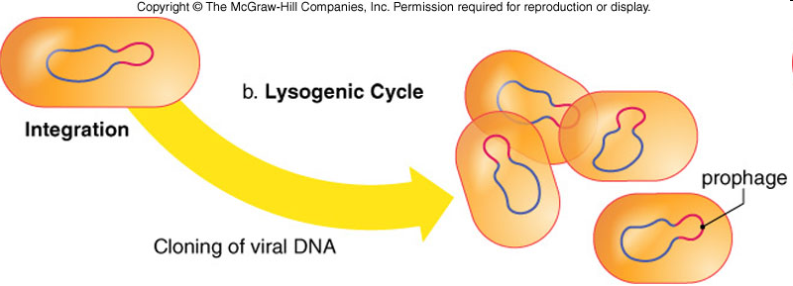
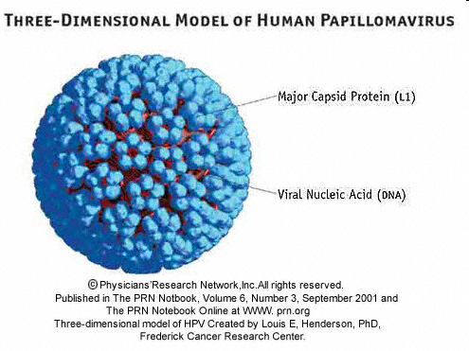
It is suspected that 75-80% of all sexually active people have HPV.
6 million people are diagnosed each year with HPV.
HPV attacks the epidermal cells of the cervix.

Slide 15

Fairly recent vaccine. Began use in June 2006 for people between the ages of 9 and 26.
Side Effects? As of 9/15/11, there were 40 million patients who received Gardasil. Of those, 20,000 reported adverse effects (and 92% of them were mild symptoms).

Slide 16


Slide 17
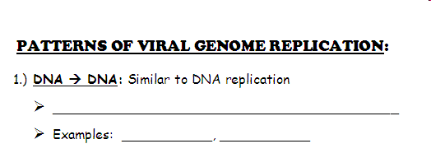

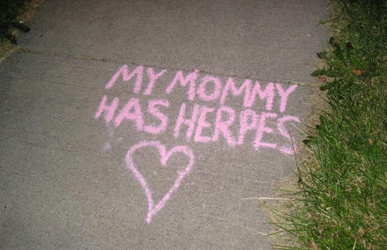

Slide 18
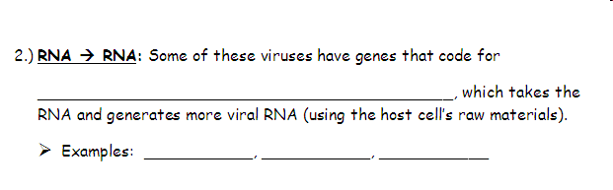
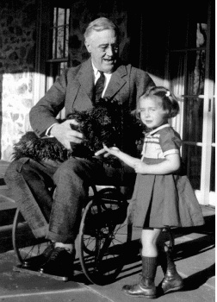
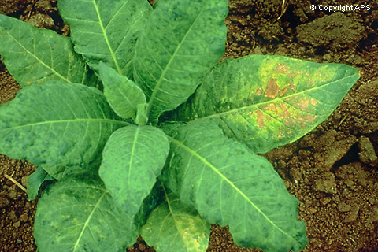


Slide 19
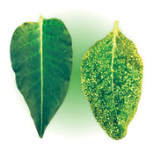

Slide 20
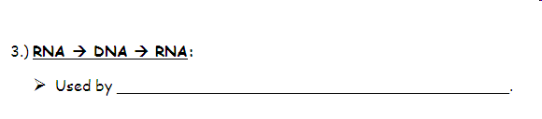
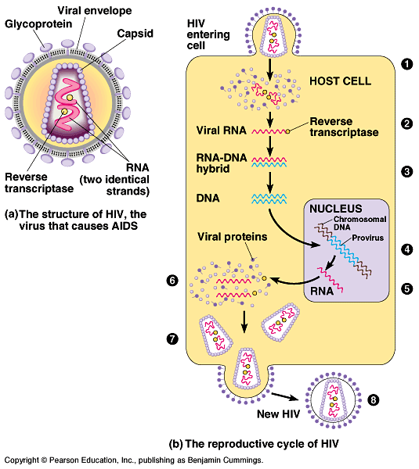
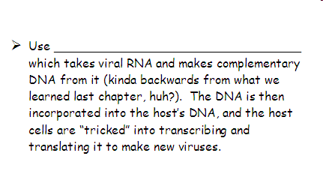

Slide 21
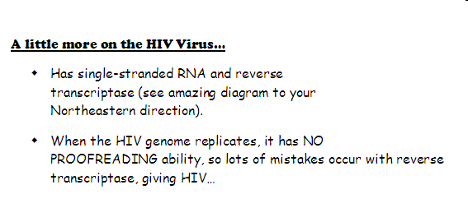

Slide 22

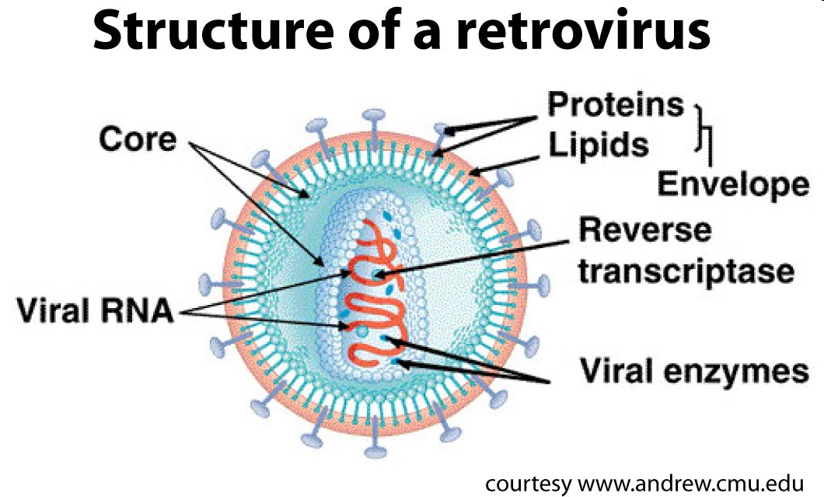

Slide 23
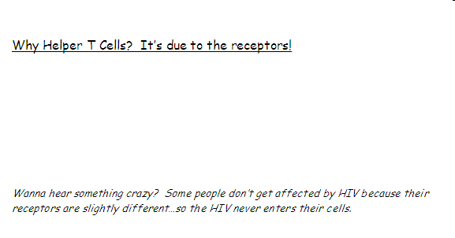

Slide 24
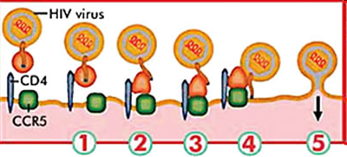

Slide 25


Slide 26
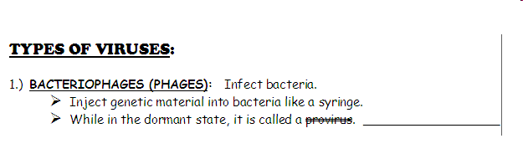
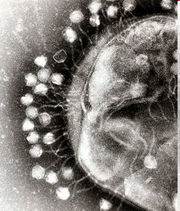

Slide 27
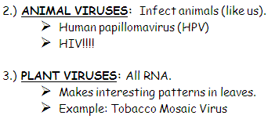

Slide 28
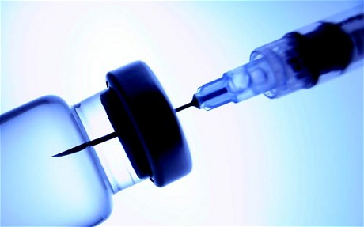
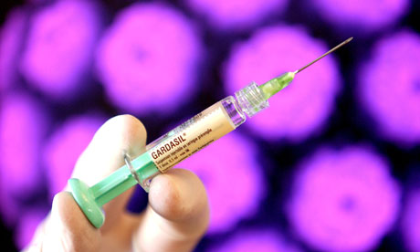

Slide 29
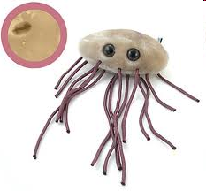
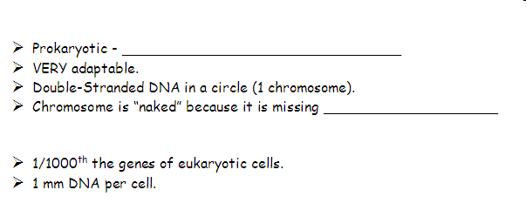
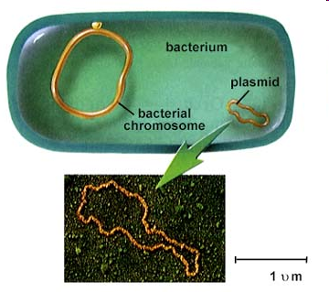
Genetics of Bacteria

Slide 30
Quick Drawing

Slide 32
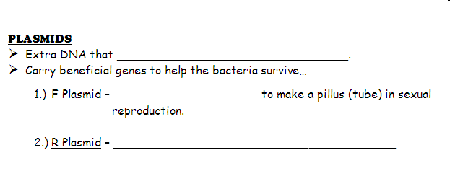

Slide 33
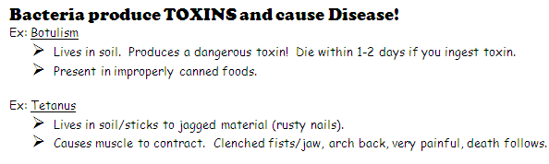
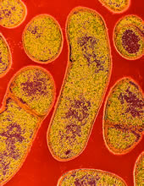
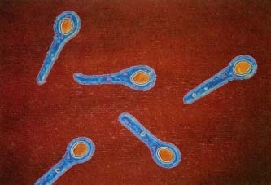



Slide 34

Amoeba porn flicks

Slide 35


Slide 36


Slide 37



Slide 38




Slide 39


Slide 40


Slide 41


Slide 42


Slide 43


Slide 44


Slide 45



Slide 46


Slide 47


Slide 48




Slide 49
Allo-what?

Slide 50



Slide 51



Slide 52


Slide 53


Slide 54

Operon | Repressor Starts: | Substrate present, Genes Are
LAC!
TRP!

Slide 55


A Operator
B Regulatory Gene
Repressor Protein
RNA Polymerase
Structural Gene

Slide 56


Slide 57



DNA ORGANIZATION IN EUKARYOTES

Slide 58



Slide 59

GENE EXPRESSION IN EUKARYOTES

Slide 60


Slide 61
Prepare for
CRAZINESS!!!

Slide 62




Slide 63



Slide 64




Slide 65



Slide 66




Slide 67


Slide 68






Slide 69

GENETIC ENGINEERING

Slide 70

In recent years, genes have been…well…messed with! We’re going to look at how genes from one organism can be added to another.
LOOK AWAY! I’m hideous!

Slide 71


Slide 72


Slide 73



Slide 74


Slide 75


Slide 76

WHO CARES ABOUT BORING BACTERIA?!!!
Yeah, well I made some people bucks-deluxe so BACK OFF!!!
Let’s see some cool stuff.

Slide 77




Slide 78


Bacteria have been genetically engineered to break down or “eat” oil. This bacteria is currently being used to clean the BP oil spill.

Slide 79


Geneticists are currently spending most of their time genetically altering crops and livestock (genetically altered food is already in our French fries and breakfast cereals)! Chickens are currently being altered to be featherless and larger so there is no time spent plucking!!!

Slide 80



Slide 81


The gene for Human Growth Hormone (HGH) has been spliced into mice. The result is mice much larger in both bone and muscle size.

Slide 82


Inspired by a recent story in the Washington Post, a genetics company has spliced the gene for spider silk proteins into dairy goats.
These new transgenic goats produce milk that can be refined into spider silk, with a tensile strength of 60,000 Lbs!!! It's 5x stronger than steel, and can be woven into Bullet proof vests hat are lighter and stronger than Kevlar.

Slide 83

Genes from fireflies have been added to random plants that allow the plants to glow. The idea is to have certain plants glow when they are in need of water.

Slide 84

The image shows transgenic mice that carry the piggyBac transposon (which comes from a moth) that has caused their cells to express red fluorescent protein.

Slide 85

Other companies are aiming to have transgenic fish in pet stores soon. These fish have jellyfish genes spliced into their own DNA.

Slide 86



More examples of transgenic animals.

Slide 87


Scientists are trying to alter chicks so that the eggs they produce will have more human proteins and antibodies!

Slide 88



Slide 89

Fish are being engineered to be larger.

Slide 90


Aside from size, genes from Northern fish are being added to Southern fish so that they can survive cold temperatures!

Slide 91

Plants can now be modified to produce a wide range of therapeutic products at a price significantly cheaper than through current methods. For example, antibodies that currently cost thousands of dollars per gram might be produced in plants for $200 per gram

Slide 92


Sheep engineered to be larger and have more wool.
Rice engineered to have more beta-carotene.

Slide 93



By inserting a protein, called Bacillus thuringiensis, or Bt, the scientists were able to create crops that protect themselves against pests. Twenty percent of the farms in the United States were using Bt and other built in insecticides as of 1998!!!

Slide 94
What Brands Have GMO's?
Blue Sky
Coca Cola
Hansen
Kraft
Nestle
Procter and Gamble
Libby's
Ocean Spray
Kellogg
Nature Valley
Nabisco
Hershey
Lifesaver
Quaker
Pepperidge Farm
Campbells
Frito Lay
Hostess
Heinz
Keebler
Crisco
Peter Pan
Smuckers
Skippy
Hormel
Progresso
Eggo
Boca
Morningstar Farms
Stouffers
Betty Crocker
Pillsbury
Aunt Jemima
Duncan Hines
Beech-nut
Enfamil
Good Start
Similac
Isomil
Yoplait
Land O Lakes
Dannon

Slide 95


In March 2006, a woman told police she and another dancer were hired to perform at a private party in an off-campus home of Duke lacrosse players. The dancer told police she was pulled into a bathroom, beaten, choked and raped by three men.

Slide 96


Armed with a judge's order, police took DNA samples with a cheek swab from 46 of the lacrosse team's 47 players.
The 47th player, the only black member of the team, did not have to provide DNA because the dancer said her attackers were white.
Authorities took DNA samples from all over the alleged victim's body, including under her fingernails, and from her possessions, such as
her cell phone and her clothes.
"The experts will tell you that if there was a condom used they would still be able to pick up DNA, latex, lubricant and all other types of things to show that." ~ Joe Cheshire (Attorney)
THERE WAS NO DNA EVIDENCE!!!

Slide 97

"It's been 395 days since this nightmare began and finally the day has come for closure. We are just as innocent today as we were back then...we have never wavered in our story."
~David Evans
Clockwise from left: David Evans, Colin Finnerty and Reade Seligmann

Slide 98


Slide 99


Slide 100




Slide 101



Slide 102


Slide 104


Slide 105


Slide 106

How can they tell?

Slide 107


Slide 108



Slide 109


Slide 110



Slide 111


Slide 112



Slide 113


Slide 114



Cloning

Slide 115


Slide 116


Slide 117


Genes and the Environment
ENVIRONMENTAL FACTORS MAY INFLUENCE GENETIC TRAITS!
List below at least 3 different examples of this:

Slide 118




Slide 119





Slide 120




Slide 121



