Slide 1
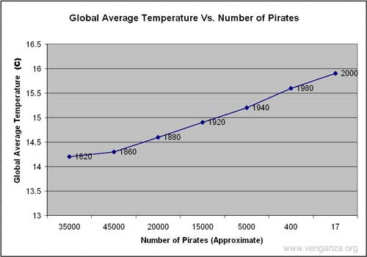

Slide 2

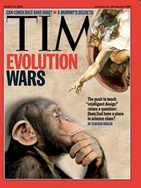

Slide 3
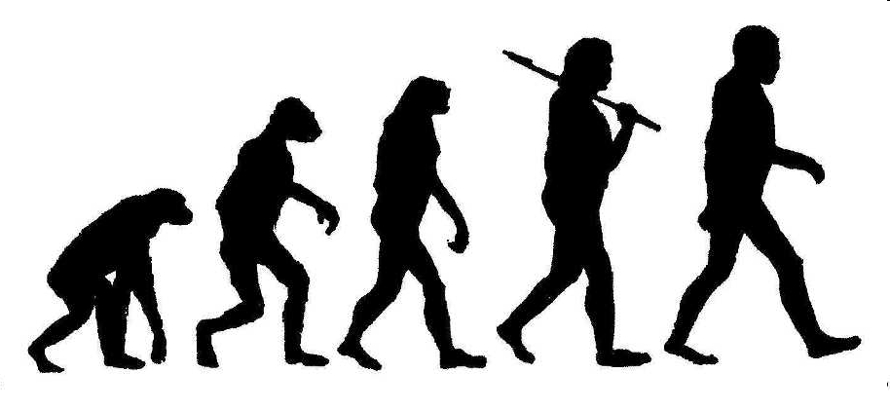
In 1999, the Kansas State Board of Education voted in favor of science education that contained NO MENTION of biological evolution, the age of the Earth, or the origin of the Universe …”
The Kansas decision sparked a statewide and nationwide controversy, and in 2001 the Board reversed its decision…BUT!!!

Slide 4
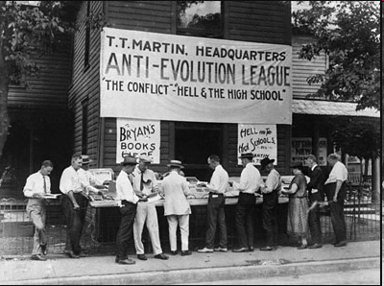
Here we go again…in May 2005, the Kansas State Board held a series of hearings to change how evolution and the origin of life would be taught in the state’s public schools.
The hearings were arranged by the Board of Education with the intent of introducing intelligent design into science classes.
What Problem Will We Get Here?
https://www.youtube.com/watch?v=7sfnnJBk3aY

Slide 5

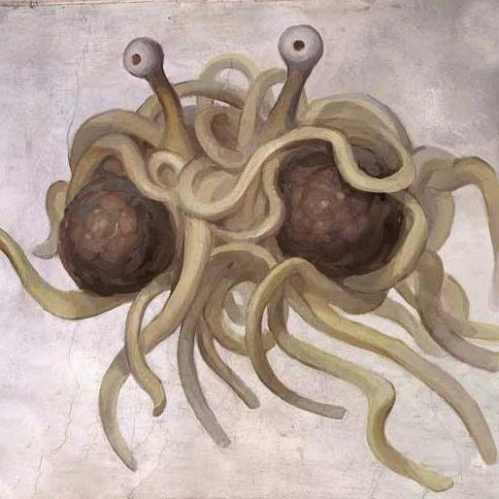

Slide 6
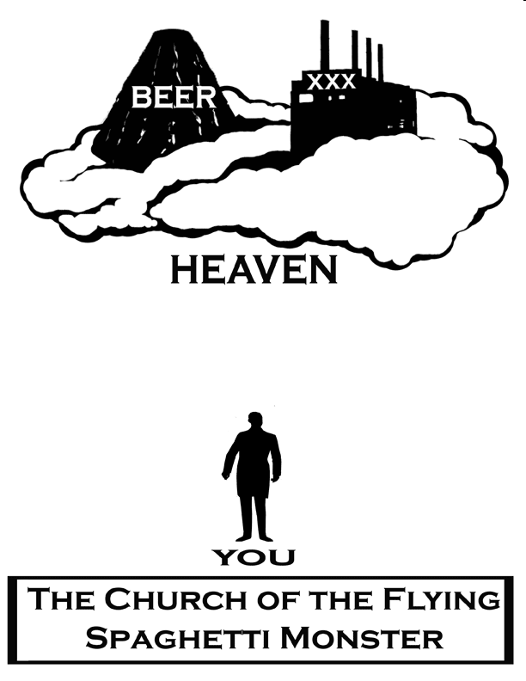

Slide 8
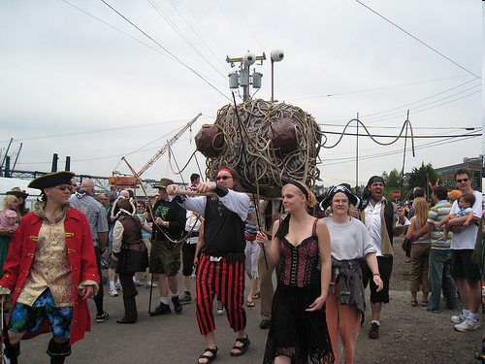
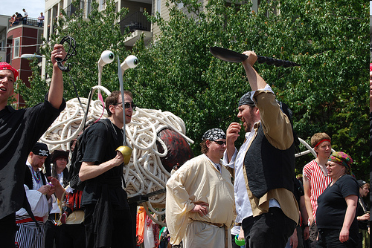

Slide 9
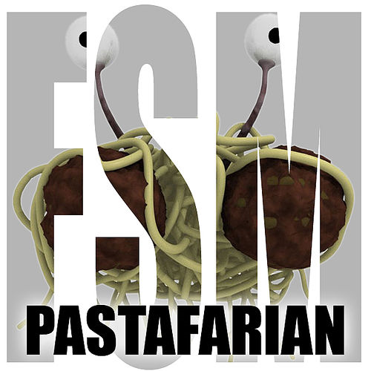

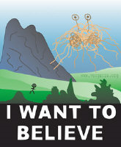



Slide 10
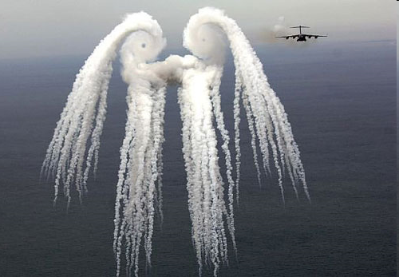


Slide 11

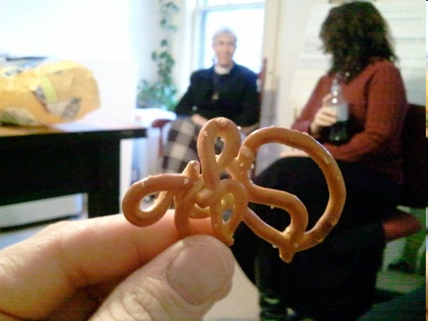

Slide 12
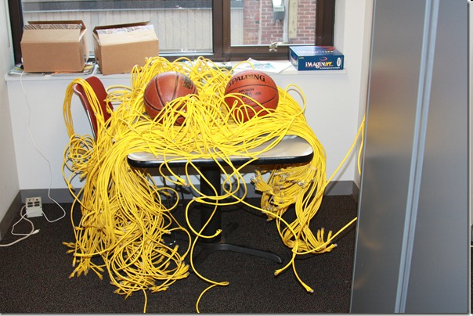
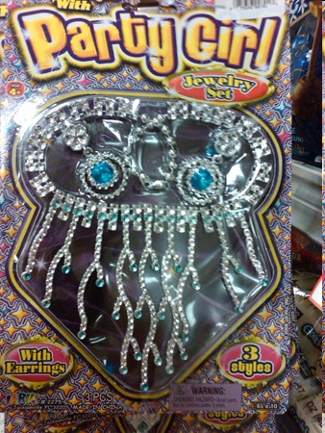

Slide 13
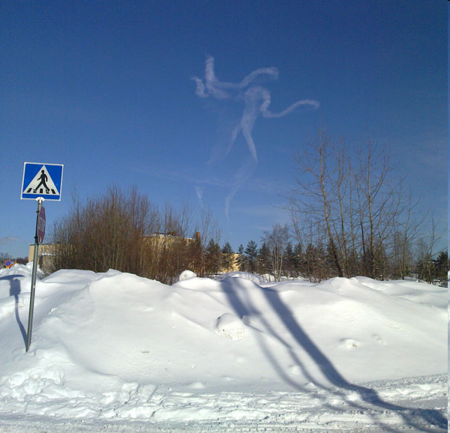
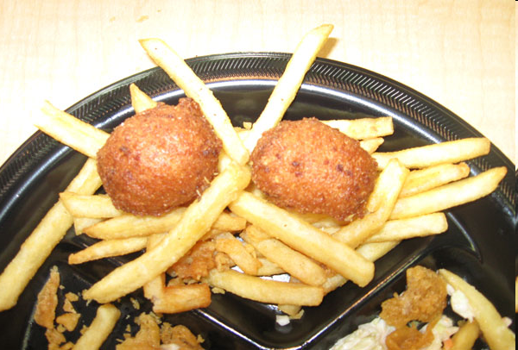

Slide 14
EVOLUTION

Slide 15
EVIDENCE FOR
EVOLUTION

Slide 16
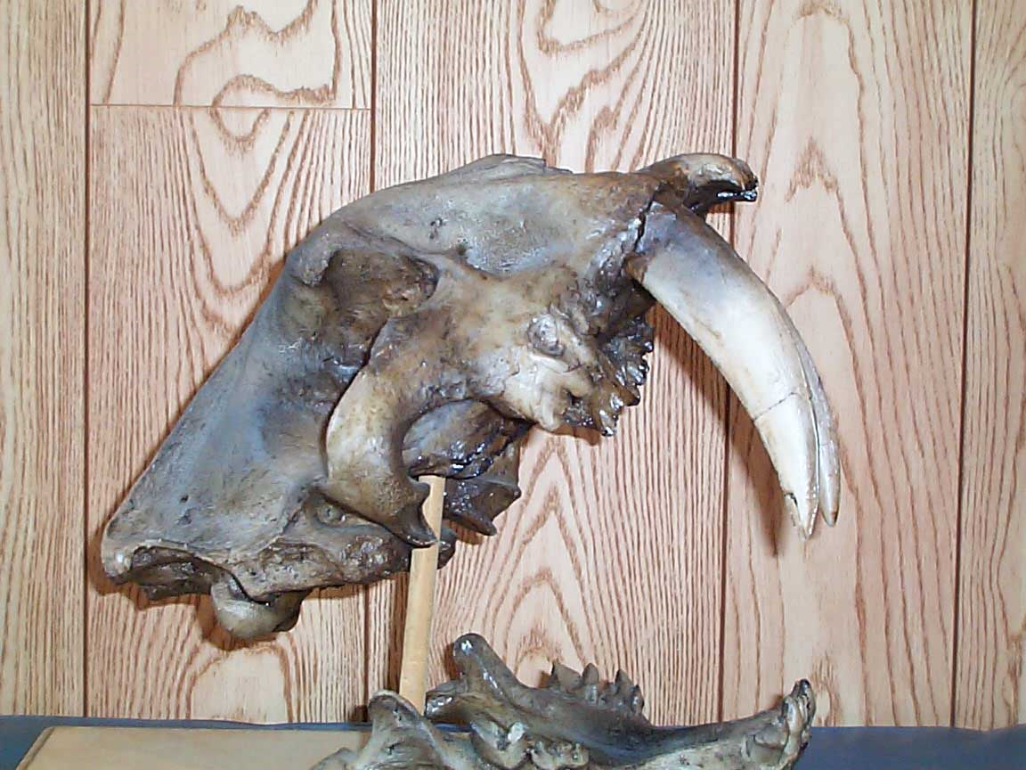
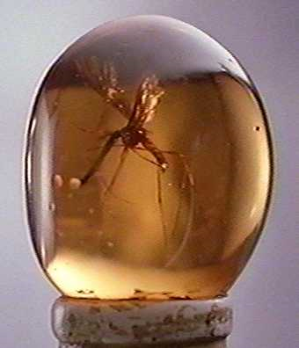
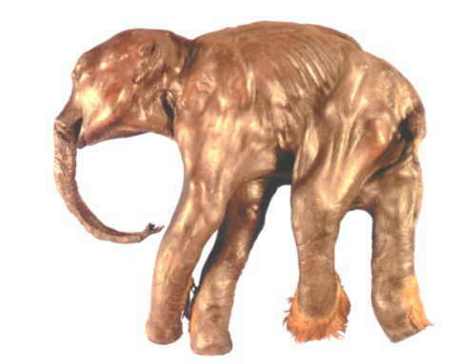
1.) Paleontology

Slide 17
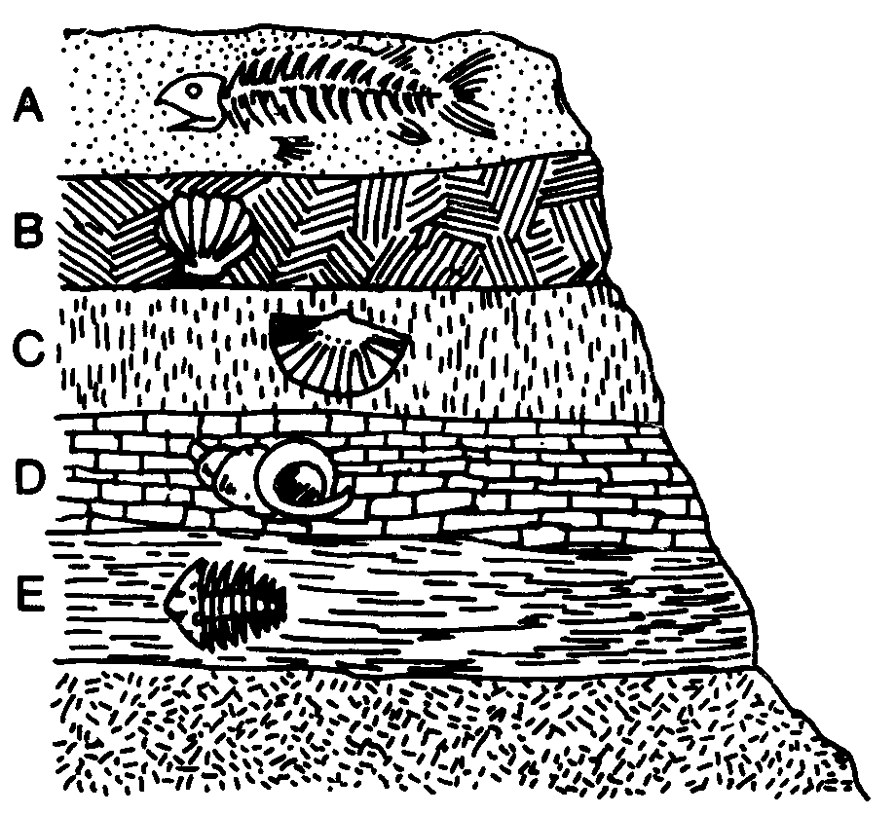

Slide 18
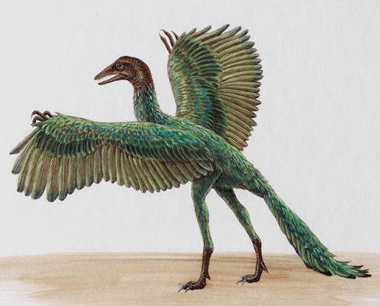
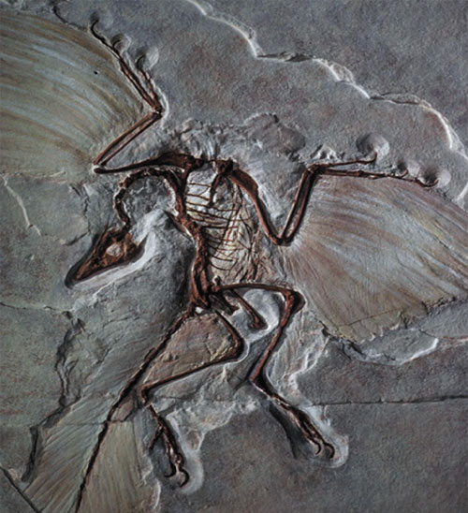
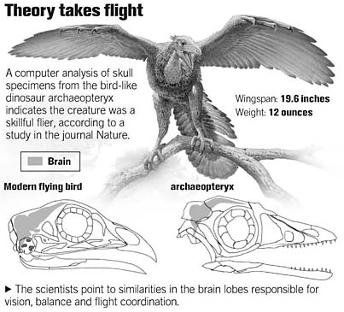
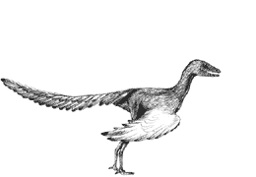
EVOLUTION OF BIRDS
Archaeopteryx
  lived about 150 mya
  links reptiles & birds
Smithsonian Museum,
Washington, DC
Notes:
18
The avian nature of the brain and inner ear of Archaeopteryx (Alonso et al. 2004) - Archaeopteryx, the earliest known flying bird from the Late Jurassic period, exhibits many shared primitive characters with more basal coelurosaurian dinosaurs (the clade including all theropods more bird-like than Allosaurus), such as teeth, a long bony tail and pinnate feathers. However, Archaeopteryx possessed asymmetrical flight feathers on its wings and tail, together with a wing feather arrangement shared with modern birds. This suggests some degree of powered flight capability but, until now, little was understood about the extent to which its brain and special senses were adapted for flight. Alonso et al. (2004) investigated this problem by computed tomography scanning and three-dimensional reconstruction of the braincase of the London specimen of Archaeopteryx. A reconstruction of the braincase and endocasts of the brain and inner ear suggest that Archaeopteryx closely resembled modern birds in the dominance of the sense of vision and in the possession of expanded auditory and spatial sensory perception in the ear. Alonso et al. (2004) concluded that Archaeopteryx had acquired the derived neurological and structural adaptations necessary for flight. An enlarged forebrain suggests that it had also developed enhanced somatosensory integration with these special senses demanded by a lifestyle involving flying ability.

Slide 19
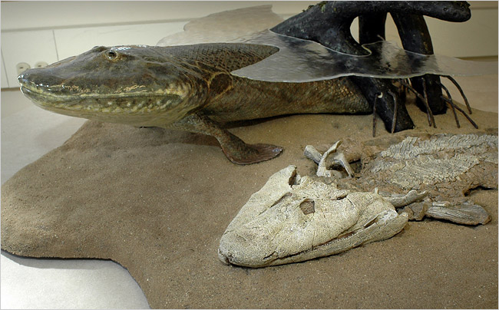
EVOLUTION OF LAND ANIMALS
2006 Fossil Discovery of Early Tetrapod
  “Tiktaalik”
  “missing link” from sea to land animals
    from swimming (0 legs) to walking (4 legs)
https://www.youtube.com/watch?v=yvDQCa7rleI
But Wait! There's More!
Notes:
19

Slide 20
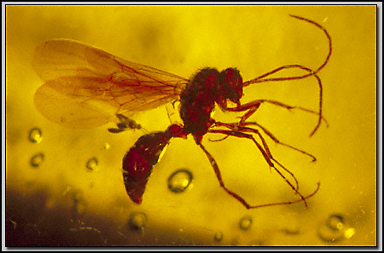
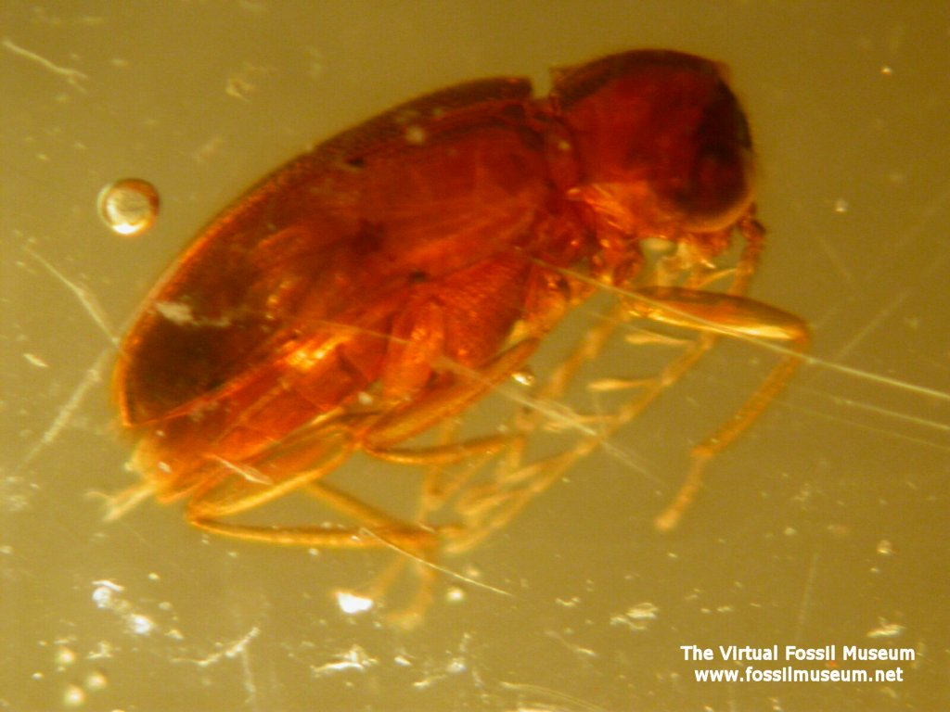
Amber

Slide 21
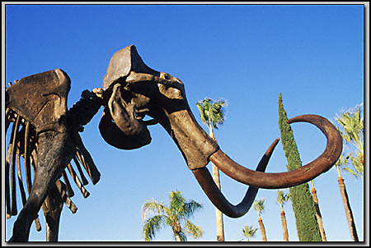
ICE
"Dima" a baby mammoth preserved in ice for 40,000 years. He was discovered in Siberia in 1977 and was named for a nearby stream.
He was around 6 months old when he died and only a bit over 3 feet tall. His teeth were slightly worn so it was apparent that he had begun to eat vegetation but still depended on his mother's milk for the bulk of his food intake.

Slide 22
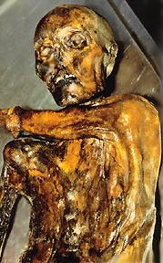
In 1991, a body was discovered originating out of the melting ice of a glacier in a small mountain passage named Tiesenjoch. After the rescue team retrieved the body from the ice, they transported it to the Department of Forensic Medicine in Innsbruck where Archaeologists determined the body was a natural mummy.
The mummy was an male adult remarkably well preserved. The condition of his equipment were also preserved in good condition. The age of the body is about 3,300 BC or late Stone Age.

Slide 23
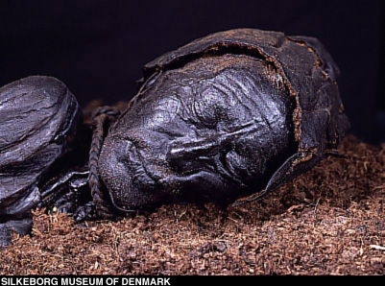
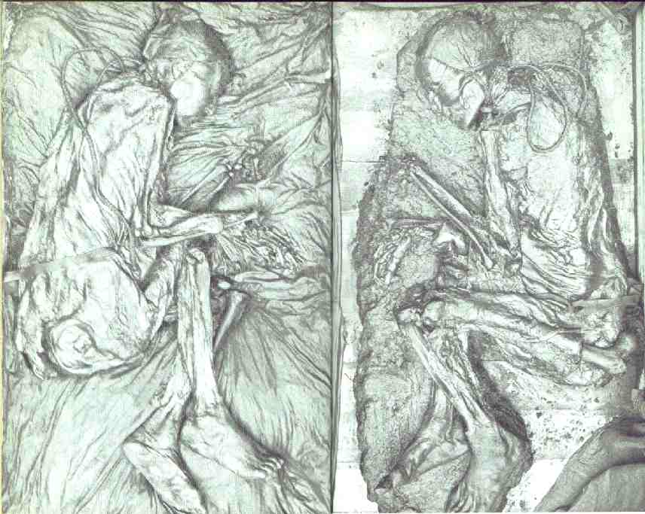
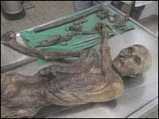
Other entire organisms have been found in tar pits and bogs!

Slide 24
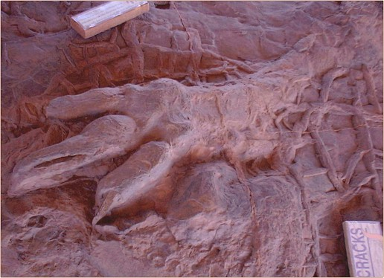
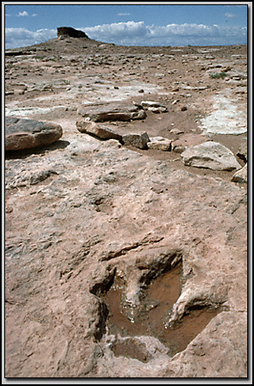
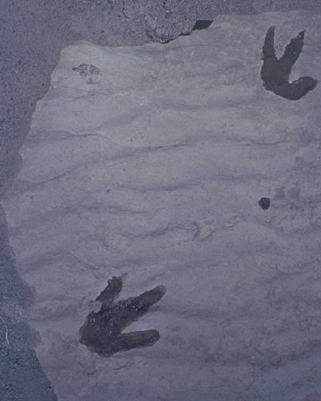
IMPRINTS
Fossilized track of Dilophosaurus, a bipedal 20-foot-long flesh-eating dinosaur, photographed on Navajo land just west of Tuba City, Arizona.

Slide 25
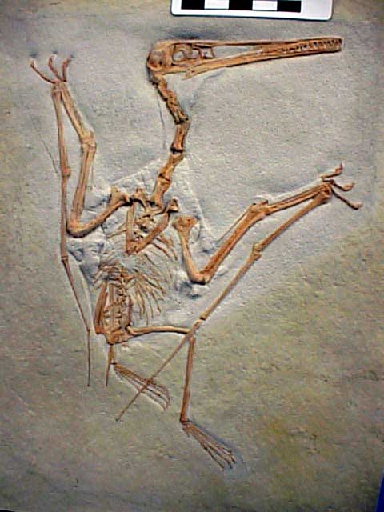
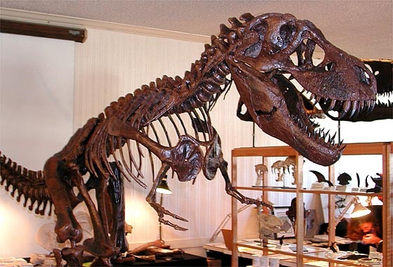
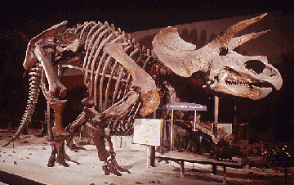
Bones

Slide 26
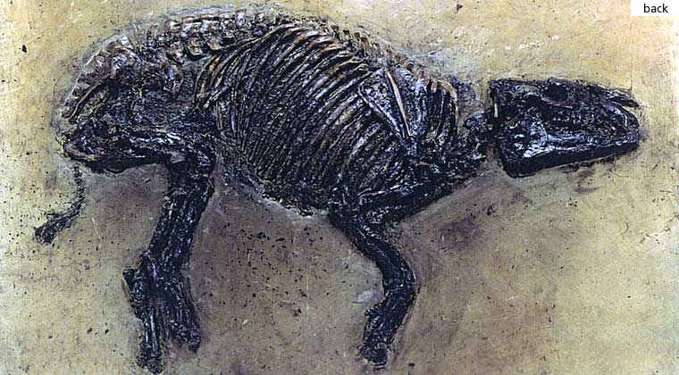

Slide 27
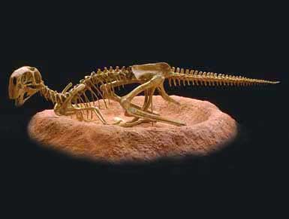
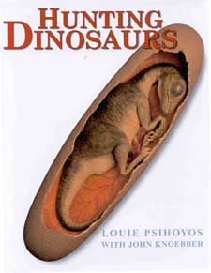
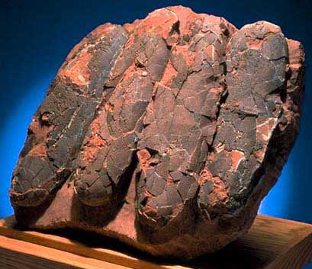
Fossilized dinosaur eggs.

Slide 28
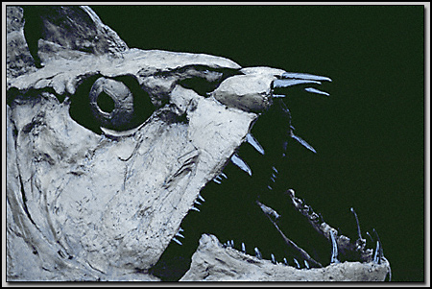
Skull of an extinct teleost fish, Xiphactinus audax, a 12-foot monster (the largest bony fish known from Cretaceous fossil deposits of North America).

Slide 29
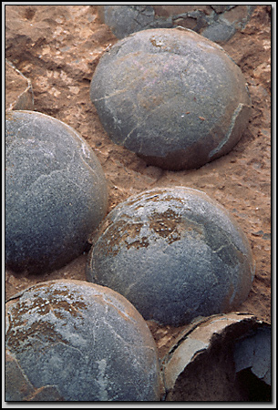
This early Cretaceous nest of dinosaur eggs, Oolithes spheroides, was collected in Henan Province of China.

Slide 30
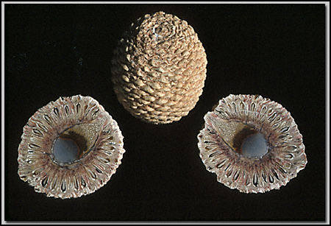
Fossilized "pine" cones of an Araucaria mirabilis tree that lived in the Jurassic of Patagonia, Argentina. Pine cones the size of pineapples!

Slide 31
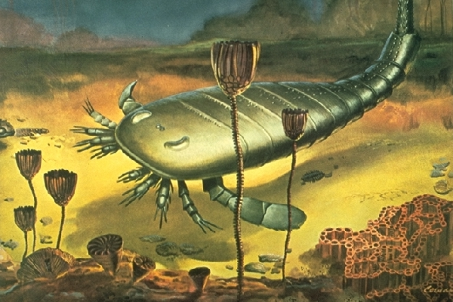
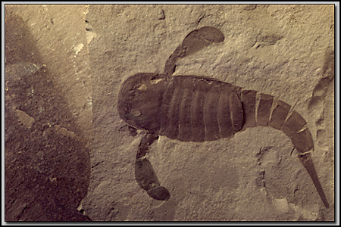
Sea scorpions were the largest free-swimming creatures (with external skeletons) of the Paleozoic era. Some attained 3 meters (10 ft.) in length and had huge pincers. This individual, Eurypterus remipes, was found in Herkimer Co., New York, USA.

Slide 32
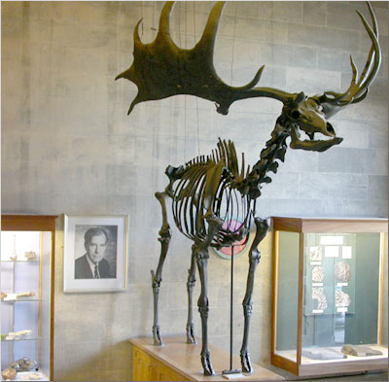
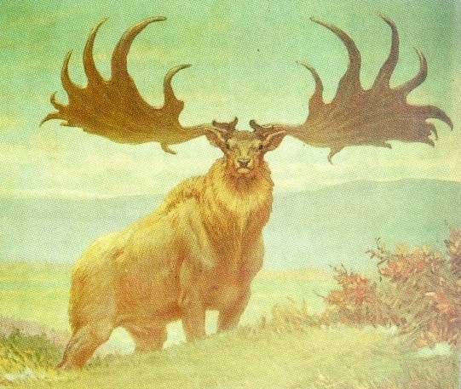
The Irish Elk is misnamed. It’s not Irish and is it not an elk. It is a giant extinct deer, the largest deer species ever, that stood up to seven feet at the shoulder with antlers spanning up to 12 feet.
The Irish elk evolved during the glacial periods of the last million years. It ranged throughout Europe, northern Asia and northern Africa. The name "Irish" has stuck because excellent, well-preserved fossils of the giant deer are especially common in lake sediments and peat bogs in Ireland.

Slide 33
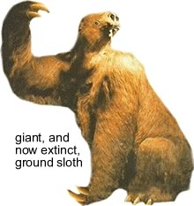

These plant-eating creatures rivaled elephants in size! They stood 6 m (20 ft) tall and weighed several tons. Ground sloths originated in South America and spread northward to the West Indies and to North America by migrating over the Central American land bridge.

Slide 34



Uintatherium was a bulky, hoofed animal was larger than a modern rhinoceros and sported an array of short, knobby horns which grew upward from its nasal bones. In addition, a pair of daggerlike canine tusks jutted downward from its upper jaw.
Uintatherium was an ancient, distant cousin of horses, elephants and whales.

Slide 35


2.) Embryology

Slide 38
So human embryos had gills and tails (as you just saw)…so some babies MUST be born with tails, right?

Slide 39




Slide 40

3.) Comparative Anatomy

Slide 41


Radius = Orange Carpals = Yellow
Ulna = Whitish Phalanges = Darker Brown

Slide 42




Slide 43



Slide 44


Slide 45



Slide 46


Slide 47



Slide 48




Slide 49






4.) Molecular Biology
Humans and Chimps have 96.2% of the same DNA!!!

Slide 50

CHROMOSOME 2 IN:
Humans
Chimps
Gorillas
Orangutans

Slide 51

Human
Macaque
Dog
Bird
Frog
Lamprey
Comparative hemoglobin structure
8
32
45
67
125
0
10
20
30
40
50
60
70
80
90
100
110
120
Number of amino acid differences between
hemoglobin (146 aa) of vertebrate species and that of humans
Notes:
51
Molecular Record
What are we comparing here? -→ comparing DNA (base sequence) & proteins (amino acid sequence)
What assumption do we make
about genes and relatedness? → the more closely related, the more DNA bases & amino acids you have in common
have to compare genes for protein the organisms have in common… can’t compare genes for proteins you don’t have

Slide 52


Mmmm...tastes like...

Slide 53


It's not that many people have been asking what Tyrannosaurus rex tasted like. But in a feat that demolishes beliefs about how long biological molecules can survive, scientists have isolated tiny amounts of the protein collagen from the thigh bone of a T. Rex that died 68 million years ago in what is now Montana.

Slide 54


There was just enough for scientists to determine the amino acid sequence of the protein. The sequence it matches closest is that of modern-day chickens.
The match is the first molecular support (besides bones) that birds and dinosaurs are evolutionary cousins. This match is stronger evidence that crows hopping around some dead road kill can claim velociraptors as great-uncles.

Slide 55






5.) Biogeography

Slide 56


Slide 57









Slide 58
Evolution Overview
JV Version
Varsity Version
X

Slide 59



Changes in populations over generations.
Changes in groups of organisms over millions of years.

Slide 60
Evidence for Evolution?

Slide 61




Evolution Theories

Slide 62


Lamarck

Slide 63


Inheritance of Acquired Characteristics

Slide 64





Slide 65


Slide 66



DARWIN

Slide 67






Slide 68




Slide 69


Darwin's Theory
Part #1
OVERPRODUCTION

Slide 70


Slide 71


Slide 72


Slide 73

Additional Notes?
Population sizes remain stable despite reproductive potential.

Slide 74

Part #2
COMPETITION

Slide 75




Additional Notes?
Resources are limited.

Slide 76


Part #3
VARIATION

Slide 77





Slide 78

Additional Notes?
Variation exists and is inheritable.

Slide 79



Part #4
SURVIVAL OF THE FITTEST

Slide 80


Additional Notes?
Those best adapted survive and reproduce.

Slide 81



https://www.youtube.com/watch?v=xpo8SdY1JSw
Evolution occurs as…
favorable traits accumulate in a population.

Slide 83


Slide 84



Slide 85


Slide 86


Slide 87


Slide 88


Slide 89


Slide 90


Slide 91


Slide 92


Slide 93


Slide 94




Slide 95



Slide 96



Slide 97



Peppered Moths
Dark vs. light variants
Year % Dark % Light
1848 5 95
1895 98 2
1995 19 81
Notes:
97

Slide 98

PEPPERED MOTH
What was the selection factor?
  Early 1800s = Pre-industrial England
    low pollution
    lichen growing on trees = light colored bark
  Late 1800s = Industrial England
    factories = soot coated trees
    killed lichen = dark colored bark
  Mid 1900s = pollution controls
    clean air laws
    return of lichen = light colored bark
Notes:
98

Slide 99


Slide 100


An outbreak of strep throat infections in Pittsburgh, Pennsylvania, involved bacteria that are resistant to erythromycin (a drug used to treat sore throats). Nearly half of the “Group A” Streptococcus bacteria analyzed by researchers had developed resistance to the drug.

Slide 101

Antibiotic-resistant bacteria are now common throughout the U.S. and much of the world. In Arizona, the most common bacteria that can cause illnesses like pneumonia and meningitis have recently developed resistance to penicillin in 30 percent of cases.

Slide 102



Slide 103


Slide 104


Slide 105


FOR MATURE AUDIENCES ONLY...

Slide 106




Slide 107



Slide 108


Slide 109


Slide 110


See what I’m saying about complex behavior and whatnot?

Slide 111


Slide 112



Slide 113


Slide 114


Hey baby…you like what you see?
Creep.

Slide 115


The Lion’s Mane…
Females are attracted to males with larger, dark manes
Correlation with higher testosterone levels
  better nutrition & health
  more muscle & aggression
  better sperm count / fertility
  more successful young
But imposes a cost to male
  HOT! Is it worth it??
Notes:
115
Even though it’s very hot to have a large mane the benefit of attracting mates and successfully producing & rearing young since you have that large mane outweighs the costs.
Females who chose these males were more “successful” (more, healthier young) and therefore had a greater opportunity to pass on the trait of being attracted to longer darker manes to their daughters and the trait of having longer, darker manes to their sons.

Slide 116


Slide 117




Slide 118




Slide 119


Slide 120





Slide 121





Slide 122



Slide 123


Slide 124


Slide 125


Slide 126


Slide 127


Slide 128


Slide 129

Result of 73 generations of breeding for hostility.

Slide 130


CT scans performed on sheep to indicate which have the best “carcass quality” for selective breeding.

Slide 131

A woman milks a mare. Horses were first domesticated in the Eurasian steppes 5,500 years ago.

Slide 132



DARWIN'S GLITCH (D'OH!)!
NOW WE KNOW…
WOO-HOO!

Slide 133


Slide 134


Slide 135


Slide 136


Slide 137


Sickle-Cell Anemia
2 Alleles for the Gene:
A = Normal
a = Sickle Cell
AA = Normal
aa = Sickle-Cell
Aa = Normal but impaired oxygen-carrying ability.
In parts of Africa, 14% are Aa…very high frequency for a deleterious gene!

Slide 139



Slide 140


Crossing two different corn strains (that were highly inbred), produces larger corn ears.

Slide 141


Slide 142


Slide 143


Predators form a certain “search image” for their prey.
Predators optimize their search effort by “standardizing prey.” The rare prey escape predation.

Slide 144



Slide 145


More on Modern Synthesis...

Slide 146



Slide 147




Slide 148



Slide 149


250,000 Amish People today (in America and Canada).
All grew from 200 founders who came to the US in the mid 1700’s.
Rarely marry outside of Amish population.
In original descendents, one of the 200 had….

Slide 150




Slide 151


Slide 152

CHEETAHS
All cheetahs share a small number of alleles
  less than 1% diversity
  as if all cheetahs are
  identical twins
  2 Bottlenecks!!!
  10,000 years ago
    Ice Age
  last 100 years
    poaching & loss of habitat
Notes:
152

Slide 153



CONSERVATION ISSUES
Peregrine Falcon
Bottlenecking is an important concept in conservation biology of endangered species
  loss of alleles from gene pool
  reduces variation
  reduces adaptability
Breeding programs must consciously outcross
Golden Lion Tamarin
Notes:
153

Slide 154


Slide 155


Slide 156


Slide 157

Genetic Equilibirum

Slide 158




Slide 159


Slide 160


Slide 161


Slide 162



Speciation
SPECIES – group of organisms that are similar and can interbreed.

Slide 163




Slide 164



Slide 165



Slide 166


Slide 167



Slide 168



Slide 169


Slide 170




Slide 171


Maintaining Reproductive Isolation
X

Slide 172

# | Mechanism | Quick Explanation
1 | Habitat Isolation
2 | Temporal Isolation
3 | Behavior Isolation
4 | Mechanical Isolation
5 | Gametic Isolation

Slide 173

# | Mechanism | Quick Explanation
1 | Hybrid Inviability
2 | Hybrid Sterility
3 | Hybrid Breakdown

Slide 174




Patterns of Evolution

Slide 175




Slide 176



Slide 177




Slide 178


Slide 179





Slide 180



Slide 181



Slide 182
THE 5 MASS EXTINCTIONS
Mass Extinction Event | Time Frame (mya) | Type of Life Effected | Hypothetical Cause
Late/End Ordovician | 439 | Estimated 85% species and 45–60% of marine genuses killed. (Trilobites, Echinoderms, Corals) | Unusually fast plate movement; glaciation leading to sharp de- clines in sea levels.
Late/End Devonian | 365 | 70–80% of all species and 30% of families vanish; marine life more decimated than freshwater and land. | Unknown if one catastrophic event or several smaller ones–possibly large asteroid or asteroid shower over time; possible glaciation and lethal temperature declines; oceanic anoxia (O₂-lacking)
Late/End Permian | 251 | Most devastating of all, eliminating 85–90% of all marine and land vertebrate species. End of trilobites and many trees. | Possible asteroid; volcanic eruptions; dropping sea levels and oceanic anoxia
Late/End Triassic | 206 | More than three quarters of all species and one quarter of families disappear. End of mammal-like reptiles and large amphibians, leaving mainly dinosaurs. | Little known but suspected fall in sea level, oceanic anoxia, major increase in rainfall. Possible comet showers or asteroid impact.
Late/End Cretaceous | 65 | 47% of marine genuses and 18% of land vertebrates wiped out, including the dinosaurs, leaving mainly turtles, lizards, birds, and mammals. | Suspected asteroid 10 km. in diameter hitting near Yucatán peninsula, coinciding with Siberian eruptions and dramatic climatic cooling.
www.youtube.com/watch?v=92oHNd8vFwo&list=PL8dPuuaLjXtMczXZUmjb3mZSU1Roxnrey&index=5

Slide 183

When's the 6th Extinction?
According to Peter Raven (Missouri Botanical Garden), species are going extinct at about 4,000 per year (1 every 15 minutes).
At current trend, 50% of all species will be extinct or endangered by 2050.

Slide 184

A recent article by the UN states that 25% of major mammalian species and 1/8 of ALL bird species will be extinct in the next 30 years.
This includes the “big cats,” elephants, rhinos, etc.

Slide 185


Slide 187


Slide 188
Review
Slides

Slide 189
A.) Stabilizing Selection
B.) Disruptive Selection
C.) Directional Selection
D.) Sexual Selection
E.) Artificial Selection
1.) The population of peppered moths in England changed from white to black in fifty years.

Slide 190
A.) Stabilizing Selection
B.) Disruptive Selection
C.) Directional Selection
D.) Sexual Selection
E.) Artificial Selection
2.) Human newborns usually weigh between 6-8 pounds.

Slide 191
A.) Stabilizing Selection
B.) Disruptive Selection
C.) Directional Selection
D.) Sexual Selection
E.) Artificial Selection
3.) Humans have bred dairy cows to produce 100 pints of milk per day.

Slide 192
A.) Stabilizing Selection
B.) Disruptive Selection
C.) Directional Selection
D.) Sexual Selection
E.) Artificial Selection
4.) In one region of New Jersey there exists two distinct types of one species of snake.

Slide 193
A.) Stabilizing Selection
B.) Disruptive Selection
C.) Directional Selection
D.) Sexual Selection
E.) Artificial Selection
5.) Large horns and giant antlers are characteristic of the male.

Slide 194


Slide 195


Slide 197


Slide 198


Slide 199


