Slide 1

Demographic Study for the Ramapo Indian Hills Regional high school District
May 30, 2024

Slide 2
Statistical Forecasting
Provide demographic services for school districts in the New York-New Jersey metropolitan area since 1998.
Performed demographic studies for approximately 200 school districts in NY & NJ.
Demographic consultant for the NYC Public Schools since 2006.

Slide 3
Richard s. grip ed.d.
Executive Director
Doctorate from Rutgers University Graduate School of Education in Educational Statistics and Measurement
Numerous publications on school demography and presentations nationally
Testified as an expert witness in school demography in several Administrative Law court hearings.

Slide 4
Purpose of the Study
Project grade-by-grade enrollments from 2024-25 through 2028-29, a 5-year period
Analyze community population trends, demographic characteristics, and age structure
Examine historical enrollments districtwide, by school, as well as enrollments of feeder K-8 school districts
Research new housing starts and the impact on school district
Compare building capacities to current and projected enrollments
Electronically “pin-map” student addresses from the 2018-29 and 2023-24 school years to show the relative concentrations of where students live

Slide 5
Historical and Projected Populations 1940-2050

Slide 6
Demographic profiles
Aggregated population of the three communities in 2020 is 40,412. Wyckoff has the largest population (16,585).
Whites are the largest race in each town. Hispanics are the second-largest race in Oakland and Wyckoff; Asians are the second-largest race in Franklin Lakes.
Franklin Lakes has the highest median age (46.3 years); all three communities are above the median age in New Jersey (39.9 years).
Foreign-born percentage is low in each community and ranges from 9.9% in Wyckoff to 17.7% in Franklin Lakes Oakland, which are lower than New Jersey (23.5%).

Slide 7
Demographic profiles
Bachelor’s degree or higher ranges from 54.2% in Oakland to 77.3% in Franklin Lakes, which are greater than that of New Jersey (43.5%).
Franklin Lakes has the highest median household income ($205K) while Oakland has the lowest ($163K). New Jersey median household income is $96K.
The percentage of renter-occupied units ranges from 7.7% in Wyckoff to 12.5% in Franklin Lakes, which are much lower than New Jersey (38.7%).
The percentage of one-unit homes, either detached or attached, ranges from 92%-96% in the three towns.
Franklin Lakes has the highest median value of an owner-occupied unit ($1.14M) while Oakland has the lowest ($536K), which are greater than New Jersey ($429K)

Slide 8
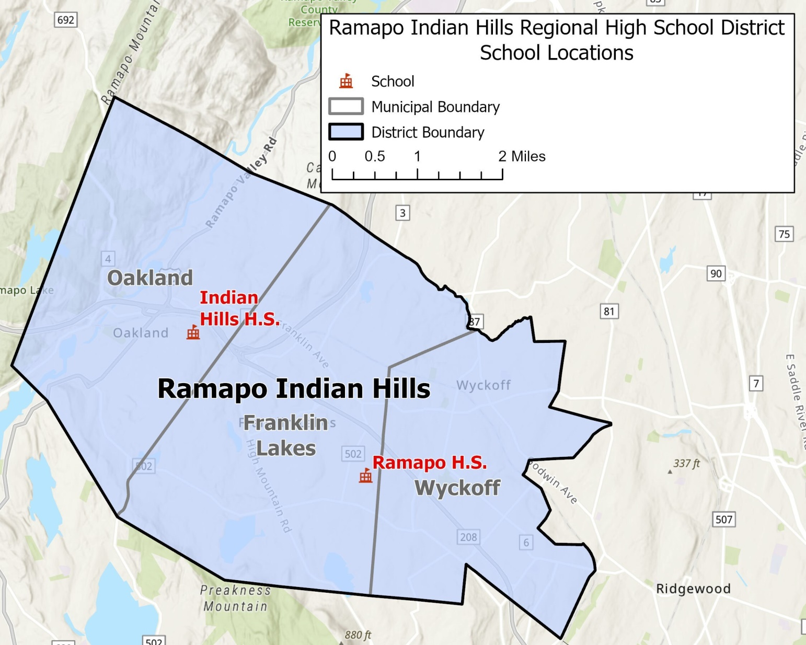
School locations

Slide 9
Historical enrollment trends
District’s 2023-24 enrollment (9-12) is 1,890.5.
2014-15 enrollment = 2,313 (decline of 422.5 students in 10 years)
Enrollments were stable through 2018-19 before declining in the last 5 years
Cohort-Survival Ratio Method (CSR) was used to project enrollments five years into the future.

Slide 10
Historical Enrollments (9-12) 2014-15 to 2023-24

Slide 11
Incoming 9th grade classes 2014-15 to 2023-24

Slide 12
Historical Enrollments by school 2014-15 to 2023-24

Slide 13
9th grade enrollment percentages by town 2018-19 to 2023-24
Year | Indian Hills High School |  |  | Ramapo High School
 | Franklin Lakes | Oakland | Wyckoff | Franklin Lakes | Oakland | Wyckoff
2018-19 | 15.5% | 92.7% | 13.2% | 84.5% | 7.3% | 86.8%
2019-20 | 24.1% | 88.1% | 13.0% | 75.9% | 11.9% | 87.0%
2020-21 | 28.9% | 87.7% | 10.8% | 71.1% | 12.3% | 89.2%
2021-22 | 20.9% | 89.1% | 20.8% | 79.1% | 10.9% | 79.2%
2022-23 | 12.6% | 76.9% | 12.2% | 87.4% | 23.1% | 87.8%
2023-24 | 10.6% | 87.1% | 15.5% | 89.4% | 12.9% | 84.5%

Slide 14
Historical Enrollments PK-8 Feeder districts 2014-15 to 2023-24
Oakland enrollments declined through 2021-22 before reversing trend.
Wyckoff’s enrollments declined through 2019-20 before reversing trend. Increasing enrollment in last four years.
Fairly stable enrollment in Franklin Lakes in last decade.
In aggregate, enrollments declined through 2019-20 before reversing trend. Enrollment is 4,521 in 2023-24, which is a decline of 353 students from 2014-15 (4,874).
Wyckoff comprises 45% of the aggregated PK-8 enrollment.

Slide 15
Historical Enrollments PK-8 Feeder districts 2014-15 to 2023-24

Slide 16
Enrollment Projection Method Cohort Survival Ratio
Ratios are calculated for each grade progression. (Ex. 100 10th graders in 2022-23 become 95 11th graders in 2023-24 = 0.95)
Ratios above 1.000 = inward migration, below 1.000 = outward migration
Survival ratios were computed for ten historical years. 2 of 4 average ratios were above 1.000.
Averages were then computed and used to project future enrollments.

Slide 17
Age Pyramid Ramapo Indian Hills regional 2010 Census

Slide 18
Age Pyramid Ramapo Indian Hills regional 2020 census

Slide 19
Change in males and females 2010-2020 Ramapo Indian Hills regional
Age Group | Males |  | Females
 | Numerical Change | Percentage Point Change | Numerical Change | Percentage Point Change
Under 5 | +23 | 0.0 | +36 | +0.1
5-9 | -324 | -0.8 | -395 | -1.0
10-14 | -382 | -1.0 | -315 | -0.8
15-19 | +16 | 0.0 | +85 | +0.2
20-24 | +509 | +1.2 | +428 | +1.0
25-29 | +212 | +0.5 | +162 | +0.4
30-34 | +119 | +0.3 | +80 | +0.2
35-39 | -4 | 0.0 | +35 | +0.1
40-44 | -372 | -1.0 | -553 | -1.4
45-49 | -681 | -1.7 | -575 | -1.5
50-54 | -250 | -0.7 | -132 | -0.4
55-59 | +394 | +0.9 | +257 | +0.6
60-64 | +211 | +0.5 | +276 | +0.7
65-69 | +233 | +0.6 | +240 | +0.6
70-74 | +259 | +0.6 | +216 | +0.5
75-79 | +93 | +0.2 | +118 | +0.3
80-84 | +48 | +0.1 | +42 | +0.1
85+ | +156 | +0.4 | +107 | +0.2

Slide 20
Approved & Proposed new housing
Potential for 195 non age-restricted new housing units - all in Oakland.
24 public school children (9-12) are projected from new developments.
Baseline enrollment projections of Indian Hills H.S. were modified to account for new housing.

Slide 21
Approved & Proposed New housing
Development (Location) | Municipality | Number of Units | Bedroom Distribution | Housing Type | Notes/Project Status
K Hovnanian (123 McCoy Road) | Oakland | 191 | Market-Rate TH (151) 3-BR Affordable APT (40) 8 1-BR 24 2-BR 8 3-BR | Townhouse (Market-Rate) Apartment (Affordable) | Approved in January 2023. Under construction. Possible occupancy in 1-2 years. 40 units will be set aside for Low-Moderate Income households (Willows at Oakland)
Howell (146 Manito Avenue) | Oakland | 4 | N/A | Detached Single-Family | Not yet approved. Being heard by the Planning Board.
Oakland Total |  | 195
Ramapo Indian Hills Regional Total |  | 195

Slide 22
Historical construction 2018-2023
Year | Municipality
 | Franklin Lakes | Oakland | Wyckoff | Total
2018 | 25 | 2 | 0 | 27
2019 | 126 | 1 | 5 | 132
2020 | 69 | 1 | 6 | 76
2021 | 47 | 3 | 2 | 52
2022 | 93 | 2 | 5 | 100
2023 | 25 | 2 | 2 | 29
Total | 385 | 11 | 20 | 416

Slide 23
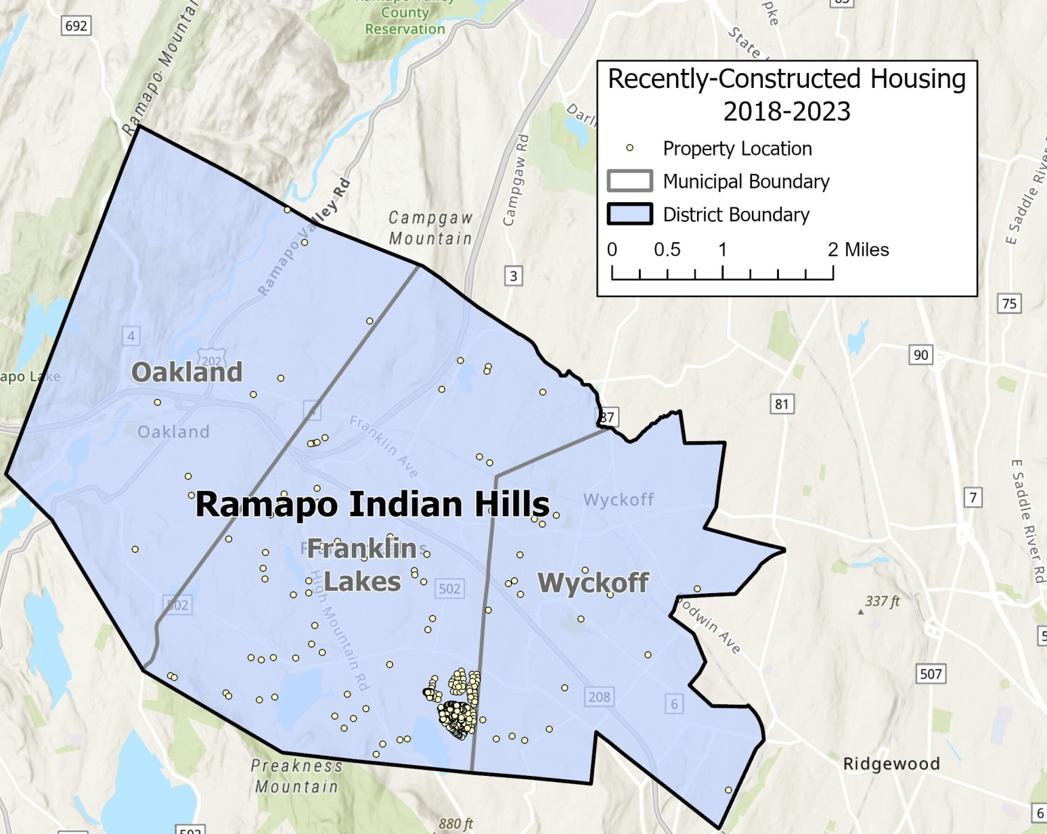
Historical construction

Slide 24
Home sales Ramapo Indian Hills regional 1994-2022

Slide 25
Enrollment projections
Enrollments were projected from 2024-25 through 2028-29, a 5-year period.
Two sets of projections - CSR 4-YR and CSR 5-YR
Enrollments are projected to decline for the next 3 years before reversing trend in both projections.
CSR 4-YR – 1,865 in 2028-29 (-25.5)
CSR 5-YR– 1,873 in 2028-29 (-17.5)

Slide 26
Enrollment projections
Indian Hills H.S. -enrollments are projected to decline in 2024-25 before reversing trend in both projections.
CSR 4-YR – 707 in 2028-29 (+8.5)
CSR 5-YR– 726 in 2028-29 (+27.5)
Ramapo H.S. -enrollments are projected to decline for next 4 years before reversing trend in both projections.
CSR 4-YR – 1,158 in 2028-29 (-34)
CSR 5-YR– 1,147 in 2028-29 (-45)

Slide 27
Capacity analysis
School | Capacity | Current Enrollment 2023-24 | Difference | Projected Enrollment 2028-29 | Difference
Indian Hills H.S. (9-12) | 1,469 | 698.5 | +770.5 | 726 | +743
Ramapo Regional H.S. (9-12) | 1,663 | 1,192 | +471 | 1,158 | +505

Slide 28
Mapping
Maps were created to compare student residential locations at two different times: 2018-19 and 2023-24.
Student counts by census block
Student density by census block
Student yield by census block

Slide 29
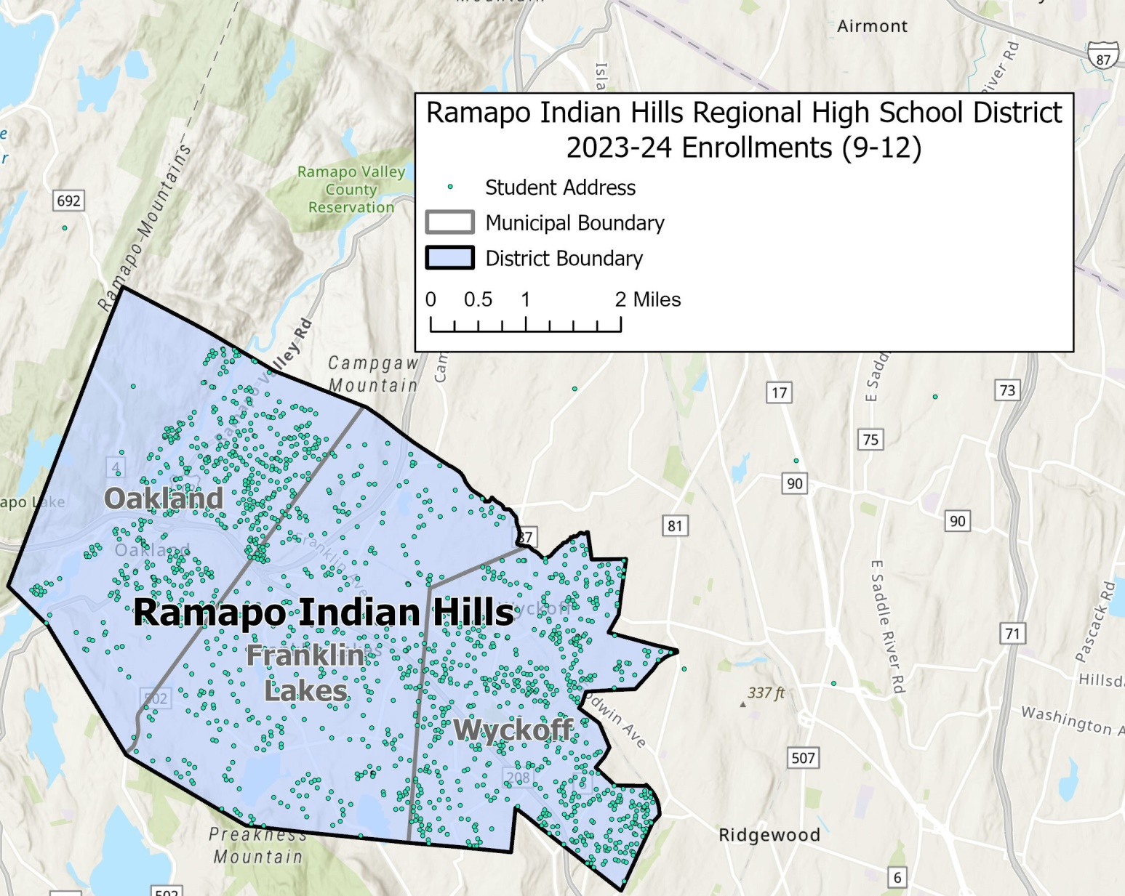
2023-24 Students (9-12)

Slide 30
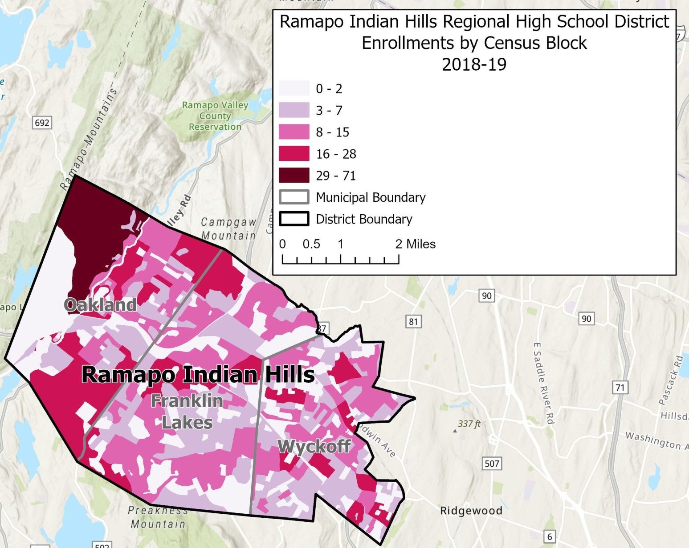
Student counts by census block 2018-19

Slide 31
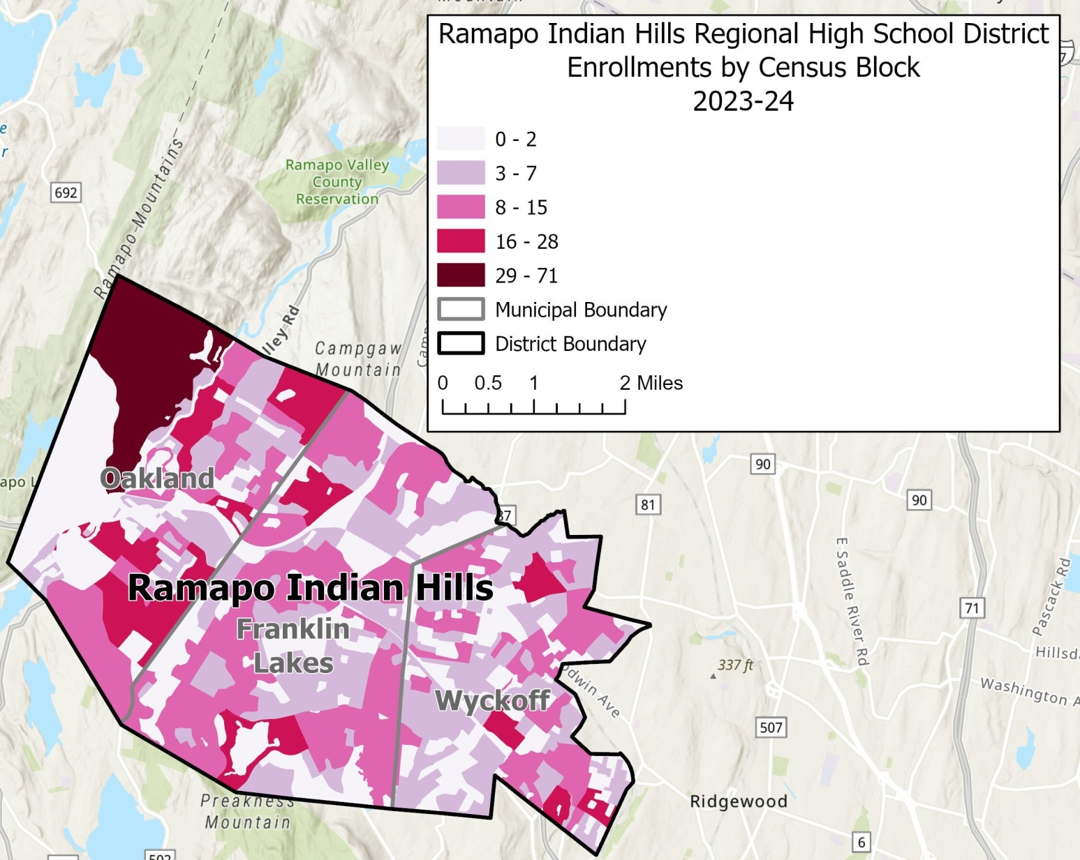
Student counts by census block 2023-24

Slide 32
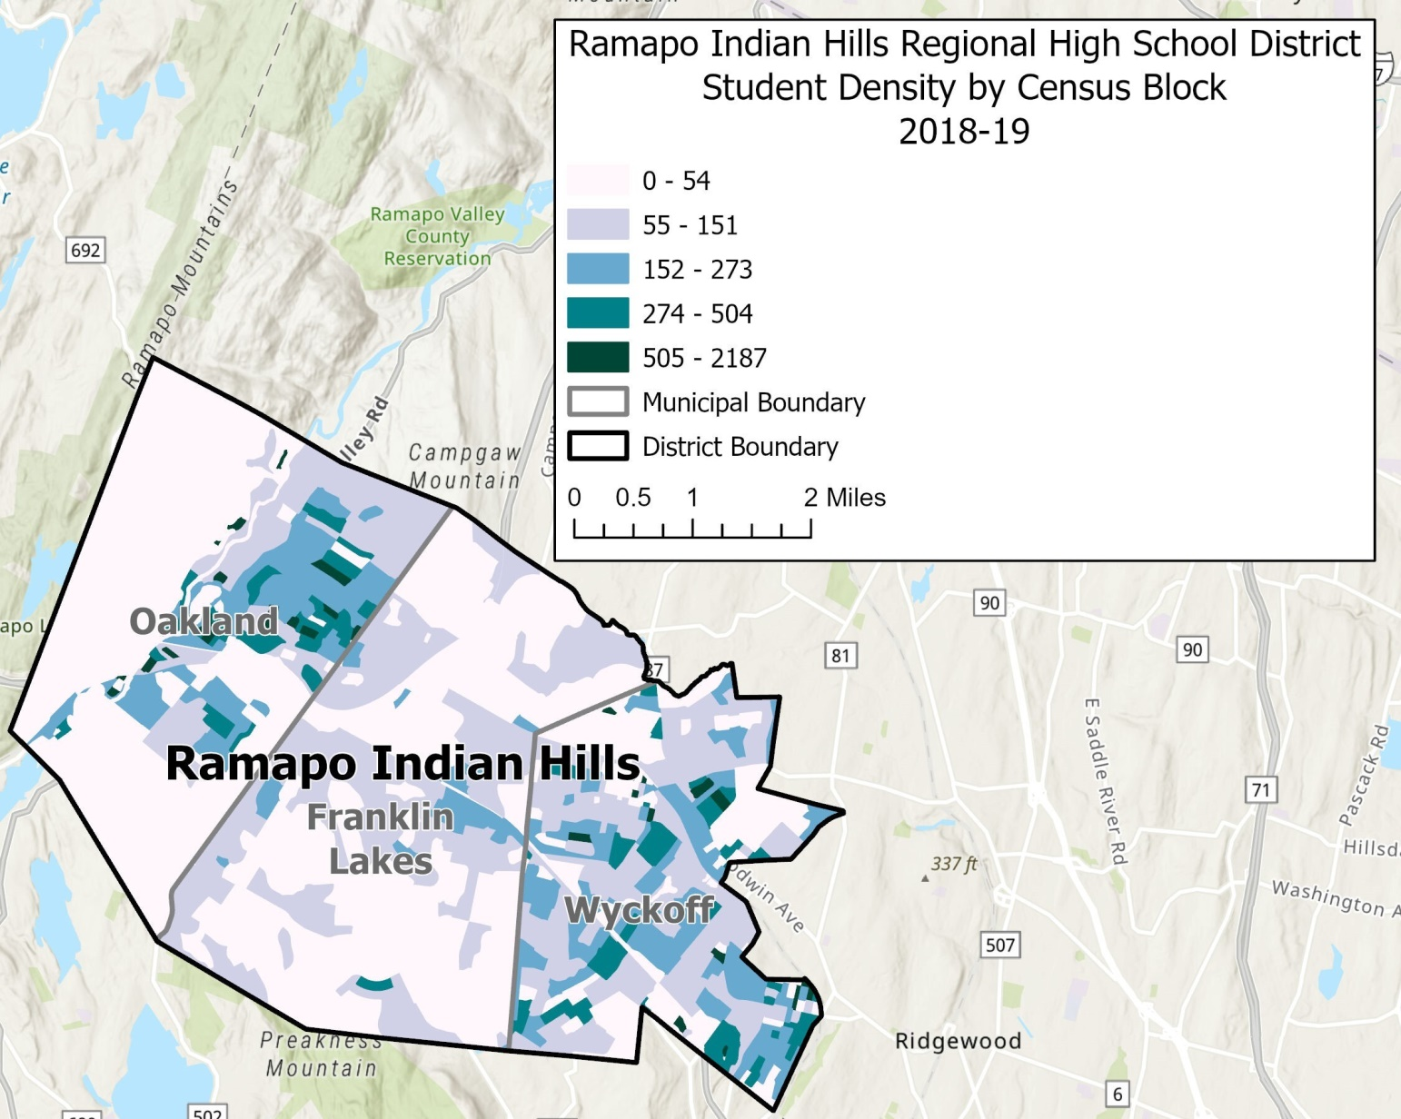
Student density by census block 2018-19

Slide 33
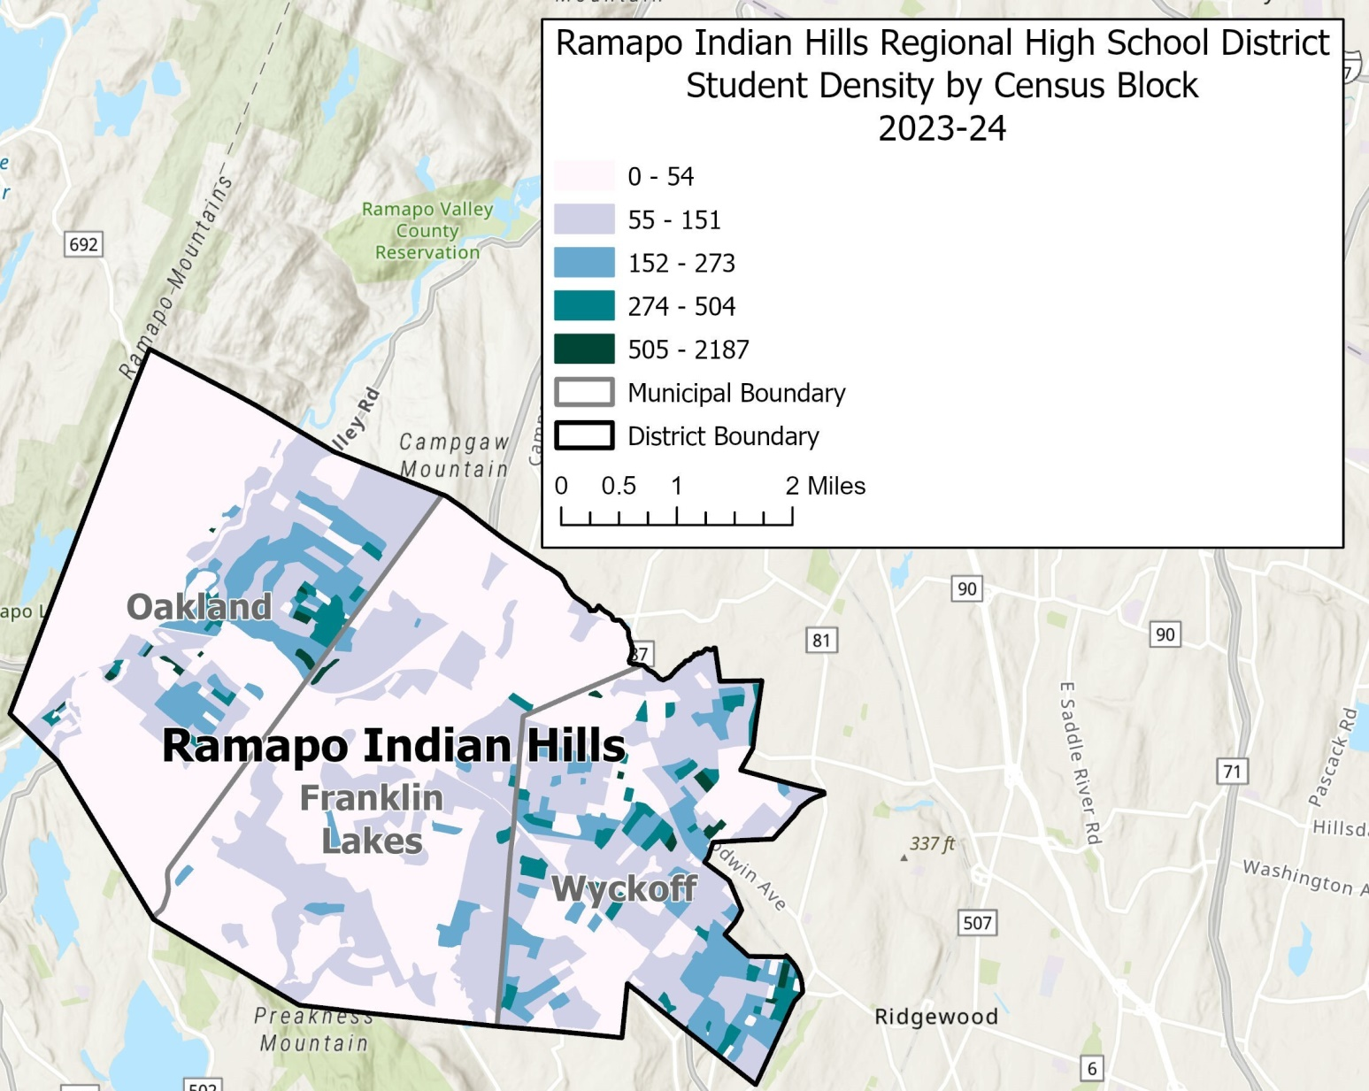
Student density by census block 2023-24

Slide 34
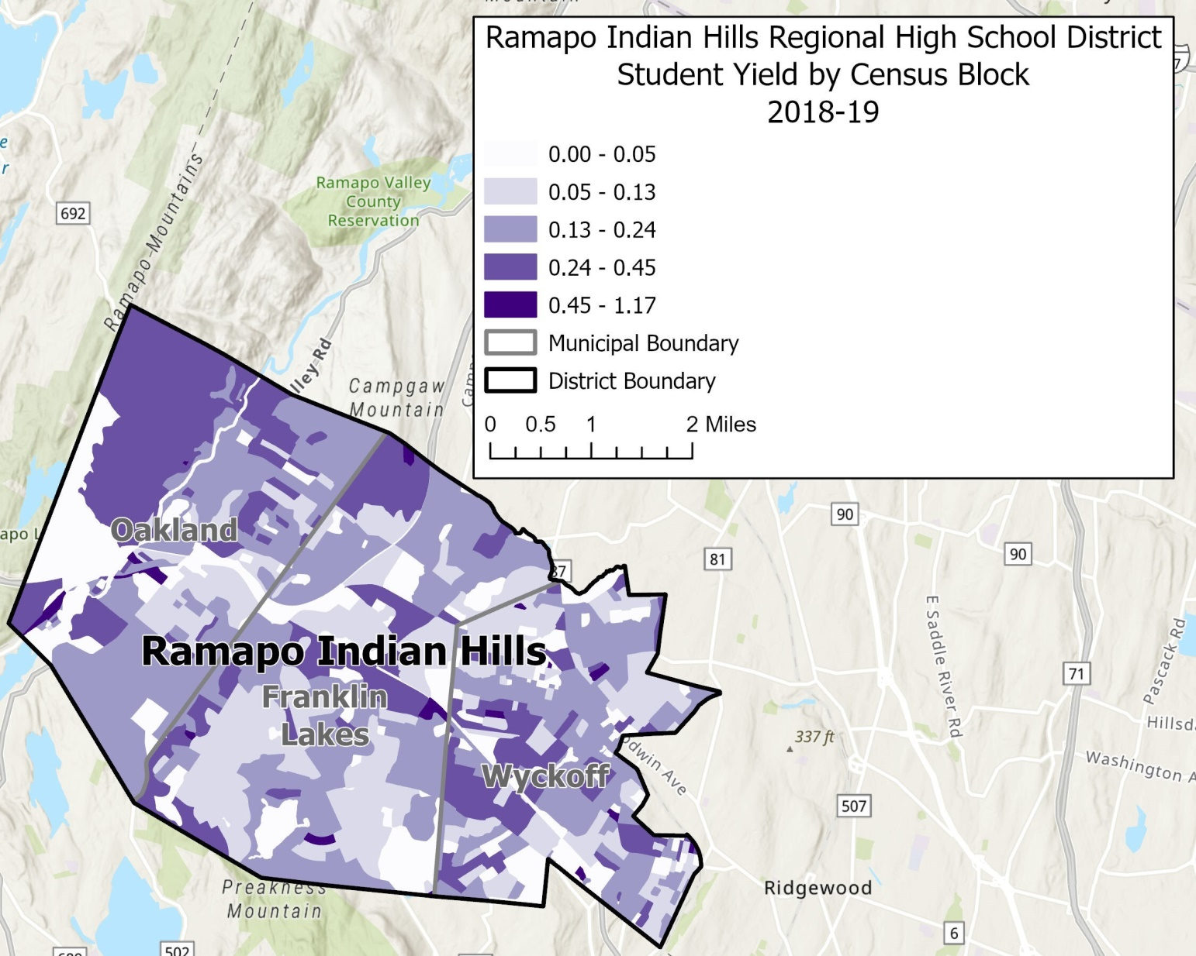
Student yield by census block 2018-19

Slide 35
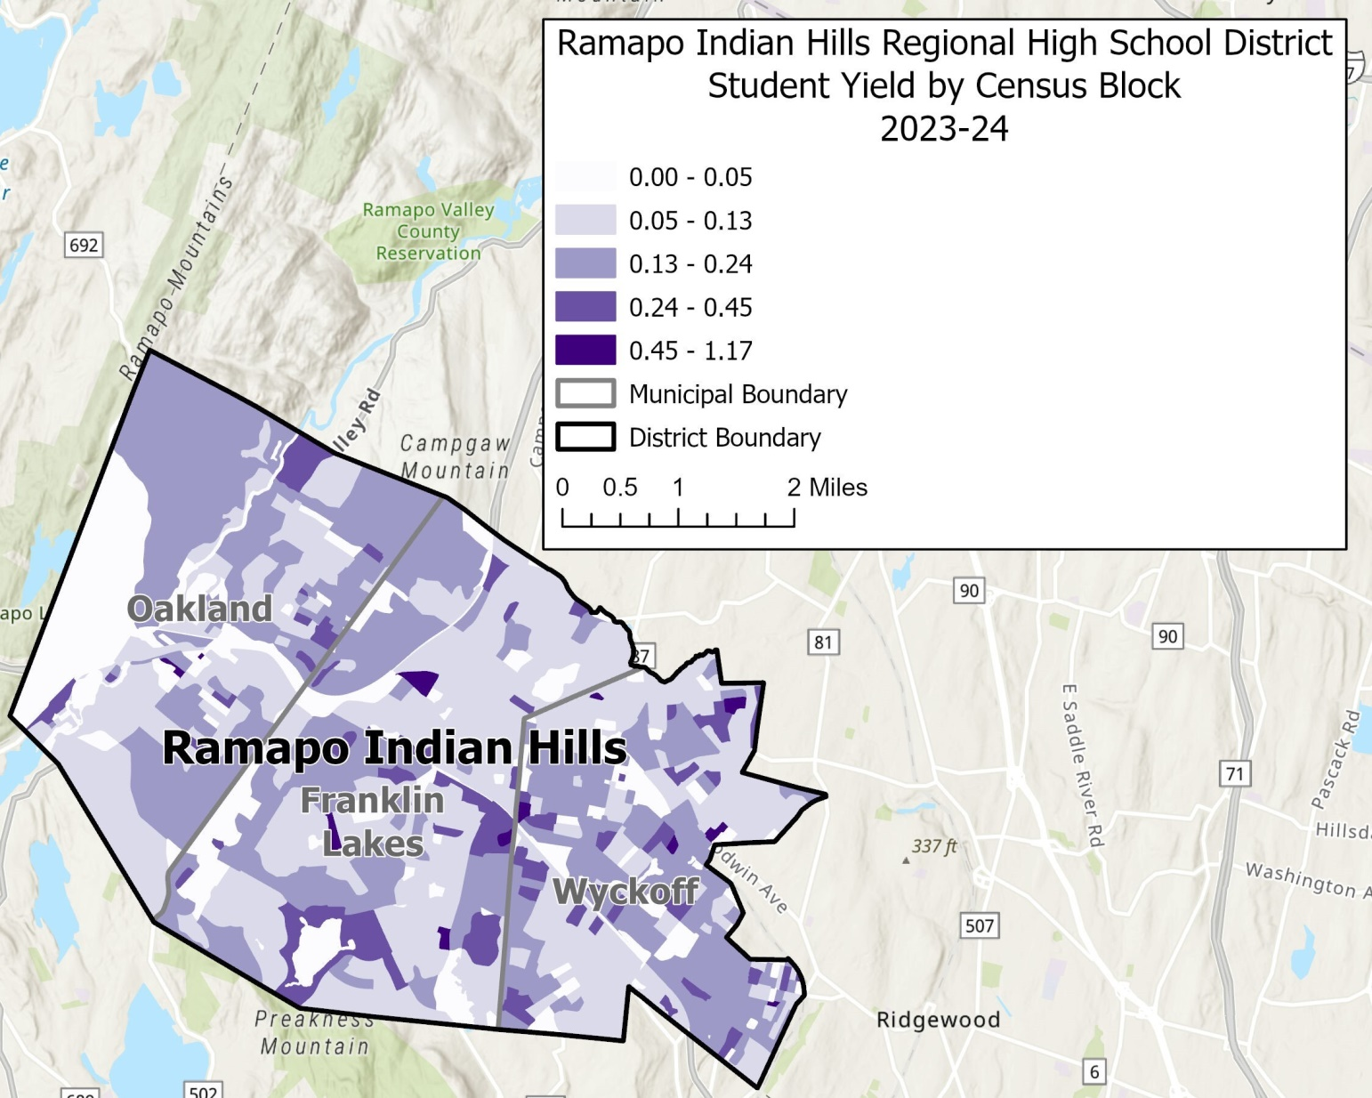
Student yield by census block 2023-24

Slide 36
Covid-19
Effects of COVID-19 on enrollment are varied across the country.
Big declines in large school districts: Los Angeles (-11,000), Broward County (-8,500), Orange County (-8,000), Charlotte-Mecklenburg (-5,000).
People are leaving large metro areas to live in rural areas, either in 2nd homes or a purchased home. Will they return?

Slide 37
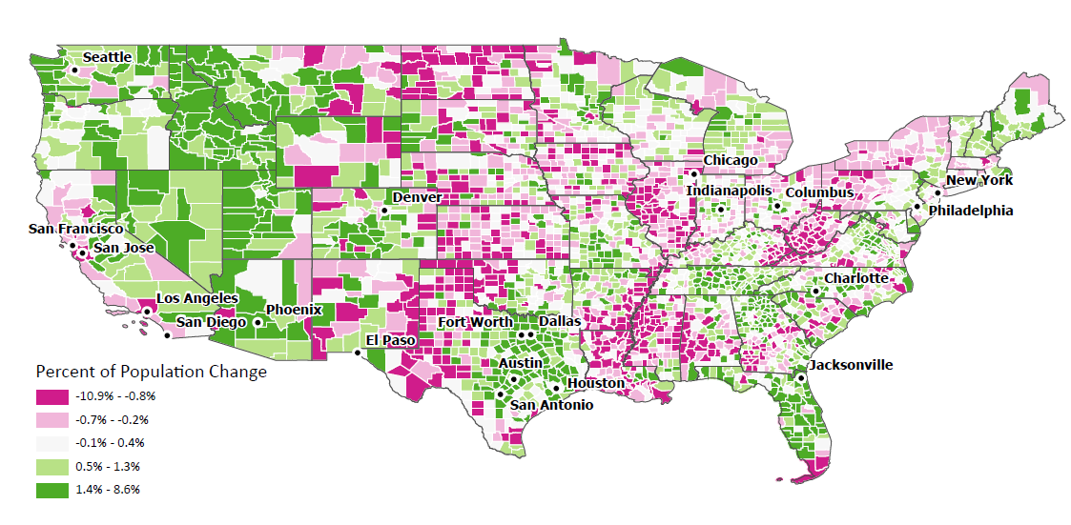
USA Population Change April 2020 to July 2021
Source: US Census Bureau, Population Estimates Program 2021

Slide 38
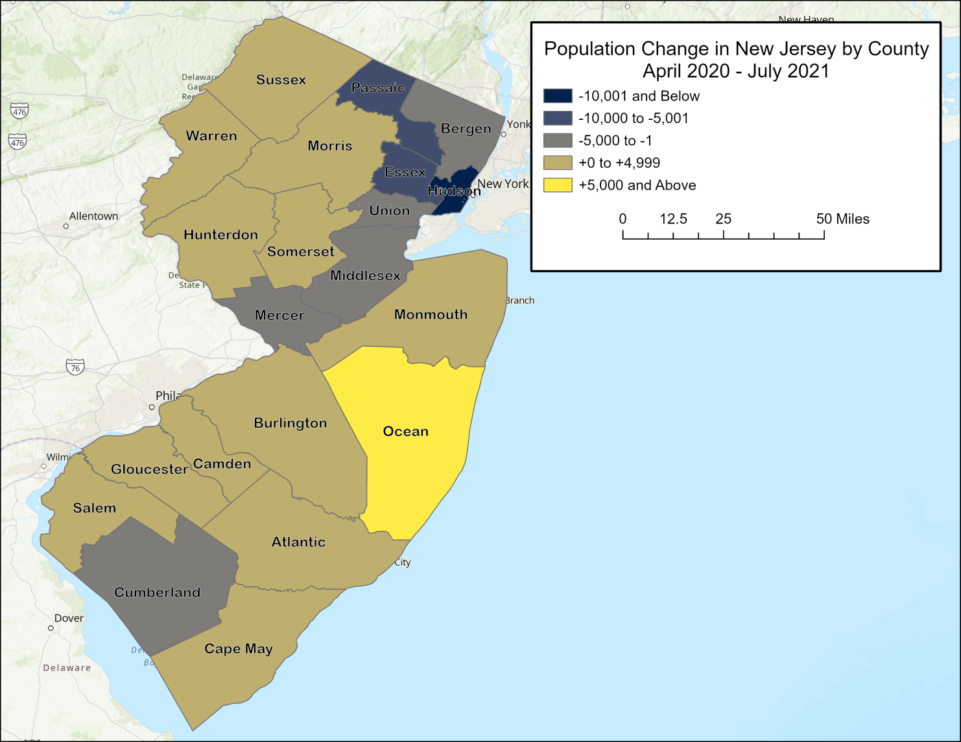
NJ Population Change April 2020 to July 2021
Source: US Census Bureau, Population Estimates Program 2021

Slide 39
summary
Enrollments have been declining in last 5 years, particularly in Indian Hills H.S.
Enrollments are projected to decline for the next three years before reversing trend, as the larger K-8 cohorts (gain of 162 students in last 4 years) move up to the high schools.

Slide 40


