Slide 1



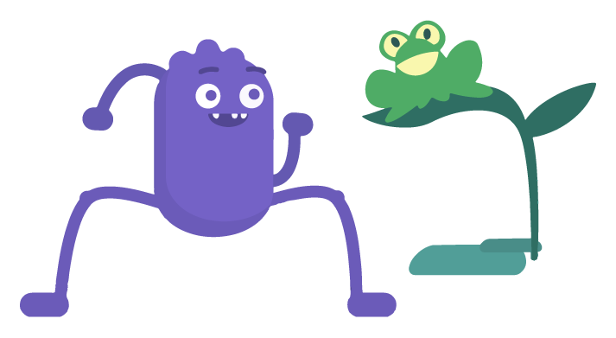

GRADE 1: DIGITAL CITIZENSHIP FAMILY ACTIVITY
Pause & Think Online
There are lots of things to think about when it comes to being a responsible digital citizen. At school
your kid is learning all about it, and now they can show you what they know! They're learning to ...
Pause and think before searching, clicking, or sharing.
Be kind online.
Find balance using media and tech.
Pay attention to their feelings to make sure they feel safe and know when to stop.
Stand up to online bullies.
Carefully choose the digital footprints — like posts, pictures, and comments — they leave behind.
Check out the music video featuring our favorite digital citizenship friends!
Watch it together (turn on captions so you can see the lyrics), and sing along!
https://www.commonsense.org/education/videos/pause-think-online
Now talk about this together:
What was your favorite part of the song? Why?
What's your favorite character? Why?
What are some ways you can do what your favorite character does?
What could be hard about it, and how would you keep going anyway?
Text the word kids to the phone number 21555 to get free weekly tips on healthy media habits.
Message and data rates may apply. STOP to unsubscribe.
commonsense.org/education
Shareable with attribution for noncommercial use. Remixing is permitted.

