Slide 1
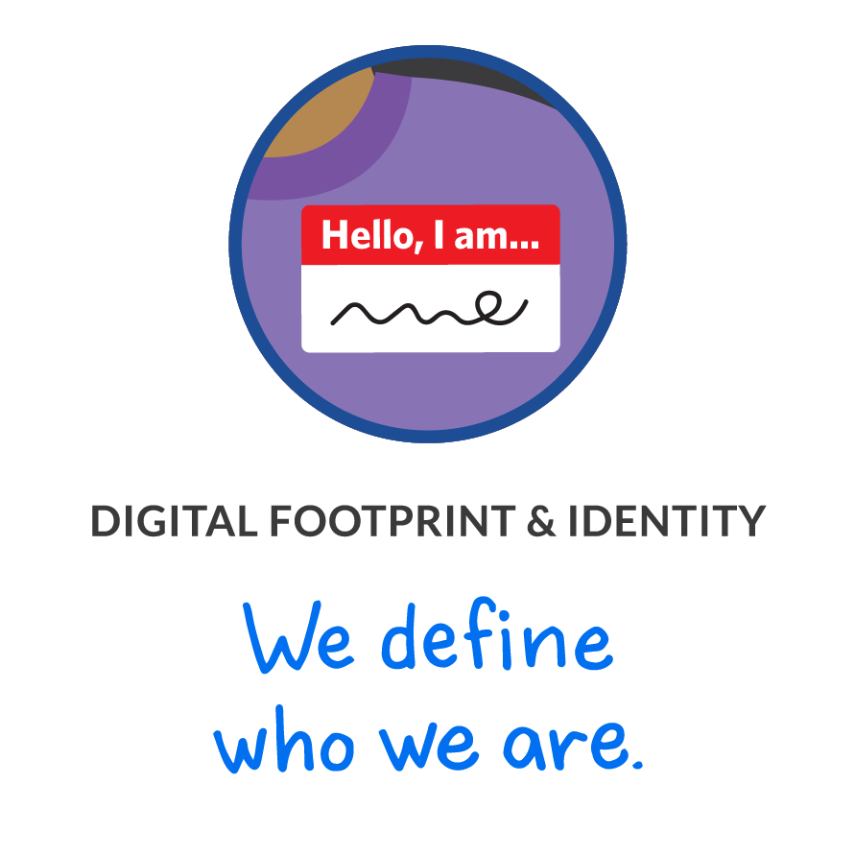




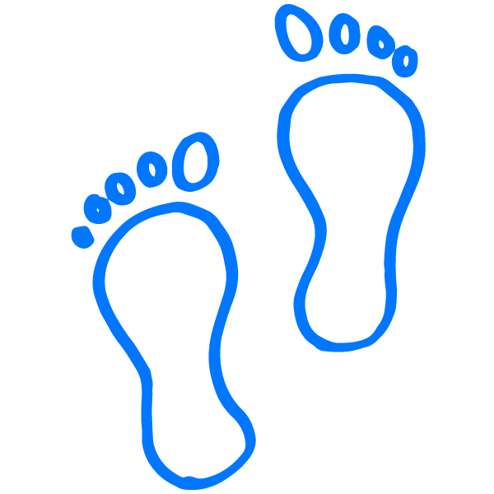

GRADES 3–4: DIGITAL CITIZENSHIP FAMILY ACTIVITY
Digital Footprint & Identity
Digital citizenship: Thinking critically and using technology responsibly to learn, create, and participate
Instructions
It's important to be aware of our digital footprint. Follow the footprints to see what you can learn about each person. Get one or more family members together to help. Don't forget to read the setup before doing the activity together!
Setup
Read aloud: What we do online leaves digital footprints that can give clues about what we do and who
we are. We should be aware of the digital footprints we're leaving and the person that we appear to be
to others online.
Activity
Read aloud: Let's follow the digital footprints, read the clues, and talk about what we learn.
Watched YouTube Minecraft videos
Played Minecraft
on a public server
Searched online for
articles about Iceland
Based on the footprints, what did you learn about this person? Discuss with each other.
Posted picture on Instagram of friend next to Hillside Elementary School sign
Searched for soccer shorts on Amazon
Streamed Imagine Dragons on Spotify
Based on the footprints, what did you learn about this person? Discuss with each other.
Played Roblox
and used chat
Watched Guardians of the Galaxy on Netflix
Used Google Docs
to write a report
Based on the footprints, what did you learn about this person? Discuss with each other.
Learn more about how to define your digital footprint at commonsense.org/family-tips-on-digital-footprint!
commonsense.org/education
Shareable with attribution for noncommercial use. Remixing is permitted.

