Slide 1



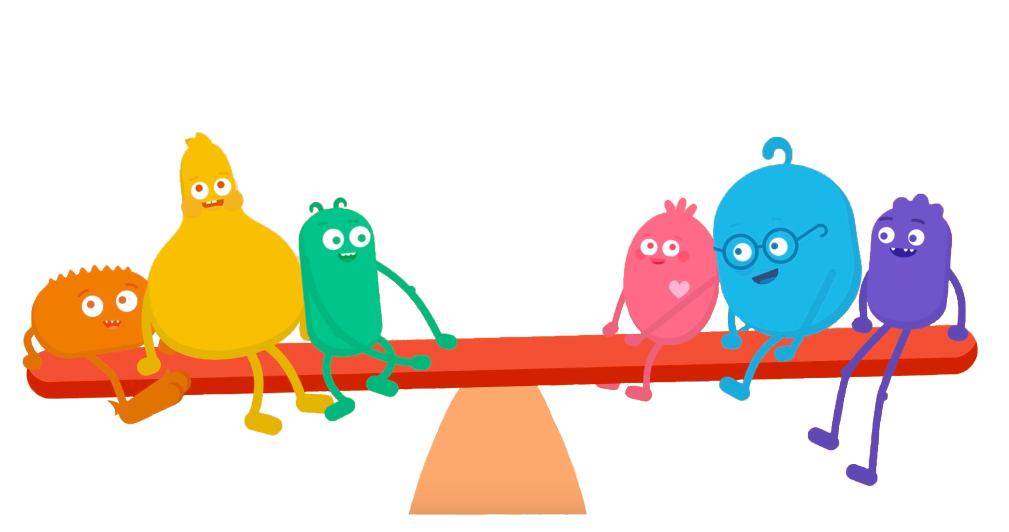

KINDERGARTEN: DIGITAL CITIZENSHIP FAMILY ACTIVITY
Media Balance Is Important
Good news:
Your kid is learning about media balance! What does that mean? They're learning to …
"Pause for people" and stop using devices when someone wants to talk.
Know when it's time to move their bodies and go outside to play.
Turn off screens before bedtime.
Ask before they use a device, and stay on trusted sites and apps.
Listen to their feelings and tell an adult if something makes them uncomfortable.
Check out the music video featuring our favorite digital citizenship friends!
Watch it together (turn on captions so you can see the lyrics), and sing along!
https://www.commonsense.org/education/videos/balance-is-important-video
Now talk about this together:
What was your favorite part of the song and why?
How can we work together to have media balance as a family?
What would that look like? You can even draw a picture that shows your whole family practicing media balance!
Text the word kids to the phone number 21555 to get free weekly tips on healthy media habits.
Message and data rates may apply. STOP to unsubscribe.
commonsense.org/education
Shareable with attribution for noncommercial use. Remixing is permitted.

