Slide 1
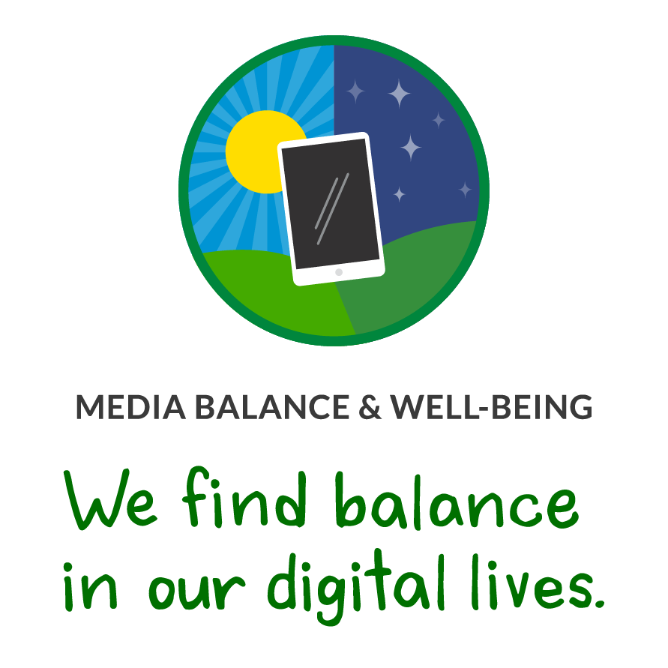


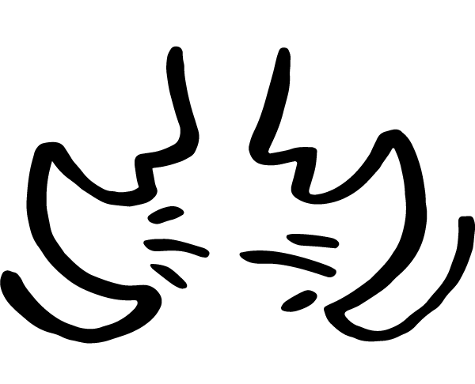


GRADES 3–5: DIGITAL CITIZENSHIP FAMILY ACTIVITY
Media Balance & Well-Being
Digital citizenship: Thinking critically and using technology responsibly to learn, create, and participate
Instructions
It's important to stay aware of how our on-screen and offscreen activities fit into our lives. Do a media balance checkup on your family. Get one or more family members together to help. Read the setup before doing the activity together!
Setup
Read aloud: We balance the food we eat to stay healthy. We also need to balance our media use. Media includes the shows and videos we watch, the video games and apps we play, and the music we listen to. Let's answer questions to see if our media use is balanced. Then we can decide if we want to make some changes.
Activity
Read aloud: Let's answer these questions together.
Do digital devices (phones, tablets, TV) ever keep us from getting enough sleep?
Do we use them while we eat?
Do we do activities together without devices?
Do we ever use them together?
Does our digital device use ever cause fights? If so, what are the fights about?
When we use our devices, how is it fun? What do we learn?
Is there anything we want to change about how we use our devices? If so, what?
Does the way your family uses media feel balanced and healthy? Give a thumbs up or thumbs down. Does your family agree? If you want to make changes, what are they? Think of changes that work for the whole family since you're all on the same team!
Learn more ways to find balance in your digital lives at commonsense.org/family-tips-on-media-balance!
commonsense.org/education
Shareable with attribution for noncommercial use. Remixing is permitted.

